Slide 1
Week 4 Assignment
Haochen Yang

Slide 2

Problem 1
For Classic Brownian Motion:
$$P_{t}= P_{t−1}+ r_{t}$$
Mean:
$$E\left(P_{t}\right)= P_{t−1}$$
Standard deviation:
$$std\left(P_{t}\right)=sigma$$

Slide 3

Problem 1
For Arithmetic Return System:
$$P_{t}= P_{t−1}(1 + r_{t})$$
Mean:
$$E\left(P_{t}\right)= P_{t−1}$$
Standard deviation:
$$std\left(P_{t}\right)= P_{t−1}∗sigma$$

Slide 4
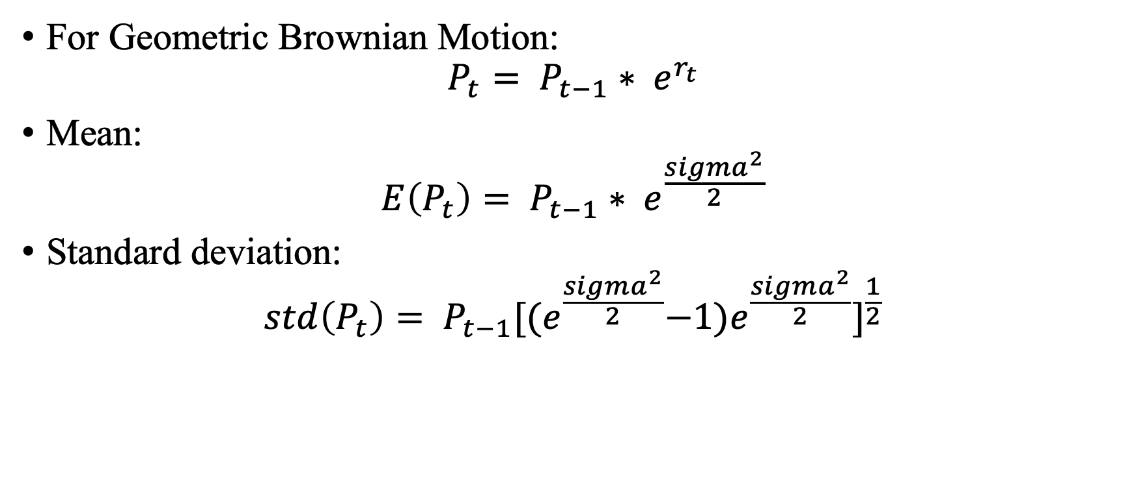
Problem 1
For Geometric Brownian Motion:
$$P_{t}= P_{t−1}∗ e^{r_{t}}$$
Mean:
$$E\left(P_{t}\right)= P_{t−1}∗ e^{\frac{{sigma}^{2}}{2}}$$
Standard deviation:
$$std\left(P_{t}\right)= P_{t−1}{[{(e}^{\frac{{sigma}^{2}}{2}}−1)e^{\frac{{sigma}^{2}}{2}}]}^{\frac{1}{2}}$$

Slide 5
Problem 1
set Pt-1 = 1, std(rt) = 0.5, and simulated for 1000 times
 | Mean |  | Standard deviation
 | Expected Mean | Simulated Mean | Expected Std | Simulated Std
Classical Brownian | 1.0000 | 1.0138 | 0.5000 | 0.5150
Arithmetic Return | 1.0000 | 0.9901 | 0.5000 | 0.4796
Geometric Brownian | 1.1331 | 1.1058 | 0.6039 | 0.6049

Slide 6
Problem 1

Slide 7
Problem 2
Method | VaR in Percentage
Normal Distribution | 5.2412%
Norma Distribution with EW Variance | 3.0177%
MLE fitted T- Distribution | 4.5809%
AR(1) | 5.7664%
Historical Simulation | 3.9484%

Slide 8
Problem 2
Method | VaR in Dollar Amount
Normal Distribution | 14.8418
Norma Distribution with EW Variance | 8.1918
MLE fitted T- Distribution | 12.8671
AR(1) | 16.4126
Historical Simulation | 10.9754

Slide 9
Problem 3
Delta normal VaR
 | VaR in Dollar Amount
Portfolio A | 15426.968
Portfolio B | 8082.572
Portfolio C | 18163.292
Portfolio Total | 38941.376

Slide 10
Problem 3
Historical simulated VaR
 | VaR in Dollar Amount
Portfolio A | 16525.829
Portfolio B | 10757.91
Portfolio C | 21981.393
Portfolio Total | 47618.778

