Slide 1
Work Break-down
Muhammad Ahsan
1
Ibrahim Qaiser
Dependency Inversion Principle
4
Command Design Pattern
Muhammad Affan Amir
2
Single Responsibility Principle
Saif Muhammad Sheikh
5
Repository Software Architectural Design
Muhammad Nabeel
3
Singleton Design Pattern

Slide 2
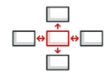

Design Principles Applied
Dependency Inversion Principle
Single Responsibility Principle

Slide 3
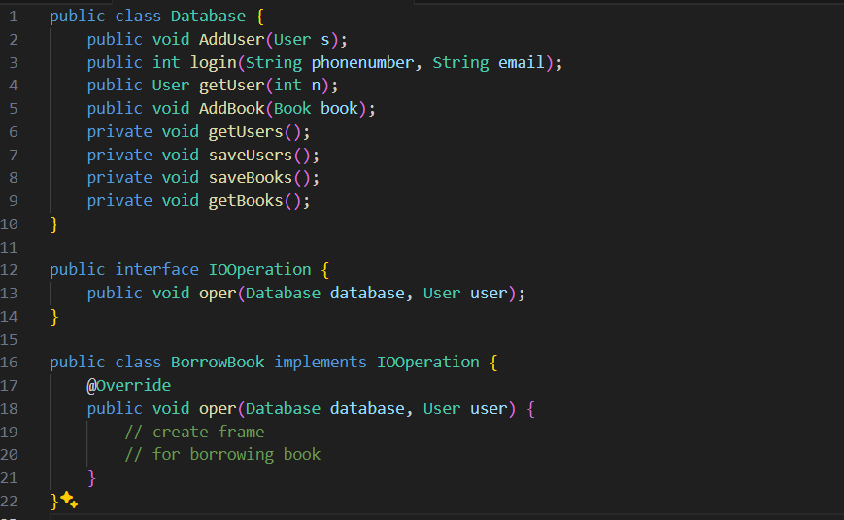
Applying Dependency Inversion Principle ( DIP )
Before Code
IO Operation interface directly depends on Database class.
Can’t utilize other database mechanisms i.e. cloud storage

Slide 4
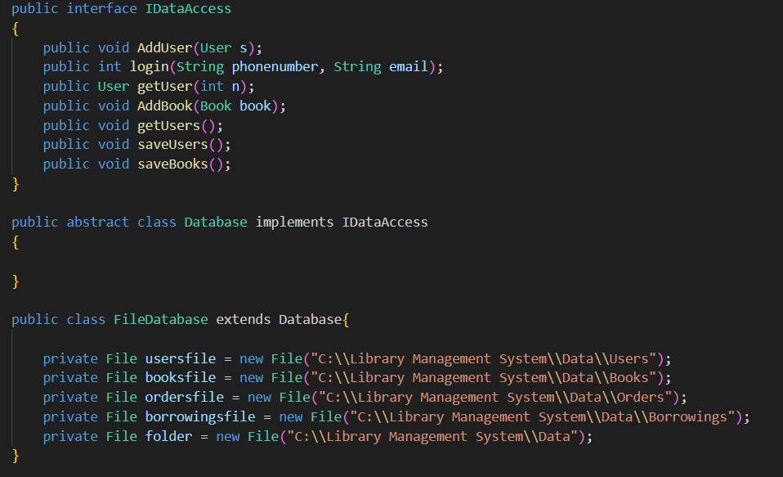
Code after Refactor:
IDataAccess class for standard functions of data access
Database abstract class
Concrete other Database implementations

Slide 5
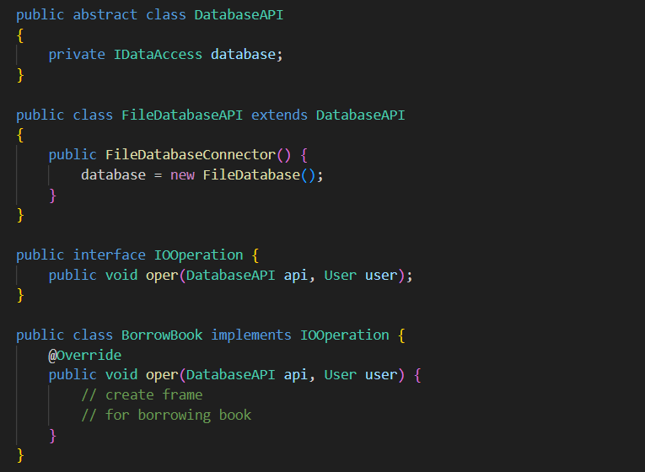
Code after Refactor:
DatabaseAPI abstract class
Concrete other databases api implementations
IO Operation uses a Database api object for accessing data

Slide 6
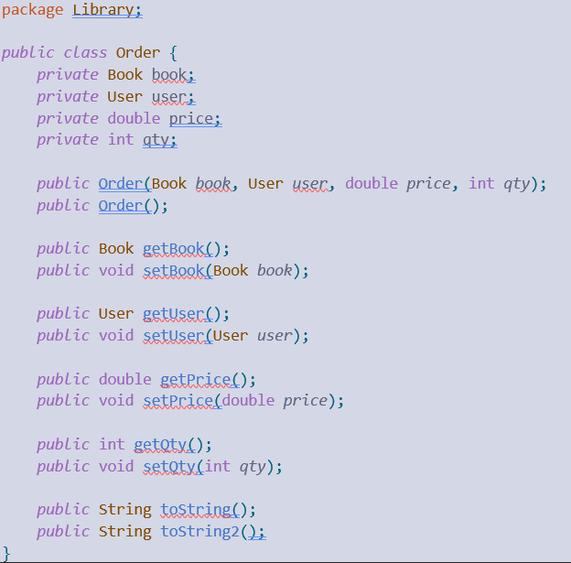
Applying Single Responsibility Principle ( SRP )
Before Code
The class ‘Order’ is responsible for managing details of an order (book, user, price, quantity), as well as providing string representation methods: ‘toString()’ and ‘toString2()’

Slide 7
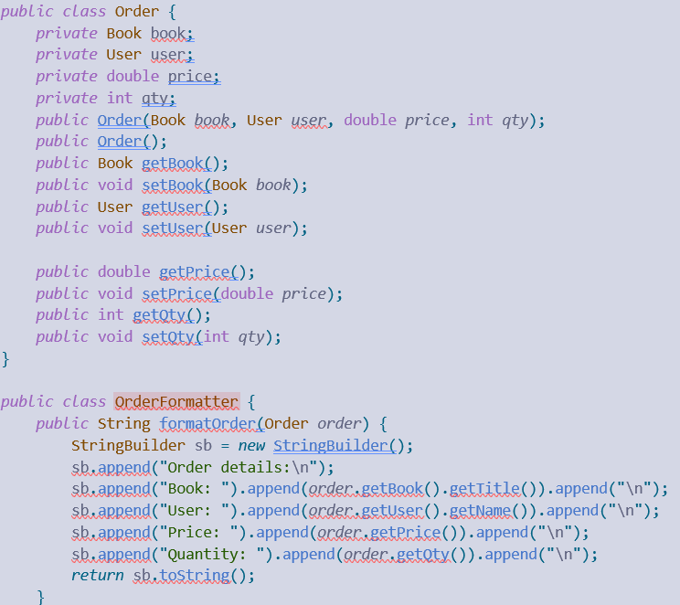
Code after Refactor:
The ‘Order’ class is now responsible for managing details of an order while ‘OrderFormatter’ class is responsible for generating string representations of orders. This separation makes it adhere to the Single Responsibility Principle.

Slide 8
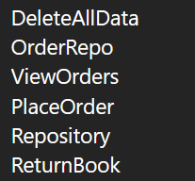
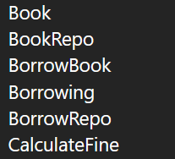

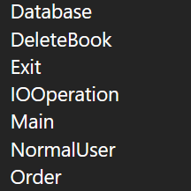
Structure of Library Management System

Slide 9

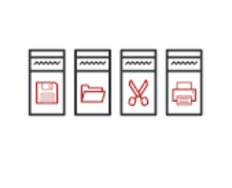
Design patterns in the project
Singleton
Command
Creational Design Pattern
Behavioural Design Pattern

Slide 10
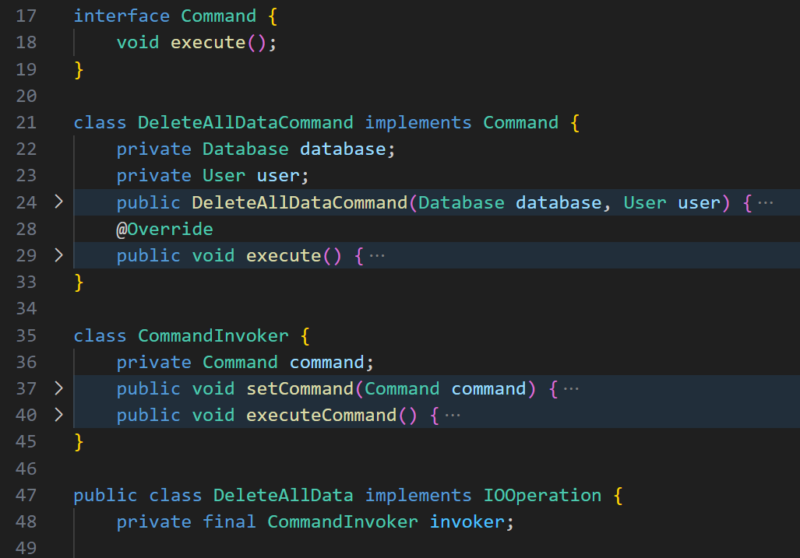
Command Design Implementation
Command Interface
Interface class to separate concerns for execution
Execute method Call
Concrete Command
DeleteAllDataCommand class for invoking concrete
command implementation
Command Invoker
CommandInvoker class to implement setting and executing
a command using setCommand and executeCommand.
Client
Class where you want to invoke command.
Here it is DeleteAllData class implementation requires calling commandInvoker

Slide 11
Repository Architecture
Repository architecture is a design pattern in software development that uses a central data structure, such as a database, to store data that is accessed by independent components.
The components communicate with the repository, but not with each other. This pattern separates the business logic of an application from the details of data storage and retrieval.

Slide 12
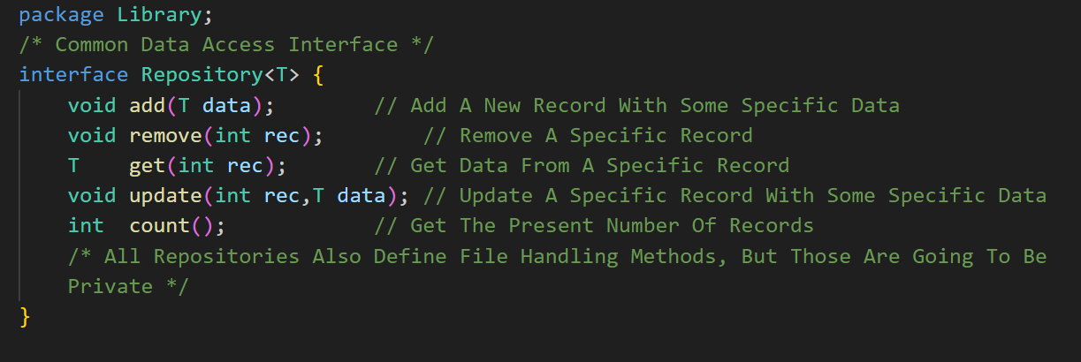
150000
Las cifras grandes pueden ayudarte a captar la atención del público

Slide 13
Database object Role Redefintion
Before the refactoring:
The Database object acted as a singular access point to four resources.
It provided almost unrestricted access to all parts of the system.
After the refactoring:
The Repository implementations themselves now provide the access to resources.
This access is provided in a better-defined manner.
The purpose of the Database object now:
It serves as a point of entry to the repositories.
It provides operations that act cooperatively on multiple resources at once.
It provides a higher level of access than the individual repositories.
It may expose these operations to the repositories themselves, allowing them to interact through a controlled interface.

