Slide 1
Encapsulation in Python
Ibrahim Qaiser and Muhammad Zaid

Slide 2
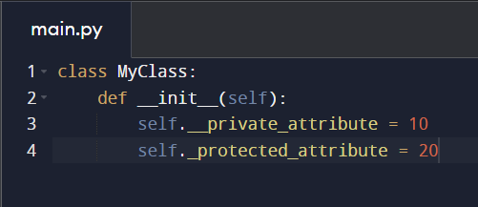
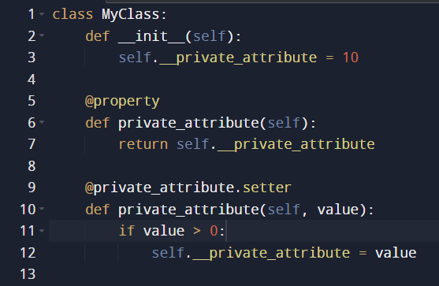
Ways to achieve Encapsulation
Private and Protected Attributes
Getters and Setters:

Slide 3
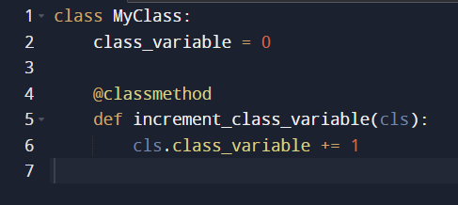
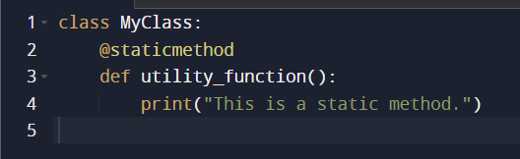
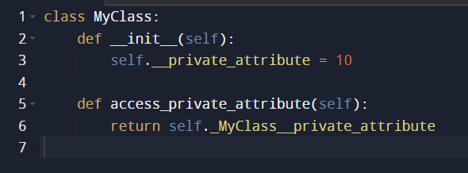
Class Methods:
Static Methods:
Name Mangling:

Slide 4
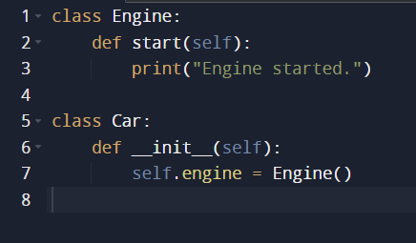
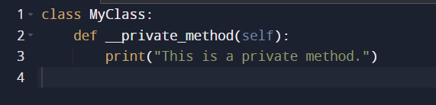
Composition:
Private Methods:

