Slide 1
Genome Sequencing
Technical Implementation
Code Discussion

Slide 2
1) Sequence Preprocessor
Read sequences from a given file
Time complexity of this class function is O(n*L), n is number of lines in given file and L be number of characters in each line.
Space complexity of this class function is O(n*L).
Returns list of provided DNA sequences.

Slide 3
2) De Bruijn Graph Constructor
Constructs graph data structure particularly de Bruijn having nodes and their neighbors from list of input sequences.
Each node of graph is of length equal to length of kMer.
Definition of k-Mer: A contiguous sequence of k nucleotides (or base pairs) that is extracted from a larger DNA or RNA sequence.
Time complexity of this constructor is O(n * L) for construction of graph while O(V+E) for accessing graph
Space complexity of this constructor is O(n * L) while O(1) for accessing graph.
Returns the List of k-Mer nodes (Keys) each of which is accessing a particular list of k-Mer nodes(Neighbors)

Slide 4
3) Error Corrector
We applied correction factor to be ‘removing bubbles’ from the graph
Definition of Bubble: A subgraph which contains multiple same starting and ending nodes (multiple paths b/w two nodes)
Removal required in order to create Eulerian Path / Graph
Time Complexity for this class method is O(|V| + |E| + |B| * log|B|) where B is number of bubble nodes
Space Complexity for this class method is O(|V| + |E| + |B|).
Returns corrected list of key[node]-value[list of nodes] same as previous graph

Slide 5
4) Graph Traverser
Turn the nodes of the given graph into a DNA sequence which should include all or about 90% of provided input sequences
Time complexity of this class function is O(V + E + S*k) where S is number of input sequences and k is k-Mer length proposed
Space complexity of this class method is O(V + E + k)
Returns the string comprising of expected DNA sequence

Slide 6
5) Sequence Validator
Validates that the proposed DNA sequence includes all the input sequences and also each base in the sequence is valid or not
Time Complexity of this class method is O(n)
Space Complexity of this class method is O(k)
Returns Boolean value after the validation

Slide 7
6) Sequence Output
Enters the proposed DNA sequence in an external file or some other logic and also the de Bruijn graph in external file
Time Complexity of this class method is O(n) and O(m*k) where m is number of nodes in the graph
Space Complexity of this class method is O(1) and O(m)

Slide 8
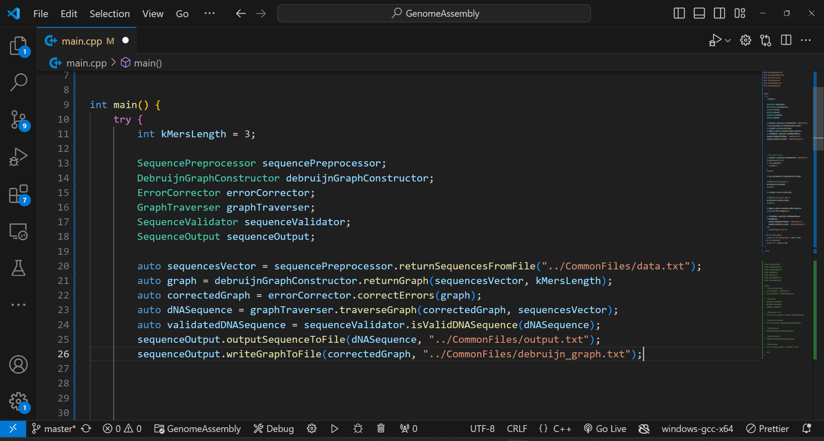
Classes and their respective methods

Slide 9
Sample Input
Graph Initial
Graph Final
ATGCGT
GCGTAGC
TAGCTAGCTA
GCTAGCGTAT
CGTATCGTA
TAGCTAG
TCG -> CGT
TAT -> ATC
CTA -> TAG TAG
GTA -> TAG TAT
AGC -> GCT GCT GCG GCT
CGT -> GTA GTA GTA
ATC -> TCG
GCG -> CGT CGT
GCT -> CTA CTA CTA
TAG -> AGC AGC AGC AGC
TGC -> GCG
ATG -> TGC
TCG -> CGT
TAT -> ATC
CTA -> TAG
GTA -> TAT
AGC -> GCG GCT
CGT -> GTA
ATC -> TCG
GCG -> CGT
GCT -> CTA
TAG -> AGC
TGC -> GCG
ATG -> TGC

Slide 10
Final DNA sequence Obtained
AGCTAGCGTATCGTATGCGTGCGTAGCTAGCTAGCTA

Slide 11
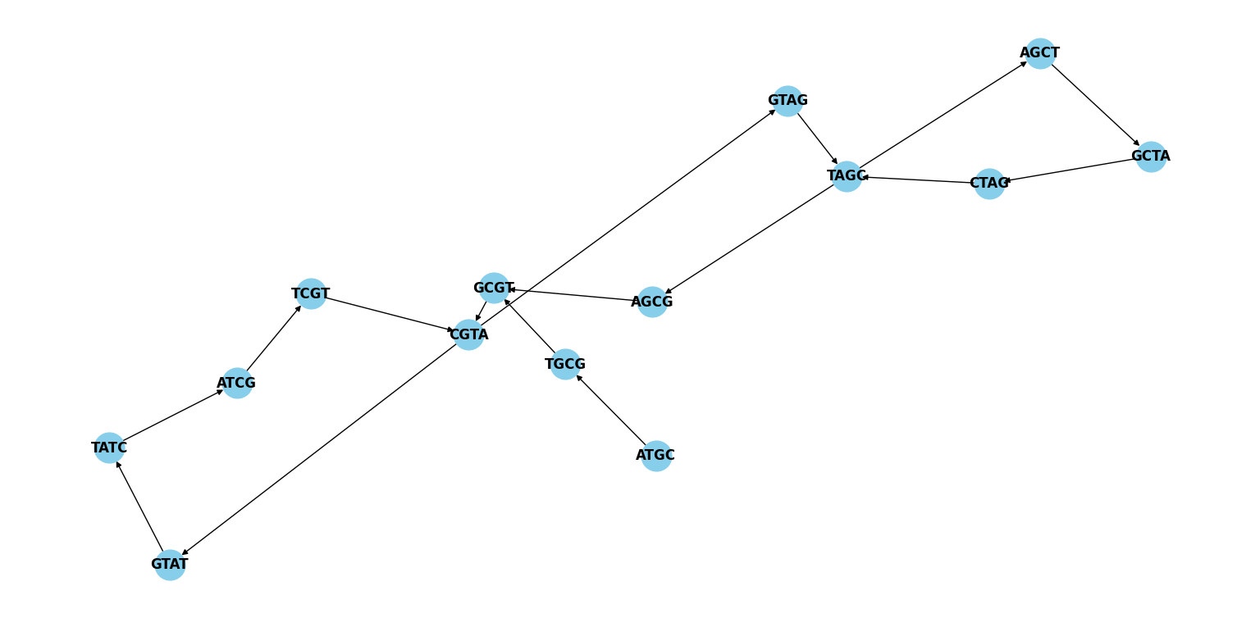
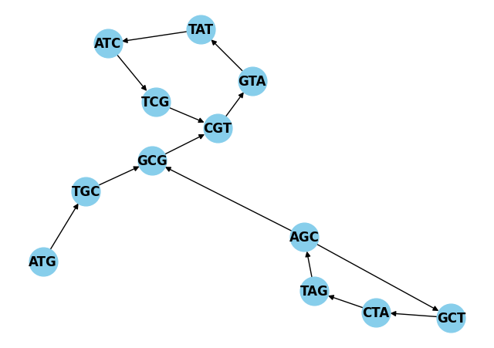
De Bruijn graphs for
k-Mers length 3 and 4

