Slide 1
Communication
and
Interpersonal Skills
Dr. Ehsan ul Hassan

Slide 2
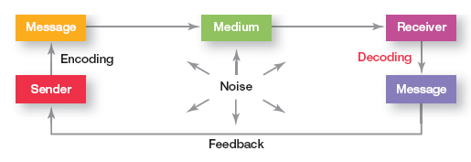
The Communication Process
Communication :
The transferring and understanding of meaning
A letter written in Spanish addressed to a person who doesn’t read Spanish can’t be
considered communication until it’s translated into a language the person does read and understand.

Slide 3
Communication Process Terms
Encoding
  The conversion of a message into some symbolic form
Message
  A purpose to be conveyed
Channel
  The medium by which a message travels
Decoding
  A receiver’s translation of a sender’s message
Feedback
  The degree to which carrying out the work activities require by a job results in the individual’s obtaining direct and clear information about the effectiveness of his / her performance

Slide 4
Written Versus Verbal Communications
Written
  Tangible
  Verifiable
  More permanent
  More precise
  More care is taken with the written word
Verbal
  Less secure
  Known receipt
  Quicker response
  Consumes less time
  Quicker feedback
Interpersonal communication
communication between two or more people
Organizational communication
which is all the patterns, networks, and systems of communication within an organization.

Slide 5
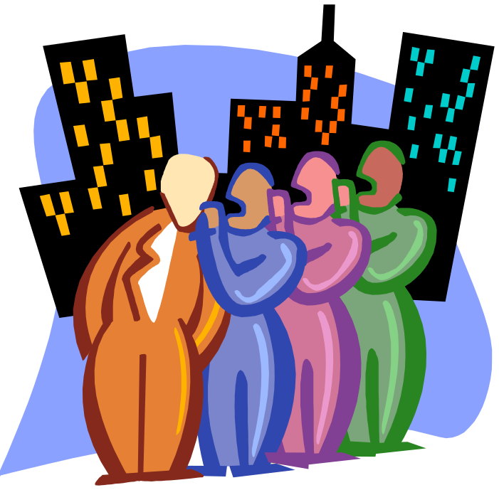
The Grapevine
“The grapevine motto: Good information passes among people fairly rapidly—bad information, even faster!”
Grapevine
  An unofficial channel of communication that is neither authorized nor supported
  by the organization.

Slide 6
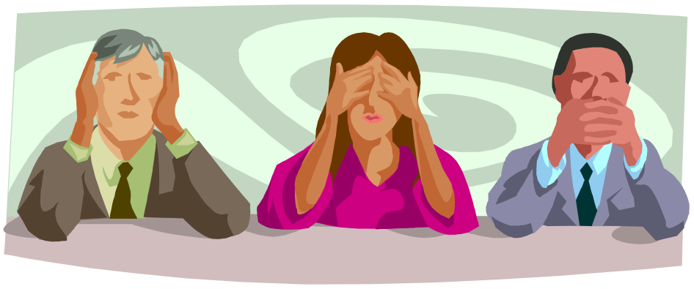
Body language
  Nonverbal communication cues such as facial expressions, gestures, and other body movements
Verbal intonation
  An emphasis given to word or phrases that conveys meaning

Slide 7
Barriers to
Effective
Communication
Overcoming Barriers to Effective Communication
Filtering
Selective Perception
Information Overload
Emotions
Language
Gender
National Culture
Use Feedback
Simplify Language
Listen actively
Constrain Emotions
Watch Nonverbal Cues

Slide 8
Communication Barriers
Filtering
  The deliberate manipulation of information to make it appear more favorable to the receiver
Emotions
  How a receiver feels when a message is received influences how he or she interprets it. Extreme emotions are most likely to hinder effective communication.
Information overload
  The result of information exceeding processing capacity

Slide 9
Communication Barriers (cont’d)
Language
  Words mean different things to different people. Age, education, and cultural background are three of the more obvious variables that influence the language a person uses and the definitions he or she gives to words.
  In an organization, employees come from diverse backgrounds and have different patterns of speech. Even employees who work for the same organization but in different departments often have different jargon.
  Technical language that is not understood by outsiders (Jargons)

Slide 10
Communication Barriers (cont’d)
Defensiveness
  When people feel they’re being threatened, they tend to react in ways that hinder effective communication and reduce their ability to achieve mutual understanding.
  They become defensive—verbally attacking others, making sarcastic remarks, being overly judgmental, or questioning others’ motives.
  National culture
  Communication differences that arise from the different languages and national cultures.
  Individualistic country – USA – Formal and clearly spelled out
  Collectivist country – Japan - more interpersonal contact & and face-to-face communication

Slide 11
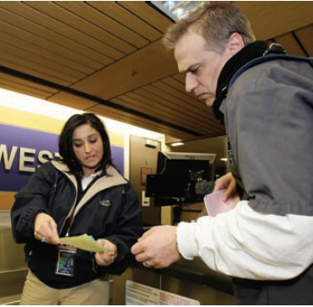
Overcoming Barriers to Effective Communication
Use Feedback
Simplify Language
Listen actively
Constrain Emotions
Watch Nonverbal Cues

Slide 12
Organizational Communication
Formal Versus Informal Communication
Formal communication - communication that takes place within prescribed organizational work arrangements.
Informal communication - communication that is not defined by the organization’s structural hierarchy.

Slide 13
Direction of Communication
Downward communication - communication that flows downward from a manager to employees.
Upward communication - communication that flows upward from employees to managers.
Lateral communication - communication that takes place among any employees on the same organizational level.

Slide 14
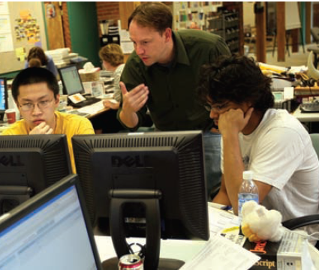
Direction of Communication (cont.)
Diagonal communication - communication that cuts across work areas and organizational levels.

Slide 15
Organizational Communication Networks
Communication Networks - the variety of patterns of vertical and horizontal flows of organizational communication.
Grapevine - the informal organizational communication network.

Slide 16
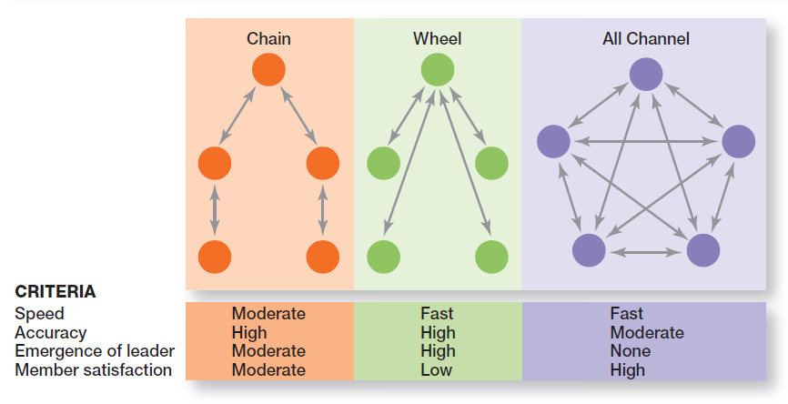
Organizational
Communication Networks
Notes:
The vertical and horizontal flows of organizational communication can be combined into a variety of patterns called communication networks. Exhibit 15-4 illustrates three common communication networks.

Slide 17
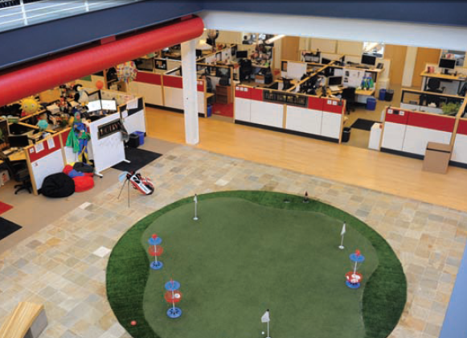
Workplace Design and Communication
Open workplaces - workplaces with few physical barriers and enclosures.

Slide 18
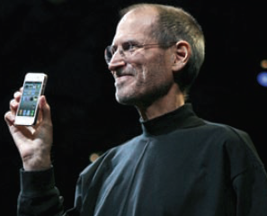
Ethical Communication
Ethical communication - communication that includes all relevant information, is true in every sense, and is not deceptive in any way.

Slide 19
Current Communication Issues
Managing Communication in an Internet World
  Legal and security issues
    Inappropriate use of company e-mail and instant messaging
    Loss of confidential and proprietary information due to inadvertent or deliberate dissemination or to hackers
  Lack of personal interaction
    Being connected is not the same as face-to-face contact
    Difficulties occur in achieving understanding and collaboration in virtual environments

Slide 20
Communication and Customer Service
Communicating Effectively with Customers
  Recognize the three components of the customer service delivery process:
    The customer
    The service organization
    The service provider
  Develop a strong service culture focused on the personalization of service to each customer.
    Listen and respond to the customer.
    Provide access to needed service information.

