Slide 1

Web Scraping and Exploratory Data Analysis on Flipkart Refrigerators

Slide 2
About me
Background ?
B.Tech in Information Technology
Graduated (2021–2025)
B.V. Raju Institute of Technology , Narsapur
Why I Want to Learn Data Science ?
To extract meaningful insights from real-world data
Strong interest in data analysis, machine learning, and problem-solving
To build a career as a Data Scientist / Software Engineer
Passionate about working with data-driven decision-making systems
Profiles ?
LinkedIn: https://www.linkedin.com/in/nenavath-nithish
GitHub: https://github.com/Nenavath-Nithish

Slide 3
Agenda
Business Problem
Online e-commerce platforms display large volumes of product data that are not easily available in structured formats
Manual data collection is time-consuming, inefficient, and prone to errors
Businesses and analysts require organized product data for price analysis, market comparison, and trend identification
Use Case
Automating the extraction of product information such as product name, price, ratings, brand, and specifications
Enabling data-driven decisions like competitive pricing and product comparison
Supporting analytical tasks such as EDA, visualization, and reporting.
Domain Understanding
Domain: E-Commerce / Retail Analytics
Focus on collecting real-time product data from online platforms
Helps retailers, analysts, and consumers understand market behavior and pricing patterns

Slide 4
Objective of the Project
To design and implement a web scraping solution for extracting online product data
To collect product details from e-commerce websites automatically
To extract attributes such as product name, brand, price, and ratings
To handle unstructured web data efficiently
To clean and preprocess the scraped data
To store the extracted data in a structured format (CSV)
To perform exploratory data analysis on the collected data
To identify pricing and brand trends in the market
To visualize insights using charts and graphs
To support data-driven decision-making using the analyzed data

Slide 5
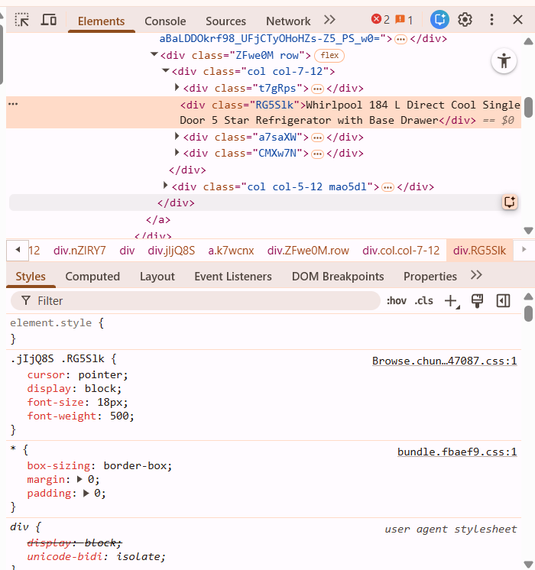
Web Scraping – Details
Websites Used
Flipkart
Web: https://www.flipkart.com/search?q=refrigerators&otracker=search&otracker1=search&marketplace=FLIPKART&as-show=on&as=off
Product category pages related to appliances
Tools & Libraries
Python
Requests
BeautifulSoup
Pandas , Numpy, Visualizations
Process Followed
Identified the target product category and relevant web pages
Sent HTTP requests to fetch web page content
Parsed HTML using BeautifulSoup
Extracted required product details such as name, price, ratings, and brand
Handled missing and inconsistent data
Stored extracted data into a structured CSV file
Verified and cleaned the data for further analysis

Slide 6
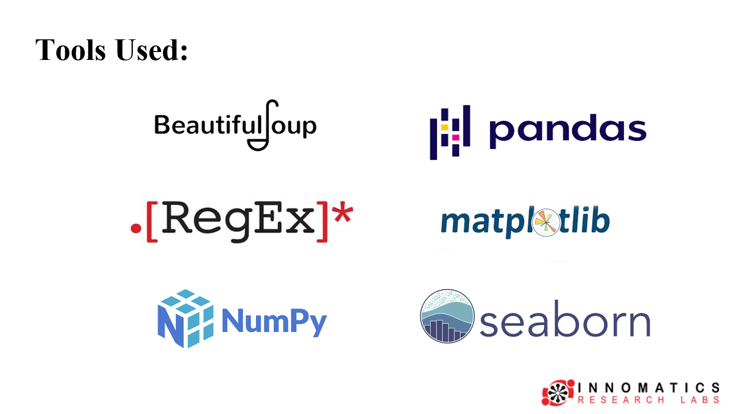

Slide 7
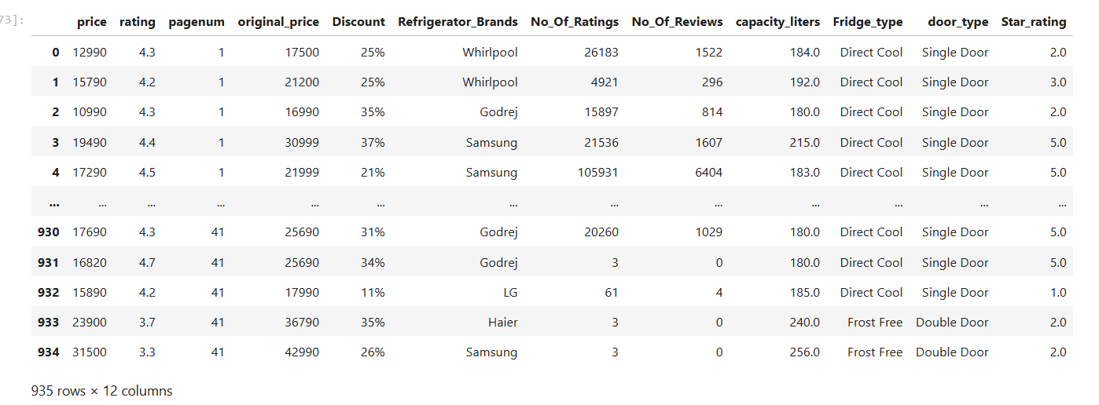
Flipkart:Cleaned_Refrigerators Dataset

Slide 8
Summary of the Data
The dataset was collected through automated web scraping from an e-commerce website
It contains detailed information about products in a selected category
Key attributes include product name, brand, price, ratings, reviews, and specifications
The data initially contained missing and inconsistent values
Data cleaning and preprocessing were performed to improve data quality
Duplicate and irrelevant entries were removed
The final dataset is structured and stored in CSV format
The dataset is suitable for exploratory data analysis and visualization
It helps in understanding pricing patterns and brand distribution
The cleaned data supports further analytical and predictive tasks

Slide 9
Exploratory Data Analysis (EDA)
A. Data Cleaning Steps
Removed duplicate product records to avoid repeated analysis
Handled missing values in Price, Rating, and Capacity columns
Cleaned the Price column by removing currency symbols and commas
Converted Price, Rating, and Capacity columns to numeric data types
Standardized text values in Refrigerator_Brands and Fridge_type
Removed inconsistent and invalid entries
Renamed column names for clarity and consistency
B. Data Manipulation Steps
Grouped data by Refrigerator_Brands to analyze brand-wise trends
Grouped data by Fridge_type to compare different refrigerator types
Created price ranges for better price distribution analysis
Sorted products based on Price and Rating
Filtered records to focus on commonly available brands and types
Prepared aggregated datasets for visualization and insights

Slide 10
Exploratory Data Analysis (EDA)
C. Univariate Analysis Steps
Analyzed Price distribution to understand market price range
Studied Rating distribution to evaluate customer satisfaction
Identified most frequently available Refrigerator_Brands
Analyzed Fridge_type frequency (Single Door, Double Door, etc.)
Examined Capacity distribution to understand popular storage sizes
Used bar charts, histograms, and box plots for visualization
D. Bivariate Analysis Steps
Compared Price vs Refrigerator_Brands to identify premium brands
Analyzed Price vs Fridge_type to understand cost differences by type
Studied Rating vs Refrigerator_Brands to compare brand performance
Compared Capacity vs Price to observe how storage impacts pricing
Used bar charts and scatter plots to identify relationships and trends

Slide 11
Exploratory Data Analysis (EDA)
E. Multivariate Analysis Steps
Analyzed Price, Rating, and Capacity together to identify value-for-money products
Studied interaction between Refrigerator_Brands, Fridge_type, and Price
Compared how different brands price similar Fridge_type and Capacity
Used heatmaps to understand correlations between numeric variables
Identified patterns where higher capacity and premium brands result in higher prices
Helped understand combined impact of multiple features on product pricing

Slide 12
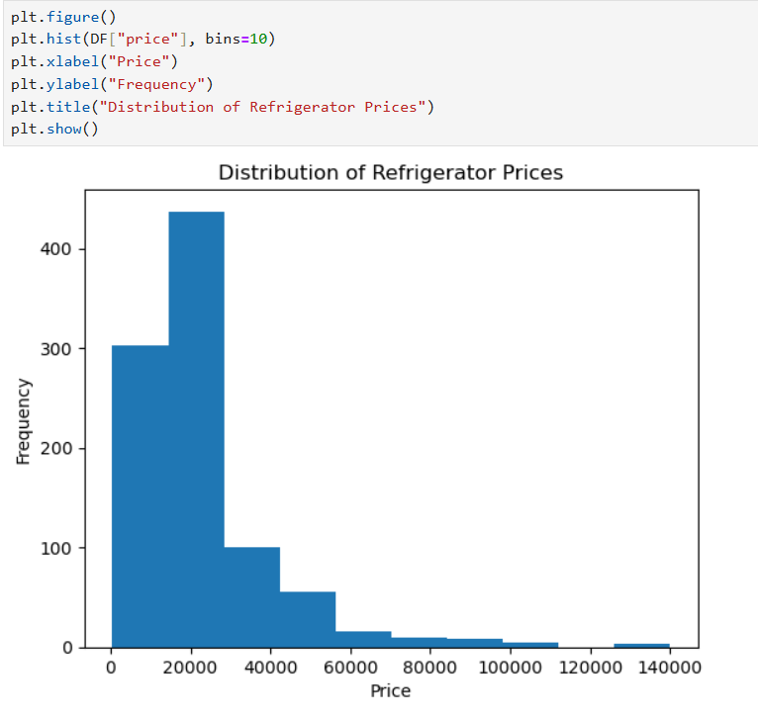
Visualizations
1.Univariate Analysis

Slide 13
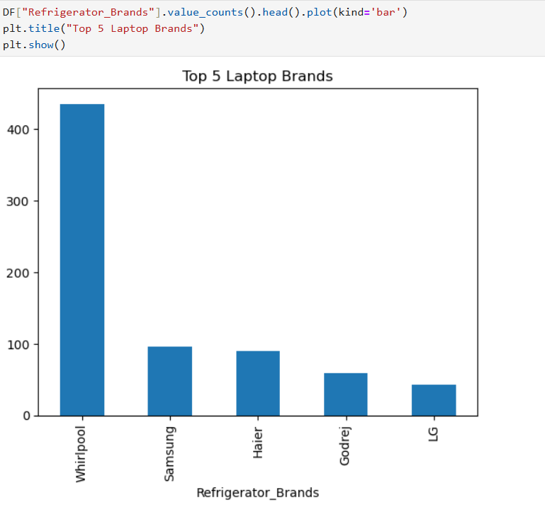
Univariate Analyis

Slide 14
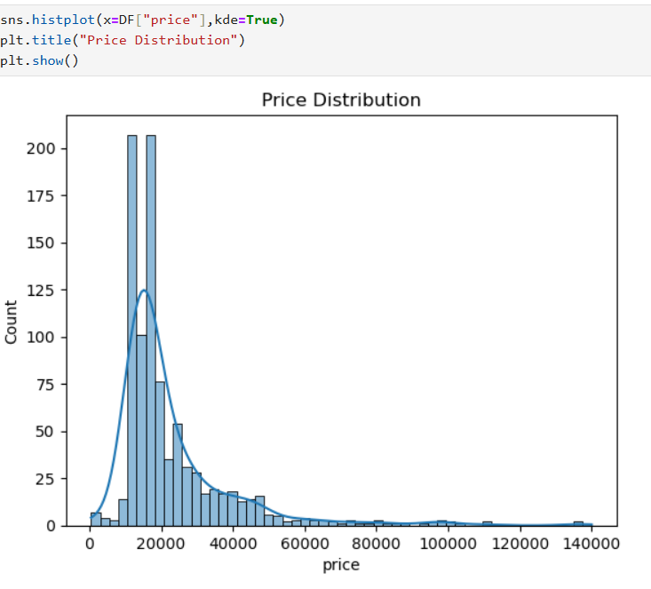
Univariate Analyis

Slide 15
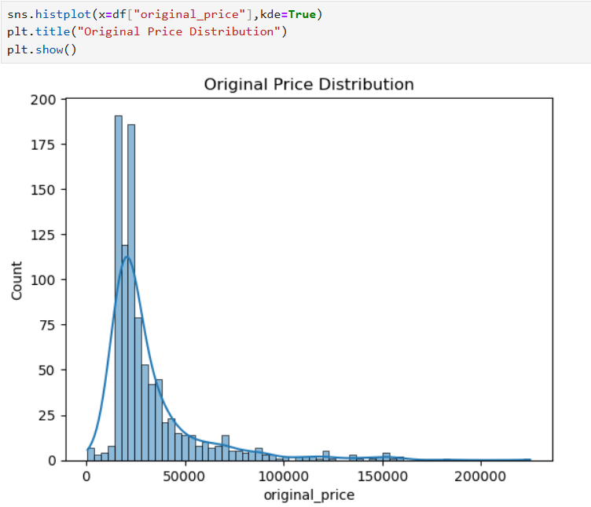
Univariate Analyis

Slide 16
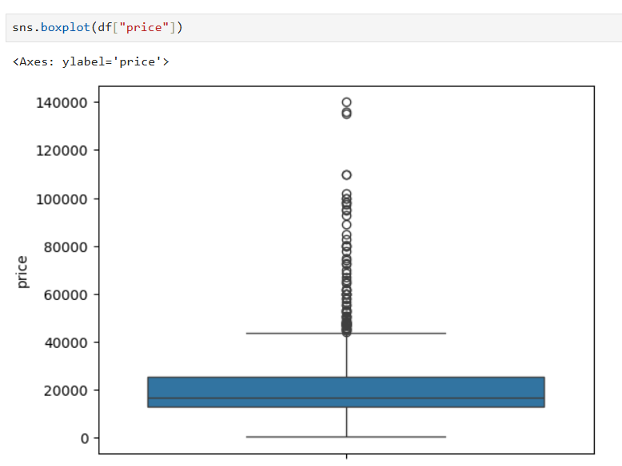
Boxplot

Slide 17
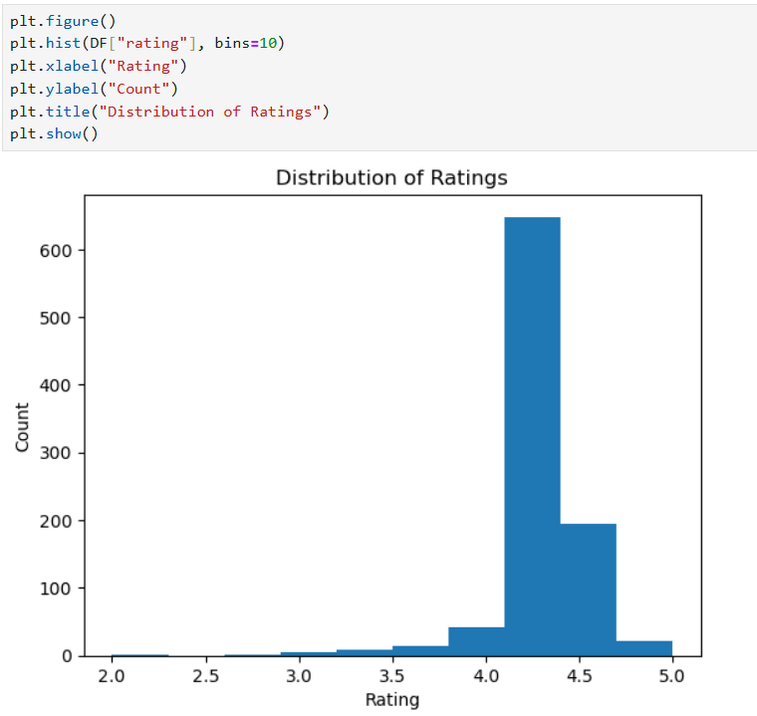

Slide 18
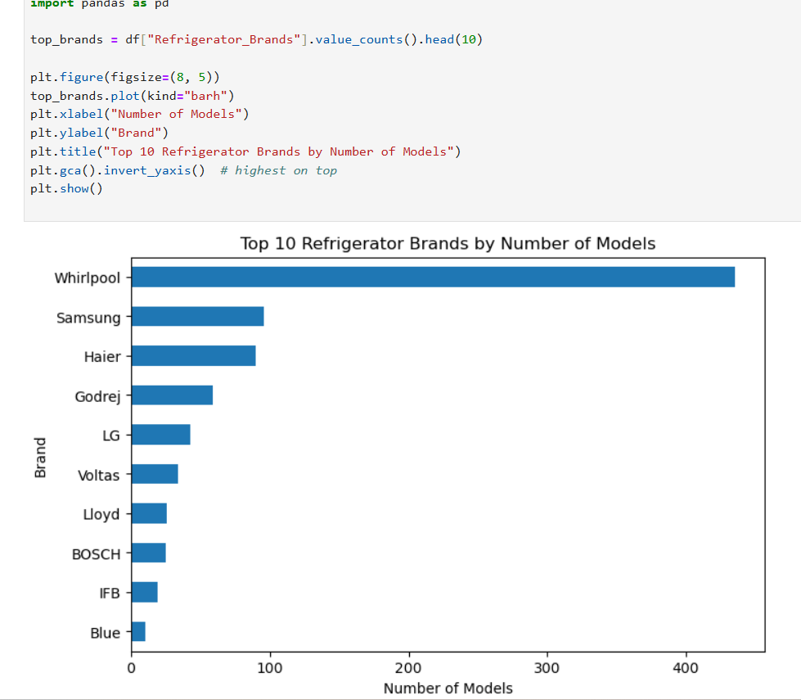
Top 10 Brands by models

Slide 19
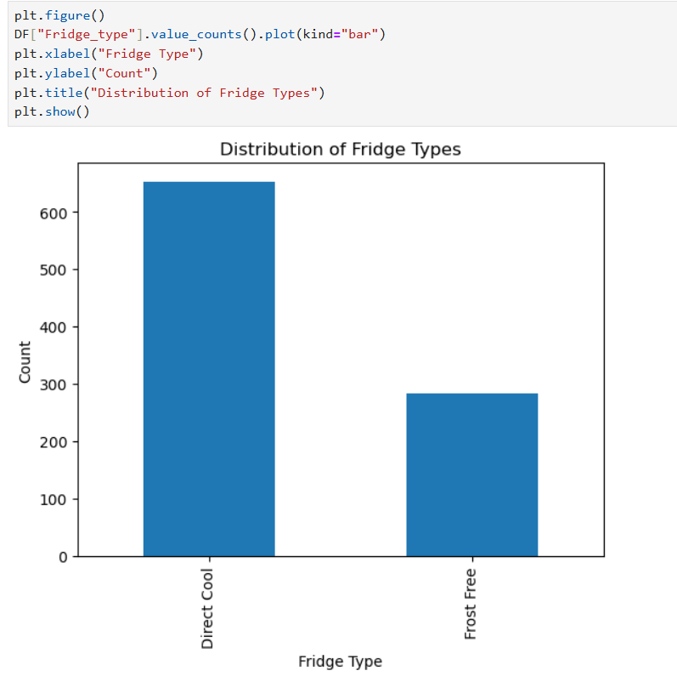
Distribution of Fridge Types:

Slide 20
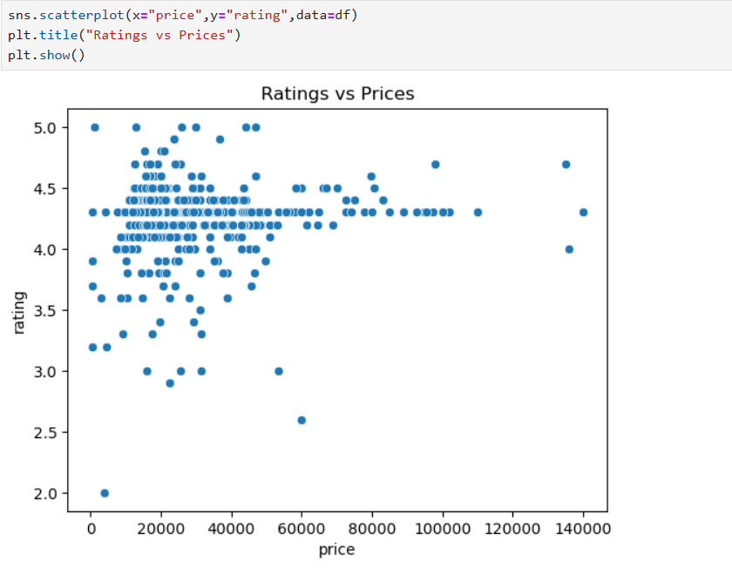
2.Bivariate Analysis

Slide 21
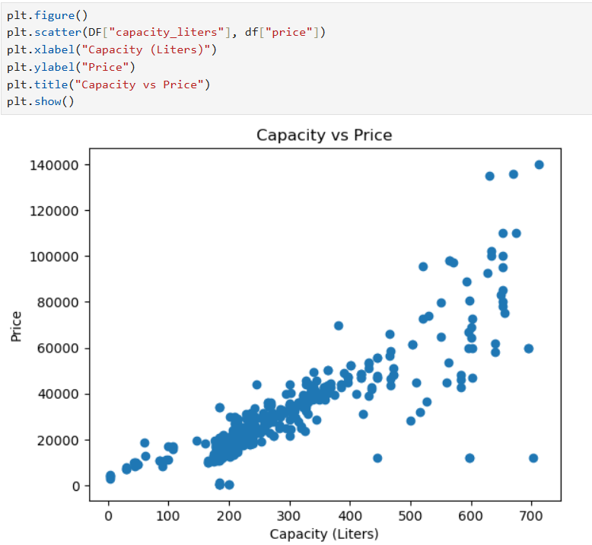
Capacity vs Price

Slide 22
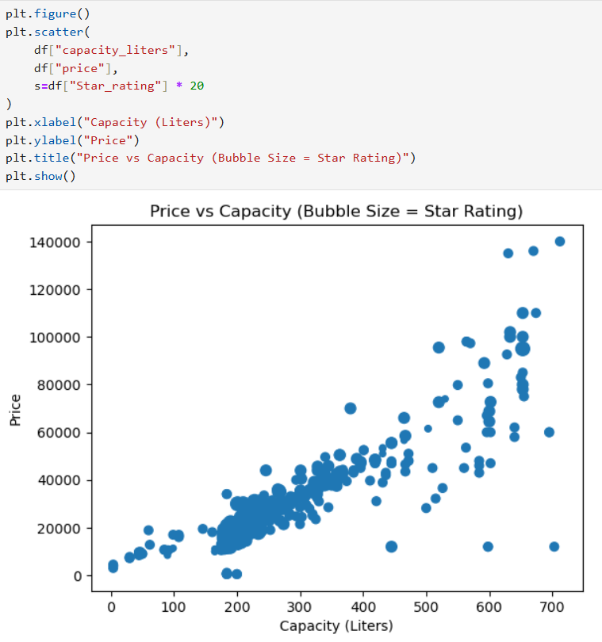
3.Multivariate Analysis

Slide 23
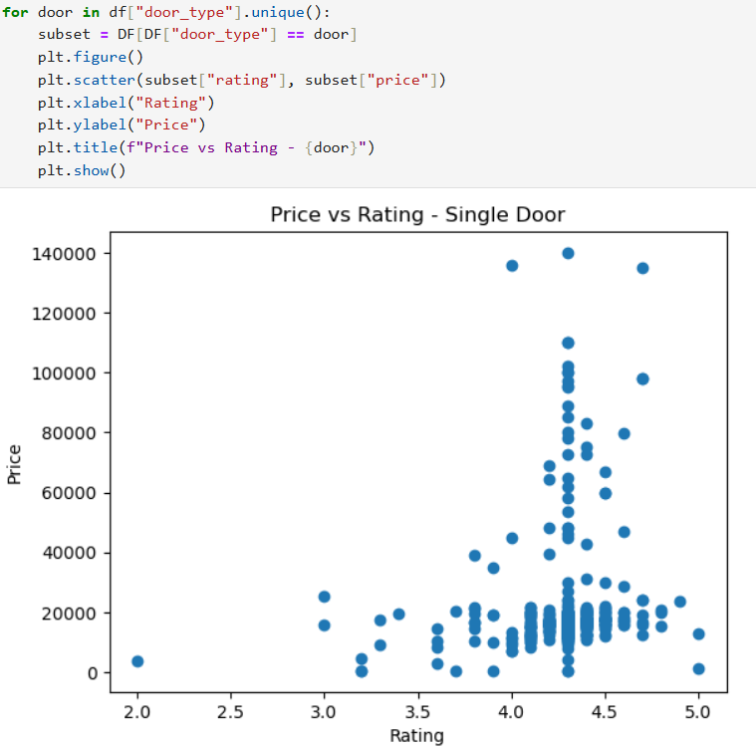
Price vs Rating

Slide 24
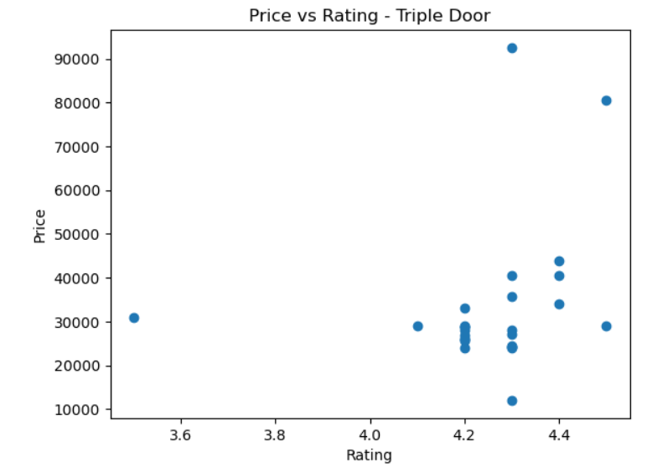
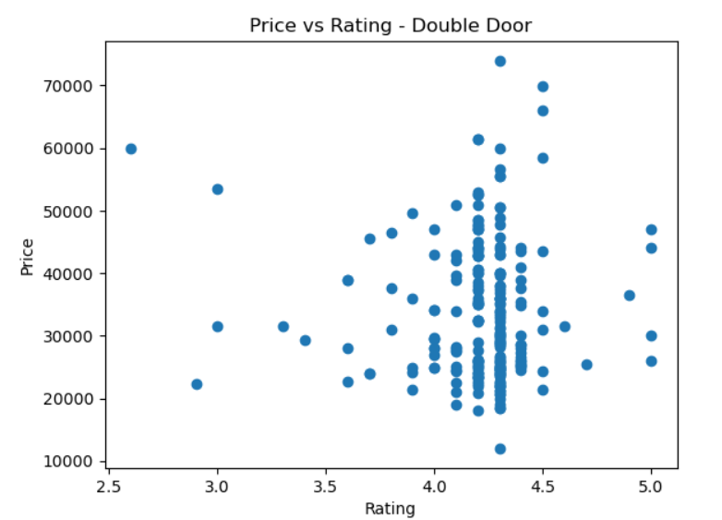
Price vs Rating

Slide 25
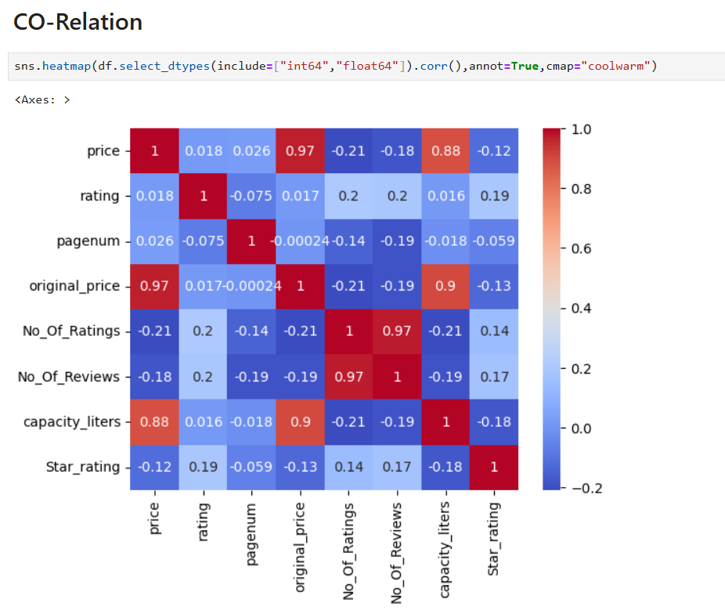
CORELATION - HEATMAP

Slide 26
Key Business Questions
Which Refrigerator_Brands offer the most products in the market?
How does Price vary across different Refrigerator_Brands?
Which Fridge_type is most commonly available and preferred?
How does Fridge_type impact the Price of refrigerators?
What is the relationship between Price and Capacity?
Which Refrigerator_Brands receive higher Ratings from customers?
Do higher-priced refrigerators always have better Ratings?
Which combinations of Brand, Fridge_type, and Capacity provide better value for money?
What price range is most common across different refrigerator types?
How can this data help businesses optimize pricing and product positioning?

Slide 27
Conclusion (Key Findings Overall)
The web scraping process successfully collected structured refrigerator data from an e-commerce platform
Refrigerator_Brands show significant variation in product availability and pricing
Price increases with higher Capacity and advanced Fridge_type models
Double Door and Multi-Door refrigerators are generally priced higher than Single Door models
Premium brands tend to offer refrigerators with higher prices and better features
Ratings do not always increase with higher price, indicating value-for-money options
Certain brands provide better-rated products within mid-price ranges
Multivariate analysis shows that Brand, Fridge_type, and Capacity together strongly influence pricing
The cleaned dataset enables meaningful analysis and visualization
Overall, the project supports data-driven insights for pricing and market analysis

Slide 28
Experience & Challenges
Experience
Gained hands-on experience in real-world web scraping using Python
Learned to work with HTML structure, tags, and classes
Improved skills in data cleaning, preprocessing, and EDA
Understood how to convert unstructured web data into structured datasets
Gained confidence in using Pandas, BeautifulSoup, and visualization techniques
Learned to analyze real market data and extract meaningful insights
Challenges Faced
Handling dynamic website structures and changing HTML elements
Dealing with missing, inconsistent, and noisy data
Cleaning price values with symbols and different formats
Managing duplicate products during scraping

Slide 29
Experience & Challenges
Understanding correct HTML tags and class names for extraction
Visualizing large datasets clearly and meaningfully
How Challenges Were Overcome
Inspected web pages carefully using browser developer tools
Applied data cleaning techniques using Pandas
Used conditional checks and exception handling
Performed step-by-step validation of scraped data
Used appropriate charts for clear visualization

Slide 30


Slide 31

THANK YOU

