Slide 1
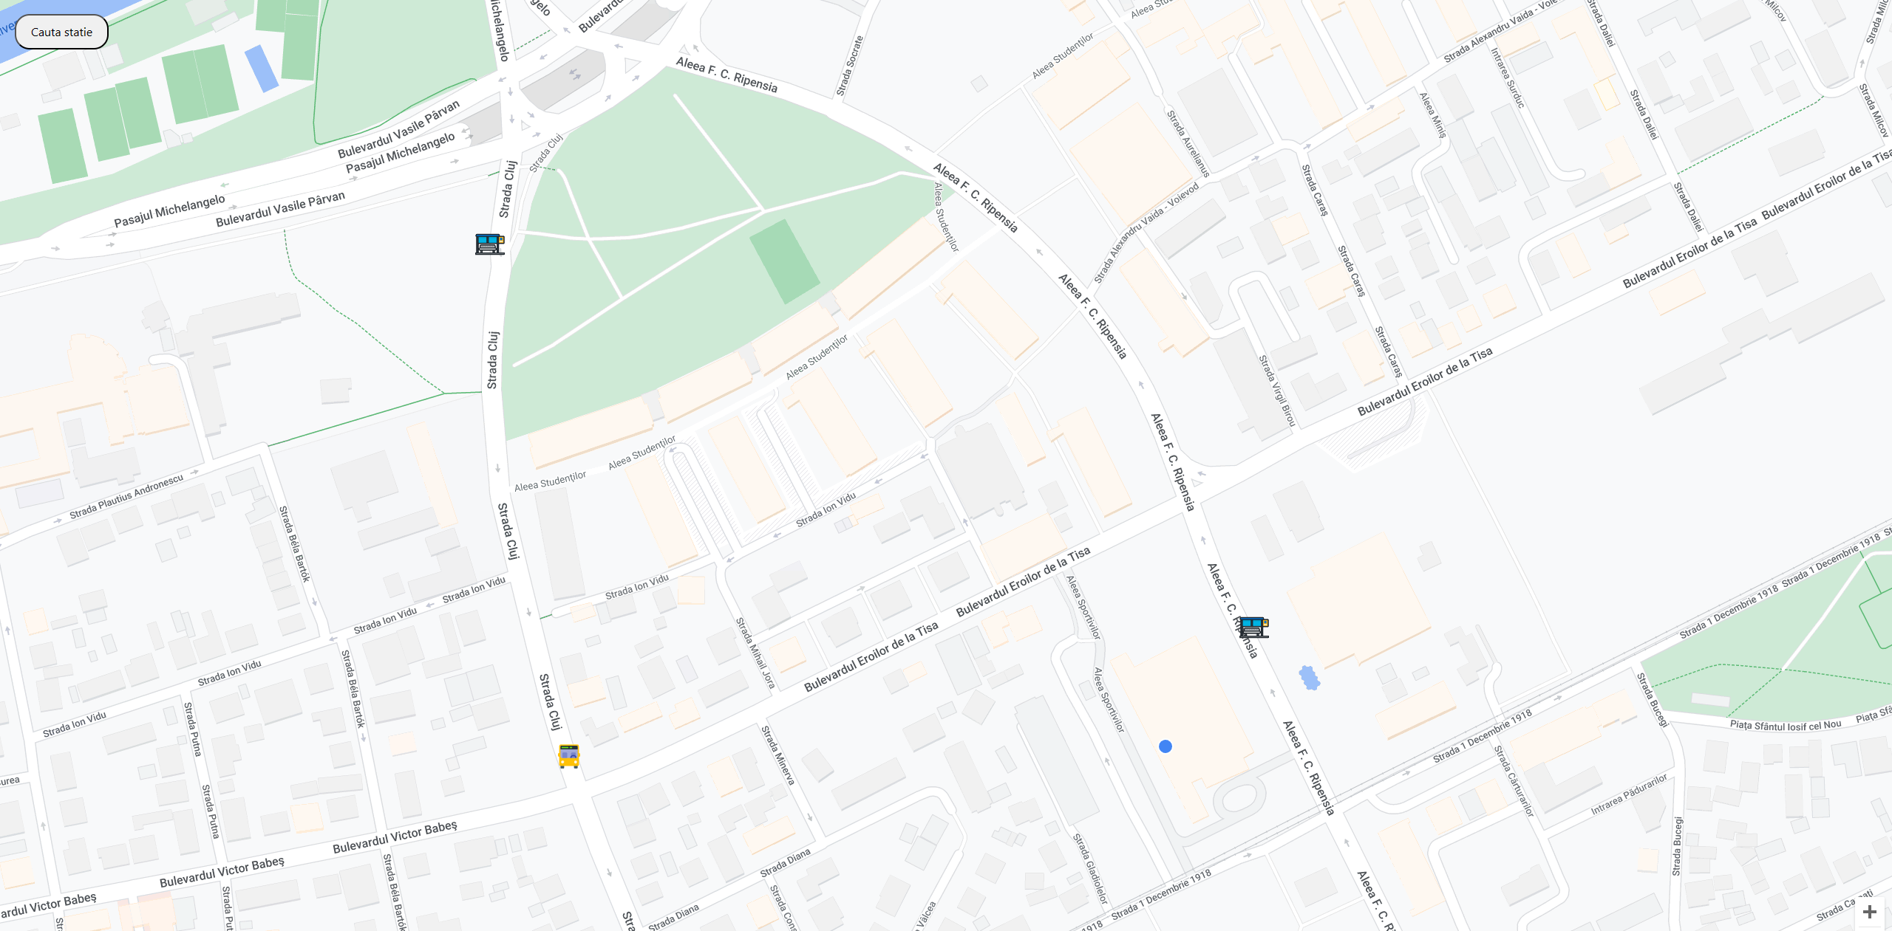
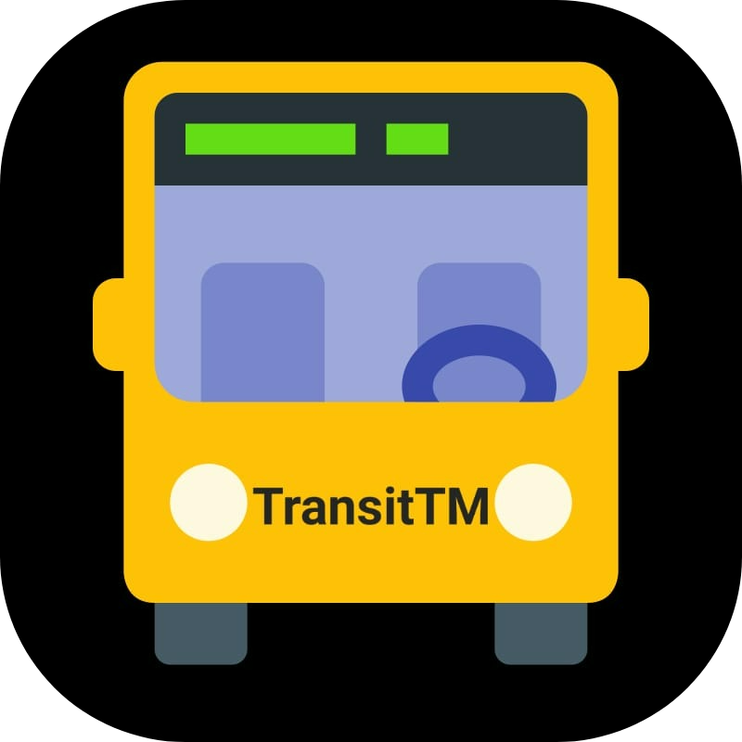
TransitTM
Done by people for people

Slide 2

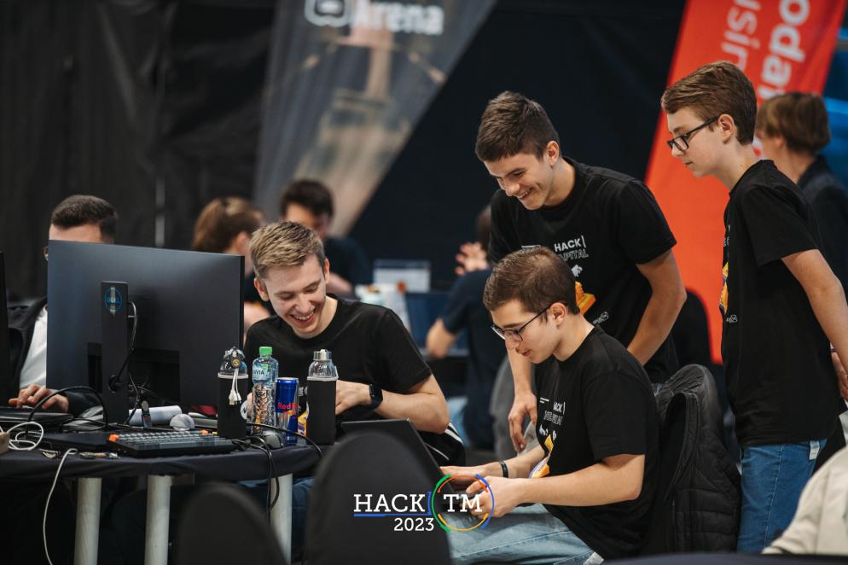
Who are we?
We are a team of highschool students who want to make a difference in our city using our programming skills. With our knowledge we aim to build a site that will offer real-time bus/tram/train tracking.

Slide 3
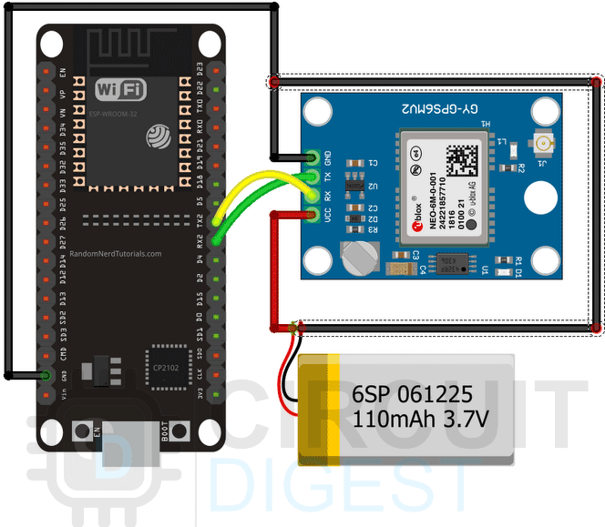
What is TransitTM?
We want to create an compact GPS module that will be mounted on the desired transportation means, using an esp32 module and a GPS sensor. Our module will be connected to the Wi-Fi available on the bus. There will also be a backend function for the drivers that allows them to select the route from the database.
We are also looking to implement a paywall on the app, that would make it even easier for the customer to travel, without taking care of going at a physical ticket station.

Slide 4
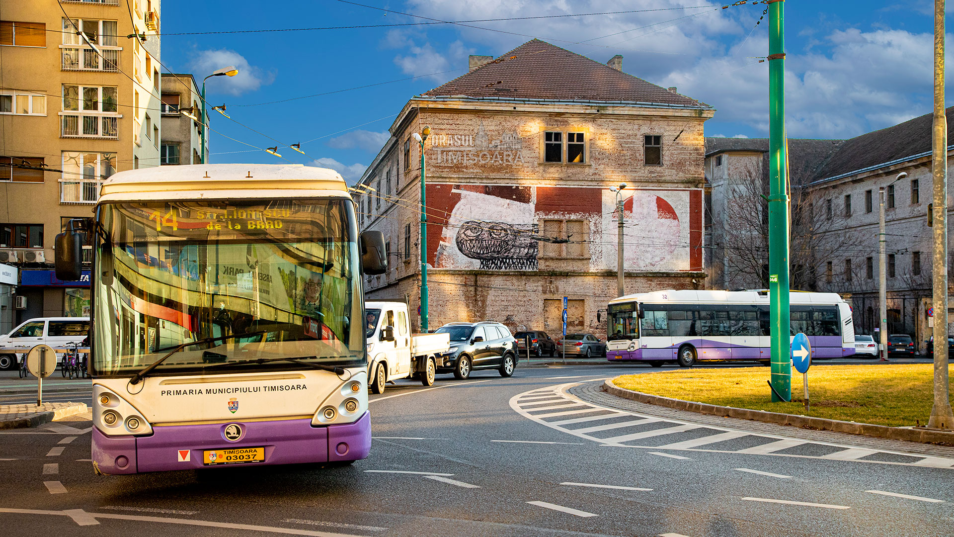
Our plan
Research
Fast implementing
Optimisation
Public Information

Slide 5


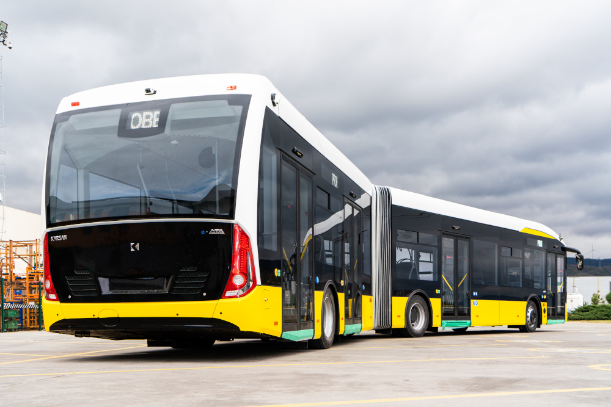



We are trying to keep the costs as low as possible, while developing the app to be the most efficient one out on the market

