Slide 1
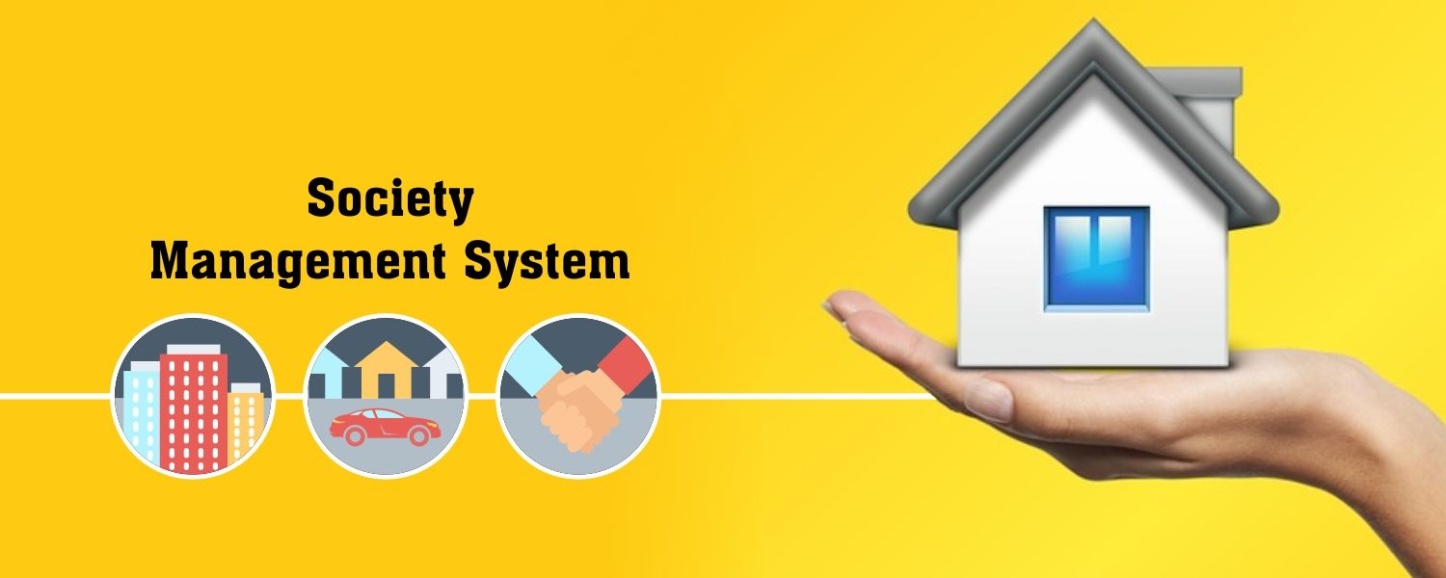

Slide 2


kadi sarva Vishwavidyalaya ldrp institute of technology and research gandhinagar
GUIDED BY:-
Prof. Dr. Hitesh Patel
DEPARTMENT OF COMPUTER ENGINEERING AND INFORMATION TECHNOLOGY

Slide 3
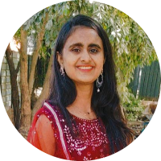



MEET OUR TEAM
Hetvi Shah
19BECE30069
Vishwa Patel
19BECE30207
Mitali Shah
19BECE30116
Nency Patel
19BECE30126

Slide 4
Outline
Abstract
Problem statement
Objective
Scope
Possible outcomes
Diagrams
Implementation
conclusion

Slide 5
ABSTRACT
The basic concept of this system, we create an android application ( web view ) to manage society with house and owner detail.
We provide platform to register society to our system, and there are many houses according to each society.
After becoming a member they can login to their account and have access to Noticeboard, Function, Helpdesk, Profile, etc. Make society well organized and socially engaged.

Slide 6
PROBLEM STATEMENT
The functions of a society are an inevitable part of our lives.
There are chores here which unknowingly take up a considerable amount of our lives.
Managing committee often gets tired of maintaining excel sheets containing members, contact information, etc.
Worse is the case where technology remains unused.
Also, residents get restless that issues are not getting resolved despite remainders and no one knows the status of the complaint raised. Such issues and many more are common in most societies.
With no appropriate tools, managing a residential complex takes too much of time, effort and money with a lot of inefficiency.
Thus, changing the way of maintaining the society information will also prove to be beneficial, improve efficiency and save us time.

Slide 7
Objective
The Main aim of this system is to provide an android application ( web view ) for society members that manages all the problems faced by a society that can be resolved by digitization.

Slide 8
scope
The scope of this system is to make societies socially engaged and improve communications and help them to manage it in well-organized manner.

Slide 9
POSSIBLE OUTCOMES
1.Collect Payments Online
A management system not only keeps track of payments but can have a portal for online transactions too.
2. Have Emergency Contacts in One Place
A page dedicated to all relevant emergency contacts like, Plumbing service, Police station, Fire station, Doctor, Security guard, Pharmacy.
3. Virtual Notice Board
Instead of wasting paper on printing notices and dropping them on every doorstep, you can use the online system to post updates to reach every person.
4. Registry of All Residents
Each new tenant or homeowner in the community can go through mandatory registration on the online system. You can use the information in case of emergency, and they are a great way to avoid fraud.
5. Access from Anywhere
Even if the residents are out of town, they will know what is going on back home through the app. It is a great way to stay connected and remain in touch with the community.
6. Online Helpdesk
There is an online helpdesk where user can directly get help for any of the problem.

Slide 10
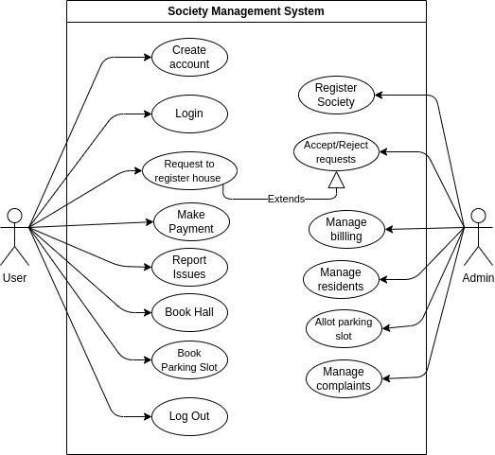
Use case diagram

Slide 11
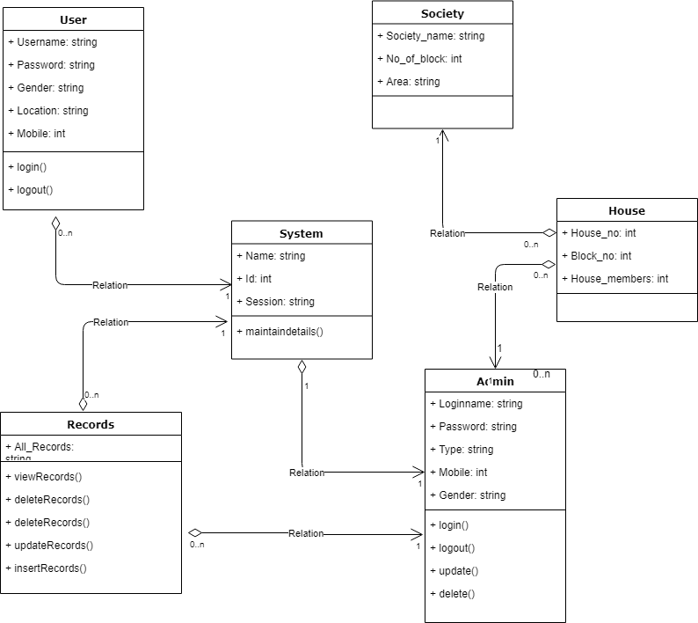
Class diagram

Slide 12
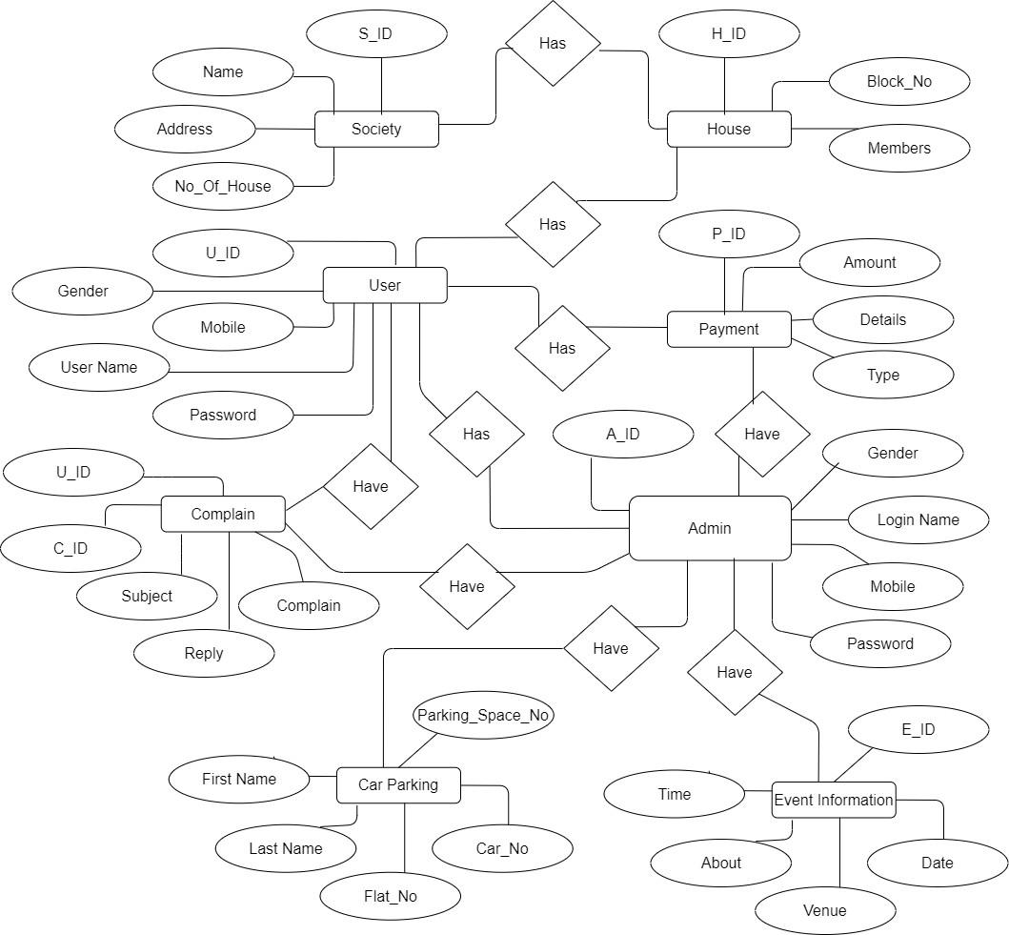
er diagram

Slide 13
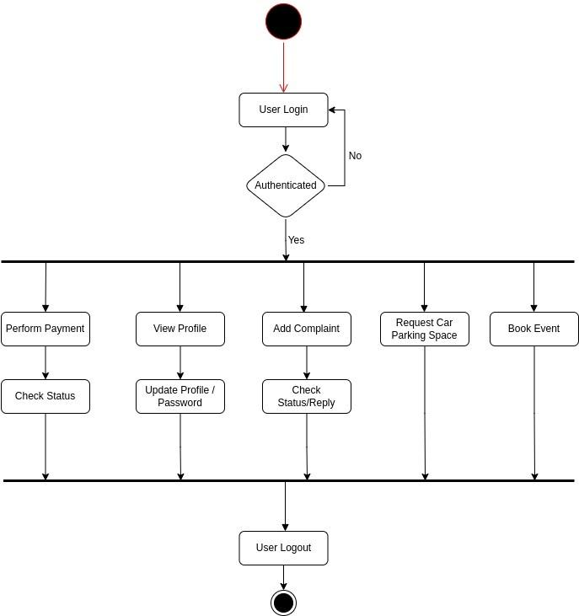
activity diagram-User

Slide 14
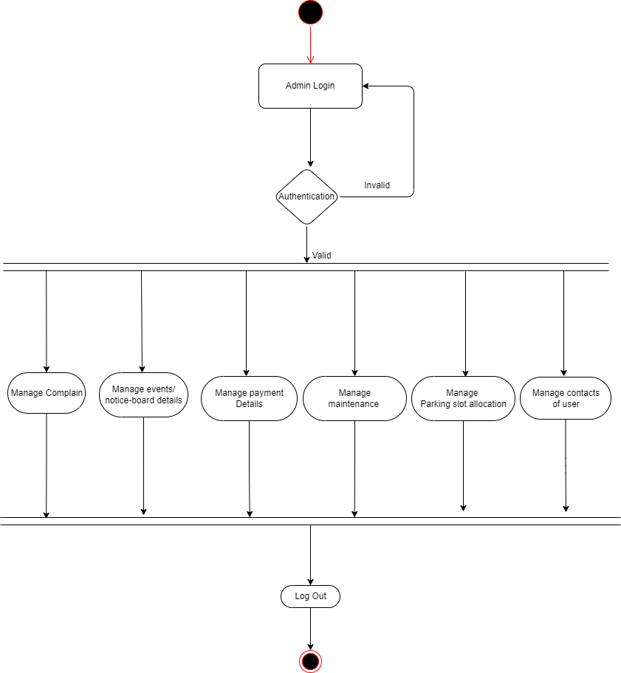
activity diagram- Admin

Slide 15
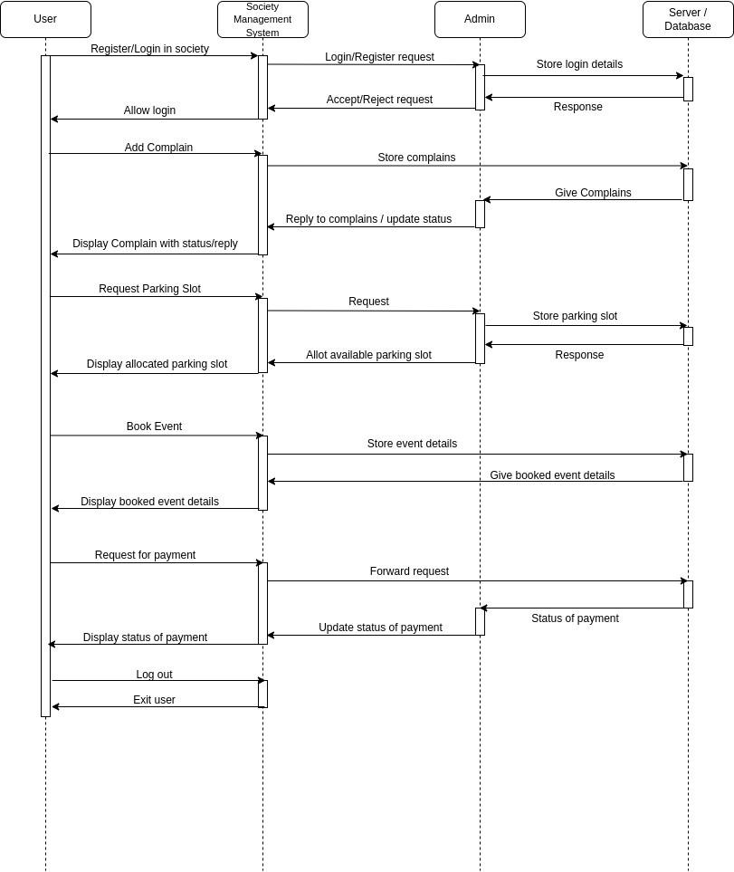
SEQUENCE diagram

Slide 16
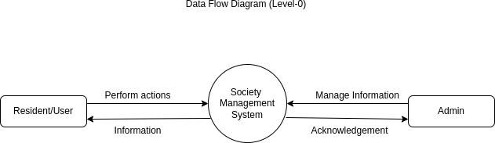
Data flow diagram

Slide 17
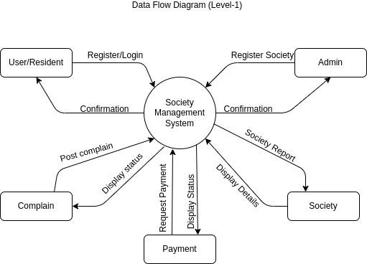
Data flow diagram

Slide 18
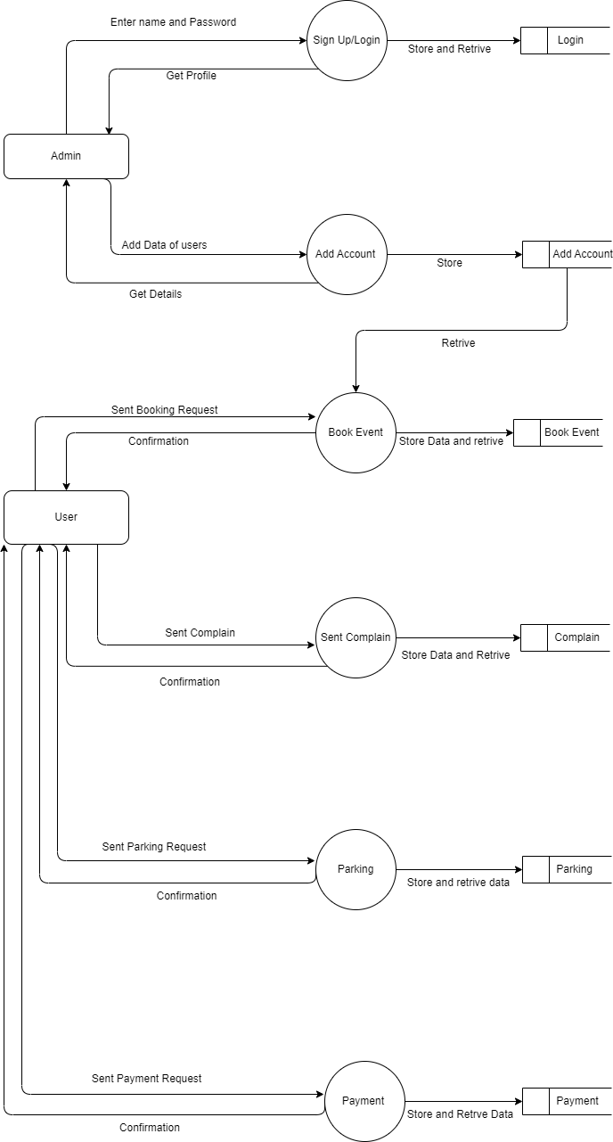
Data flow diagram
LEVEL 2

Slide 19

IMPLEMENTATION

Slide 20
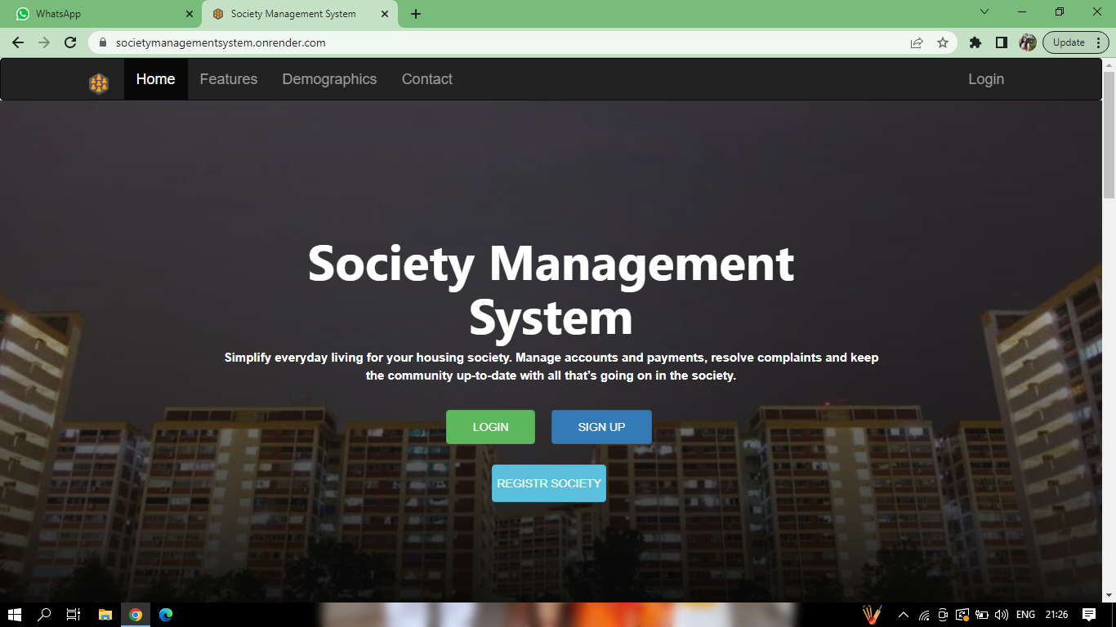

Slide 21
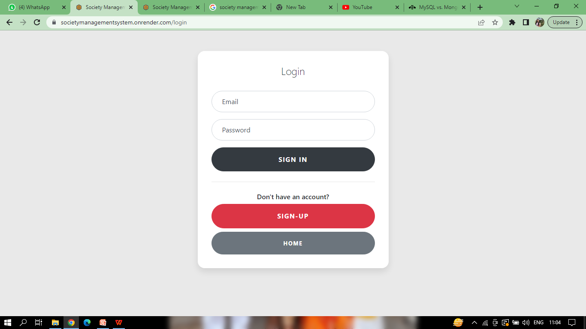

Slide 22
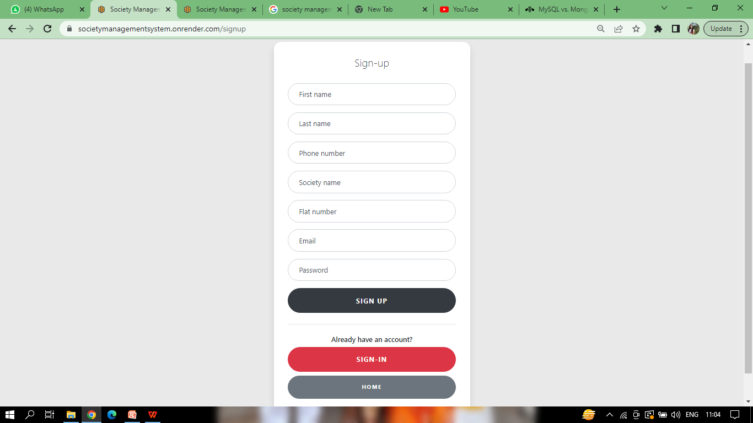

Slide 23
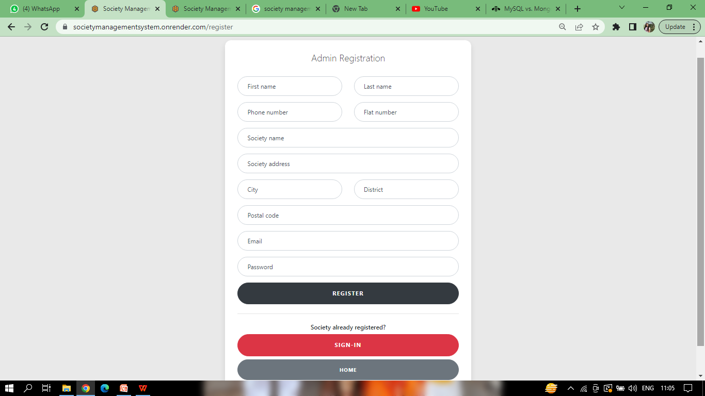

Slide 24
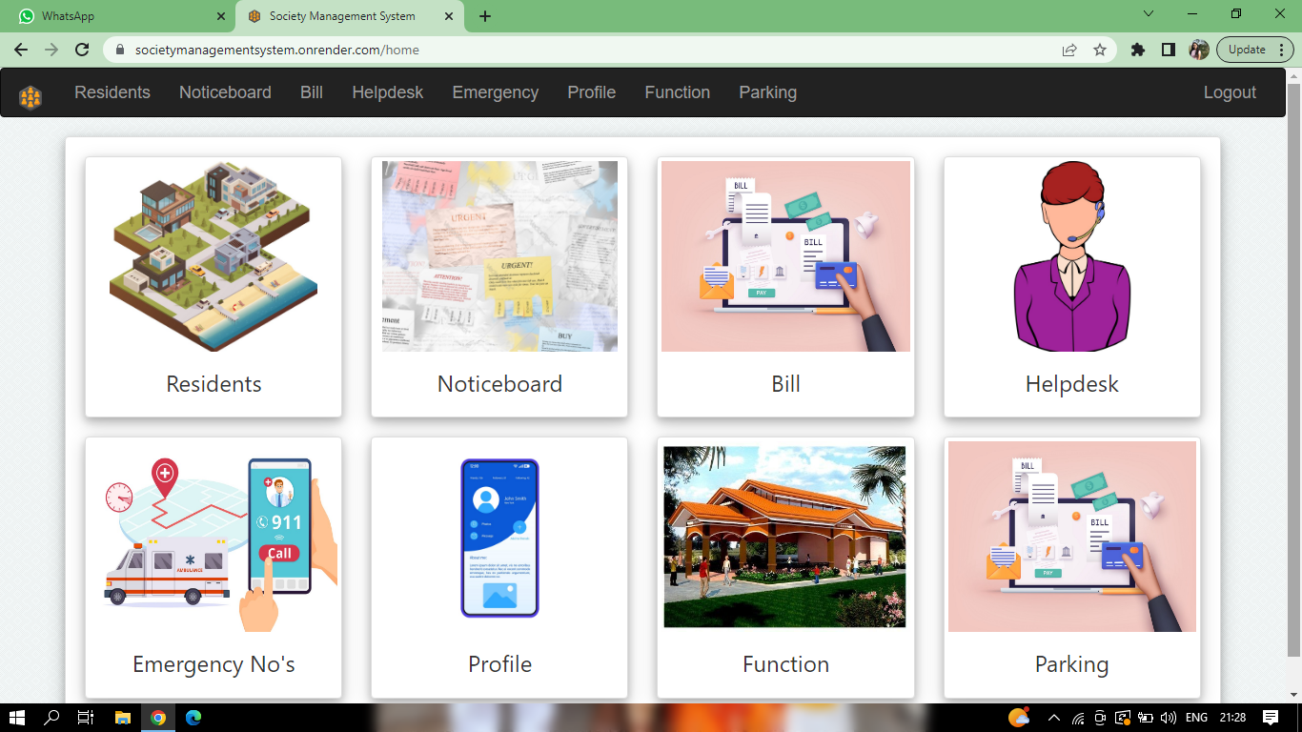

Slide 25
Conclusion
Thus, our application tries to comfort its users with easily understandable as well as essential functionalities.
Our application is implemented to manage the affairs of a society by requiring the committee member to enter and save minimal amount of information.
Thus, this application provides a virtual tour of the society.
It is capable of simplifying everyday living for your housing society.
Manage accounts, due payments, resolve complaints and keep the community up-to-date with all that’s going on in the society-to a single click.

Slide 26


