Slide 1
Employee Shift
Scheduling System
Team: Misha Patel & Anuj Nene
Date: November 25, 2025

Slide 2
Key Features:
- Automated shift scheduling
- Conflict detection
- Employee management
- Time-off tracking
- Analytics & reporting

Slide 3
What is This Application?
- Desktop application for managing employee schedules in intramural sports programs
- Automates scheduling process and prevents conflicts
- Handles employee availability, time-off requests, and hour tracking
- Provides analytics and reporting for administrators

Slide 4
Problem Statement
1. Manual Scheduling is Time- Consuming
- Checking availability for each employee
- Avoiding double-booking
- Ensuring qualified staff
2. Human Errors
- Scheduling conflicts
- Forgetting time-off requests
- Overworking employees
3. No Centralized System
- Scattered information
- Poor communication
- Difficult to track hours

Slide 5
Technology Used
Frontend:
- Java 21 - Core programming language
- JavaFX 21 - Rich desktop UI framework
- CSS - Custom styling
Backend:
- SQL Server - Database management
- JDBC - Database connectivity
- BCrypt - Password encryption
Build & Tools:
- Maven - Dependency management
- PowerShell - Build scripts
- VS Code - Development environment
External Libraries:
- mssql-jdbc.jar - Microsoft SQL Server JDBC Driver
- bcrypt.jar - Password hashing

Slide 6
Intelligent Scheduling Algorithm
Hard Constraints
Soft Preferences
- Employee availability
- No double-booking
- Under max weekly hours
- Sport expertise match
- Time-off respected
- Higher expertise preferred
- Even workload distribution
- Preferred time slots
- Balance assignments

Slide 7
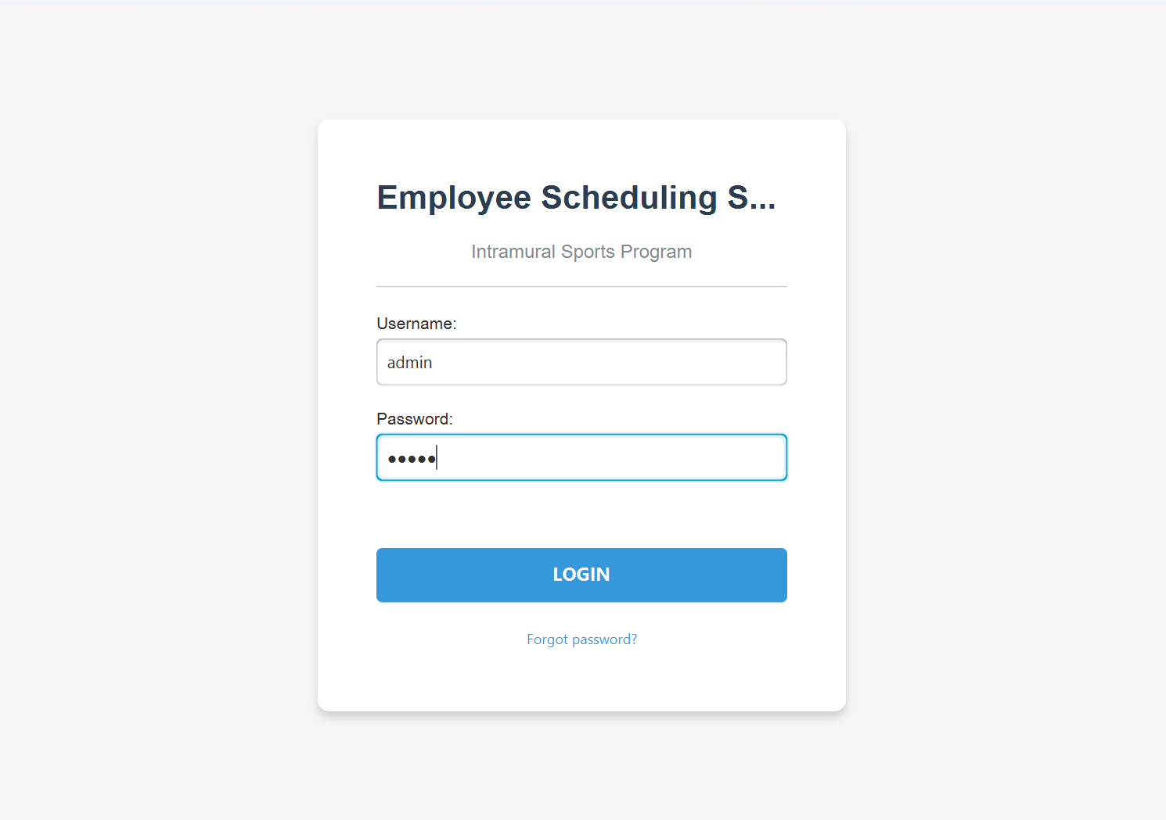
Login Interface

Slide 8
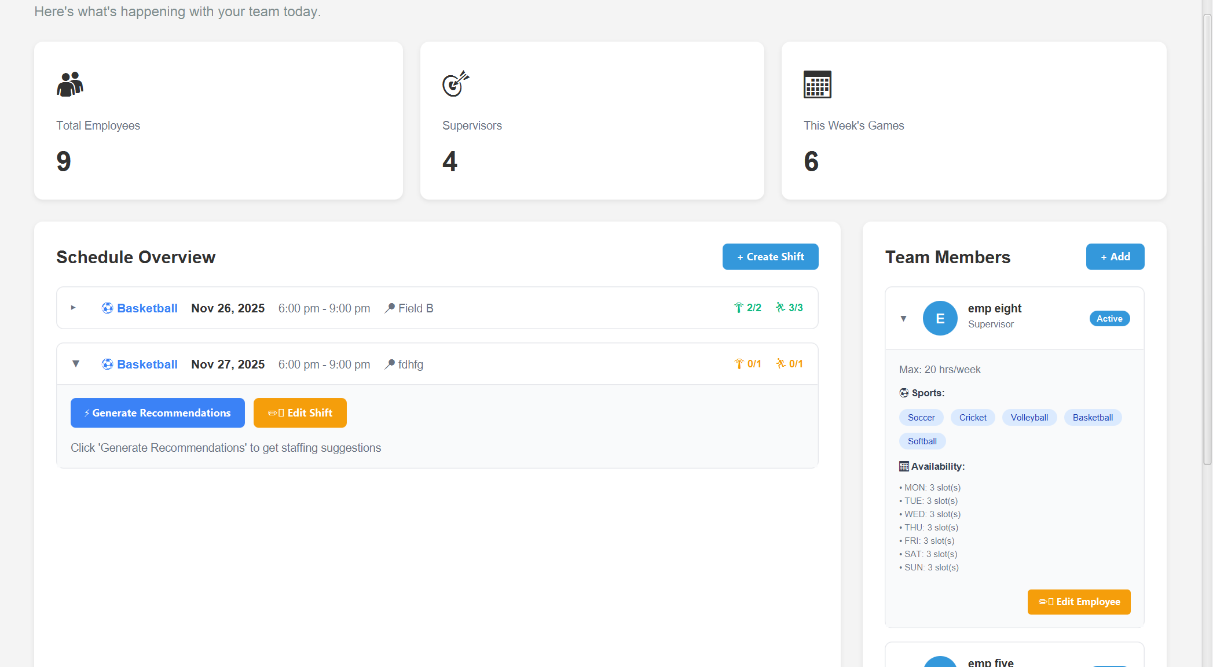
Admin Dashboard
Features Visible:
- Upcoming shifts
- Team statistics
- Active employees
- Recent activities

Slide 9
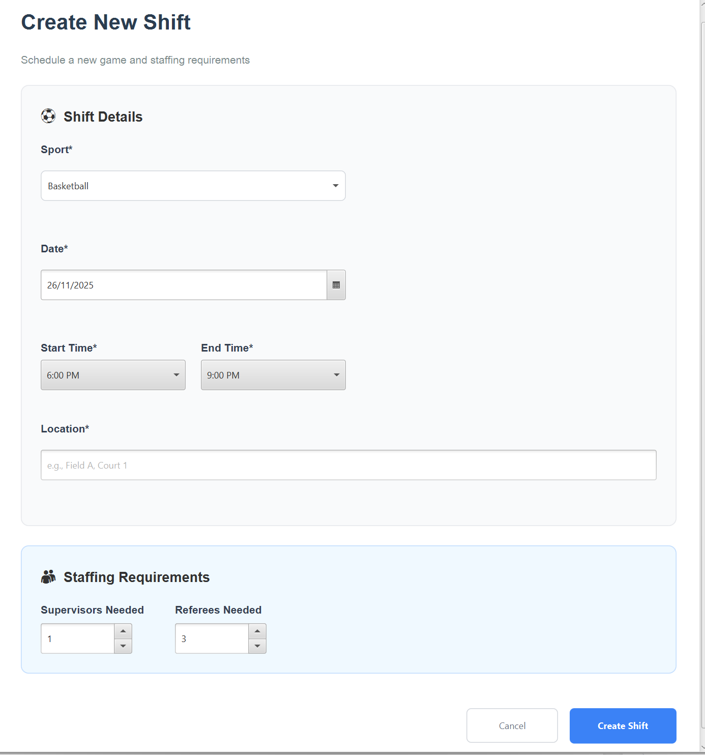
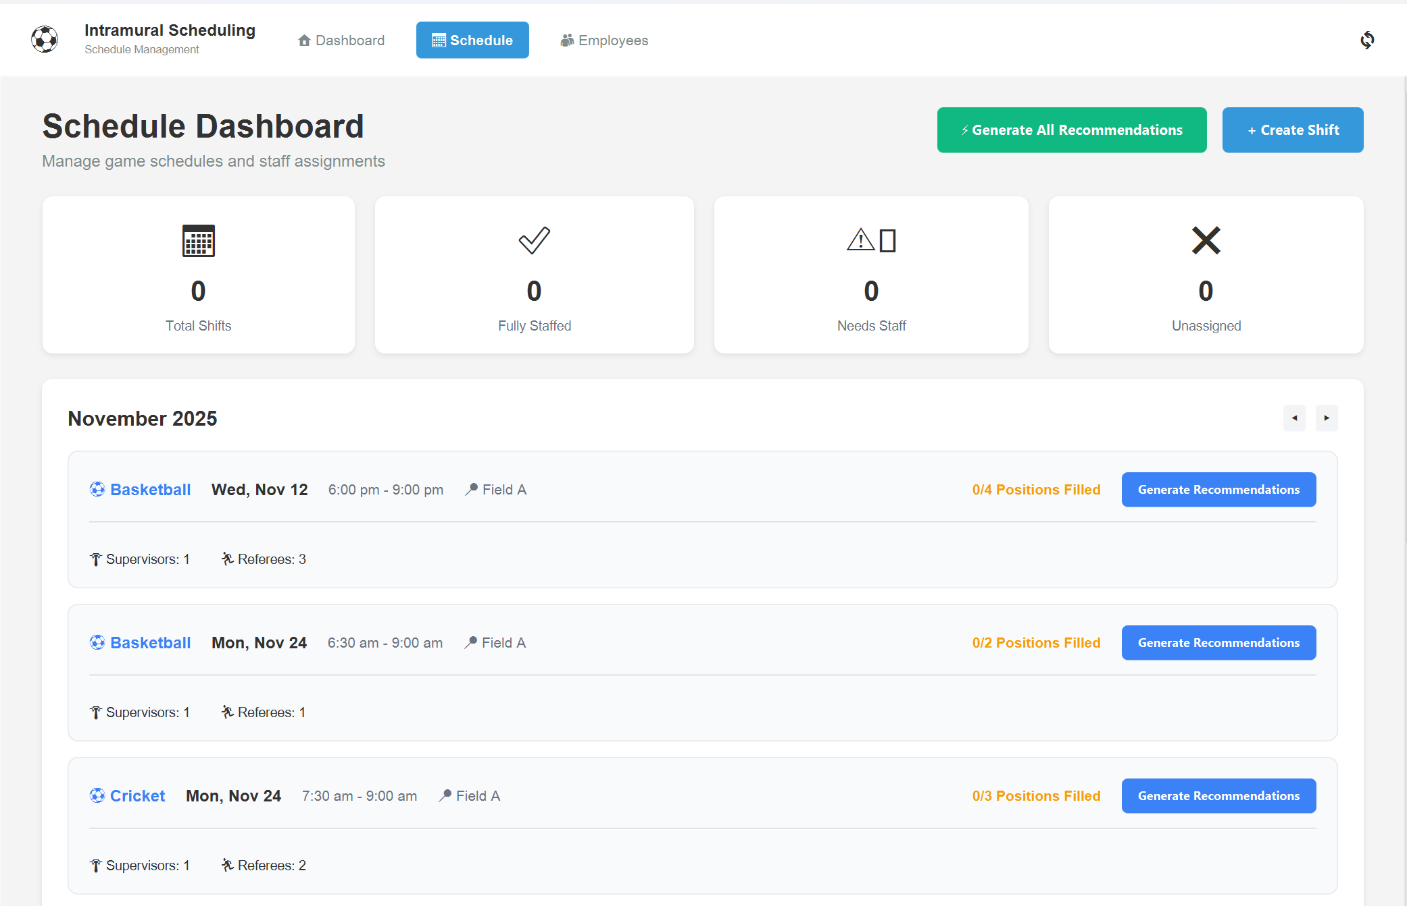
Shift Scheduling
- Date picker (with validation)
- Time selection
- Sport dropdown
- Location field
- Staffing requirements (refs, supervisors)
- Validation in action

Slide 10
Employee Management
- Employee listing
- Search/filter functionality
- Add new employee form
- Name validation
- Sport expertise selection
- Active/inactive status

Slide 11
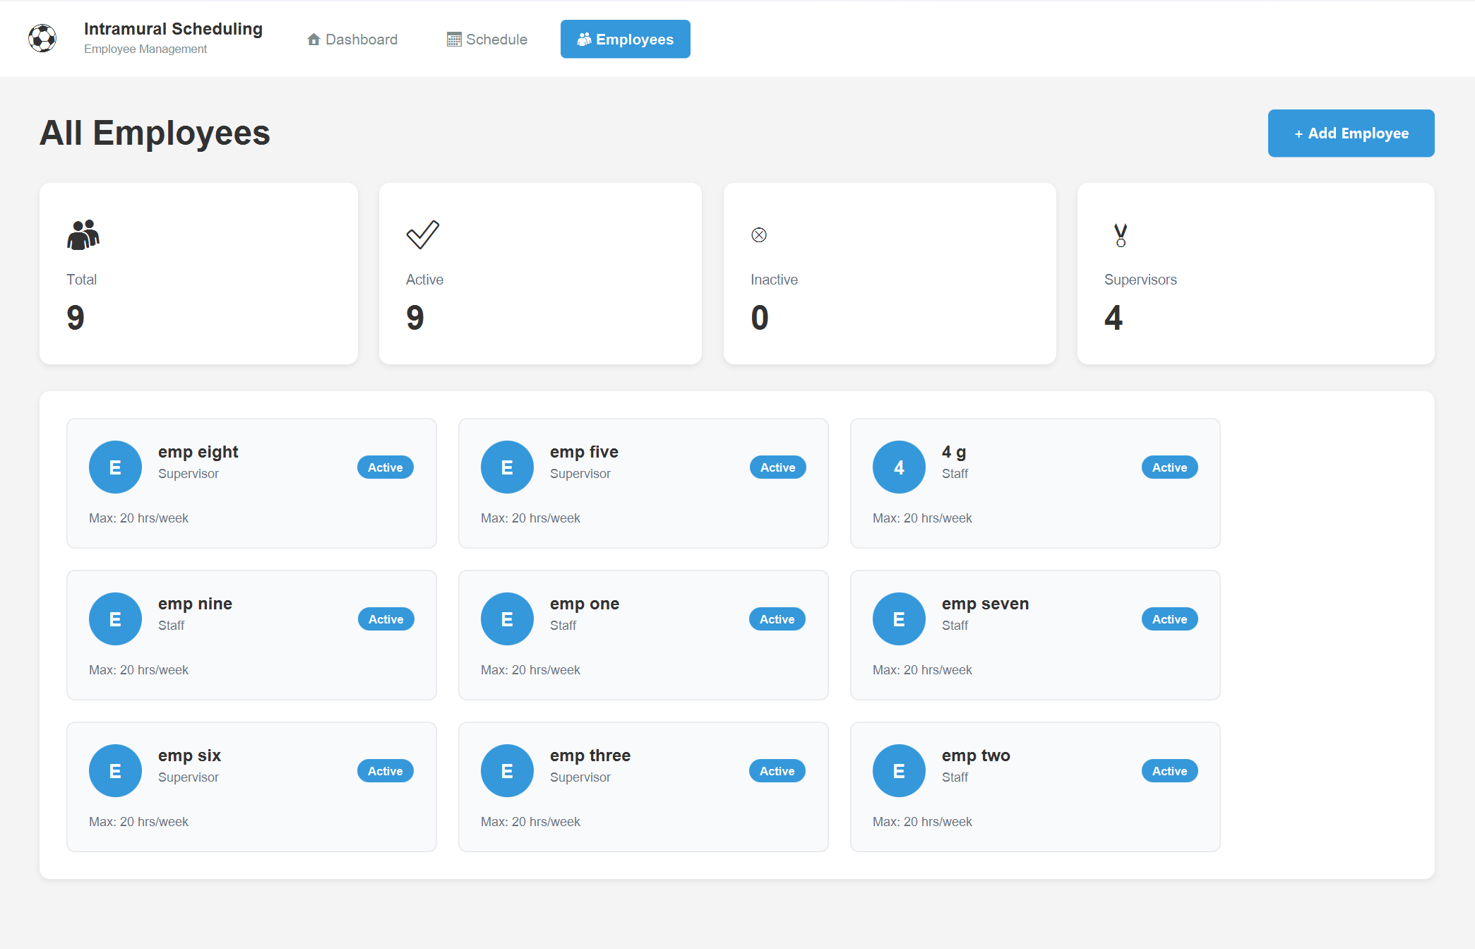
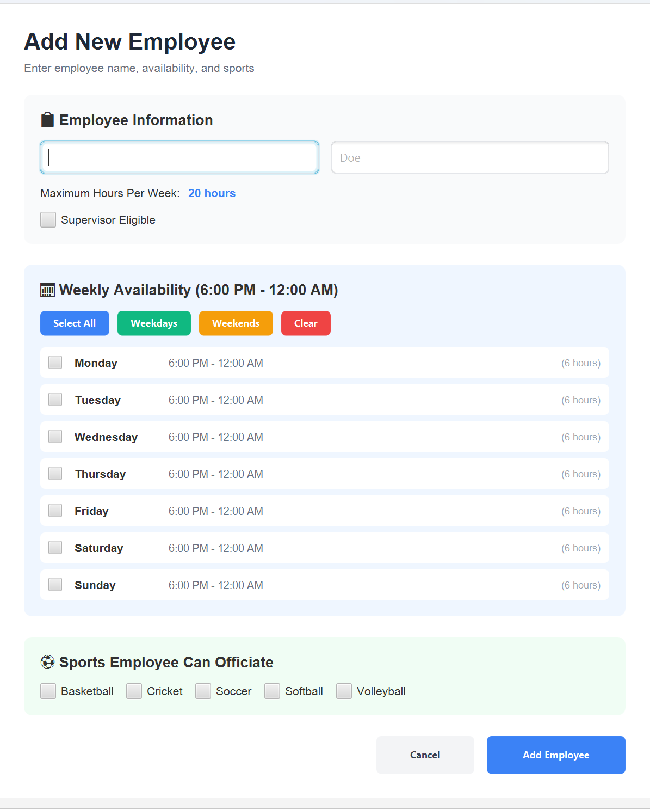
Employee Management
Employee listing
Search/filter functionality
Add new employee form
Name validation
Sport expertise selection
Active/inactive status

Slide 12
Running the Application
Step 1: Setup Database
CREATE DATABASE SchedulingSystem;
Run schema.sql
Step 2:Configure Connection
Edit: resources/config/application.properties
db.url=jdbc:sqlserver://localhost:1433;.
db.username=your_username
db.password=your_password
Step 3: Run Application
powershell
.\run_login.ps1
Prerequisites:
Java 21 or higher
SQL Server installed
JavaFX SDK 21
Database created and configured

Slide 13
Code Organization
com.intramural.scheduling/
├── 📂 model/ - Data classes (9 files)
├── 📂 dao/ - Database layer (7 files)
├── 📂 service/ - Business logic (7 files)
├── 📂 controller/ - UI controllers (6 files)
├── 📂 view/ - JavaFX screens (6 files)
├── 📂 util/ - Helper classes (3 files)
└── 📂 exception/ - Custom exceptions (5 files)

Slide 14
Future Scope
3. Advanced Analytics
- Predictive scheduling
- Performance metrics
- Cost analysis
4. Integration
- Calendar export (iCal)
- Payroll system integration
- Third-party APIs
Email Notifications
- Shift reminders
- Schedule changes
- Time-off approvals
2. Mobile App
- React Native/Flutter version
- Push notifications
- Quick availability updates

Slide 15
THANK YOU

