Slide 1

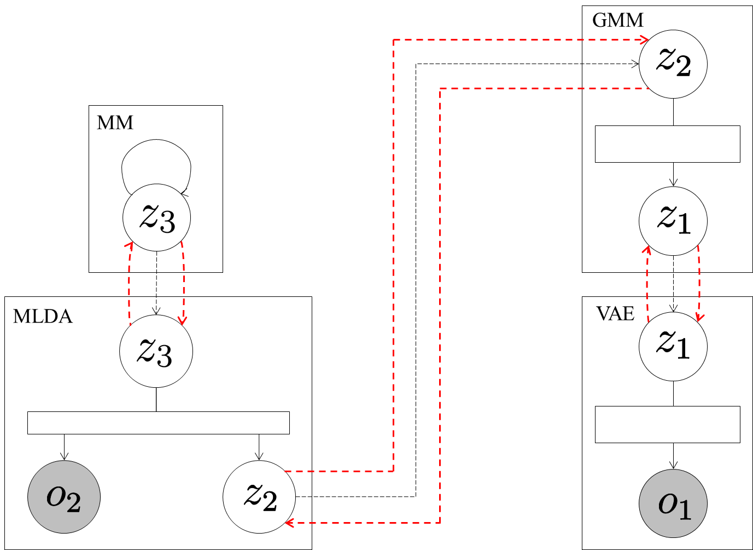




Send .
Send probabilities
of considering
transition.
Send .
Send latent
variables .
Send mean of
distribution of classes.
Send .

