Slide 1
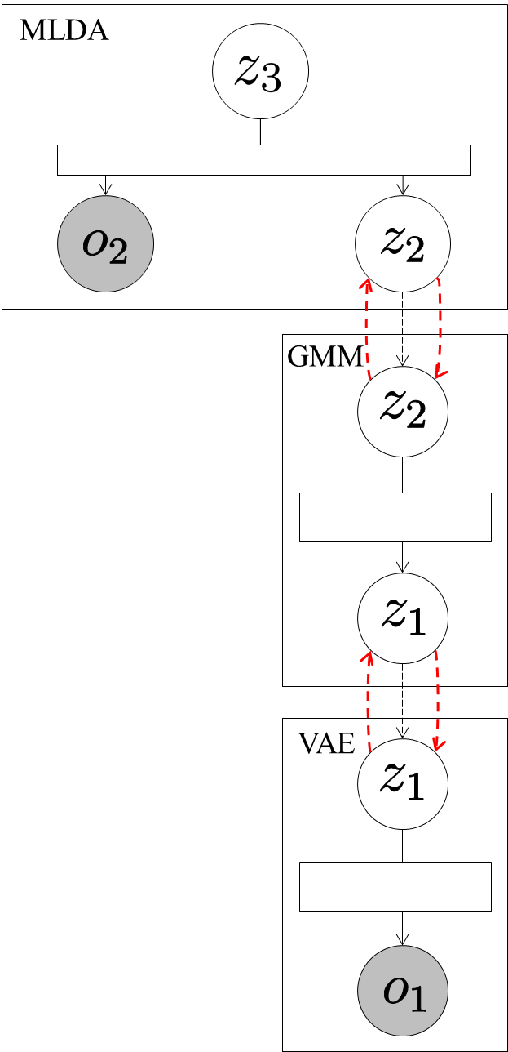




Send .
Send .
Send latent variables .
Send mean of
distribution of classes.

