Slide 1
Graph Clustering and Community Detection

Slide 2
TABLE OF CONTENTS
Introduction
SCoDA
Implementation
1
3
5
2
4
6
State-of-the-art
CoEuS
Conclusions

Slide 3
INTRODUCTION

Slide 4
Importance of graphs
Graphs are a powerful tool for modeling, analyzing and understanding relationships between entities
Graphs are widely used in several fields
Computer science (e.g. used as storage format in graph databases);
Social sciences (e.g. used to represent social ties in social networks);
Physics (e.g. used to model connections between particles in a fluid);
Biology (e.g. used to represent interactions between cells’ components);
etc..
Notes:
- Computer science: e.g., to serve as the storage format in graph databases;
- Social sciences: e.g., to perform sentiment analysis in social networks;
- Physics: e.g., to model connections between particles in a fluid;
- Biology: to represent and analysize biological networks and the interactions between cell’s components
- etc.

Slide 5
Graph clustering and Community detection
GOAL: identify clusters of vertices that are connected, according to some measure or definition of similarity, and separate them from those with which they do not correlate.
CHALLENGES
Real-world networks can be massive;
Networks may be dynamic (i.e. edge deletion);
Communities may overlap.
No universally accepted definition for a “good” cluster, however in general
good means that nodes inside a community are cohesive;
and loosely connected w.r.t. nodes outside of the community.
- Typically no distinction between the two in the literature [1]

Slide 6
Graph clustering and Community detection
Def. Graph Clustering: generally involves partitioning the vertices of a graph into groups based on some measure of similarity. [2]
Similarity can be interpreted in different ways w.r.t.
vertex attributes;
vertices’ behaviour;
etc..
Def. Community Detection: focuses on identifying groups of vertices densely connected between each other w.r.t. the rest of the graph, based on the graph structure. [3]

Slide 7
STATE OF THE ART

Slide 8
State-of-the-art: an overview
Several community detection algorithms, based on a variety of approaches, exist.
The communities may be
overlapping, i.e. a node can belong to more than one community;
non-overlapping, i.e. a node can belong to at most one community.
Popular techniques include
Quality metric optimization (e.g. modularity, conductance);
Random walks;
Spectral clustering;
Seed-set expansion;
etc..
Notes:
Modularity: most relevant/popular, high value = good community, assesses the relative density of edges within a subgraph/community w.r.t. the density that would be expected in a randomly generated graph with same degree distribution
Conductance: low value = good community, ratio between number of edges connecting a community to rest of graph (cut size) and number of edges inside the community (volume)
Random-waks: propbabilistic technique where graph is traversed by a random walker which is expected to get “trapped” in good communities due to the high number of internal edges, so the probability of ending up in a specific node can reveal the importance of centrality of that specific node or that specific community in the graph
Spectral clustering: robust to noise, based on eigenvectors of the graph’s Laplacian matrix to find clusters, the laplacian matrix of a graph encodes information about graph’s structure and connectivity. Computed by subtracting matrix with the degrees on the diagonal and adjacency matrix (1 if nodes I,j are connected). The intuition is that eigenvectors of this matrix for the smallest non-zero eigenvalues will have large values if the nodes are in the same community, low values in the other case. So you group vertices that have similar eigenvecto values.

Slide 9
The streaming model
Community detection is a challenging topic due to the huge size of most real-world networks (e.g. million of vertices, billion of edges).
Being able to scale up to massive graphs while maintaining performance is not easy.
Solution: process the graph as a stream of edges (i.e. data stream model)
Insert-only streams: only edges insertion;
Dynamic streams: edges insertion and/or edges deletion.

Slide 10
SCoDA

Slide 11
SCoDA
SCoDA [3] is a linear time, linear space, (insert-only) stream-based algorithm for community detection.
IDEA: if an edge e is randomly chosen it is more likely to connect vertices of the same community (i.e. intra-community edge).
If we consider a random permutation of the edges, it is expected for intra-community edges to arrive early, and for inter-community edges to arrive late
Adjacent nodes of an early edge will be put in the same community, adjacent nodes of a late edge will be separated.
IDEA

Slide 12
SCoDA
Def.: an edge arrives early if the current degrees of its adjacent nodes u and v, accounting for previously arrived edges only, is low.
This is implemented with a threshold parameter D, an edge is considered to be early if the degrees of its adjacent nodes are below the threshold.
Different possibilities for tuning D:
Average degree: average degree value over the network;
Median degree: median of the degree value over the network;
Mode of the degree distribution: most common degree in the network excluding leaf nodes (i.e. nodes with degree 1).

Slide 13
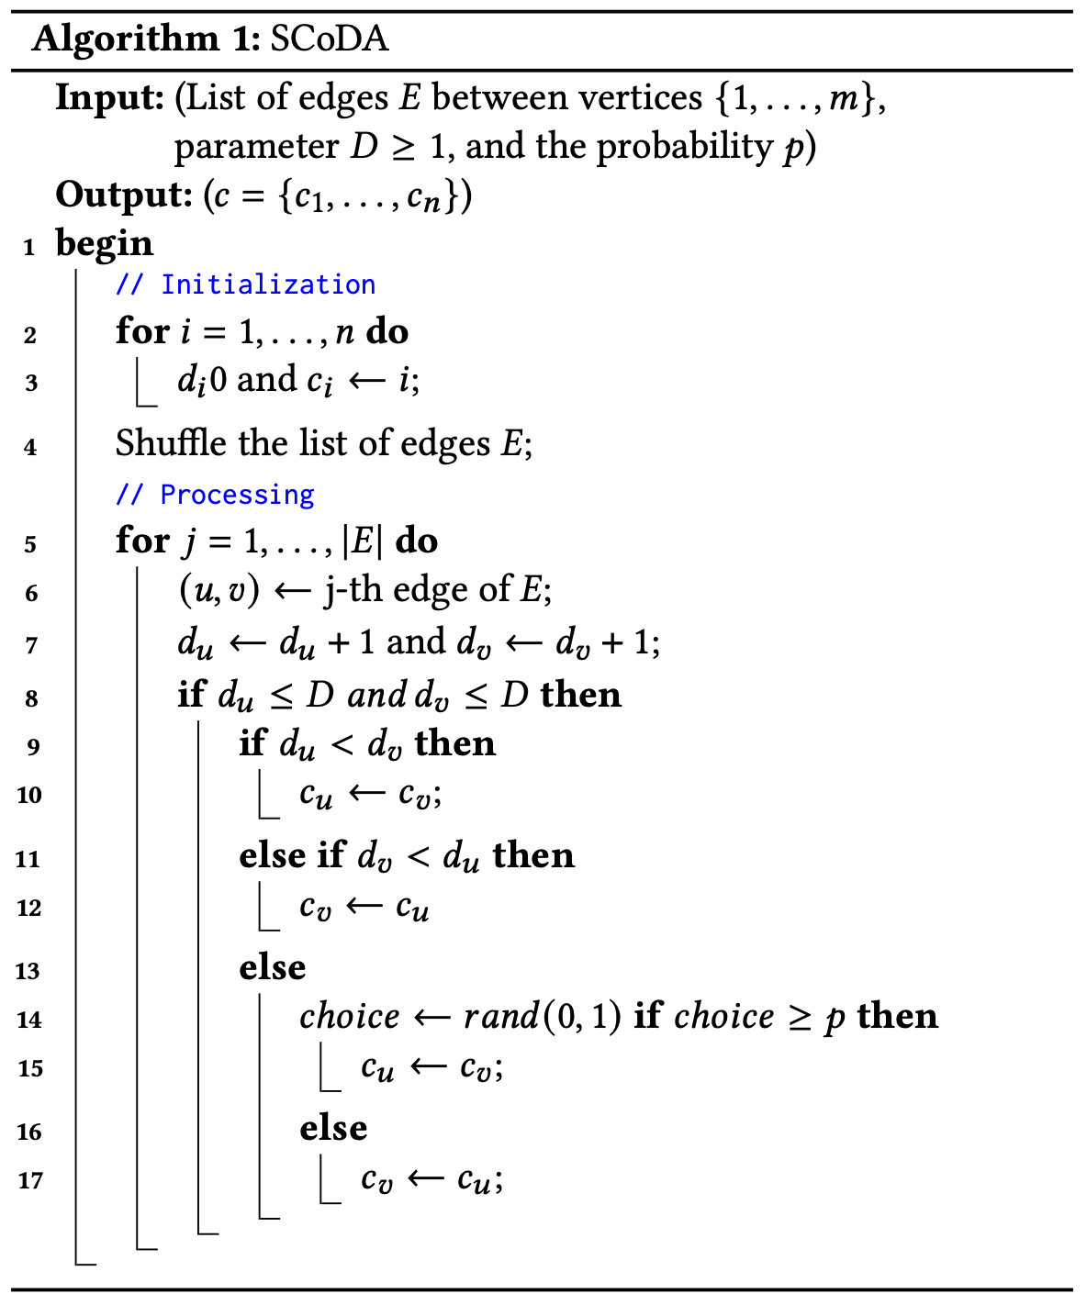
SCoDA: pseudo-code and complexity
n: number of nodes m: number of edges
Time complexity: O(m) (m >> n)
Space complexity: O(n)
UPDATE RULE

Slide 14
CoEuS

Slide 15
CoEuS
CoEuS [4] is a (insert-only) stream-based algorithm based on seed-set expansion.
Seed-set expansion: communities are expanded based on their corresponding initialized seed-set (i.e. set of node ids)
Seed-sets initialization is crucial for the algorithm’s outcome.
No restrictions on the order in which edges arrive (i.e. shuffling is not needed)

Slide 16
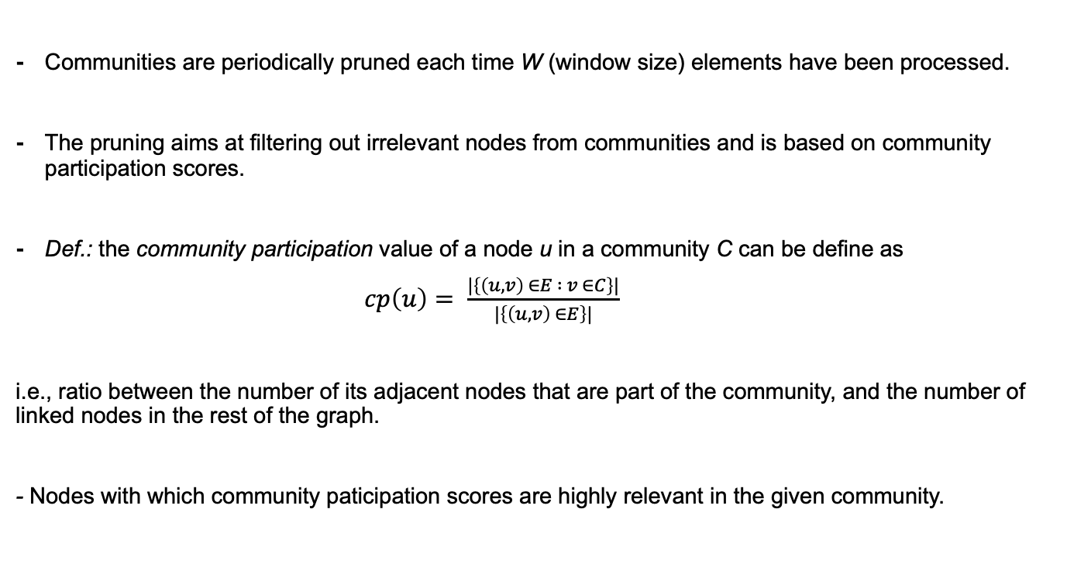
CoEuS: community participation
Communities are periodically pruned each time W (window size) elements have been processed.
The pruning aims at filtering out irrelevant nodes from communities and is based on community participation scores.
Def.: the community participation value of a node u in a community C can be define as
$cp\left(u\right)= \frac{|\left\{\left(u,v\right) ∈E : v ∈C\right\}|}{|\left\{\left(u,v\right) ∈E\right\}|}$
i.e., ratio between the number of its adjacent nodes that are part of the community, and the number of linked nodes in the rest of the graph.
- Nodes with which community paticipation scores are highly relevant in the given community.

Slide 17
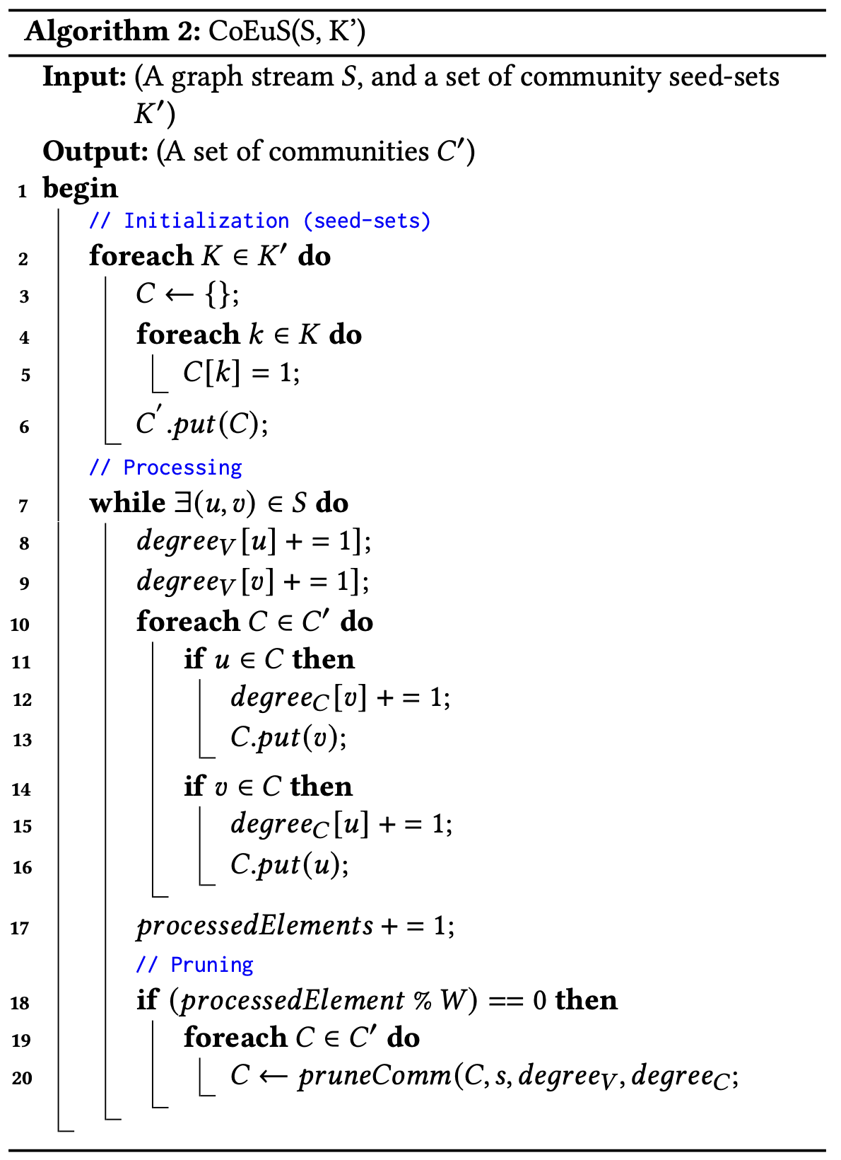
CoEuS: pseudo-code and complexity
n: number of nodes
m: number of edges
c: number of ground-truth communities
Time complexity: O(m*c)
Space complexity: O(n*(c + 1))
UPDATE RULE

Slide 18
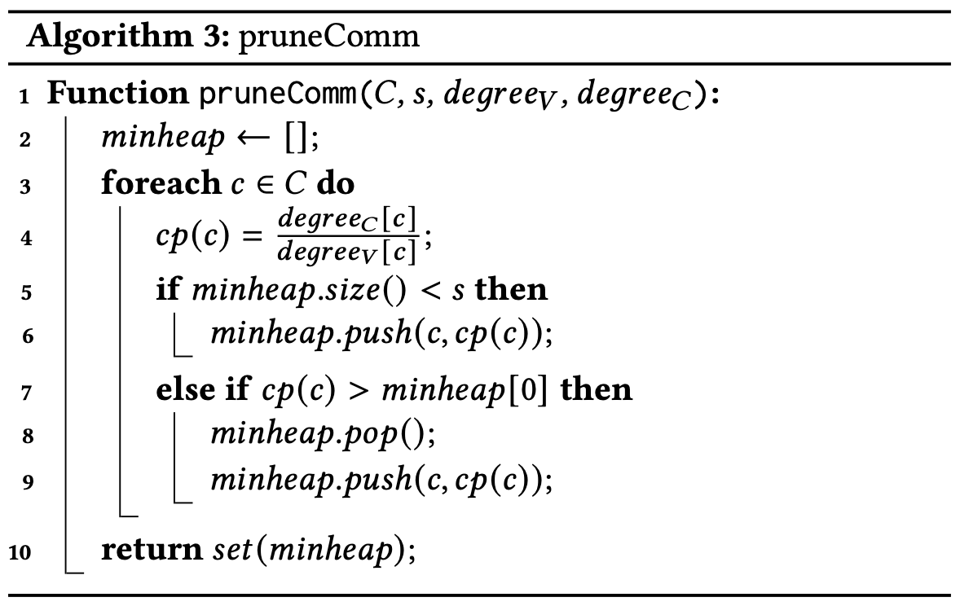
CoEuS: pruneComm
Min-heap used to prune communities based on their community scores
s is a threshold that represent the community size a community should have

Slide 19
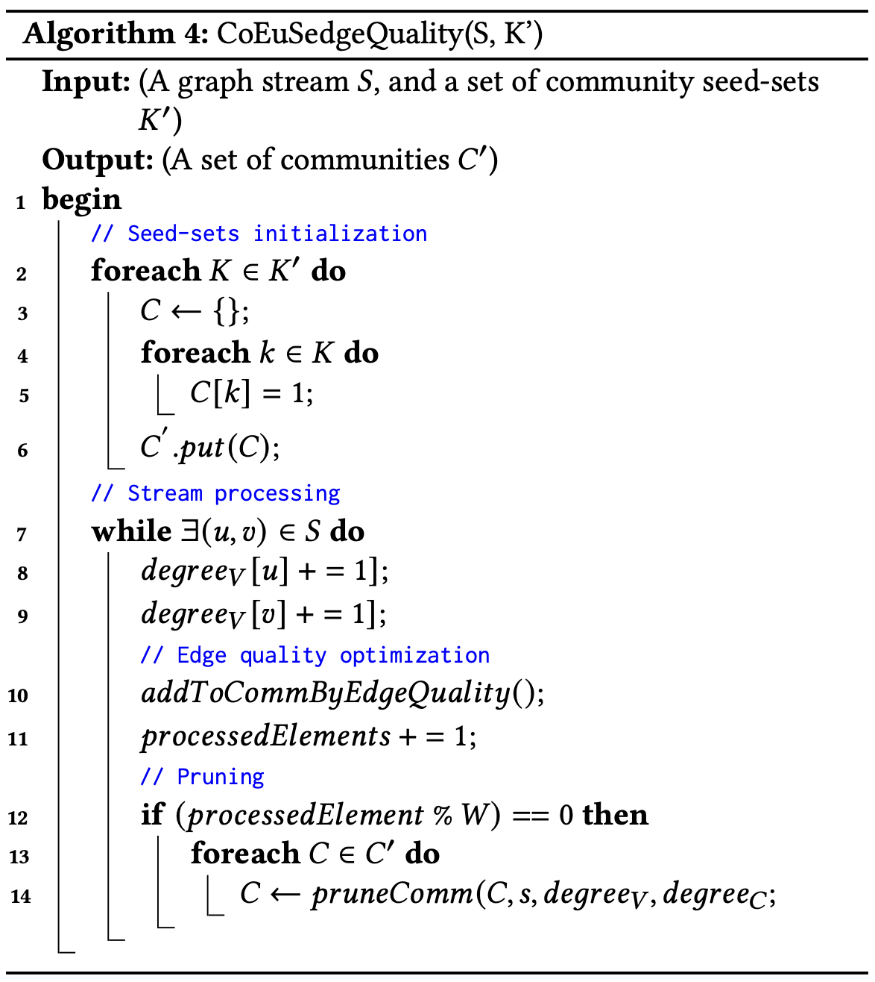
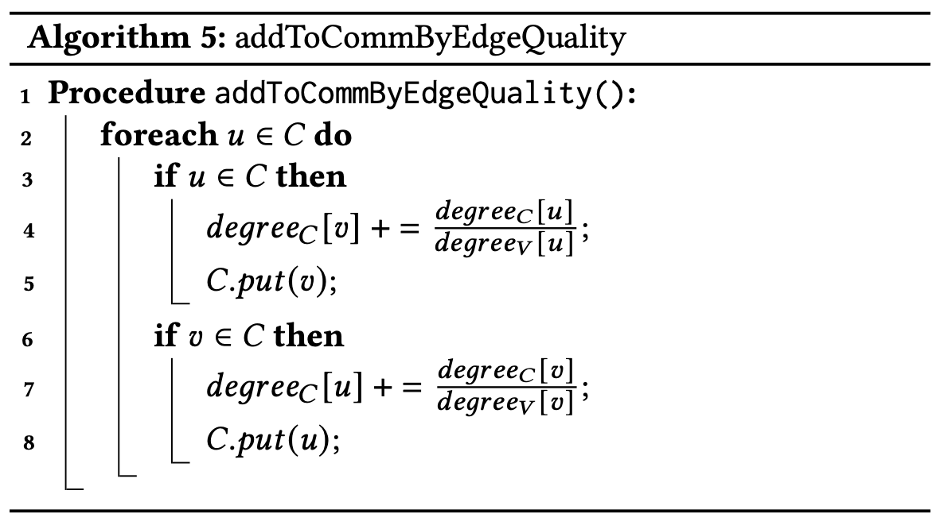
CoEuS: edgeQuality optimization
UPDATE RULE
EQ UPDATE RULE

Slide 20
IMPLEMENTATION

Slide 21
Implementation choices
Implementation of SCoDA and CoEuS in Java.
Stream processing through Java input/output streams (i.e. BufferedReader and BufferedWriter).
SCoDA random permutation with Fisher Yates Shuffling algorithm.
CoEuS seed-sets initialized with <MAX_SEEDS> ramdom nodes from ground-truth communities.

Slide 22
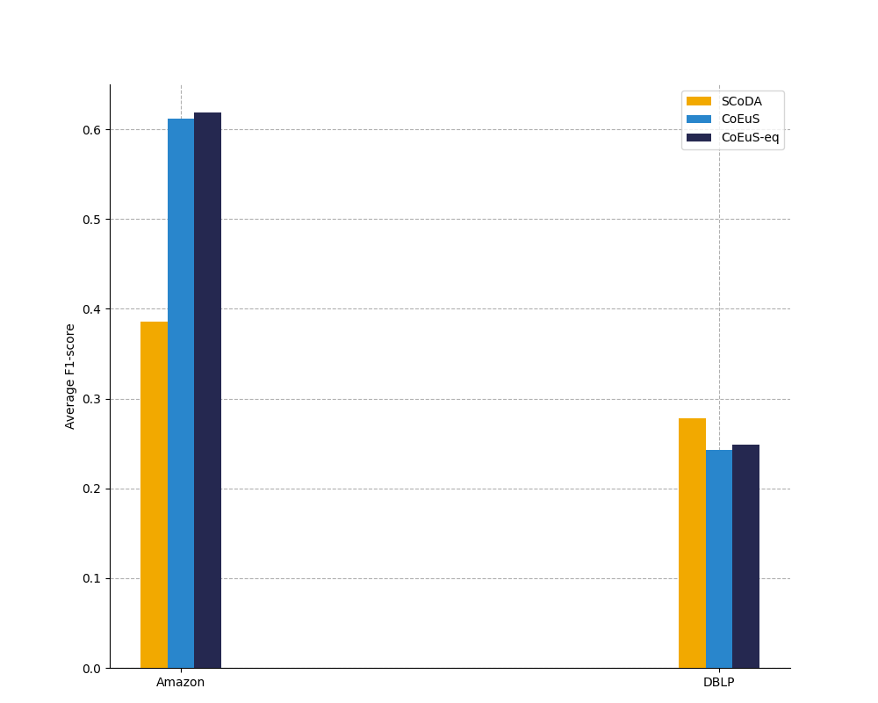

DATASETS:
Datasets from Stanford Large Network Dataset Collection [5].
Amazon
DBLP
- Top 5000 ground-truth communities with at least three (> 3)
github.com/NennoMP/community-detection

Slide 23
CONCLUSIONS

Slide 24
Conclusions
Community detection is a challenging research topic due to massive real-world networks.
The streaming model is a viable approach to solve scalability issues in large-scale networks.
SCoDA requires a random permutation of the edges list before processing the stream.
SCoDA is not able to execute in an online-fashion, as the shuffling requires the entire graph to be available at once.
CoEuS space complexity is non-trivial for massive networks with a high number of nodes and communities.
CoEuS does not require a pre-processing shuffling step, and would be able execute in an online-fashion.

Slide 25
BIBLIOGRAPHY
[1] Santo Fortunato. 2010. Community detection in graphs. Physics reports.
[2] Isa Inuwa-Dutse, Mark Liptrott, and Ioannis Korkontzelos. 2021. A multilevel clustering technique for community detection. Neurocomputing.
[3] Alexandre Hollocou, Julien Maudet, Thomas Bonald, and Marc Lelarge. 2017. A linear streaming algorithm for community detection in very large networks. CoRR (2017).
[4] Panagiotis Liakos, Alexandros Ntoulas and Alex Delis. 2017. COEUS:community detection via seed-set expansion on graph streams. In 2017 IEEE International Conference on Big Data (Big Data).
[5] Jure Leskovec and Andrej Krevl. 2014. Snap Datasets: Standford Large Network Dataset Collection.

Slide 27
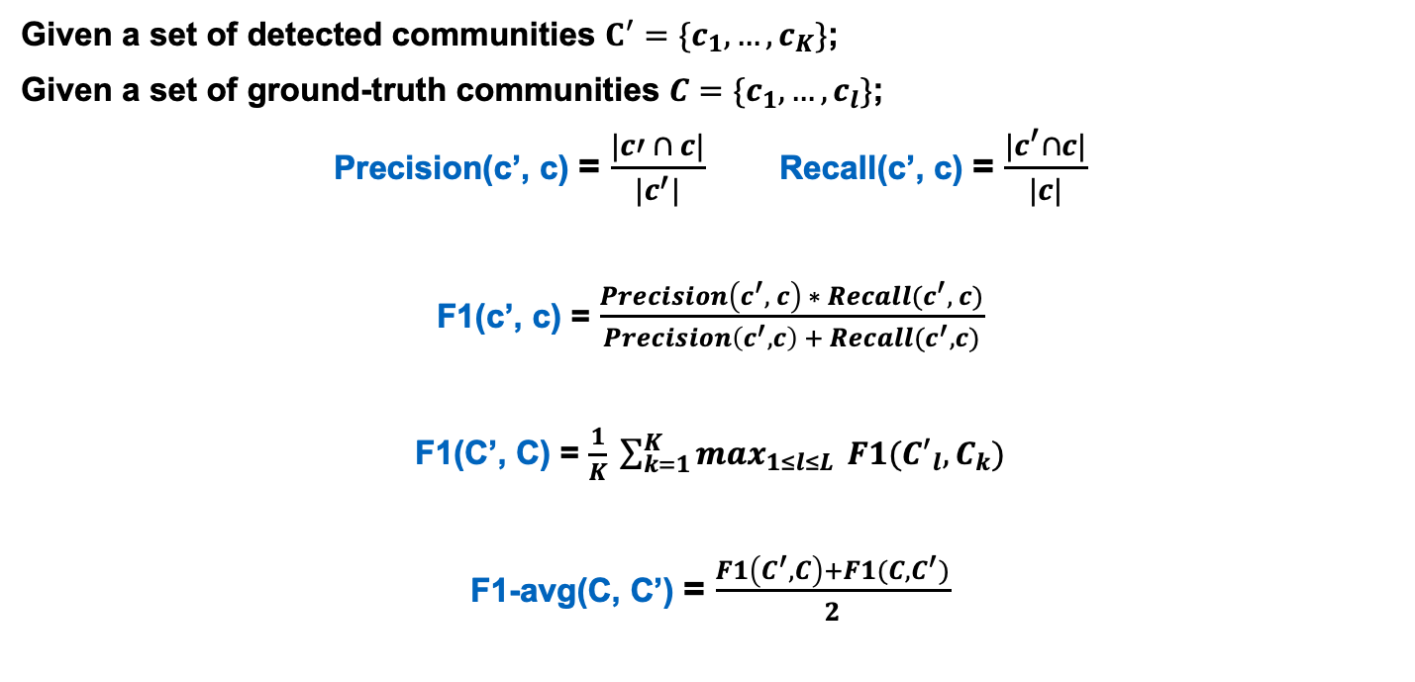
Average F1-score
Given a set of detected communities $C^{′}={\{c}_{1}, …, c_{K}\}$;
Given a set of ground-truth communities $C=\{c_{1}, …, c_{l}\}$;
Precision(c’, c) = $\frac{|c′ ∩ c|}{|c^{′}|}$ Recall(c’, c) = $\frac{|c^{′}∩c|}{|c|}$
F1(c’, c) = $\frac{Precision\left(c^{′}, c\right) ∗ Recall(c^{′}, c)}{Precision\left(c^{′}, c\right) + Recall(c^{′}, c)}$
F1(C’, C) = $\frac{1}{K} \sum_{k=1}^{K}{\max_{1≤l≤L}} F1({C^{′}}_{l}, C_{k})$
F1-avg(C, C’) = $\frac{F1\left(C^{′}, C\right)+F1(C, C^{′})}{2}$

