Slide 1

Discrete-event simulation with SimPy
Matteo Pinna
Complex Models for Complex Systems 2022

Slide 2
TABLE OF CONTENTS
Discrete-event Simulation
SimPy
Project
1
2
3

Slide 3
Discrete-event Simulation
1

Slide 4
Discrete-event simulation
Discrete-event simulation (DES) allows to model a system as a discrete sequence of events in time.
Terminology
State: system configuration
Event: (instantaneous) update of state variables
Activity: sequence of events (process)
Event notice: future event description
Future Event List (FEL): list of future events
Goals
Monitor resource usage
Identify bottlenecks
Identify configuration optimizations
Simulate high-risk, high-cost real world events
Notes:
- System -> rela-life event
Events occurr at specific point in time triggering a change of state
Main goals are resource utilization/consumption, queues etc..

Slide 5
SimPy
2

Slide 6

SimPy
SimPy is a process-based, open-source, discrete-event simulation framework based on standard Python.
Processes are defined as Python generator functions (i.e. iterator of events).
Modules
Environment
Events
Processes
Resources
https://simpy.readthedocs.io/en/latest/
Notes:
Realtime is usefull when you want to analyze real-time behaviour (trivial) or if you have human interaction with the simulation
Limited capacity congestion points are modeled by shared resources provided
(timeouts, process are events, asynchronous interrupts, condition events wait &, |)
Resources are like semaphores

Slide 7
Environment
The (simulation) environment manages simulation time, scheduling and processing of events.
Types
Environment: simulate as fast as possible
Realtime Environment: wall clock time (real-time)
Simulation executions
Until events exhaustion
Until a specific simulation time
Until a specific event is triggered
Notes:
Realtime is usefull when you want to analyze real-time behaviour (trivial) or if you have human interaction with the simulation

Slide 8
Environment
env = simpy.Environment()
env.run()
Event exhaustion based
SIM_TIME = 100
env = simpy.Environment() env.run(until=SIM_TIME)
Simulation time based
def my_process(env):
yield env.timeout(10)
env = simpy.Environment() proc = env.process(my_process(env))
env.run(until=proc)
Event-triggered based
Notes:
Realtime is usefull when you want to analyze real-time behaviour (trivial) or if you have human interaction with the simulation
Environment reference (explicit) because global object may intrdocue problems /hard to find bugs

Slide 9
Events
SimPy events are very similar to deferreds, futures or promises and can be in one of the following states:
Not triggered (Event.triggered == False)
Triggered (Event.triggered == True)
Processed (Event.processed == True)
Features
Let time pass with Timeout
Wait on multiples events at once
Interrupt an event
Yield on another process
Notes:
Realtime is usefull when you want to analyze real-time behaviour (trivial) or if you have human interaction with the simulation

Slide 10
Timeout Events
def student_seminar(env):
duration = random.randint(10, 30)
yield env.timeout(duration)
return duration
def lecturer(env):
for i in range(5):
val = yield env.process(student_seminar(env))
print(f’Seminar {i} - duration {val}')
Notes:
Realtime is usefull when you want to analyze real-time behaviour (trivial) or if you have human interaction with the simulation

Slide 11
Asynchronous Interrupts
def student_seminar(env):
try:
duration = random.randint(10, 30)
yield env.timeout(duration)
except simpy.Interrupt as interrupt:
print(interrupt.cause)
def lecturer(env):
for _ in range(5):
seminar_process = yield env.process(student_seminar(env))
yield env.timeout(25)
seminar_process.interrupt('Too long presentation')
Notes:
Realtime is usefull when you want to analyze real-time behaviour (trivial) or if you have human interaction with the simulation

Slide 12
Condition Events/Processes
def student_seminar(env):
try:
duration = random.randint(10, 30)
yield env.timeout(duration)
except simpy.Interrupt as interrupt:
print(interrupt.cause)
def lecturer(env):
for _ in range(5):
seminar_process = yield env.process(student_seminar(env))
results = yield seminar_process | env.timeout(25)
if seminar_process not in results:
seminar_process.interrupt('Too long presentation')
Notes:
Realtime is usefull when you want to analyze real-time behaviour (trivial) or if you have human interaction with the simulation

Slide 13
Shared Resources
SimPy shared resources are used to model process interaction and congestion points.
Resources have a (usually limited) capacity and allow process to queue up in order to acquire/release one.
Types
Resource: usable by a limited number of processes at a time.
Store: allow processes to produce/consume Python objects
Container: model producer-consumer behaviour of a discrete or homogeneous bulk.
Notes:
Realtime is usefull when you want to analyze real-time behaviour (trivial) or if you have human interaction with the simulation

Slide 14
Shared Resources
Resource
Store
Container
Max.
+2
-3
Queue
Resource
Process
Object
Notes:
Resource -> priority, preemptive
Store -> Filter, Priority ->
Container -> level and capacity

Slide 15
Shared Resources
def use_resource(id, env, priority):
yield env.timeout(5)
with resource.request(priority=priority) as req:
yield req # wait on resource
print(f'{id} got resource at {env.now}')
yield env.timeout(5)
env = simpy.Environment()
resource = simpy.Resource(env, capacity=1)
env.process(use_resource(1, env, priority=0))
env.process(use_resource(2, env, priority=0))
env.process(use_resource(3, env, priority=-1))
def use_resource(id, env):
yield env.timeout(5)
with resource.request() as req:
yield req # wait on resource
print(f'{id} got resource at {env.now}')
yield env.timeout(5)
env = simpy.Environment()
resource = simpy.Resource(env, capacity=1)
env.process(use_resource(1, env))
env.process(use_resource(2, env))
env.process(use_resource(3, env))

Slide 16
Project
3

Slide 17
Harbour simulation
It has been decided to simulate the maritime traffic inside a commercial port for cargo loading/unloading and bunkering (i.e. ship refueling).
Reasons
Logistic challenge
High-risk, High-cost simulation
Scenario in which waiting times are extremely important
Notes:
Realtime is usefull when you want to analyze real-time behaviour (trivial) or if you have human interaction with the simulation

Slide 18
Implementation
Regularly a ship will arrive at the harbour entrance waiting for an available dock and tug transport.
Some ships will have higher priority w.r.t. to common ships (e.g. emergency, goods transported, etc..).
Each ship bunkering will take different time depending on its missing fuel.
Docked ships will wait for bunkering and cargo load/unload events to terminate before leaving.
Exiting ships will again need to acquire a tug for the undocking procedure, to free as fast as possible the dock they will get priority above all entering ships.
Notes:
Realtime is usefull when you want to analyze real-time behaviour (trivial) or if you have human interaction with the simulation
Limited capacity congestion points are modeled by shared resources provided
(timeouts, process are events, asynchronous interrupts, condition events wait &, |)
Resources are like semaphores

Slide 19



Domain components
The main components of our system will be either implemented as iterators (Ship) or Python objects (Tug, Fuel Barge)
Their behavior as shared resource will then be obtained by putting such objects inside a SimPy Store or FilterStore.
Ship
Tug
Fuel Barge
Notes:
Realtime is usefull when you want to analyze real-time behaviour (trivial) or if you have human interaction with the simulation
Limited capacity congestion points are modeled by shared resources provided
(timeouts, process are events, asynchronous interrupts, condition events wait &, |)
Resources are like semaphores

Slide 20
Notes:
Realtime is usefull when you want to analyze real-time behaviour (trivial) or if you have human interaction with the simulation
Limited capacity congestion points are modeled by shared resources provided
(timeouts, process are events, asynchronous interrupts, condition events wait &, |)
Resources are like semaphores

Slide 21
Simulation parameters
A ship arrives on average every 20 minutes (exponential distribution λ = 1/0.2)
It will be assumed that the ships with higher priority will be the 20% of total ships.
Other events will be simulated with guassian distributions (Table 1)
Also, a simulation with tug maintenance periodically performed will be considered.
 | #
DOCKS | 20
TUGS | 8
FUEL BARGES | 8
 | MEAN (μ) | STD. DEV. (σ)
DOCKING | 1 | 0.25
BUNKERING | 2 | 0.25
CARGO | 4 | 0.50
BARGE REFUEL | 1 | 0.25
TUG MAINTENANCE FREQUENCY | 24 | 5
TUG MAINTENANCE TIME | 5 | 1
Table 2
Table 1
Notes:
Realtime is usefull when you want to analyze real-time behaviour (trivial) or if you have human interaction with the simulation
Limited capacity congestion points are modeled by shared resources provided
(timeouts, process are events, asynchronous interrupts, condition events wait &, |)
Resources are like semaphores

Slide 22
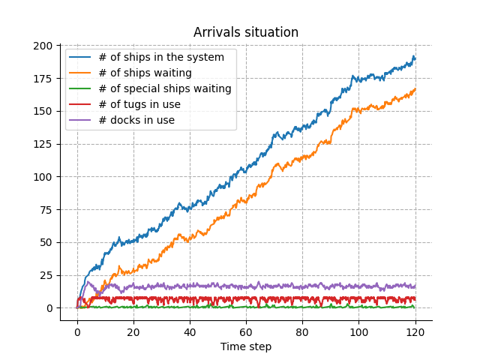
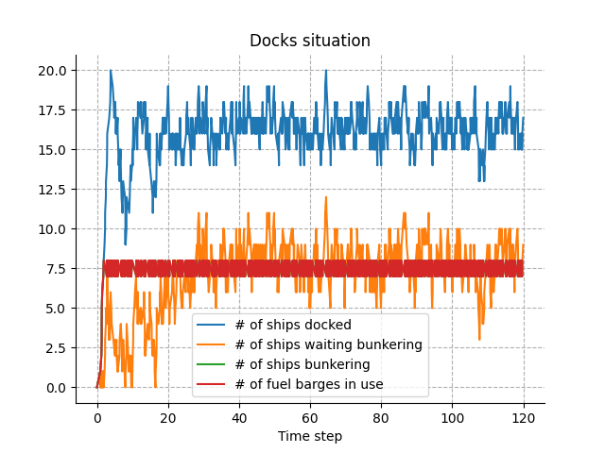
Simulation analyses
20 Docks | 8 Tugs | 8 Barges
Notes:
Realtime is usefull when you want to analyze real-time behaviour (trivial) or if you have human interaction with the simulation
Limited capacity congestion points are modeled by shared resources provided
(timeouts, process are events, asynchronous interrupts, condition events wait &, |)
Resources are like semaphores

Slide 24
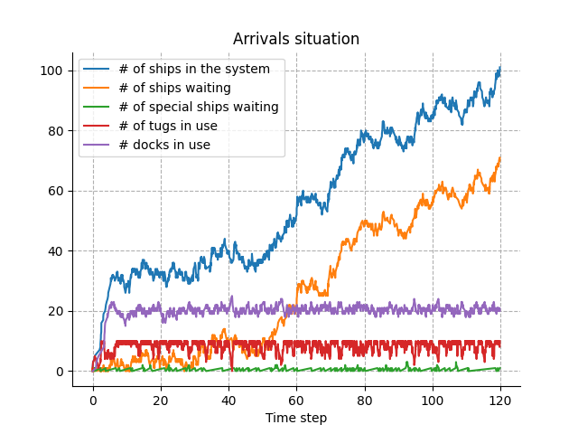
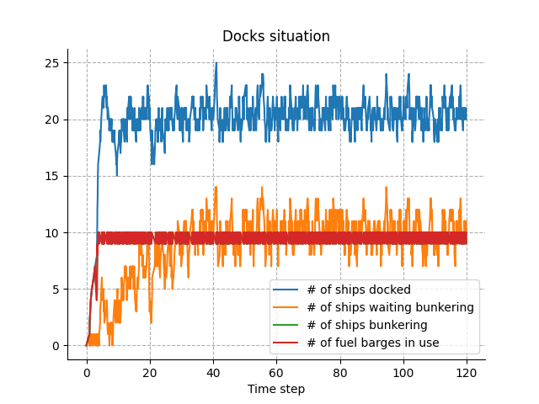
Simulation analyses
25 Docks | 10 Tugs | 10 Barges
Notes:
Realtime is usefull when you want to analyze real-time behaviour (trivial) or if you have human interaction with the simulation
Limited capacity congestion points are modeled by shared resources provided
(timeouts, process are events, asynchronous interrupts, condition events wait &, |)
Resources are like semaphores

Slide 26
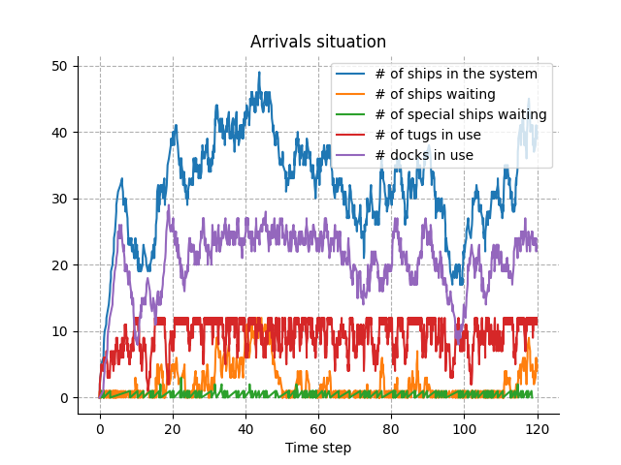
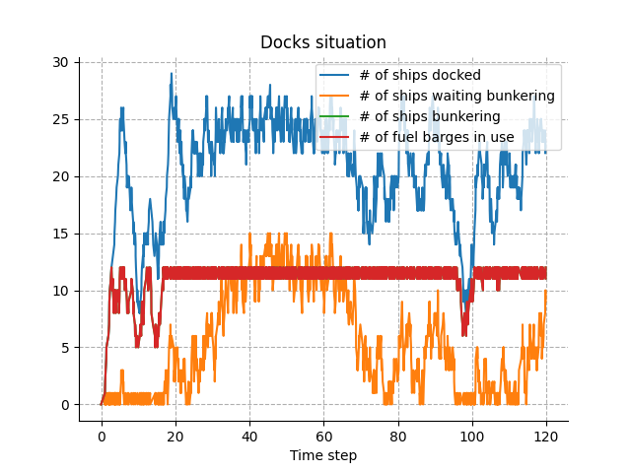
Simulation analyses
30 Docks | 12 Tugs | 12 Barges
Notes:
Realtime is usefull when you want to analyze real-time behaviour (trivial) or if you have human interaction with the simulation
Limited capacity congestion points are modeled by shared resources provided
(timeouts, process are events, asynchronous interrupts, condition events wait &, |)
Resources are like semaphores

Slide 28
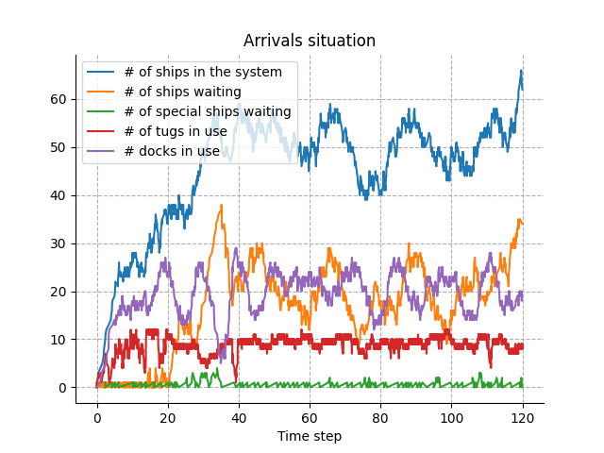
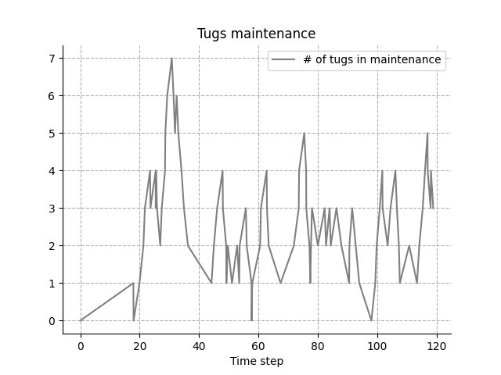
Simulation analyses
Let’s now consider a more complex scenario, where each Tug will require (or be scheduled for) maintenance, hence it will be out of service.
30 Docks | 12 Tugs | 12 Barges (Tug maintenance)
Notes:
Realtime is usefull when you want to analyze real-time behaviour (trivial) or if you have human interaction with the simulation
Limited capacity congestion points are modeled by shared resources provided
(timeouts, process are events, asynchronous interrupts, condition events wait &, |)
Resources are like semaphores

Slide 29
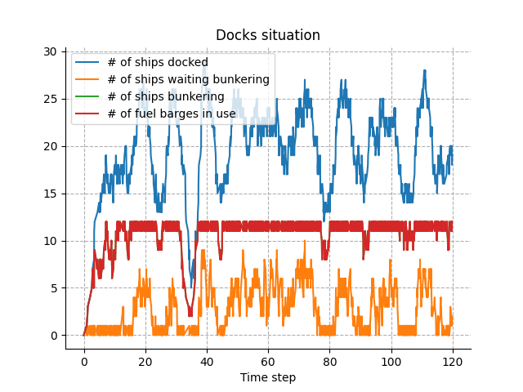
Simulation analyses
Let’s now consider a more complex scenario, where each Tug will require or be scheduled for maintenance on average very 24 hours, hence it will be out of service
30 Docks | 12 Tugs | 12 Barges (Tug maintenance)
Notes:
Realtime is usefull when you want to analyze real-time behaviour (trivial) or if you have human interaction with the simulation
Limited capacity congestion points are modeled by shared resources provided
(timeouts, process are events, asynchronous interrupts, condition events wait &, |)
Resources are like semaphores

Slide 31

CONCLUSIONS
SimPy complements standard Python by including discrete-event simulations and is extremely easy to learn and use.
DES and SimPy are powerful tools for simulating complex real-world system, identify bottlenecks and possible improvements.
It would be very interesting to try modeling a system having real-world data and requirements.
https://github.com/NennoMP/dse-harbour-simulation
Notes:
Realtime is usefull when you want to analyze real-time behaviour (trivial) or if you have human interaction with the simulation
Limited capacity congestion points are modeled by shared resources provided
(timeouts, process are events, asynchronous interrupts, condition events wait &, |)
Resources are like semaphores

Slide 32
Thanks!
ANY QUESTIONS?

