Slide 1
1. Selected Topic

Slide 2

Social Media Impact – Suicidal Rates
UT Austin Data Analytics & Visualization Bootcamp – Final Project by :
Quang Nguyen
Tina Bellon
Ima Richburg
Nensi Dobaria
Namrata Shah

Slide 3
2. Reason for topic selection

Slide 4

Reason for Topic Selection
Suicide is a serious societal problem and the result of complex socioeconomic and cultural factors. Even if our analysis should show that social media use only has a minimal impact, we believe any measure to decrease risk and increase suicide prevention is worth pursuing.

Slide 5
3. Data source description

Slide 6
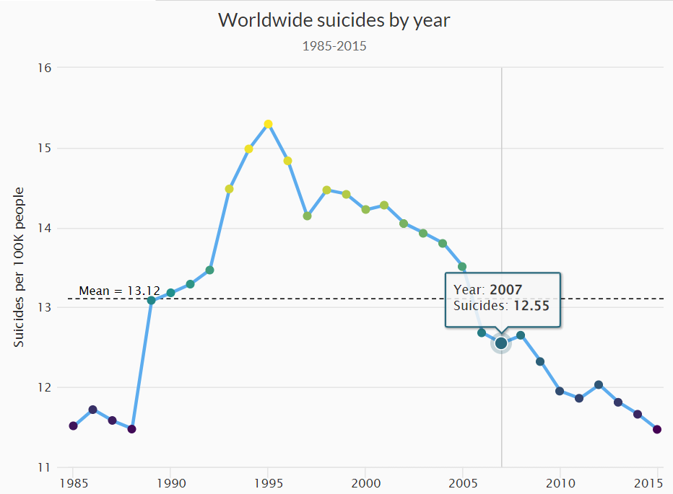
Suicide Rates Overview 1985 to 2016 – From Kaggle
We are using a suicide data set from Kaggle, which lists suicides from around the world by country from 1985 until 2015. The data is split by gender, age and generation, and also lists the respective country's Human Development Index and GDP in a particular year.

Slide 7
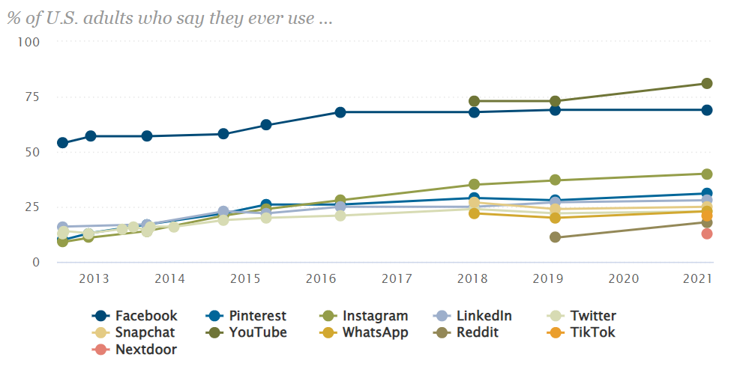
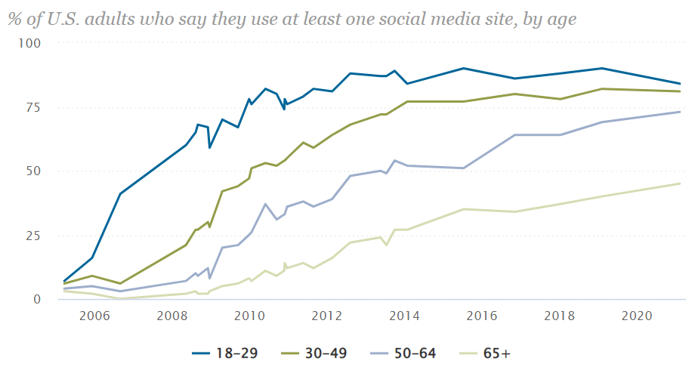
Social Media Fact Sheet – from Pew Research center
For social media usage, we rely on a Pew Research dataset that collected the share of U.S. adults using different forms of social media from 2005 through 2021. The data is broken down by age groups.

Slide 8
4. Applied technologies

Slide 9
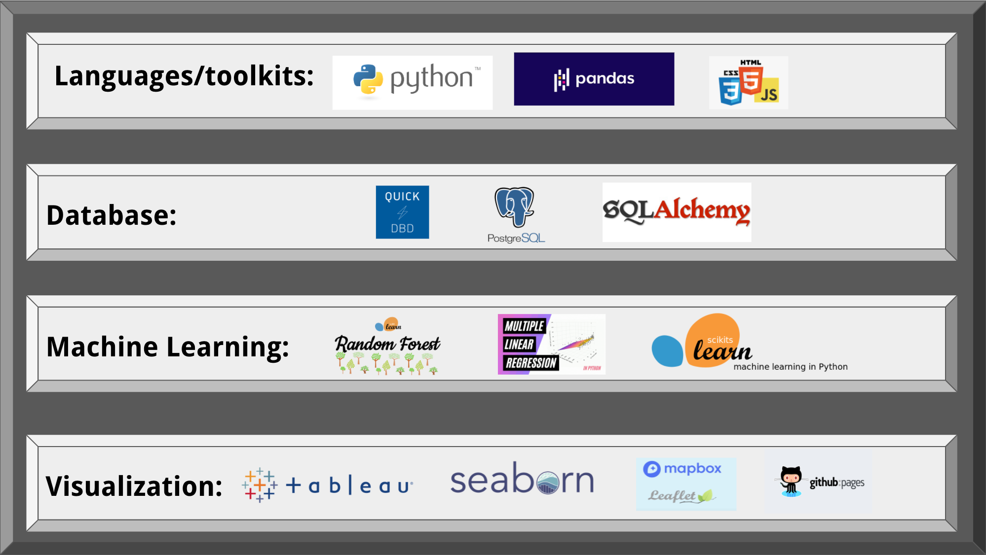
Technologies, languages, tools, and algorithms used throughout the project

Slide 10
5. Analytical objectives

Slide 11
Questions we hope to answer with data
We wanted to determine whether an uptick in social media use in recent years overlaps with an increase in suicide rates, particularly among younger cohorts who use social media in the greatest numbers. To determine correlation, we plan to visualize U.S. suicide rates and social media use over time.

Slide 12
6. Data exploration

Slide 13
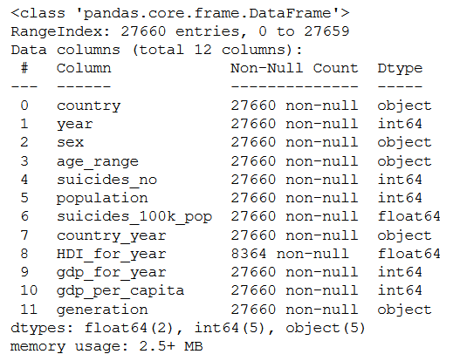
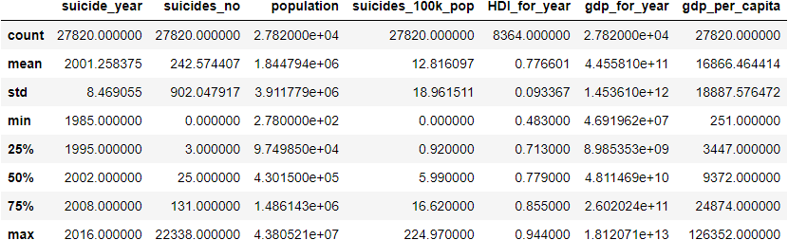
Pandas Info and describe Functions

Slide 14
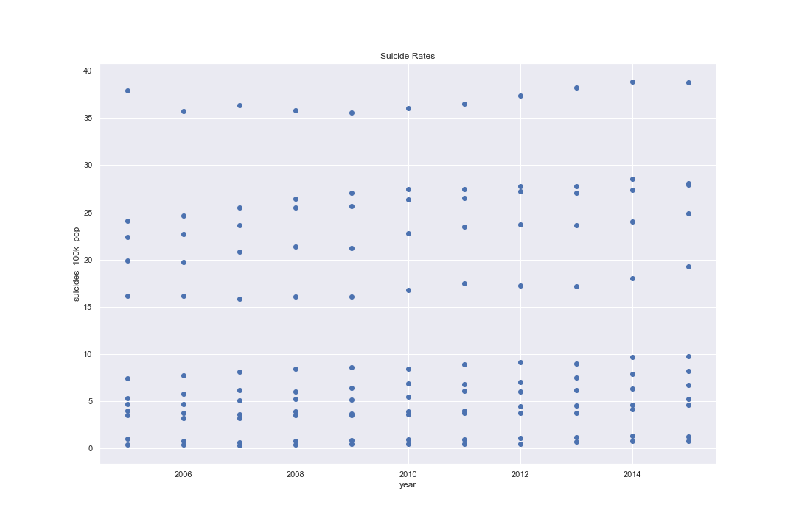
Visual Exploratory data Analysis

Slide 15
7. Data analysis

Slide 16
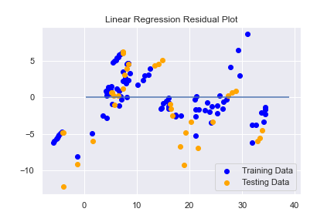
Machine learning - linear Regression Model
“Best Fit” line through all data points
MSE: 24.55
R-squared: 0.8315
Training Score: 0.9120
Testing Score: 0.8315

Slide 17
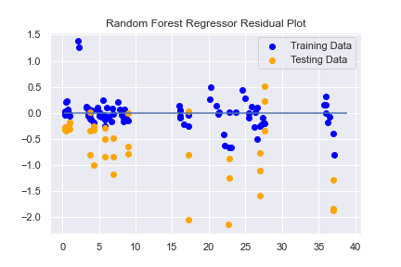
Machine learning - random forest regressor Model
Averages of weaker Decision Trees
MSE: 0.8826
R-squared: 0.9939
Training Score: 0.9994
Testing Score: 0.9939

Slide 18
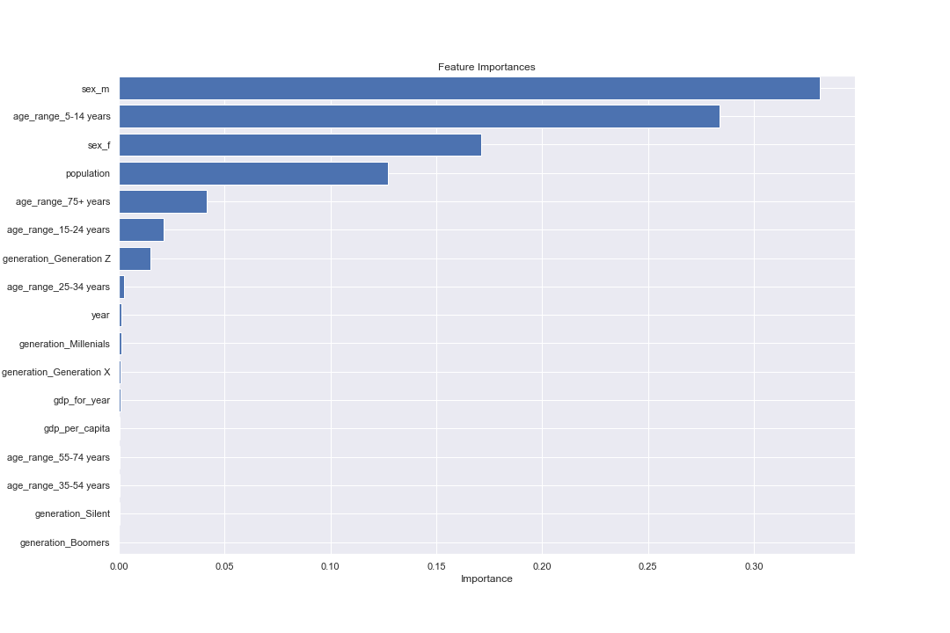
random forest regressor feature Importance

Slide 19
8. Results of analysis

Slide 20
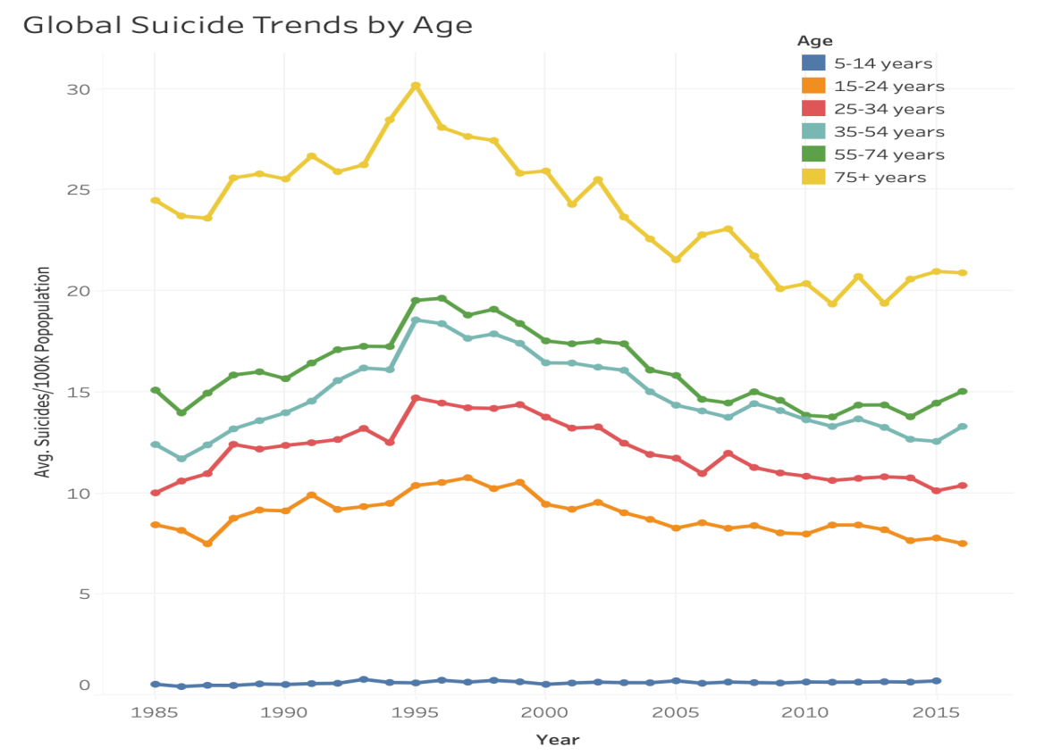
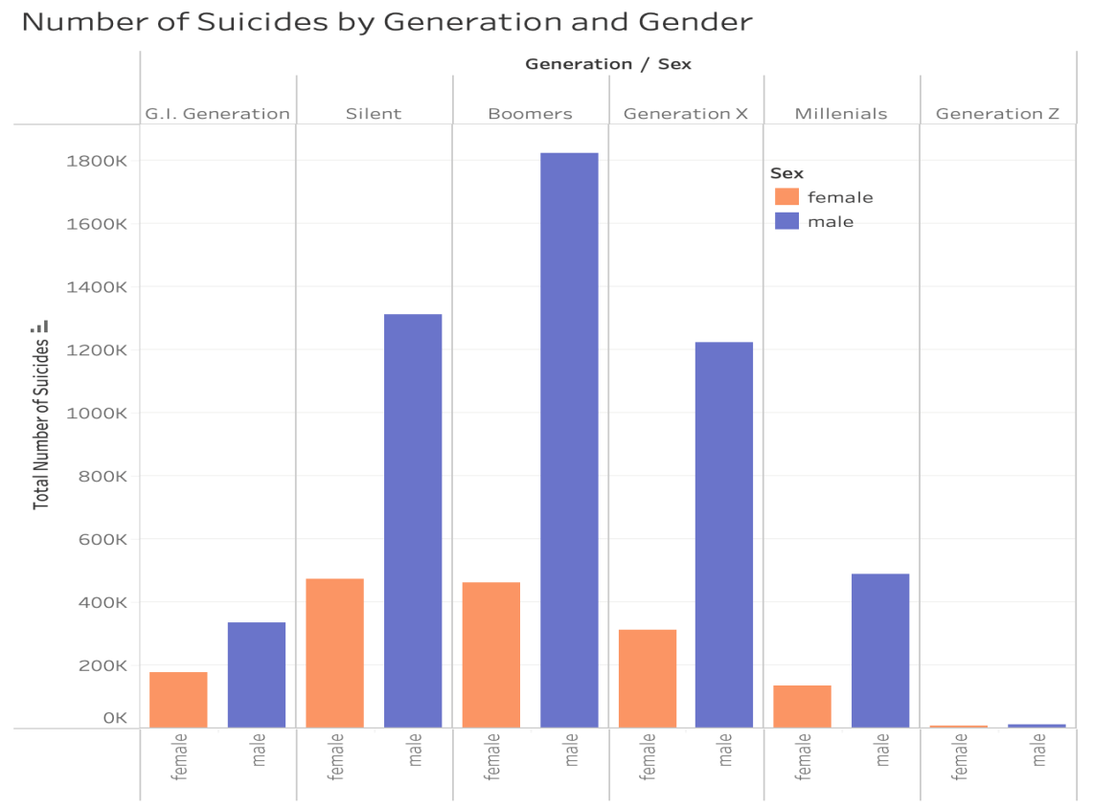
Tableau Dashboard

Slide 21
9. Recommendations for future analysis

Slide 22
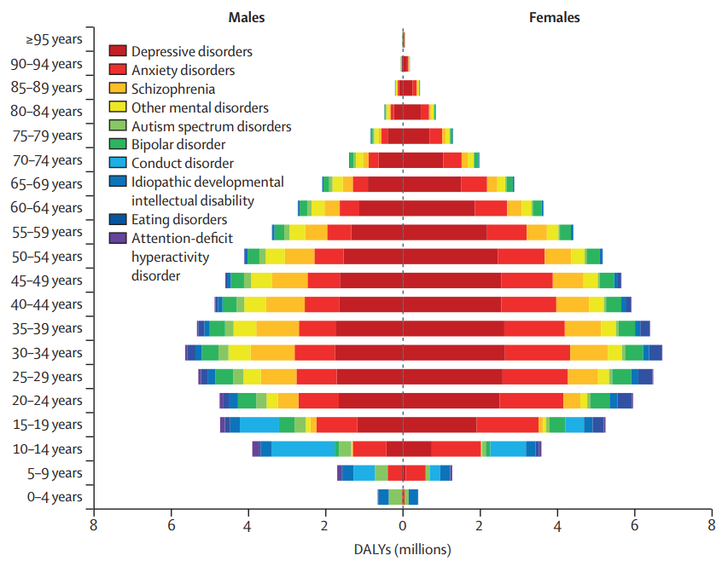


Slide 23
10. limitations

Slide 24



