Slide 1

One of the Factor of Suicide Rates – Social Media Usage
UT Austin Data Analytics & Visualization Bootcamp – Final Project by :
Quang Nguyen
Tina Bellon
Ima Richburg
Nensi Dobaria
Namrata Shah

Slide 2
Table of Contents
Overview
The Data Source
Data Cleaning
Data Analysis
Data Visualization
Final Takeaway
Technologies Used
Machine Learning

Slide 3

Overview
Social media makes it easy to connect with people from around the entire world. While this is positive, it also has detrimental effects. As social media and smartphone use has increased, so have mental health conditions.

Slide 4
The Data Sources
Two data sets will be utilized to determine the relationship between social media engagement and suicide rates in the US.
Suicide US data CSV file from Kaggle
Social media usage CSV file from Pew Research

Slide 5
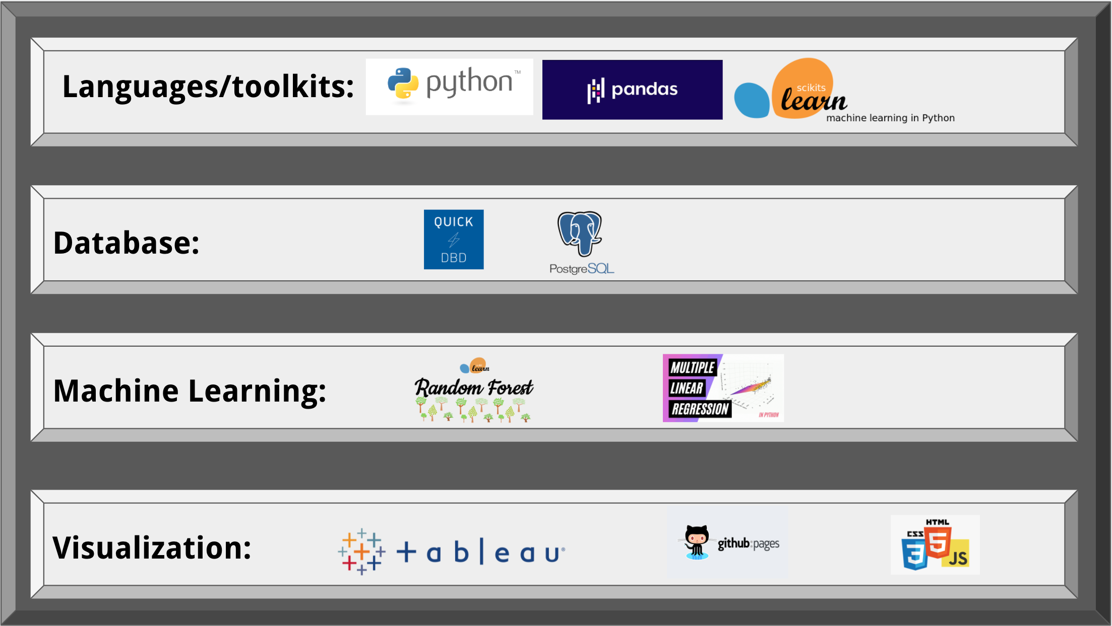
Technologies Used

