Slide 1

Learning Algorithm: Application of Union Find in Undirected Graph Problems
Qiang (Neo) Hao
Learning Design and Technology & Computer Science
University of Georgia
Notes:
Good afternoon, everyone. My name is Neo. Today we are going to learn about the application of union find in undirected graph problems.

Slide 2
Structure
Union Find
Naïve Version
Practice
Optimized Version
Practice
Cycle Detection
Practice
Kruskal's algorithm
Notes:
This lecture will last for an hour. I will teach for 50 minutes and leave 10 minutes afterwards for Q & A.
The learning content will cover 4 topics, including two versions of union find, cycle detection and k algorithm. After each topic we are going to work on a related practice together.
We will not be able to cover everything. By my experience, we can only finish the two versions of union find given one hour.

Slide 3
Structure
Union Find
Naïve Version
Practice
Optimized Version
Practice
Cycle Detection
Practice
Kruskal's algorithm

Slide 4
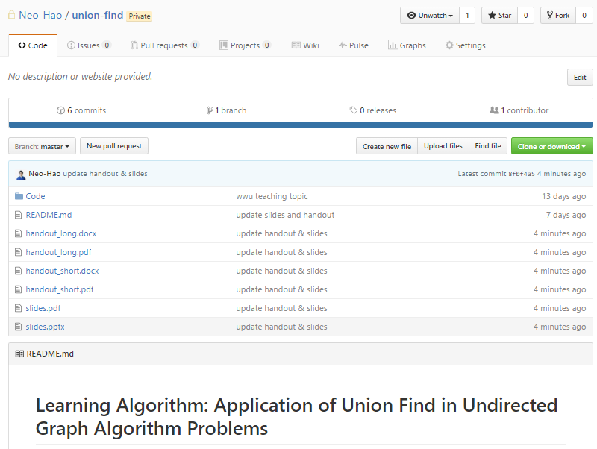
Structure
Union Find
Naïve Version
Practice
Optimized Version
Practice
Cycle Detection
Practice
Kruskal's algorithm
https://github.com/Neo-Hao/union-find
Notes:
But don’t worry. All the learning materials, including the slides and answers to the practice is on Github. You can simply clone a repo at a later time. The url of the repo is on the first page of your handout.

Slide 5
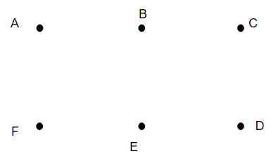
Union Find
Given a graph, determine whether two vertices are somehow connected.
Data Structure
Notes:
Okay. Let’s get started on union find. What is union find? It’s a data structure that solves a certain type of graph problems.
As is listed here, this problem is typically solved by union find. Given a ……. like A and B are connected as we know. The two vertices don’t have to be directly connected, like C and E are considered connected as well.

Slide 6
Union Find
Given a graph, determine whether two vertices are somehow connected.
Data Structure
makeSet
union
findSet
Notes:
Union find solves this problem by using three operations, makeSet, union and findSet.
makeSet simply converts the single given vertex into a set. By set I mean a collection of distinct objects, a concept you learnt in discrete math
union merges two given sets together. For all the sets we create or merged, we appoint a vertex as its representative.
findSet will return the representative of the given set.

Slide 7
Union Find
Given a graph, determine whether two vertices are somehow connected.
Data Structure
makeSet(A)
makeSet(B)
makeSet(C)
makeSet(D)
makeSet(E)
makeSet(F)
union(A, B)
union(C, D)
union(E, D)
findSet(A) == findSet(D)
Notes:
Let’s get some intuition of how union find works by seeing an example first. Here is a sequence of union find operations. We are gonna execute them on the graph as you see on their left. The whole operation is trying to determine if A and D are somehow connected.
From 1 to 6, they are all makeSet opeartions.,
From 7 to 9, they are all all union operations.
The last operation is the key.
We use close circle to indicate a set, and the little star to indicate the representative of a set.

Slide 8
Union Find
Given a graph, determine whether two vertices are somehow connected.
Data Structure
makeSet(A)
……
union(A, B)
union(C, D)
union(E, D)
findSet(A) == findSet(D)
Notes:
After running operations from 1 to 6, our data structure would be showing up like this. Each vertex belongs to a separate set now.
The next operation is union(A, B), which will merge the two sets into one, and assign A as the new representative.

Slide 9
Union Find
Given a graph, determine whether two vertices are somehow connected.
Data Structure
makeSet(A)
……
union(A, B)
union(C, D)
union(E, D)
findSet(A) == findSet(D)
Notes:
The next operation is union(C, D), which merge the two sets together, and assign C as the new representative.

Slide 10
Union Find
Given a graph, determine whether two vertices are somehow connected.
Data Structure
makeSet(A)
……
union(A, B)
union(C, D)
union(E, D)
findSet(A) == findSet(D)
Notes:
The next operation is union(E,D), D belongs to the set containing both C and D. So we ll merge the set of E into the set of CD, and assign C as the new representative of the new set.

Slide 11
Union Find
Given a graph, determine whether two vertices are somehow connected.
Data Structure
makeSet(A)
……
union(A, B)
union(C, D)
union(E, D)
findSet(A) == findSet(D)
Notes:
The lastoperation calls findSet on A and D separately. findSet(A) returns the rep of the set where A belongs to, which is A. findSet(D) returns the rep of the set where D belongs to, which is C. A is different from C, so this operation returns False.
It may seem so obvious that A and D is not connected, and union find seems like a over kill, but actually it’s not. The graph we have here is quite small.

Slide 12
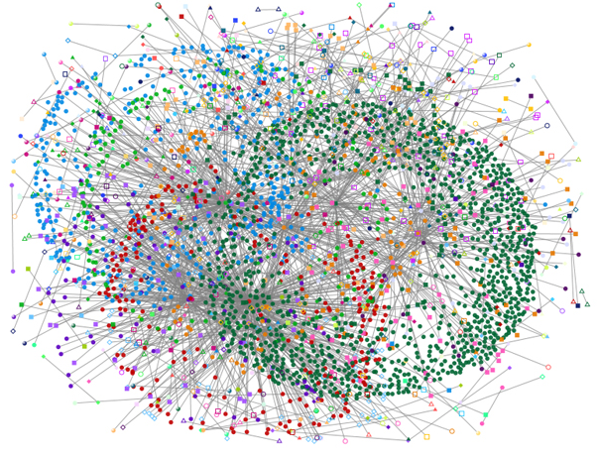
Union Find
Given a graph, determine whether two vertices are somehow connected.
Data Structure
A
B
Notes:
What if I give you a graph like this. You can see that first we need a computer to do this. Second we need the union find to be as optimized as possible.

Slide 13
Union Find
Given a graph, determine whether two vertices are somehow connected.
Data Structure
A
Application:
Network security
Social network analysis
Image Processing
B
Notes:
Union find has a wide range of applications in XX, XX, and XX, and the graphs union find need to deal with are usually very large.

Slide 14
Union Find
Approaches
Naïve Union Find
Optimized Union Find
Notes:
After seeing the example you already have some sense how union find works. Let’s cover in depth of two versions of union find.

Slide 15
Union Find – Naïve Version
makeSet
union
findSet
Node:
val
parent
Notes:
We are going to cover the three operations one by one. But firstly, we need a new class to support the three operations. We call this class Node. Basically, we will convert every vertex to a node and avoid operating directly on any vertices.
The new class has two attributes, one is val, the other is parent.
The val attribute will be used to store the given vertex.
The parent attribute will be used to store another node, and it will help us locate the representative of a set. The rule for a node to be a representative is that its parent is equal to itself. We ll cover this in details later.

Slide 16
Union Find – Naïve Version
makeSet
makeSet(v):
n = Node(v)
n.parent = n
Time Complexity
O(1)
Notes:
makeSet is the easiest operation. The whole purpose of makeSet is to create a node using a given vertex, so we can further apply operations such as findSet and union on the node.
The parameter of makeSet operation is a single vertex. When we call makeSet, we create a new Node using the vertex’s value, make the node as its own parent.
The time complexity of this operation is O(1), which is very simple.

Slide 17
Union Find – Naïve Version
makeSet
makeSet(v):
n = Node(v)
n.parent = n
Time Complexity
O(1)
Notes:
If we run makeSet on every vertex of the given graph, the graph would look like this. Since the parent of every node happens to be itself, every node is a representative so far.

Slide 18
Union Find – Naïve Version
union
union(n1, n2):
i = findSet(n1)
j = findSet(n2)
if i == j:
return
else:
j.parent = i
Notes:
union operation takes two nodes n1 and n2 as the parameters, and call findSet on the two nodes separately. So far let’s not worry about the details of findSet. The only thing we need to understand is that findSet takes a node as the parameter and returns the representative of the set which the node belongs to.
I and j are the two representatives of two sets. If they happened to be equal to each other, we do nothing. If they are different, we make I as the parent of j.
Maybe this still sounds confusing somehow. Let’s run a sequence of union operations and you will have a better idea of what it does.

Slide 19
Union Find – Naïve Version
union
union(n1, n2):
i = findSet(n1)
j = findSet(n2)
if i == j:
return
else:
j.parent = i
union(A, B)
union(C, D)
union(F, E)
union(D, E)
union(B, E)
C.parent ?
D.parent ?
E.parent ?
Notes:
Say we have this graph, and we have already run makeSet on every vertex of the graph. Now we have five union operations as is shown here. union function is defined.
A small question for you to figure out is what would the parents of C, D, E be afterwards. I ll give 3 minutes to figure out. Feel free to talk to the person sitting next to you if you have no clues.
……
Okay. Let’s do it together.

Slide 20
Union Find – Naïve Version
union(A, B)
union(C, D)
union(F, E)
union(D, E)
union(B, E)
union
Notes:
The first operation is union(A,B).
The representatives of the set A is just node A, and the representative of set B is just node B.
Since they are different, we make A as the new parent of B.
As A’s parent is itself, so A becomes the new representative of the set AB

Slide 21
Union Find – Naïve Version
union(A, B)
union(C, D)
union(F, E)
union(D, E)
union(B, E)
union
A
B
Notes:
We will use the tree structure to show the relationship between a node and its parent.
The next operation is union(C, D). For the same reason, C becomes the new representative of set CD.

Slide 22
Union Find – Naïve Version
union(A, B)
union(C, D)
union(F, E)
union(D, E)
union(B, E)
union
A
C
B
D
Notes:
The next operation is union(F, E). For the same reason, F becomes the new representative of set FE.

Slide 23
Union Find – Naïve Version
union(A, B)
union(C, D)
union(F, E)
union(D, E)
union(B, E)
union
A
C
B
D
F
E
Notes:
The next operation is union(D, E). D is in set CD, and its representative is C. E is in set FE, and its representative is F. Since they are different, we make C as the new parent of F, and C becomes the representative of the set CDFE.

Slide 24
Union Find – Naïve Version
union(A, B)
union(C, D)
union(F, E)
union(D, E)
union(B, E)
union
A
C
B
D
F
E
Notes:
The next operation is union(B, E). B is in set AB, and its representative is A. E is in set CDEF, and its representative is C. Since they are different, we make A as the new parent of C, and A becomes the representative of the set that ABCDEF.

Slide 25
Union Find – Naïve Version
union(A, B)
union(C, D)
union(F, E)
union(D, E)
union(B, E)
union
A
B
C
F
D
E
Notes:
The answer to the question that I asked you is right in the tree structure we have here.

Slide 26
Union Find – Naïve Version
union(A, B)
union(C, D)
union(F, E)
union(D, E)
union(B, E)
union
A
B
C
F
D
C.parent = A
D.parent = C
E.parent = F
E
Notes:
The parent of C is A, the parent of D is C and the parent of E is F.
From the tree you can see why we need a new class Node and what role the parent attribute plays in the process. Every node has a parent, but a parent is not necessarily a representative of a set. Only when a node is at the top of the tree, its parent will point to itself, and it becomes the representative.

Slide 27
Union Find – Naïve Version
union
union(n1, n2):
i = findSet(n1)
j = findSet(n2)
if i == j:
return
else:
j.parent = i
Time Complexity
???
Notes:
What’s the time complexity of union operation?
We can’t answer that because as see, in the union function another function findSet is called. The rest if else condition is only O(1). So the time complexity of union all depends on the complexity of findSet.

Slide 28
Union Find – Naïve Version
findSet
Notes:
Okay. findSet
findSet is the third and the last operation.

Slide 29
Union Find – Naïve Version
findSet
findSet(n):
if n.parent == n:
return n
return findSet(n.parent)
Notes:
As we mentioned, findSet takes a node as the parameter and returns the representative of the set the node belongs to.
Only when the parent of a node points to itself, it would be the representative of the set.
Therefore, the findSet operation is recursive. When the given node is the parent we return the given node. Otherwise we call findSet recursively on the node’s parent.

Slide 30
Union Find – Naïve Version
findSet
findSet(n):
if n.parent == n:
return n
return findSet(n.parent)
A
B
C
F
D
E
Notes:
A good way of thinking it through is to look at the tree structure we drew previously.
On any given node, say F.
We ll check if its parent points to itself first. Apparently not, then we call findSet on F’s parent, which is C.
Sam as F, C’s parent doesn’t point to itself. So we call findSet again on C’s parent, which is A.
A’s parent points to itself, so we return A.

Slide 31
Union Find – Naïve Version
findSet
findSet(n):
if n.parent == n:
return n
return findSet(n.parent)
Time Complexity
O(n)
Notes:
The time complexity of findSet is O(n), where n is the number of vertices in a graph
The worst case is that when every node has only one child, and all nodes forms a single tree

Slide 32
Union Find – Naïve Version
findSet
findSet(n):
if n.parent == n:
return n
return findSet(n.parent)
A
B
C
Time Complexity
O(n)
D
F
E
Notes:
looking like this, and when given the node at the deepest level, which is E, we need to traverse the whole graph to reach the representative.
That’s why the time complexity is O(n)

Slide 33
Union Find – Naïve Version
union
union(n1, n2):
i = findSet(n1)
j = findSet(n2)
if i == j:
return
else:
j.parent = i
Time Complexity
O(n)
Notes:
As we determined the time complexity of findSet operation, the time complexity of union can also be determined. Same as findSet, it’s also O(n)

Slide 34
Union Find
Approaches
Naïve Union Find
makeSet – O(1)
union – O(n)
findSet – O(n)
O(mn), where m stands for the number of operations
Notes:
Therefore, given m operations of Naïve union find, the total running time would be O(m*n), because the worst case of a single operation takes O(n) time.
On the first page of your handout, there is a table. The left side is the pseudo code of union find, the right side is the implementation of union find in Python. There is a little tweak in the implementation, where we want each operations to take vertices as inputs. Except for that, everything stays the same. If you don’t code in Python, it should not be a difficult task to translate the code into the language you use either.
That is all about the naïve union find. Any questions.
Okay.

Slide 35
Structure
Union Find
Naïve Version
Practice
Optimized Version
Practice
Cycle Detection
Practice
Kruskal's algorithm
Notes:
Okay. As we covered the naïve version of union find, lets take a look at its application. You can turn to page 7 on you handout. Question 1.

Slide 36
Q1. Number of Connected Components in an Undirected Graph
Given n nodes labeled from 0 to n - 1 and a list of undirected edges (each edge is a pair of nodes), write a function to find the number of connected components in an undirected graph.
Example 1:
0 3
| |
1 --- 2 4
Given n = 5 and edges = [[0, 1], [1, 2], [3, 4]], return 2.
Notes:
Given n nodes labeled from 0 to n - 1 and a list of undirected edges (each edge is a pair of nodes), write a function to find the number of connected components in an undirected graph.
And there are two given examples. In the first example, 0, 1, 2 compose a connected components, and 3, 4 compose another connected components, so we return 2.

Slide 37
Q1. Number of Connected Components in an Undirected Graph
Given n nodes labeled from 0 to n - 1 and a list of undirected edges (each edge is a pair of nodes), write a function to find the number of connected components in an undirected graph.
Example 2:
0 4
| |
1 --- 2 --- 3
Given n = 5 and edges = [[0, 1], [1, 2], [2, 3], [3, 4]], return 1
Notes:
In the second example, all nodes together make a single connected component.

Slide 38
Q1. Number of Connected Components in an Undirected Graph
Given n nodes labeled from 0 to n - 1 and a list of undirected edges (each edge is a pair of nodes), write a function to find the number of connected components in an undirected graph.
Example 2:
0 4
| |
1 --- 2 --- 3
Given n = 5 and edges = [[0, 1], [1, 2], [2, 3], [3, 4]], return 1
def countComponents(self, n, edges):
"""
:type n: int
:type edges: List[List[int]]
:rtype: int
"""
Notes:
The input are largely defined for you, n as the number of vertices in the graph, and edges as a list of pairs, each pair stands for an edge.
You don’t necessarily need a laptop to work on. You can use whatever coding languages you prefer or even pseudo code. I ll give you 5 minutes to work on this question. Feel free to discuss with the person sitting next to you.
…
A hint for you is that you may need to revise the structure of naïve union find data structure by adding a new attribute.
…
Let’s do it together.

Slide 39
Q1. Number of Connected Components in an Undirected Graph
Class Union(object):
def __inint__(self):
# … …
self.count = 0
def makeSet(self, v):
# … …
self.count += 1
def union(self, n1, n2):
# … …
self.count -= 1
Notes:
The modification in need is nothing more than 3 lines. For every Union class, we create a global variable called count. When we call makeSet, we increment it by 1. When we call union, we decrement it by 1. When we need to determine the number of connected components, we return it.
Why would this modification work? If you think about it, makeSet operation generates a signle component, so the number increases by 1. union operation merges a component with others, so the number of components decrease by 1.

Slide 40
Q1. Number of Connected Components in an Undirected Graph
Class Union(object):
def __inint__(self):
# … …
self.count = 0
def makeSet(self, v):
# … …
self.count += 1
def union(self, n1, n2):
# … …
self.count -= 1
union(self, n1, n2):
i = findSet(n1)
j = findSet(n2)
if i == j:
return
else:
j.parent = I
self.count -= 1
Notes:
The only thing you need to pay attention to is that in union operations, only when the two representatives are different from each other, the count will decrease by 1. Otherwise we do nothing.
Let’s see an example by the description.

Slide 41
Q1. Number of Connected Components in an Undirected Graph
Example of count
makeSet(A)
makeSet(B)
……
makeSet(F)
union(A, B)
union(B, E)
union(A, E)
Notes:
Say we have this graph here, and a sequence of union find operations. First parts are all makeSet on every single vertex. Second part are three union operations. And this time our Union class is modified with the count as a global variable.

Slide 42
Q1. Number of Connected Components in an Undirected Graph
Example of count
makeSet(A)
makeSet(B)
……
makeSet(F)
union(A, B)
union(B, E)
union(A, E)
Notes:
What number would count have if we run all the makeSet operations in the first part?

Slide 43
Q1. Number of Connected Components in an Undirected Graph
Example of count
makeSet(A)
makeSet(B)
……
makeSet(F)
union(A, B)
union(B, E)
union(A, E)
Count = 6
Notes:
Everytime we call makeSet on a vertex, count increases by 1. We have 6 vertices, so count would be 6.
The next operation is union(A,B). We do everything the same as before, and decrement count by 1.

Slide 44
Q1. Number of Connected Components in an Undirected Graph
Example of count
makeSet(A)
makeSet(B)
……
makeSet(F)
union(A, B)
union(B, E)
union(A, E)
Count = 6
Count = 5
Notes:
So it is 5 now. The next operation is union(B, E). We do everything as before, and decrement the count by 1.

Slide 45
Q1. Number of Connected Components in an Undirected Graph
Example of count
makeSet(A)
makeSet(B)
……
makeSet(F)
union(A, B)
union(B, E)
union(A, E)
Count = 6
Count = 5
Count = 4
Notes:
So It’s 4 now. The next operation is union(A, E). What would count be if run this operation?

Slide 46
Q1. Number of Connected Components in an Undirected Graph
Example of count
makeSet(A)
makeSet(B)
……
makeSet(F)
union(A, B)
union(B, E)
union(A, E)
Count = 6
Count = 5
Count = 4
Count = 4
Notes:
We would do nothing actually because A and E are in the same set, so count would still be 4. Examine the graph, we do have only 4 connected component, so you can see our modification works.

Slide 47
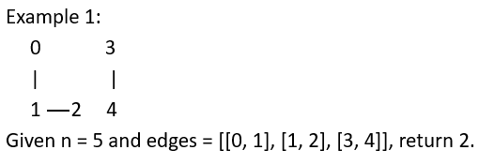
Q1. Number of Connected Components in an Undirected Graph
def countComponents(self, n, edges):
union = Union()
for i in range(n):
union.makeSet(i)
for i, j in edges:
union.union(i, j)
return union.count
Notes:
Except for the modification to union find data structure, the rest is very simple. Firstly, we make call makeSet on every node. Secondly, we call union on every edges. At last, we return the count.
Any questions?

Slide 48
Structure
Union Find
Naïve Version
Practice
Optimized Version
Practice
Cycle Detection
Practice
Kruskal's algorithm
Notes:
Okay. Let’s talk about the optimized union find now.

Slide 49
Union Find
Approaches
Naïve Union Find
makeSet – O(1)
union – O(n)
findSet – O(n)
O(mn), where m stands for the number of operations
A
Graph: 5000 vertices
Union find: 5 operations
Max steps: 25000
B
Notes:
As we know, given m operations of naïve union find, it will take O(mn) time in total. Suppose we have a graph with 5000 vertices, 5 operations would take 25, 000 steps to finish. It is quite slow in deed.

Slide 50
Union Find – Optimized Version
Goals:
makeSet – O(1)
union – O(n)
findSet – O(n)
O(X)
where x is a constant
O(X)
Notes:
The goal of optimized union find is to decrease the running time for both union and findSet operations from n to a constant number.

Slide 51
Union Find – Optimized Version
Optimizations:
Union by rank
Path compression
Notes:
There are two optimizations in total. The first is called union by rank, and the second is called path compression. We ll cover union by rank first.

Slide 52
Union Find – Optimized Version
Optimizations:
Union by rank
Rule for merging set A and B:
if A is larger or equal to B:
merge B into A
else:
merge A into B
Notes:
What is union by rank? It is a rule for merging sets. Basically the rule says that given a set, we will only merge it into another set that has equal or larger size. In other words, we ll always let the representative of the larger set be the representative of the newly merged set.

Slide 53
Union Find – Optimized Version
Optimizations:
Union by rank
Rule for merging set A and B:
if A is larger or equal to B:
merge B into A
else:
merge A into B
Time Complexity:
findSet(v) – O(lg n)
union(v) – O(lg n)
Notes:
This optimization will decrease the time complexity of both findSet and union to lg n. Why is that?

Slide 54
Union Find – Optimized Version
Optimizations:
Union by rank
Rule for merging set A and B:
if A is larger or equal to B:
merge B into A
else:
merge A into B
A, B, C, D, E, F, G, H
Notes:
Suppose we have a graph with 8 vertices from A to H, assuming we have converted each of them into a node.
Starting from an arbitrary node, how many times can the set it belongs to be merged into another set with equal or larger size, in the worst case, if we follow the idea of union by rank? The worst case would happen when every merging is between two sets with equal sizes.

Slide 55
Union Find – Optimized Version
Optimizations:
Union by rank
Rule for merging set A and B:
if A is larger or equal to B:
merge B into A
else:
merge A into B
A, B, C, D, E, F, G, H
A
Notes:
Say we arbitrarily start from A, and merge it with another set. Remember we are counting the number of union operations in the worst case, so the other set must of the same number of nodes as set A. In this case B would work. So we merge them.

Slide 56
Union Find – Optimized Version
Optimizations:
Union by rank
Rule for merging set A and B:
if A is larger or equal to B:
merge B into A
else:
merge A into B
A, B, C, D, E, F, G, H
B
A
E, F, G,H
C, D
Notes:
Now we have AB. AB has 2 nodes as a set. We need another set with 2 nodes for the worst-case merging. CD would work.

Slide 57
Union Find – Optimized Version
Optimizations:
Union by rank
Rule for merging set A and B:
if A is larger or equal to B:
merge B into A
else:
merge A into B
A, B, C, D, E, F, G, H
B
A
E, F, G,H
C, D
Notes:
Now we have ABCD as a new set. EFGH would be the only eligible set to merge.

Slide 58
Union Find – Optimized Version
Optimizations:
Union by rank
Rule for merging set A and B:
if A is larger or equal to B:
merge B into A
else:
merge A into B
A, B, C, D, E, F, G, H
B
A
E, F, G,H
C, D
Notes:
So we have the final set including every node now, and we have run union operations for 3 times in total.

Slide 59
Union Find – Optimized Version
Optimizations:
Union by rank
Rule for merging set A and B:
if A is larger or equal to B:
merge B into A
else:
merge A into B
A, B, C, D, E, F, G, H
B
A
E, F, G,H
C, D
How many times can a number starting from 1 double itself before reaching n? --- O(lg n)
Notes:
Actually the question I asked you is essentially the same as this question listed here. How many times can a number starting from 1 double itself before reaching n. The answer is lg n. If n is 8, lg n is 3.
In other words, if we do union by rank, the depth of the tree structure would be no deeper than lg n.

Slide 60
Union Find – Optimized Version
Optimizations:
Union by rank
Rule for merging set A and B:
if A is larger or equal to B:
merge B into A
else:
merge A into B
A, B, C, D, E, F, G, H
B
A
E, F, G,H
C, D
How many times can a number starting from 1 double itself before reaching n? --- O(lg n)
findSet(v) – O(lg n)
union(v) – O(lg n)
Notes:
This would constrain the time complexity of findSet to O(lg n). In turn, union’s time complexity would also be O(lg n)

Slide 61
Union Find – Optimized Version
Optimizations:
Union by rank
Rule for merging set A and B:
if A is larger or equal to B:
merge B into A
else:
merge A into B
Notes:
How do we reflect this idea to the data structure? We need to make changes in three places, including the Node class, makeSet function and union function.

Slide 62
Union Find – Optimized Version
Optimizations:
Union by rank
Rule for merging set A and B:
if A is larger or equal to B:
merge B into A
else:
merge A into B
Node:
val
parent
rank
makeSet(v):
n = Node(v)
n.parent = n
n.rank = 0
Notes:
Firstly, We add a new attribute rank to the Node class, and let the rank of a node to represent the size of the set the node belongs to.
Secondly, we initialize the rank of the newly created node to be 0 in makeSet function.

Slide 63
Union Find – Optimized Version
Optimizations:
Union by rank
Rule for merging set A and B:
if A is larger or equal to B:
merge B into A
else:
merge A into B
union(n1, n2):
i = findSet(n1)
j = findSet(n2)
if i == j: return
if i.rank > j.rank:
j.parent = i
elif i.rank < j.rank:
i.parent = j
else:
j.parent = i
i.rank += 1
Notes:
union function would be changed a lot. I and j here are still two representatives. If they are the same, still we do nothing.
In the otherwise situation:
If the rank of I is bigger, we make I as the parent of j. Otherwise, we make j as the parent of i. If they are equal, we still make I as the parent of j, and also increment I’s rank.

Slide 64
Union Find – Optimized Version
union
union(A, B)
union(C, D)
union(F, E)
union(D, E)
union(B, E)
0
0
0
0
0
0
Notes:
Let’s run the same sequence of union operations we did in naïve union find, just to get a better idea of how union by rank works.
We ll use the number in small box by every node to represent its rank.

Slide 65
Union Find – Optimized Version
union(A, B)
union(C, D)
union(F, E)
union(D, E)
union(B, E)
union
0
0
0
0
0
0
Notes:
The first operation is union(A,B). The returned representatives of set A and B are just A, B. Since their ranks are the same, so we make A as the parent of B and increment its rank.

Slide 66
Union Find – Optimized Version
union(A, B)
union(C, D)
union(F, E)
union(D, E)
union(B, E)
union
A
B
1
0
0
0
0
0
Notes:
We still use the tree structure to represent the relationship between a node and its parent. The next operation is union(C,D), which is similar. We make C as the parent of D and increment its rank.

Slide 67
Union Find – Optimized Version
union(A, B)
union(C, D)
union(F, E)
union(D, E)
union(B, E)
union
A
C
B
D
1
0
1
0
0
0
Notes:
The next operation is union(F,E). The same rule applies. We make F as the parent of E and increment its rank.

Slide 68
Union Find – Optimized Version
union(A, B)
union(C, D)
union(F, E)
union(D, E)
union(B, E)
union
A
C
B
D
1
0
1
F
E
1
0
0
Notes:
The next operation is union(D,E). C and F are the returned representatives. Since they have the same ranks. We make C as the new parent of F, and increment its rank.

Slide 69
Union Find – Optimized Version
union(A, B)
union(C, D)
union(F, E)
union(D, E)
union(B, E)
union
A
C
B
D
1
0
2
F
E
1
0
0
Notes:
The last operation is union(B, E). The returned representatives are A and C. Since C has a higher rank, we make C as the parent of A.

Slide 70
Union Find – Optimized Version
union(A, B)
union(C, D)
union(F, E)
union(D, E)
union(B, E)
union
C
D
1
0
2
A
F
B
E
1
0
0
Notes:
So we have a tree structure generated here.

Slide 71
Union Find – Optimized Version
union(A, B)
union(C, D)
union(F, E)
union(D, E)
union(B, E)
union
C
1
0
2
A
F
D
B
E
1
0
0
A
B
C
F
D
E
Notes:
In comparison with the tree we generate previously using naïve union find, you can see union by rank minimized the depths of the tree.

Slide 72
Union Find – Optimized Version
Optimizations:
Union by rank
Path compression
Notes:
That’s the first optimization called union by rank. The second optimization is called path compression.

Slide 73
Union Find – Optimized Version
Optimizations:
Union by rank
Path compression
Flatten the structure of the tree whenever findSet is used.
Notes:
What it all means is simply to flatten the tree structure whenever findSet is called. As you know the findSet will finally locate the representative of the set the node belongs to.
The optimization is all about updating the parent of the node to the representative before returning the representative.

Slide 74
Union Find – Optimized Version
Optimizations:
Union by rank
Path compression
Flatten the structure of the tree whenever findSet is used.
findSet(n):
if n.parent == n:
return n
return findSet(n.parent)
findSet(n):
if n.parent != n:
n.parent = findSet(n.parent)
return n.parent
Notes:
The implementation is very simple, because the idea is not complex.

Slide 75
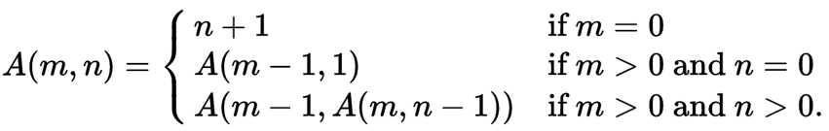
Union Find – Optimized Version
Amortized time per operation:
O(a(n)), where a(n) is the inverse of the function n = f(x, x)
f(x, x) is Ackermann function
a(n) is less than 5 for all remotely practical values of n.
Notes:
The two optimizations together will make the amortized time complexity of the two operations to O(a(n)), where a(n) is the inverse of Akerman function. Due to time limit and the reason that you might not learn amortized algorithm yet, we will not provide you the details of the mathematical proof here.
You only need to know that Ackermann function increases very fast, so its inverse would decrease very fast as well. Practically a(n) would be less than 5 for any practically big value of n.

Slide 76
Union Find
Approaches
Naïve Union Find
Optimized Union Find
O(mn), where m stands for the number of operations
O(m* a(n)), where m stands for the number of operations
A
A
Graph: 5000 vertices
Naïve union find: 5 operations
Max steps: 25000
Graph: 5000 vertices
Optimized union find: 5 operations
Max steps: 25
B
B
Notes:
In contrast, 5 operations using optimized union find takes only 25 steps, 1000 time smaller than naïve union find.
On page 2 of your handout, there is a table. The left is the pseudo code and the right is Python implementation. Similar to naïve union find, we had a little tweak in the implementation which allows operations to take vertices as input. Except for that, everything stays the same.

Slide 77
Structure
Union Find
Naïve Version
Practice
Optimized Version
Practice
Cycle Detection
Practice
Kruskal's algorithm

Slide 78
Q2. Number of Islands
A 2d grid map of m rows and n columns is initially filled with water. We may perform an addLand operation which turns the water at position (row, col) into a land. Given a list of positions to operate, count the number of islands after each addLand operation. An island is surrounded by water and is formed by connecting adjacent lands horizontally or vertically. You may assume all four edges of the grid are all surrounded by water.

Slide 79
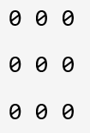
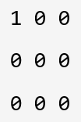

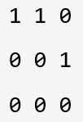
Q2. Number of Islands
Given m = 3, n = 3, positions = [[0,0], [0,1], [1,2], [2,1]].
1 1 2 Return [1, 1, 2]

Slide 80
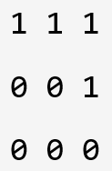
Q2. Number of Islands
Given m = 3, n = 3, positions = [[0,0], [0,1], [1,2], [2,1]].
1 1 2 1 Return [1, 1, 2, 1]

Slide 81
Q2. Number of Islands
 | 1
0 | 1 | 1
 | 0
(1, 1)

Slide 82
Q2. Number of Islands
 | 1
0 | 1 | 1
 | 0
(1, 1)
Neighbors: (0, 1), (2, 1), (1, 0), (1, 2)

Slide 83
Q2. Number of Islands
 | 1
0 | 1 | 1
 | 0
(1, 1)
Neighbors: (0, 1), (2, 1), (1, 0), (1, 2)
(x, y)

Slide 84
Q2. Number of Islands
 | 1
0 | 1 | 1
 | 0
(1, 1)
Neighbors: (0, 1), (2, 1), (1, 0), (1, 2)
(x, y)
Neighbors: (x-1, y), (x+1, y), (x, y+1), (x, y-1)

Slide 85
Q2. Number of Islands
def numIslands2(self, m, n, positions):
islands = Union()
result = []
for i, j in positions:
islands.makeSet((i,j))
neighbors = [(i+1,j), (i-1,j), (i,j+1), (i,j-1)]
for x, y in neighbors:
if (x,y) in islands.table:
islands.union((x,y),(i,j))
result.append(islands.count)
return result

Slide 86
Structure
Union Find
Naïve Version
Practice
Optimized Version
Practice
Cycle Detection
Practice
Kruskal's algorithm

Slide 87
Cycle Detection

Slide 88
Cycle Detection
Cycle detection refers to the algorithmic problem of finding a cycle in a sequence of iterated function values.

Slide 89
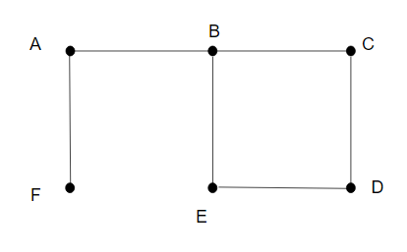
Cycle Detection
Cycle detection refers to the algorithmic problem of finding a cycle in a sequence of iterated function values.

Slide 90
Cycle Detection
cycleDetect(G):
foreach v ∈ G.V:
MAKE-SET(v)
foreach (u, v) in G.E:
if FIND-SET(u) ≠ FIND-SET(v):
UNION(u, v)
else:
return True
return False

Slide 91
Cycle Detection – Step 1
AB, BE, EF, CD, BF, DE, CE, BC

Slide 92
Cycle Detection – Step 2
AF, AB, CD, DE, BC, BE

Slide 93
Cycle Detection – Step 2
AF, AB, CD, DE, BC, BE
AF
findSet(A) findSet(F)

Slide 94
Cycle Detection – Step 2
AF, AB, CD, DE, BC, BE
AF
findSet(A) findSet(F)

Slide 95
Cycle Detection – Step 2
AF, AB, CD, DE, BC, BE
AB
findSet(A) findSet(B)

Slide 96
Cycle Detection – Step 2
AF, AB, CD, DE, BC, BE
AB
findSet(A) findSet(B)

Slide 97
Cycle Detection – Step 2
AF, AB, CD, DE, BC, BE
CD
findSet(C) findSet(D)

Slide 98
Cycle Detection – Step 2
AF, AB, CD, DE, BC, BE
CD
findSet(C) findSet(D)

Slide 99
Cycle Detection – Step 2
AF, AB, CD, DE, BC, BE
DE
findSet(D) findSet(E)

Slide 100
Cycle Detection – Step 2
AF, AB, CD, DE, BC, BE
DE
findSet(D) findSet(E)

Slide 101
Cycle Detection – Step 2
AF, AB, CD, DE, BC, BE
BC
findSet(B) findSet(C)

Slide 102
Cycle Detection – Step 2
AF, AB, CD, DE, BC, BE
BC
findSet(B) findSet(C)

Slide 103
Cycle Detection – Step 2
AF, AB, CD, DE, BC, BE
BE
findSet(B) findSet(E)

Slide 104
Cycle Detection – Step 2
AF, AB, CD, DE, BC, BE
BE
findSet(B) findSet(E)
Result: True

Slide 105
Cycle Detection – Time Complexity
cycleDetect(G):
foreach v ∈ G.V:
MAKE-SET(v)
foreach (u, v) in G.E:
if FIND-SET(u) ≠ FIND-SET(v):
UNION(u, v)
else:
return True
return False

Slide 106
Cycle Detection – Time Complexity
cycleDetect(G):
foreach v ∈ G.V:
MAKE-SET(v)
foreach (u, v) in G.E:
if FIND-SET(u) ≠ FIND-SET(v):
UNION(u, v)
else:
return True
return False
O(V)
O(E)
TOTAL:
O(V) + O(E)

Slide 107
Cycle Detection – Time Complexity
cycleDetect(G):
foreach v ∈ G.V:
MAKE-SET(v)
foreach (u, v) in G.E:
if FIND-SET(u) ≠ FIND-SET(v):
UNION(u, v)
else:
return True
return False
O(V)
O(E)
TOTAL:
O(V)

Slide 108
Structure
Union Find
Naïve Version
Practice
Optimized Version
Practice
Cycle Detection
Practice
Kruskal's algorithm

Slide 109
Q3. Graph Valid Tree
Given n nodes labeled from 0 to n - 1 and a list of undirected edges (each edge is a pair of nodes), write a function to check whether these edges make up a valid tree.
For example:
Given n = 5 and edges = [[0, 1], [0, 2], [0, 3], [1, 4]], return true.
Given n = 5 and edges = [[0, 1], [1, 2], [2, 3], [1, 3], [1, 4]], return false.

Slide 110
Q3. Graph Valid Tree
Given n nodes labeled from 0 to n - 1 and a list of undirected edges (each edge is a pair of nodes), write a function to check whether these edges make up a valid tree.
For example:
Given n = 5 and edges = [[0, 1], [0, 2], [0, 3], [1, 4]], return true.
Given n = 5 and edges = [[0, 1], [1, 2], [2, 3], [1, 3], [1, 4]], return false.
def validTree(self, n, edges):
"""
:type n: int
:type edges: List[List[int]]
:rtype: bool
"""

Slide 111
Q3. Graph Valid Tree
Valid Tree:
If there are n nodes, there must be n-1 edges.
There is no loop.

Slide 112
Q3. Graph Valid Tree
def validTree(self, n, edges):
if len(edges) != n-1: return False
union = Union()
for u, v in edges:
union.makeSet(u)
union.makeSet(v)
for u, v in edges:
if union.findSet(u) == union.findSet(v):
return False
else:
union.union(u, v)
return True

Slide 113
Structure
Union Find
Naïve Version
Practice
Optimized Version
Practice
Cycle Detection
Practice
Kruskal's algorithm

Slide 114
Kruskal's algorithm

Slide 115
Kruskal's algorithm
Weighted Graph:
A weighted graph refers to an edge-weighted graph, where edges have weights or values.

Slide 116
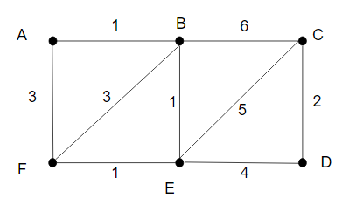
Kruskal's algorithm
Weighted Graph:
A weighted graph refers to an edge-weighted graph, where edges have weights or values.

Slide 117
Kruskal's algorithm
Minimum Spanning Tree:
A minimum spanning tree is a subset of the edges of a connected, edge-weighted graph that connects all the vertices together, without any cycles and with the minimum possible total edge weight.

Slide 118
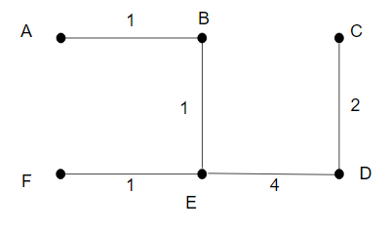
Kruskal's algorithm
Minimum Spanning Tree:
A minimum spanning tree is a subset of the edges of a connected, edge-weighted graph that connects all the vertices together, without any cycles and with the minimum possible total edge weight.

Slide 119
Kruskal's algorithm
KRUSKAL(G):
Result = ∅
foreach v ∈ G.V:
MAKE-SET(v)
foreach (u, v) in G.E ordered by increasing order of weight(u, v):
if FIND-SET(u) ≠ FIND-SET(v):
Result = Result ∪ {(u, v)}
UNION(u, v)
return Result

Slide 120
Kruskal's algorithm – Step 1
AB, BE, EF, CD, BF, DE, CE, BC

Slide 121
Kruskal's algorithm – Step 2
AB, BE, EF, CD, BF, DE, CE, BC

Slide 122
Kruskal's algorithm – Step 3
AB, BE, EF, CD, BF, DE, CE, BC

Slide 123
Kruskal's algorithm – Step 3
AB, BE, EF, CD, BF, DE, CE, BC
AB
findSet(A) findSet(B)

Slide 124
Kruskal's algorithm – Step 3
AB, BE, EF, CD, BF, DE, CE, BC
AB
findSet(A) findSet(B)
Result: AB

Slide 125
Kruskal's algorithm – Step 3
AB, BE, EF, CD, BF, DE, CE, BC
BE
findSet(B) findSet(E)
Result: AB

Slide 126
Kruskal's algorithm – Step 3
AB, BE, EF, CD, BF, DE, CE, BC
BE
findSet(B) findSet(E)
Result: AB, BE

Slide 127
Kruskal's algorithm – Step 3
AB, BE, EF, CD, BF, DE, CE, BC
EF
findSet(E) findSet(F)
Result: AB, BE

Slide 128
Kruskal's algorithm – Step 3
AB, BE, EF, CD, BF, DE, CE, BC
EF
findSet(E) findSet(F)
Result: AB, BE, EF

Slide 129
Kruskal's algorithm – Step 3
AB, BE, EF, CD, BF, DE, CE, BC
CD
findSet(C) findSet(D)
Result: AB, BE, EF

Slide 130
Kruskal's algorithm – Step 3
AB, BE, EF, CD, BF, DE, CE, BC
CD
findSet(C) findSet(D)
Result: AB, BE, EF, CD

Slide 131
Kruskal's algorithm – Step 3
AB, BE, EF, CD, BF, DE, CE, BC
BF
findSet(B) findSet(F)
Result: AB, BE, EF, CD

Slide 132
Kruskal's algorithm – Step 3
AB, BE, EF, CD, BF, DE, CE, BC
DE
findSet(D) findSet(E)
Result: AB, BE, EF, CD

Slide 133
Kruskal's algorithm – Step 3
AB, BE, EF, CD, BF, DE, CE, BC
DE
findSet(D) findSet(E)
Result: AB, BE, EF, CD, DE

Slide 134
Kruskal's algorithm – Step 3
AB, BE, EF, CD, BF, DE, CE, BC
DE
findSet(D) findSet(E)
Result: AB, BE, EF, CD, DE

Slide 135
Kruskal's algorithm – Time Complexity
KRUSKAL(G):
Result = ∅
foreach v ∈ G.V:
MAKE-SET(v)
foreach (u, v) in G.E ordered by increasing order of weight(u, v):
if FIND-SET(u) ≠ FIND-SET(v):
Result = Result ∪ {(u, v)}
UNION(u, v)
return Result

Slide 136
Kruskal's algorithm – Time Complexity
KRUSKAL(G):
Result = ∅
foreach v ∈ G.V:
MAKE-SET(v)
foreach (u, v) in G.E ordered by increasing order of weight(u, v):
if FIND-SET(u) ≠ FIND-SET(v):
Result = Result ∪ {(u, v)}
UNION(u, v)
return Result
O(V)
O(E log E)
O(E)
TOTAL:
O(V) + O(E log E) + O(E)

Slide 137
Kruskal's algorithm – Time Complexity
KRUSKAL(G):
Result = ∅
foreach v ∈ G.V:
MAKE-SET(v)
foreach (u, v) in G.E ordered by increasing order of weight(u, v):
if FIND-SET(u) ≠ FIND-SET(v):
Result = Result ∪ {(u, v)}
UNION(u, v)
return Result
O(V)
O(E log E)
O(E)
TOTAL:
O(E log E)

Slide 138
neohao@uga.edu Thanks!

