Slide 1

Application of Union Find in Undirected Graph Algorithm Problems
Qiang (Neo) Hao
Learning Design and Technology & Computer Science
University of Georgia

Slide 2
Structure
Union Find
Naïve Version
Optimized Version
Cycle Detection
Kruskal's algorithm

Slide 3
Structure
Union Find
Naïve Version
Practice
Optimized Version
Practice
Cycle Detection
Practice
Kruskal's algorithm

Slide 4
Structure
Union Find
Naïve Version
Practice
Optimized Version
Practice
Cycle Detection
Practice
Kruskal's algorithm
https://github.com/Neo-Hao/union-find

Slide 5
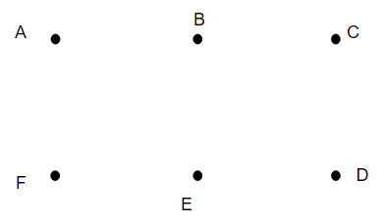
Union Find
Data Structure
makeSet
findSet
union

Slide 6
Union Find
Data Structure
makeSet(A)
makeSet(B)
makeSet(D)
union(A, B)
findSet(A) == findSet(D)

Slide 7
Union Find
Data Structure
makeSet(A)
makeSet(B)
makeSet(D)

Slide 8
Union Find
Data Structure
makeSet(A)
makeSet(B)
makeSet(D)
union(A, B)

Slide 9
Union Find
Data Structure
makeSet(A)
makeSet(B)
makeSet(D)
union(A, B)

Slide 10
Union Find
Data Structure
makeSet(A)
makeSet(B)
makeSet(D)
union(A, B)
findSet(A) == findSet(D)

Slide 11
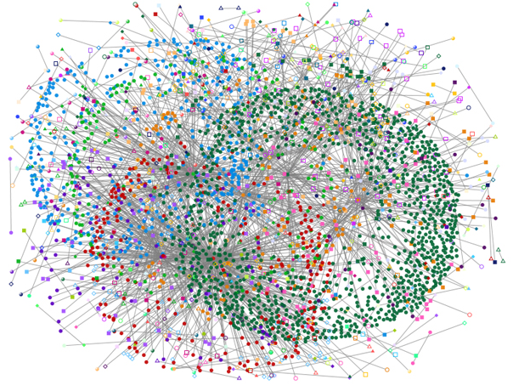
Union Find
Data Structure
A
B

Slide 12
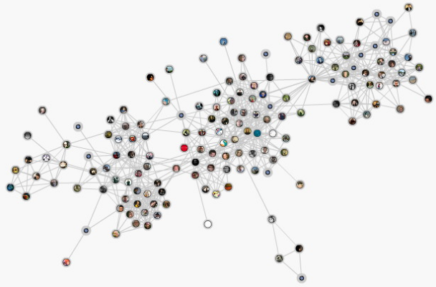
Union Find
Application:
Network security
Social network analysis
Image Processing

Slide 13
Union Find
Implementations
Naïve Union Find
Optimized Union Find

Slide 14
Union Find – Naïve Version
Implementation

Slide 15
Union Find – Naïve Version
Implementation
Node:
val
parent

Slide 16
Union Find – Naïve Version
makeSet
makeSet(v):
n = Node(v)
n.parent = n

Slide 17
Union Find – Naïve Version
makeSet
makeSet(v):
n = Node(v)
n.parent = n
Time Complexity
O(1)

Slide 18
Union Find – Naïve Version
union

Slide 19
Union Find – Naïve Version
union
union(A, B)
union(C, D)
union(F, E)
union(D, E)
union(B, E)

Slide 20
Union Find – Naïve Version
union
union(A, B)
union(C, D)
union(F, E)
union(D, E)
union(B, E)
findSet

Slide 21
Union Find – Naïve Version
union
union(A, B)
union(C, D)
union(F, E)
union(D, E)
union(B, E)
union(n1, n2):
i = findSet(n1)
j = findSet(n2)
if i == j:
return
else:
j.parent = i
findSet

Slide 22
Union Find – Naïve Version
union
union(A, B)
union(C, D)
union(F, E)
union(D, E)
union(B, E)
union(n1, n2):
i = findSet(n1)
j = findSet(n2)
if i == j:
return
else:
j.parent = i
E.parent ?
D.parent ?
C.parent ?

Slide 23
Union Find – Naïve Version
union(A, B)
union(C, D)
union(F, E)
union(D, E)
union(B, E)
union

Slide 24
Union Find – Naïve Version
union(A, B)
union(C, D)
union(F, E)
union(D, E)
union(B, E)
union
A
B

Slide 25
Union Find – Naïve Version
union(A, B)
union(C, D)
union(F, E)
union(D, E)
union(B, E)
union
A
C
B
D

Slide 26
Union Find – Naïve Version
union(A, B)
union(C, D)
union(F, E)
union(D, E)
union(B, E)
union
A
C
B
D
F
E

Slide 27
Union Find – Naïve Version
union(A, B)
union(C, D)
union(F, E)
union(D, E)
union(B, E)
union
A
C
B
D
F
E

Slide 28
Union Find – Naïve Version
union(A, B)
union(C, D)
union(F, E)
union(D, E)
union(B, E)
union
A
B
C
F
D
E

Slide 29
Union Find – Naïve Version
union(A, B)
union(C, D)
union(F, E)
union(D, E)
union(B, E)
union
A
B
C
F
D
E.parent ?
D.parent ?
C.parent ?
E

Slide 30
Union Find – Naïve Version
union(A, B)
union(C, D)
union(F, E)
union(D, E)
union(B, E)
union
A
B
C
F
D
E.parent = F
D.parent = C
C.parent = A
E

Slide 31
Union Find – Naïve Version
union(A, B)
union(C, D)
union(F, E)
union(D, E)
union(B, E)
union
union(n1, n2):
i = findSet(n1)
j = findSet(n2)
if i == j:
return
else:
j.parent = i
Time Complexity
???

Slide 32
Union Find – Naïve Version
findSet

Slide 33
Union Find – Naïve Version
findSet
A
B
C
F
D
table(E) = F
table(D) = C
table(C) = A
E

Slide 34
Union Find – Naïve Version
findSet
findSet(n):
if n.parent == n:
return n
return findSet(n.parent)

Slide 35
Union Find – Naïve Version
findSet
findSet(n):
if n.parent == n:
return n
return findSet(n.parent)
Time Complexity
O(n)

Slide 36
Union Find – Naïve Version
union(A, B)
union(C, D)
union(F, E)
union(D, E)
union(B, E)
union
union(n1, n2):
i = findSet(n1)
j = findSet(n2)
if i == j:
return
else:
j.parent = i
Time Complexity
O(n)

Slide 37
Union Find
Implementations
Naïve Union Find
makeSet – O(1)
union – O(n)
findSet – O(n)
O(mn), where m stands for the number of operations

Slide 38
Q1. Number of Connected Components in an Undirected Graph
Given n nodes labeled from 0 to n - 1 and a list of undirected edges (each edge is a pair of nodes), write a function to find the number of connected components in an undirected graph.
Example 1:
0 3
| |
1 --- 2 4
Given n = 5 and edges = [[0, 1], [1, 2], [3, 4]], return 2.

Slide 39
Q1. Number of Connected Components in an Undirected Graph
Given n nodes labeled from 0 to n - 1 and a list of undirected edges (each edge is a pair of nodes), write a function to find the number of connected components in an undirected graph.
Example 2:
0 4
| |
1 --- 2 --- 3
Given n = 5 and edges = [[0, 1], [1, 2], [2, 3], [3, 4]], return 1

Slide 40
Q1. Number of Connected Components in an Undirected Graph
Given n nodes labeled from 0 to n - 1 and a list of undirected edges (each edge is a pair of nodes), write a function to find the number of connected components in an undirected graph.
Example 2:
0 4
| |
1 --- 2 --- 3
Given n = 5 and edges = [[0, 1], [1, 2], [2, 3], [3, 4]], return 1
def countComponents(self, n, edges):
"""
:type n: int
:type edges: List[List[int]]
:rtype: int
"""

Slide 41
Q1. Number of Connected Components in an Undirected Graph
Class Union(object):
def __inint__(self):
# … …
self.count = 0
def makeSet(v):
# … …
self.count += 1
def union():
# … …
self.count -= 1

Slide 42
Q1. Number of Connected Components in an Undirected Graph
Example of count
makeSet(A)
makeSet(B)
……
makeSet(F)
union(A, B)
union(B, C)
union(A, C)

Slide 43
Q1. Number of Connected Components in an Undirected Graph
Example of count
makeSet(A)
makeSet(B)
……
makeSet(F)
union(A, B)
union(B, C)
union(A, C)

Slide 44
Q1. Number of Connected Components in an Undirected Graph
Example of count
makeSet(A)
makeSet(B)
……
makeSet(F)
union(A, B)
union(B, C)
union(A, C)
Count = 6

Slide 45
Q1. Number of Connected Components in an Undirected Graph
Example of count
makeSet(A)
makeSet(B)
……
makeSet(F)
union(A, B)
union(B, C)
union(A, C)
Count = 6
Count = 5

Slide 46
Q1. Number of Connected Components in an Undirected Graph
Example of count
makeSet(A)
makeSet(B)
……
makeSet(F)
union(A, B)
union(B, C)
union(A, C)
Count = 6
Count = 5
Count = 4

Slide 47
Q1. Number of Connected Components in an Undirected Graph
Example of count
makeSet(A)
makeSet(B)
……
makeSet(F)
union(A, B)
union(B, C)
union(A, C)
Count = 6
Count = 5
Count = 4
Count = 4

Slide 48
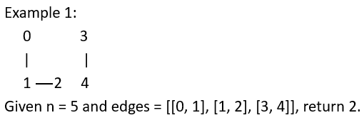
Q1. Number of Connected Components in an Undirected Graph
def countComponents(self, n, edges):
"""
:type n: int
:type edges: List[List[int]]
:rtype: int
"""
union = Union()
for i in range(n):
union.makeSet(i)
for i, j in edges:
union.union(i, j)
return union.count

Slide 49
Union Find – Optimized Version

Slide 50
Union Find – Optimized Version
Naïve Union Find
makeSet – O(1)
union – O(n)
findSet – O(n)
O(1)
O(1)

Slide 51
Union Find – Optimized Version
Optimizations:
Union by rank
Path compression

Slide 52
Union Find – Optimized Version
Optimizations:
Union by rank
Rule for merging set A and B:
if A is larger or equal to B:
merge B into A
else:
merge A into B

Slide 53
Union Find – Optimized Version
Optimizations:
Union by rank
Rule for merging set A and B:
if A is larger or equal to B:
merge B into A
else:
merge A into B
Time Complexity:
findSet(v) – O(lg n)
union(v) – O(lg n)

Slide 54
Union Find – Optimized Version
Optimizations:
Union by rank
Rule for merging set A and B:
if A is larger or equal to B:
merge B into A
else:
merge A into B
Time Complexity:
findSet(v) – O(lg n)
union(v) – O(lg n)
union(n1, n2):
i = findSet(n1)
j = findSet(n2)
if i == j:
return
else:
j.parent = i

Slide 55
Union Find – Optimized Version
Optimizations:
Union by rank
Rule for merging set A and B:
if A is larger or equal to B:
merge B into A
else:
merge A into B
A, B, C, D, E, F, G, H

Slide 56
Union Find – Optimized Version
Optimizations:
Union by rank
Rule for merging set A and B:
if A is larger or equal to B:
merge B into A
else:
merge A into B
A, B, C, D, E, F, G, H
A

Slide 57
Union Find – Optimized Version
Optimizations:
Union by rank
Rule for merging set A and B:
if A is larger or equal to B:
merge B into A
else:
merge A into B
A, B, C, D, E, F, G, H
B
A
E, F, G,H
C, D

Slide 58
Union Find – Optimized Version
Optimizations:
Union by rank
Rule for merging set A and B:
if A is larger or equal to B:
merge B into A
else:
merge A into B
A, B, C, D, E, F, G, H
B
A
E, F, G,H
C, D

Slide 59
Union Find – Optimized Version
Optimizations:
Union by rank
Rule for merging set A and B:
if A is larger or equal to B:
merge B into A
else:
merge A into B
A, B, C, D, E, F, G, H
B
A
E, F, G,H
C, D

Slide 60
Union Find – Optimized Version
Optimizations:
Union by rank
Rule for merging set A and B:
if A is larger or equal to B:
merge B into A
else:
merge A into B
A, B, C, D, E, F, G, H
B
A
E, F, G,H
C, D
How many times can a number starting from 1 double itself before reaching n? --- O(lg n)

Slide 61
Union Find – Optimized Version
Optimizations:
Union by rank
Rule for merging set A and B:
if A is larger or equal to B:
merge B into A
else:
merge A into B
A, B, C, D, E, F, G, H
B
A
E, F, G,H
C, D
How many times can a number starting from 1 double itself before reaching n? --- O(lg n)
findSet(v) – O(lg n)
union(v) – O(lg n)

Slide 62
Union Find – Optimized Version
Optimizations:
Union by rank
Rule for merging set A and B:
if A is larger or equal to B:
merge B into A
else:
merge A into B

Slide 63
Union Find – Optimized Version
Optimizations:
Union by rank
Rule for merging set A and B:
if A is larger or equal to B:
merge B into A
else:
merge A into B
Node:
val
parent
rank

Slide 64
Union Find – Optimized Version
Optimizations:
Union by rank
Rule for merging set A and B:
if A is larger or equal to B:
merge B into A
else:
merge A into B
union(n1, n2):
i = findSet(n1)
j = findSet(n2)
if i == j: return
if i.rank > j.rank:
j.parent = i
elif i.rank < j.rank:
i.parent = j
else:
j.parent = i
i.rank += 1

Slide 65
Union Find – Optimized Version
Optimizations:
Union by rank
union(n1, n2):
i = findSet(n1)
j = findSet(n2)
if i == j: return
if i.rank > j.rank:
j.parent = i
elif i.rank < j.rank:
i.parent = j
else:
j.parent = i
i.rank += 1
union(n1, n2):
i = findSet(n1)
j = findSet(n2)
if i == j: return
j.parent = i

Slide 66
Union Find – Optimized Version
union
union(A, B)
union(C, D)
union(F, E)
union(D, E)
union(B, E)

Slide 67
Union Find – Optimized Version
union
union(A, B)
union(C, D)
union(F, E)
union(D, E)
union(B, E)
0
0
0
0
0
0

Slide 68
Union Find – Optimized Version
union(A, B)
union(C, D)
union(F, E)
union(D, E)
union(B, E)
union
0
0
0
0
0
0

Slide 69
Union Find – Optimized Version
union(A, B)
union(C, D)
union(F, E)
union(D, E)
union(B, E)
union
A
B
1
0
0
0
0
0

Slide 70
Union Find – Optimized Version
union(A, B)
union(C, D)
union(F, E)
union(D, E)
union(B, E)
union
A
C
B
D
1
0
1
0
0
0

Slide 71
Union Find – Optimized Version
union(A, B)
union(C, D)
union(F, E)
union(D, E)
union(B, E)
union
A
C
B
D
1
0
1
F
E
1
0
0

Slide 72
Union Find – Optimized Version
union(A, B)
union(C, D)
union(F, E)
union(D, E)
union(B, E)
union
A
C
B
D
1
0
2
F
E
1
0
0

Slide 73
Union Find – Optimized Version
union(A, B)
union(C, D)
union(F, E)
union(D, E)
union(B, E)
union
C
D
1
0
2
A
F
B
E
1
0
0

Slide 74
Union Find – Naïve Version
union(A, B)
union(C, D)
union(F, E)
union(D, E)
union(B, E)
union
A
B
C
F
D
E

Slide 75
Union Find – Optimized Version
union(A, B)
union(C, D)
union(F, E)
union(D, E)
union(B, E)
union
C
D
1
0
2
A
F
B
E
1
0
0

Slide 76
Union Find – Optimized Version
Optimizations:
Union by rank
Path compression

Slide 77
Union Find – Optimized Version
Optimizations:
Union by rank
Path compression
Flatten the structure of the tree whenever findSet is used.

Slide 78
Union Find – Optimized Version
Optimizations:
Union by rank
Path compression
Flatten the structure of the tree whenever findSet is used.
findSet(n):
if n.parent == n:
return n
return findSet(n.parent)

Slide 79
Union Find – Optimized Version
Optimizations:
Union by rank
Path compression
Flatten the structure of the tree whenever findSet is used.
findSet(n):
if n.parent == n:
return n
return findSet(n.parent)
findSet(n):
if n.parent != n:
n.parent = findSet(n.parent)
return n.parent

Slide 80
Union Find – Optimized Version
Optimizations:
Union by rank
Path compression
Flatten the structure of the tree whenever findSet is used.
findSet(n):
if n.parent == n:
return n
return findSet(n.parent)
findSet(n):
if n.parent != n:
n.parent = findSet(n.parent)
return n.parent
O(a(n)), where a(n) is less than 5 for all remotely vertices.

Slide 81
Q2. Number of Islands
A 2d grid map of m rows and n columns is initially filled with water. We may perform an addLand operation which turns the water at position (row, col) into a land. Given a list of positions to operate, count the number of islands after each addLand operation. An island is surrounded by water and is formed by connecting adjacent lands horizontally or vertically. You may assume all four edges of the grid are all surrounded by water.

Slide 82
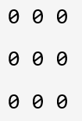
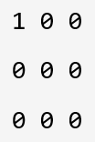

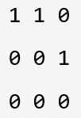
Q2. Number of Islands
Given m = 3, n = 3, positions = [[0,0], [0,1], [1,2], [2,1]].
1 1 2 Return [1, 1, 2]

Slide 83
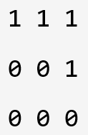
Q2. Number of Islands
Given m = 3, n = 3, positions = [[0,0], [0,1], [1,2], [2,1]].
1 1 2 1 Return [1, 1, 2, 1]

Slide 84
Q2. Number of Islands
 | 1
0 | 1 | 1
 | 0
(1, 1)

Slide 85
Q2. Number of Islands
 | 1
0 | 1 | 1
 | 0
(1, 1)
Neighbors: (0, 1), (2, 1), (1, 0), (1, 2)

Slide 86
Q2. Number of Islands
 | 1
0 | 1 | 1
 | 0
(1, 1)
Neighbors: (0, 1), (2, 1), (1, 0), (1, 2)
(x, y)

Slide 87
Q2. Number of Islands
 | 1
0 | 1 | 1
 | 0
(1, 1)
Neighbors: (0, 1), (2, 1), (1, 0), (1, 2)
(x, y)
Neighbors: (x-1, y), (x+1, y), (x, y+1), (x, y-1)

Slide 88
Q2. Number of Islands
def numIslands2(self, m, n, positions):
islands = Union()
result = []
for i, j in positions:
islands.makeSet((i,j))
neighbors = [(i+1,j), (i-1,j), (i,j+1), (i,j-1)]
for x, y in neighbors:
if (x,y) in islands.table:
islands.union((x,y),(i,j))
result.append(islands.count)
return result

Slide 89
Cycle Detection

Slide 90
Cycle Detection
Cycle detection refers to the algorithmic problem of finding a cycle in a sequence of iterated function values.

Slide 91
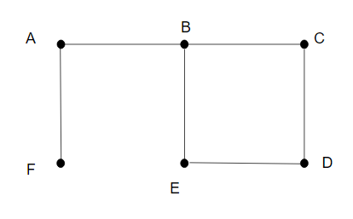
Cycle Detection
Cycle detection refers to the algorithmic problem of finding a cycle in a sequence of iterated function values.

Slide 92
Cycle Detection
Cycle detection refers to the algorithmic problem of finding a cycle in a sequence of iterated function values.

Slide 93
Cycle Detection
cycleDetect(G):
A = ∅
foreach v ∈ G.V:
MAKE-SET(v)
foreach (u, v) in G.E:
if FIND-SET(u) ≠ FIND-SET(v):
UNION(u, v)
else:
return True
return False

Slide 94
Cycle Detection – Step 1
AB, BE, EF, CD, BF, DE, CE, BC

Slide 95
Cycle Detection – Step 2
AF, AB, CD, DE, BC, BE

Slide 96
Cycle Detection – Step 2
AF, AB, CD, DE, BC, BE
AF
findSet(A) findSet(F)

Slide 97
Cycle Detection – Step 2
AF, AB, CD, DE, BC, BE
AF
findSet(A) findSet(F)

Slide 98
Cycle Detection – Step 2
AF, AB, CD, DE, BC, BE
AB
findSet(A) findSet(B)

Slide 99
Cycle Detection – Step 2
AF, AB, CD, DE, BC, BE
AB
findSet(A) findSet(B)

Slide 100
Cycle Detection – Step 2
AF, AB, CD, DE, BC, BE
CD
findSet(C) findSet(D)

Slide 101
Cycle Detection – Step 2
AF, AB, CD, DE, BC, BE
CD
findSet(C) findSet(D)

Slide 102
Cycle Detection – Step 2
AF, AB, CD, DE, BC, BE
DE
findSet(D) findSet(E)

Slide 103
Cycle Detection – Step 2
AF, AB, CD, DE, BC, BE
DE
findSet(D) findSet(E)

Slide 104
Cycle Detection – Step 2
AF, AB, CD, DE, BC, BE
BC
findSet(B) findSet(C)

Slide 105
Cycle Detection – Step 2
AF, AB, CD, DE, BC, BE
BC
findSet(B) findSet(C)

Slide 106
Cycle Detection – Step 2
AF, AB, CD, DE, BC, BE
BE
findSet(B) findSet(E)

Slide 107
Cycle Detection – Step 2
AF, AB, CD, DE, BC, BE
BE
findSet(B) findSet(E)
Result: True

Slide 108
Cycle Detection – Time Complexity
cycleDetect(G):
A = ∅
foreach v ∈ G.V:
MAKE-SET(v)
foreach (u, v) in G.E:
if FIND-SET(u) ≠ FIND-SET(v):
UNION(u, v)
else:
return True
return False

Slide 109
Cycle Detection – Time Complexity
cycleDetect(G):
A = ∅
foreach v ∈ G.V:
MAKE-SET(v)
foreach (u, v) in G.E:
if FIND-SET(u) ≠ FIND-SET(v):
UNION(u, v)
else:
return True
return False
O(V)
O(E)
TOTAL:
O(V) + O(E)

Slide 110
Cycle Detection – Time Complexity
cycleDetect(G):
A = ∅
foreach v ∈ G.V:
MAKE-SET(v)
foreach (u, v) in G.E:
if FIND-SET(u) ≠ FIND-SET(v):
UNION(u, v)
else:
return True
return False
O(V)
O(E)
TOTAL:
O(V)

Slide 111
Q3. Graph Valid Tree
Given n nodes labeled from 0 to n - 1 and a list of undirected edges (each edge is a pair of nodes), write a function to check whether these edges make up a valid tree.
For example:
Given n = 5 and edges = [[0, 1], [0, 2], [0, 3], [1, 4]], return true.
Given n = 5 and edges = [[0, 1], [1, 2], [2, 3], [1, 3], [1, 4]], return false.

Slide 112
Q3. Graph Valid Tree
Given n nodes labeled from 0 to n - 1 and a list of undirected edges (each edge is a pair of nodes), write a function to check whether these edges make up a valid tree.
For example:
Given n = 5 and edges = [[0, 1], [0, 2], [0, 3], [1, 4]], return true.
Given n = 5 and edges = [[0, 1], [1, 2], [2, 3], [1, 3], [1, 4]], return false.
def validTree(self, n, edges):
"""
:type n: int
:type edges: List[List[int]]
:rtype: bool
"""

Slide 113
Q3. Graph Valid Tree
Valid Tree:
If there are n nodes, there must be n-1 edges.
There is no loop.

Slide 114
Q3. Graph Valid Tree
def validTree(self, n, edges):
if len(edges) != n-1: return False
union = Union()
for u, v in edges:
union.makeSet(u)
union.makeSet(v)
for u, v in edges:
if union.findSet(u) == union.findSet(v):
return False
else:
union.union(u, v)
return True

Slide 115
Kruskal's algorithm

Slide 116
Kruskal's algorithm
Weighted Graph:
A weighted graph refers to an edge-weighted graph, where edges have weights or values.

Slide 117
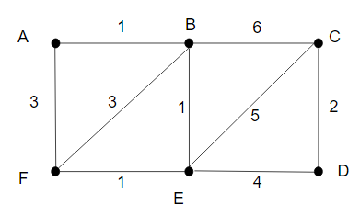
Kruskal's algorithm
Weighted Graph:
A weighted graph refers to an edge-weighted graph, where edges have weights or values.

Slide 118
Kruskal's algorithm
Minimum Spanning Tree:
A minimum spanning tree is a subset of the edges of a connected, edge-weighted graph that connects all the vertices together, without any cycles and with the minimum possible total edge weight.

Slide 119
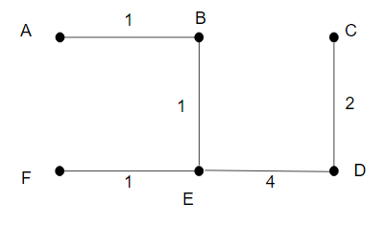
Kruskal's algorithm
Minimum Spanning Tree:
A minimum spanning tree is a subset of the edges of a connected, edge-weighted graph that connects all the vertices together, without any cycles and with the minimum possible total edge weight.

Slide 120
Kruskal's algorithm
KRUSKAL(G):
A = ∅
foreach v ∈ G.V:
MAKE-SET(v)
foreach (u, v) in G.E ordered by increasing order of weight(u, v):
if FIND-SET(u) ≠ FIND-SET(v):
A = A ∪ {(u, v)}
UNION(u, v)
return

Slide 121
Kruskal's algorithm – Step 1
AB, BE, EF, CD, BF, DE, CE, BC

Slide 122
Kruskal's algorithm – Step 2
AB, BE, EF, CD, BF, DE, CE, BC

Slide 123
Kruskal's algorithm – Step 3
AB, BE, EF, CD, BF, DE, CE, BC

Slide 124
Kruskal's algorithm – Step 3
AB, BE, EF, CD, BF, DE, CE, BC
AB
findSet(A) findSet(B)

Slide 125
Kruskal's algorithm – Step 3
AB, BE, EF, CD, BF, DE, CE, BC
AB
findSet(A) findSet(B)
Result: AB

Slide 126
Kruskal's algorithm – Step 3
AB, BE, EF, CD, BF, DE, CE, BC
BE
findSet(B) findSet(E)
Result: AB

Slide 127
Kruskal's algorithm – Step 3
AB, BE, EF, CD, BF, DE, CE, BC
BE
findSet(B) findSet(E)
Result: AB, BE

Slide 128
Kruskal's algorithm – Step 3
AB, BE, EF, CD, BF, DE, CE, BC
EF
findSet(E) findSet(F)
Result: AB, BE

Slide 129
Kruskal's algorithm – Step 3
AB, BE, EF, CD, BF, DE, CE, BC
EF
findSet(E) findSet(F)
Result: AB, BE, EF

Slide 130
Kruskal's algorithm – Step 3
AB, BE, EF, CD, BF, DE, CE, BC
CD
findSet(C) findSet(D)
Result: AB, BE, EF

Slide 131
Kruskal's algorithm – Step 3
AB, BE, EF, CD, BF, DE, CE, BC
CD
findSet(C) findSet(D)
Result: AB, BE, EF, CD

Slide 132
Kruskal's algorithm – Step 3
AB, BE, EF, CD, BF, DE, CE, BC
BF
findSet(B) findSet(F)
Result: AB, BE, EF, CD

Slide 133
Kruskal's algorithm – Step 3
AB, BE, EF, CD, BF, DE, CE, BC
DE
findSet(D) findSet(E)
Result: AB, BE, EF, CD

Slide 134
Kruskal's algorithm – Step 3
AB, BE, EF, CD, BF, DE, CE, BC
DE
findSet(D) findSet(E)
Result: AB, BE, EF, CD, DE

Slide 135
Kruskal's algorithm – Step 3
AB, BE, EF, CD, BF, DE, CE, BC
DE
findSet(D) findSet(E)
Result: AB, BE, EF, CD, DE

Slide 136
Kruskal's algorithm – Time Complexity
KRUSKAL(G):
A = ∅
foreach v ∈ G.V:
MAKE-SET(v)
foreach (u, v) in G.E ordered by increasing order of weight(u, v):
if FIND-SET(u) ≠ FIND-SET(v):
A = A ∪ {(u, v)}
UNION(u, v)
return

Slide 137
Kruskal's algorithm – Time Complexity
KRUSKAL(G):
A = ∅
foreach v ∈ G.V:
MAKE-SET(v)
foreach (u, v) in G.E ordered by increasing order of weight(u, v):
if FIND-SET(u) ≠ FIND-SET(v):
A = A ∪ {(u, v)}
UNION(u, v)
return
O(V)
O(E log E)
O(E)
TOTAL:
O(V) + O(E log E) + O(E)

Slide 138
Kruskal's algorithm – Time Complexity
KRUSKAL(G):
A = ∅
foreach v ∈ G.V:
MAKE-SET(v)
foreach (u, v) in G.E ordered by increasing order of weight(u, v):
if FIND-SET(u) ≠ FIND-SET(v):
A = A ∪ {(u, v)}
UNION(u, v)
return
O(V)
O(E log E)
O(E)
TOTAL:
O(E log E)

Slide 139
neohao@uga.edu Thanks!

