Slide 1
Quantum LLMs
Using Quantum Computing to Analyze and Process Semantic Information
Paper Summary Presentation
Author: Timo Aukusti Laine

Slide 2
Research Motivation
Explore connections between Large Language Models (LLMs) and quantum mechanics
Investigate whether quantum circuits can model semantic similarity
Reduce computational limitations of traditional LLM processing
Introduce complex-valued embeddings with magnitude + phase

Slide 3
Core Idea
Map semantic embeddings into quantum circuits
Use quantum interference and superposition to analyze meaning
Estimate cosine similarity using quantum measurements
Demonstrate experiments on real IBM quantum hardware

Slide 4
LLM Embeddings
Traditional embeddings use real-valued vectors
Cosine similarity measures semantic closeness
Complex embeddings add phase information
Potentially captures richer semantic relationships

Slide 5
Double-Slit Analogy
Paper compares semantic interactions to the double-slit experiment
Semantic contexts behave like interfering quantum waves
Constructive interference → semantic similarity
Destructive interference → semantic dissimilarity

Slide 6
Quantum Circuit Design
Hadamard gate creates superposition
S-gate introduces phase rotation
Quantum probabilities estimate cosine similarity
Each embedding dimension corresponds to qubit operations

Slide 7
Experimental Example
Compared embeddings of 'dog' and 'cat'
Qiskit simulator closely matched theoretical calculations
Demonstrated feasibility of semantic similarity estimation
Quantum results approximated classical cosine similarity

Slide 8
Real Quantum Hardware Test
Used Google EmbeddingGemma sentence transformer
128-dimensional embeddings executed on IBM Quantum Cloud
Quantum cosine similarity: 0.8635
Classical cosine similarity: 0.8682

Slide 9
Challenges
Current quantum hardware is noisy
Large embeddings require many qubits
Decoherence and gate errors reduce accuracy
Quantum advantage is not yet practical

Slide 10
Future Directions
Quantum-enhanced NLP and semantic search
Hybrid quantum-classical language models
Quantum kernels and variational algorithms
Potential reduction in GPU dependence

Slide 11
Conclusion
Paper demonstrates a conceptual bridge between LLMs and quantum mechanics
Quantum circuits can approximate semantic similarity
Research remains exploratory but promising
Future advances in quantum hardware may unlock new NLP capabilities

Slide 12
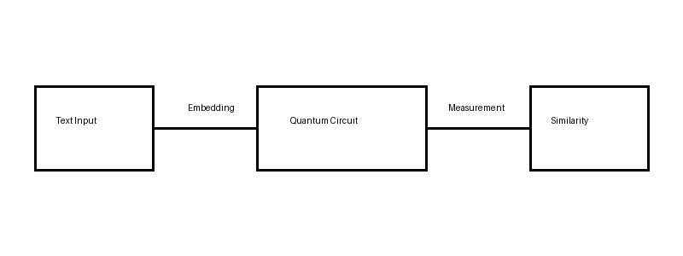
Quantum Semantic Flow

