Slide 1
Fe: RSCAN vs PBE
Lennart Gundelach
30.07.2019
Oxford

Slide 2
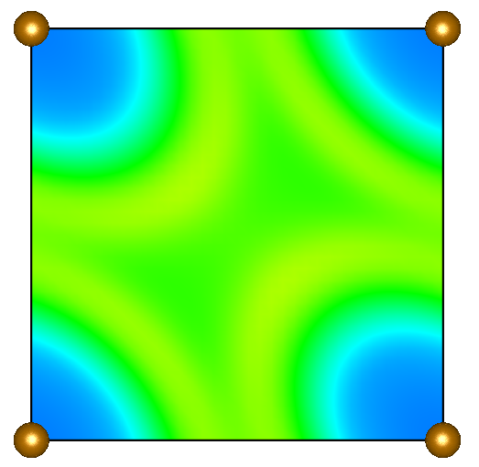
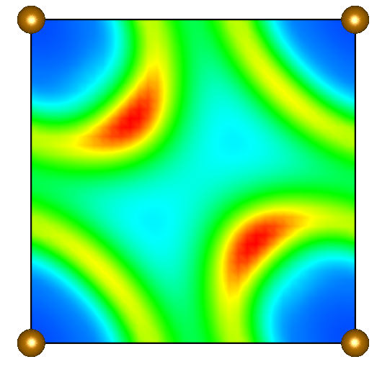
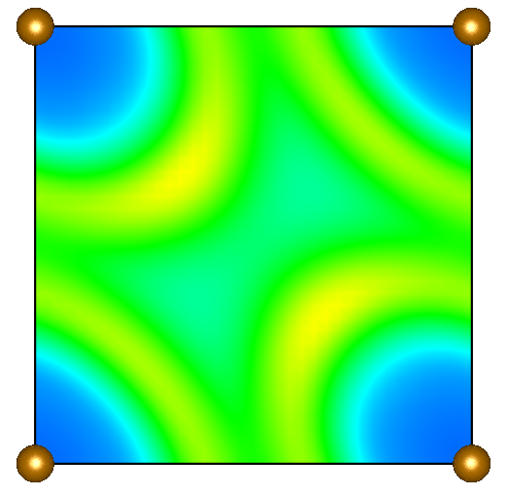
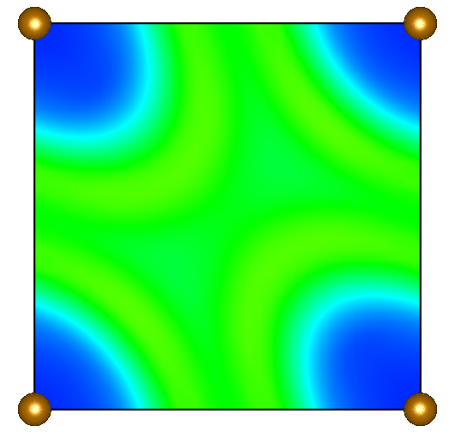
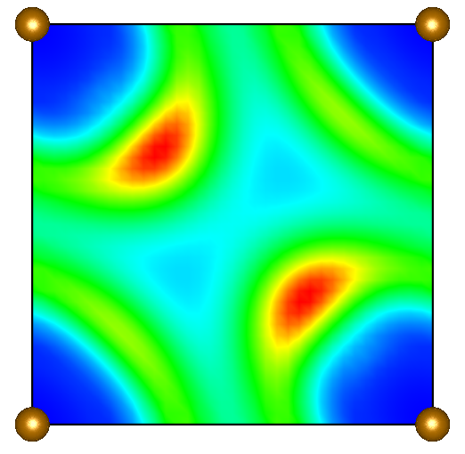
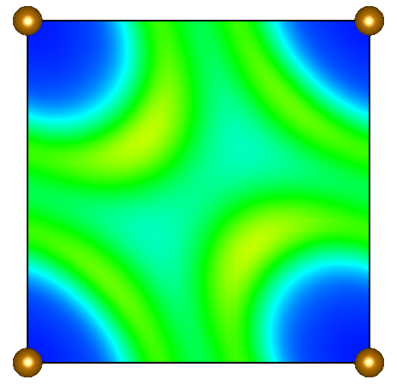
Plane: (100), Distance from origin: 0d
X, spin up
X, spin down
C
RSCAN
PBE

Slide 3
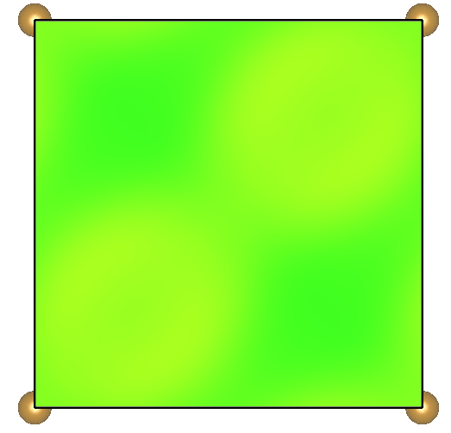
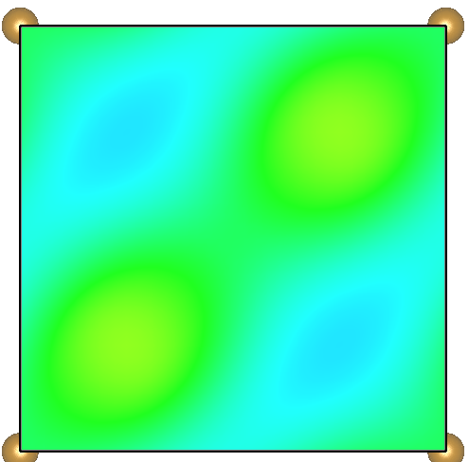
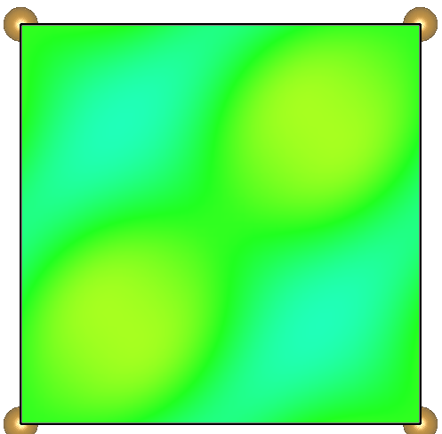
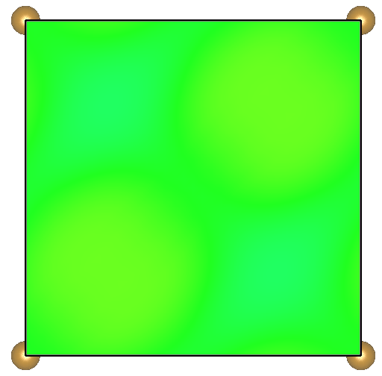

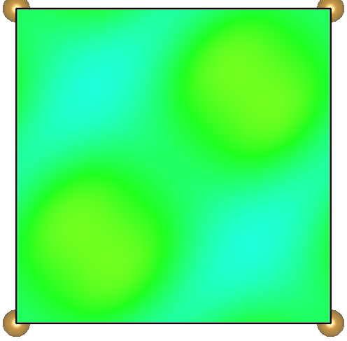
(100), 0.5d
X, spin up
X, spin down
C
RSCAN
PBE

Slide 4
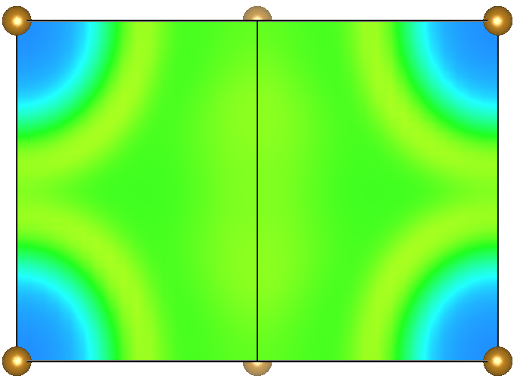
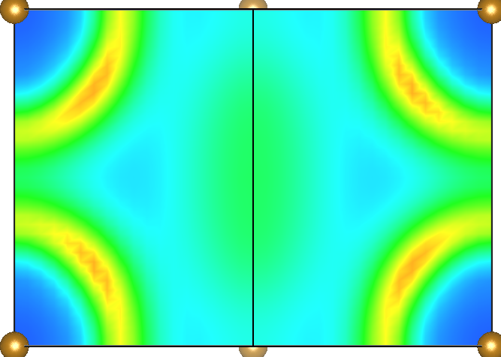
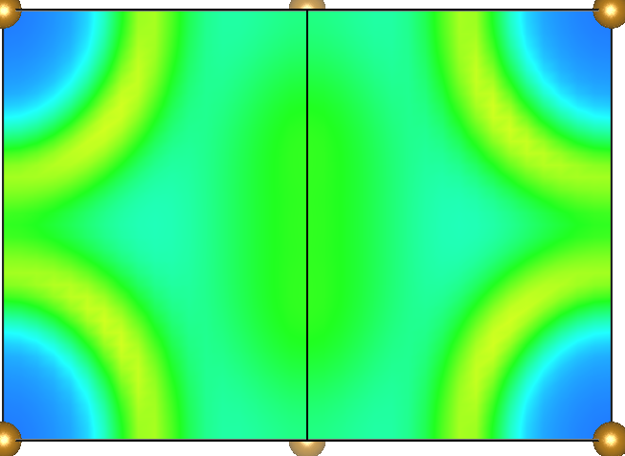
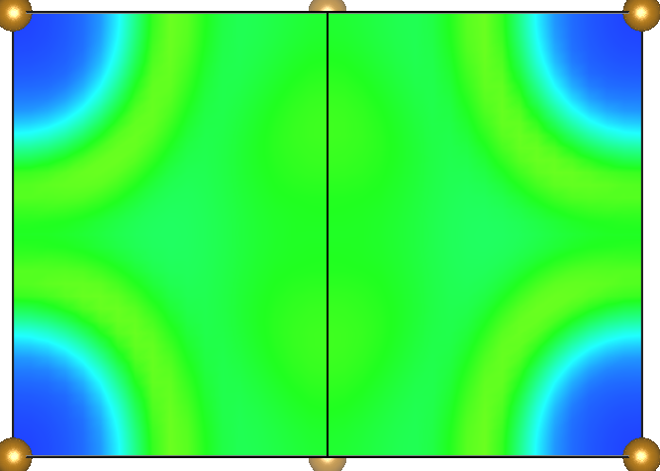
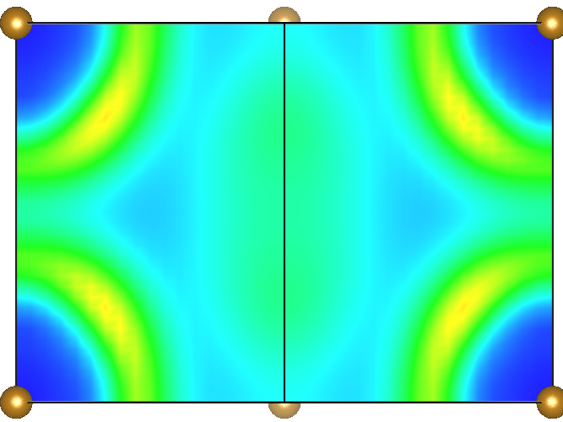
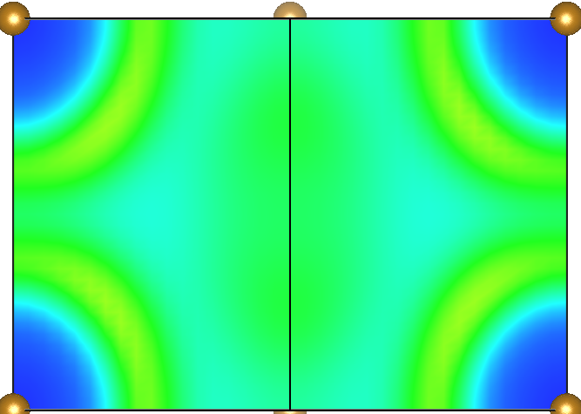
(110), 1d
X, spin up
X, spin down
C
RSCAN
PBE

Slide 5
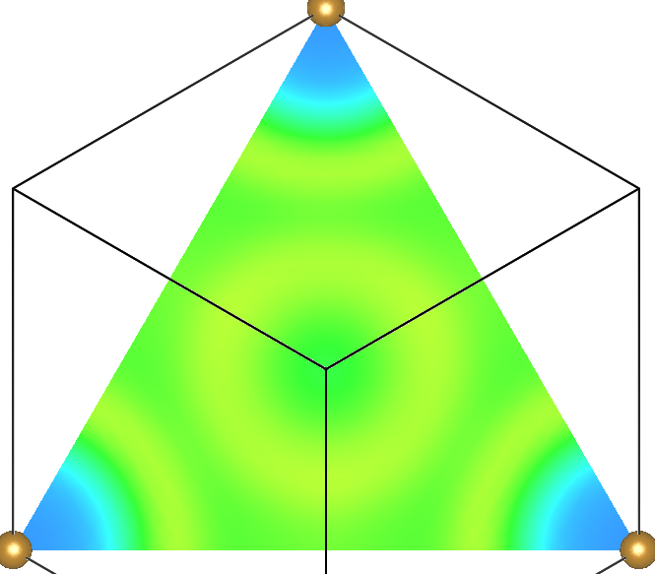
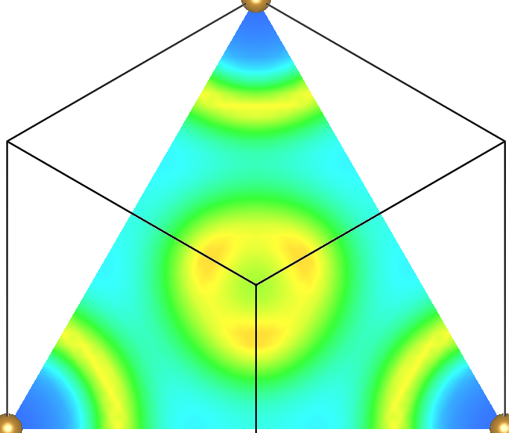

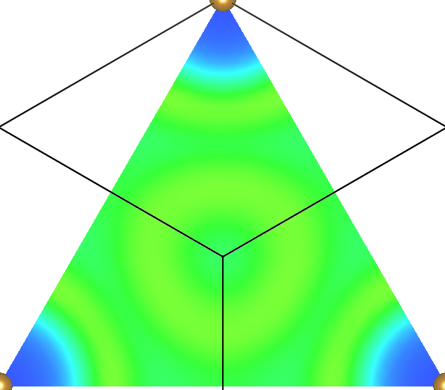
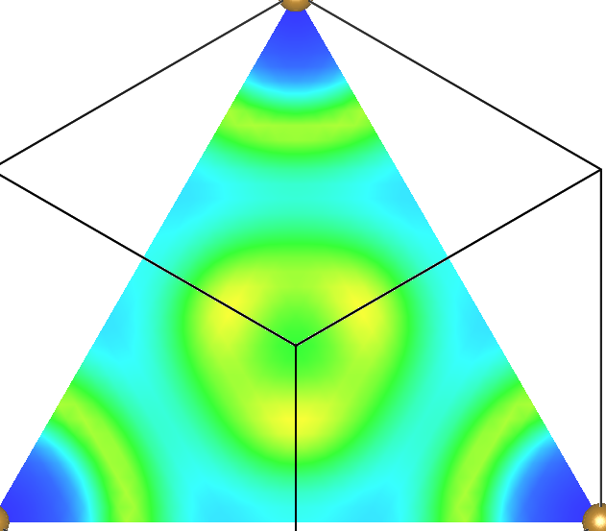
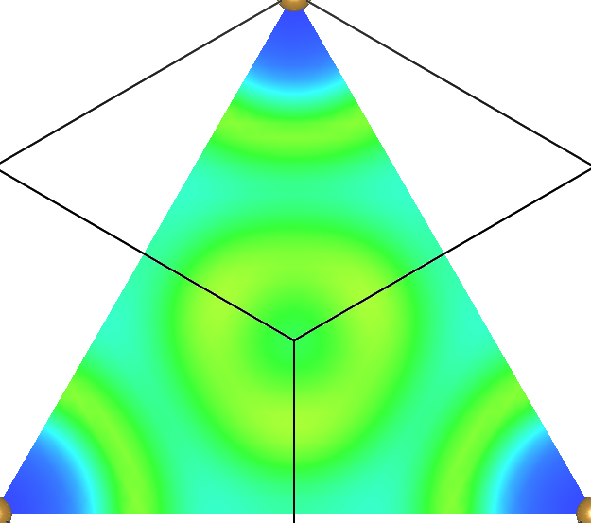
(111), 1d
X, spin up
X, spin down
C
RSCAN
PBE
PBE

Slide 6

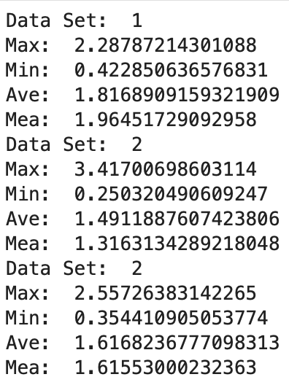
Observations
Shape of spatial patterns same in PBE and RSCAN
Shape of spatial distributions same for X_up, X_down, C
Magnitudes different for X_up, X_down, C
This is supported by summary statistics
see left hand side for alpha(1-3) in Fe using RSCAN

Slide 7
Further Questions
What do the spatial patterns of alpha tell us about local chemistry?
How big is the pseudopotential region and does it correspond to the blue regions of very low alpha surrounding the atom sites?
Why is X_down noticeably large in iron, and can this trend be observed in other materials
If the spatial distributions for alpha(1-3) are so similar, why are the frequency distributions so distinct.
i.e there must be more than just a shift in magnitude between alphas

