Slide 1
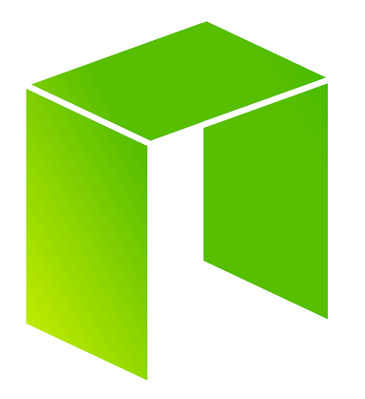
Introduction to NEO
The best choice for
decentralized applications

Slide 2


About me
Malcolm 孟柯 Lerider
Double M.Sc.
Industrial Engineering and Management
Computer Science and Engineering
Software Engineer
Accenture
Team Manager R&D
Webpower
Software Dev. Manager
Webpower
Senior R&D Manager
NEO

Slide 3



What is NEO?
Digital Assets
+
Smart Economy
Digital Identity
+
Smart Contracts

Slide 4
Why haven’t we entered the era of Smart Economy yet?
How much would you use WhatsApp if you had to pay each time you sent a message?
How much would you use Facebook if you had to pay each time you wanted to watch your friends updates?
The above is how other blockchain platforms are structured today!

Slide 5
The problems with PoW and PoS
This structure is however in direct conflict with the interest of decentralized applications.
Many large scale applications need the transactions to be free of charge for the end user, while still ensuring stable service (transaction time). This will always be a conflict of interest for PoW and PoS systems.
Block creators are incentivized by economic rewards
If a transaction do not include a transaction fee, then the block creators have no interest in resolving it.
This is just how PoW and PoS has to be structured. If there is no economic reward in creating blocks, then there will be less nodes participating in the network, directly influencing network security.

Slide 6
NEO is created for large scale dApps
Mainchain speeds
NEO: 1000 – 10 000 tps (single core)
BTC: 3 - 4 tps
ETH: 10 – 20 tps
No transaction fees. Initial 10 GAS fee is for free. Simple Smart Contracts can be run for free.
More freedom to application developers to choose the business model that are most suitable to their business. Service and usage fees can be charged in any way offchain.
Confirmations needed
NEO: 1 and only 1
BTC: 6+
ETH: 20+

Slide 7
 | 手续费 [Gas] |  |  | 手续费 [Gas]
Runtime.CheckWitness | 0,2 |  | OpCode.PUSH16 [or less] | 0
Blockchain.GetHeader | 0,1 |  | OpCode.NOP | 0
Blockchain.GetBlock | 0,2 |  | OpCode.APPCALL | 0,01
Blockchain.GetTransaction | 0,1 |  | OpCode.TAILCALL | 0,01
Blockchain.GetAccount | 0,1 |  | OpCode.SHA1 | 0,01
Blockchain.GetValidators | 0,2 |  | OpCode.SHA256 | 0,01
Blockchain.GetAsset | 0,1 |  | OpCode.HASH160 | 0,02
Blockchain.GetContract | 0,1 |  | OpCode.HASH256 | 0,02
Transaction.GetReferences | 0,2 |  | OpCode.CHECKSIG | 0,1
Account.SetVotes | 1 |  | OpCode.CHECKMULTISIG [per signature] | 0,1
Validator.Register | 1000 |  | 其它（每行OpCode） | 0,001
Asset.Create （system asset） | 5000
Asset.Renew （system asset） | 5000
Contract.Create | 500
Contract.Migrate | 500
Storage.Get | 0,1
Storage.Put [per KB] | 1
Storage.Delete | 0,1
其它（每行OpCode） | 0,001
docs.neo.org (tutorials on C#, Java and Python)

Slide 8
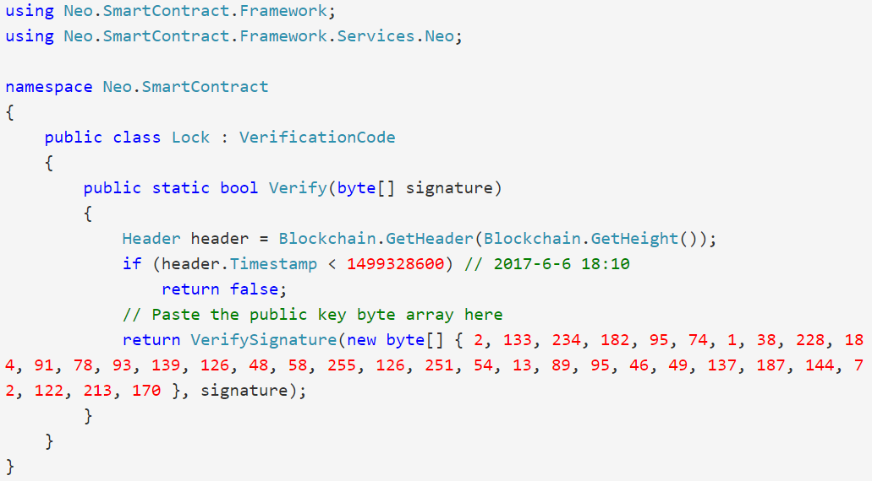
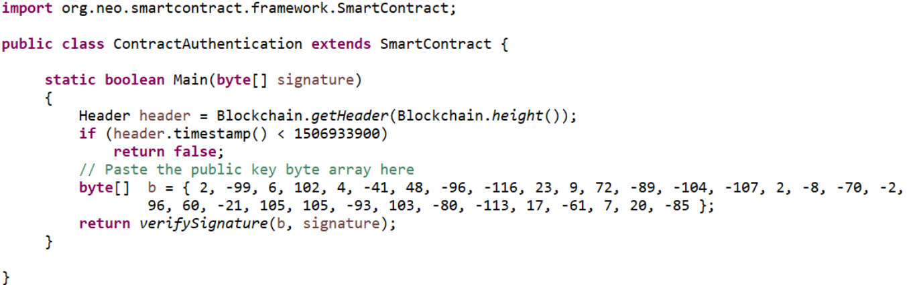

Slide 9

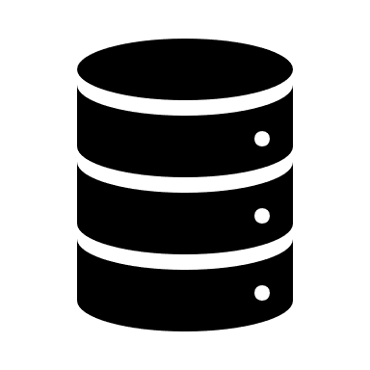


NeoX: Allowing private-public chains
ONT
DNA
ONT
ONT
DNA
DNA

Slide 10
Summary
For large scale decentralized applications, transaction cost, transaction time (including confirmations) is a big obstacle and restriction to possible business models.
NEO is built for large scale dApps and is free to use for the end user. Fees (GAS) are instead charged for deploying contracts and registering assets.
Transaction volume is not an issue with 1000+ tps on main chain and plenty off-chain scaling possibilites.
NeoX will make the NEO ecosystem quite unique. NEO contain the public ledger for digital assets, identity and smart contracts.

Slide 11
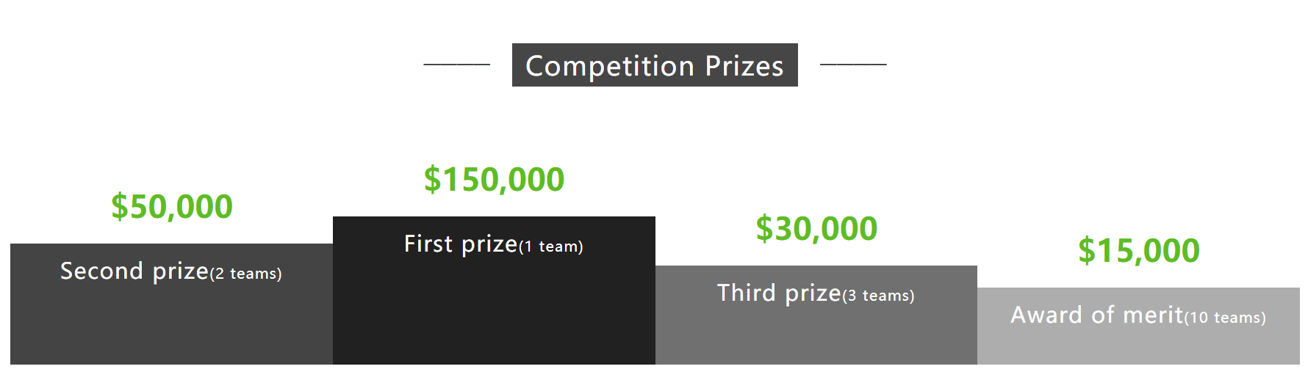
Competition www.neo.org/competition.html

Slide 12
www.neo.org
docs.neo.org
malcolm@neo.org
github.com/neo-project
github.com/CityOfZion
github.com/NewEconoLab discord.gg/GmT2Z29

