Slide 2
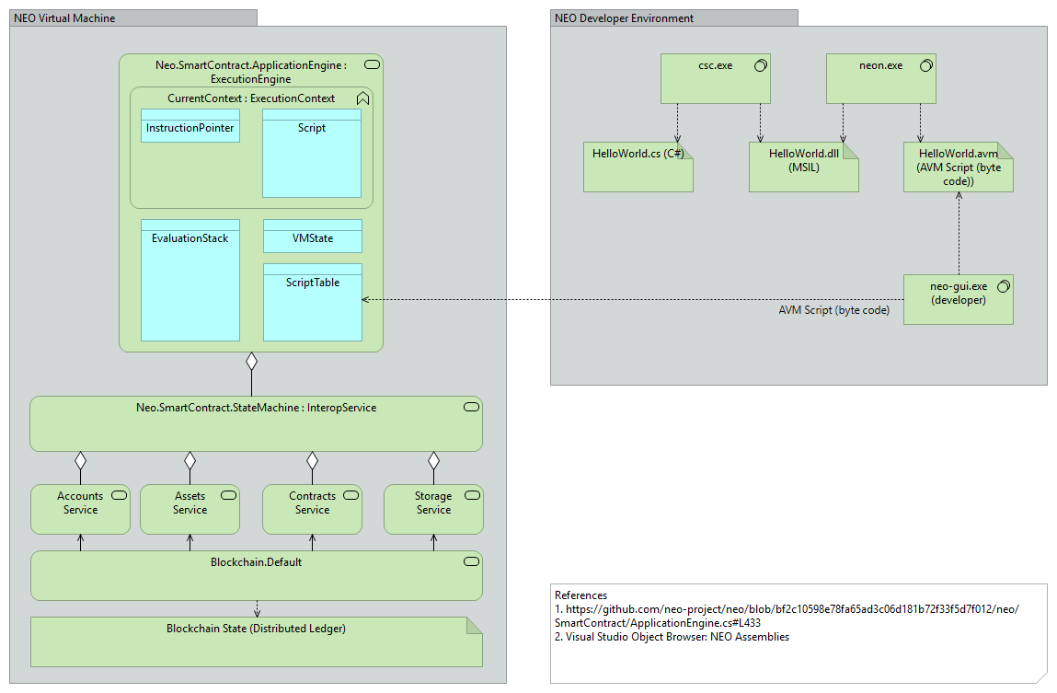
G
H
B
D
J
I
K
A
C
E
M
F
L
N
O
P
Q
R
S
T
U

