Slide 1
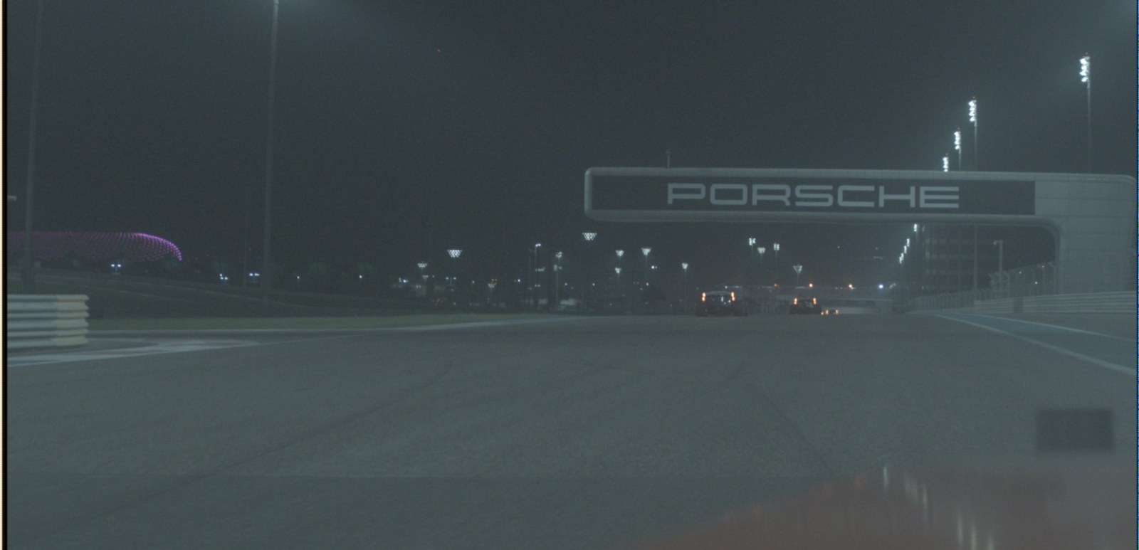
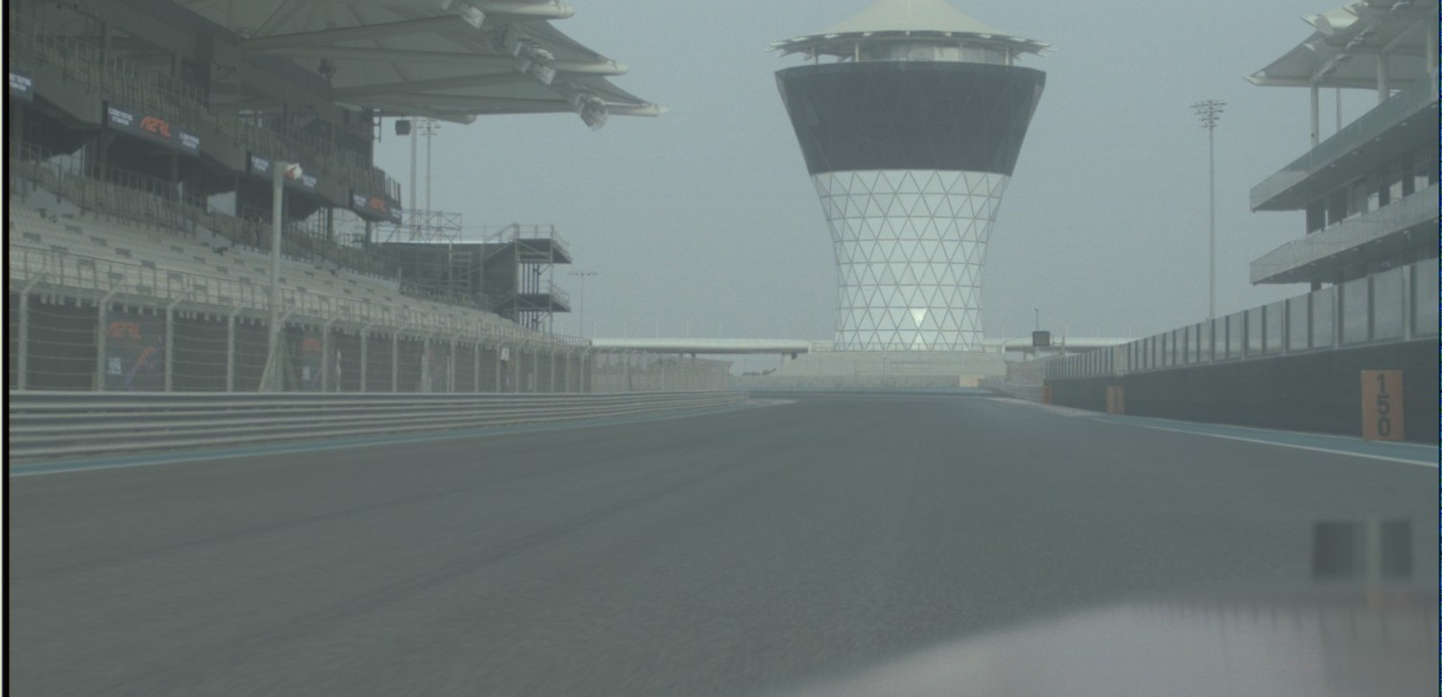
Where is the car?
NATIONAL AI HACKATHON 2026 · CONSTRUCTOR LABS CHALLENGE
Team name: fill in
Cameras only. No GNSS, no LiDAR, no peeking at future frames.
Night · 39 m/s
Daylight sample
Training: 1194 s of night driving
Hidden test: may be faster, in different light
10 Hz
one pose for every camera frame
4 m
driven between two frames at 40 m/s
< 1 m
sideways accuracy needed to hold a racing line
Camera-only localization of a race car · Constructor Labs challenge
1 / 6
Notes:
Picture a race car at forty metres per second, at night. Between two camera frames it has travelled four metres. We have to say where it is, to under a metre sideways, using cameras only: no GPS, no lidar. And the estimate may only use images up to now, which is what causal means, exactly as on the real car.
Our training recording is a night session, on the left. But the hidden test may be faster and in different light, like the daylight sample on the right. So the problem is really two problems: locate precisely, and do it in light we have never labelled.
Next: our idea in one picture.

Slide 2
Recognise the place. Track the motion. Fuse both.
OUR IDEA
WHAT THE CAMERAS SEE
4 cameras
Front and side views, cropped to the track
Place network
ResNet-18 turns each view into a 256-number fingerprint
Map lookup
Finds the most similar training views near our estimate
Kalman filter
Predicts with the motion, then corrects with the map match.
Each is weighted by how much it is trusted.
Pose
x, y, heading, 10 times a second
HOW THE CAR MOVED
Car telemetry
Speed and turn rate, as the rules allow
Dead reckoning
Adds up distance and turning since the last frame
Cross-check
Motion learned from camera pairs is the backup
In plain words: Fingerprint
A list of 256 numbers describing a view. Similar views give similar numbers.
In plain words: Map
Every training frame stored with its fingerprint and its known position, night and synthetic daylight.
In plain words: Kalman filter
A standard way to blend a prediction with a measurement, trusting each by its confidence.
Camera-only localization of a race car · Constructor Labs challenge
2 / 6
Notes:
Here is the whole system. Top lane, the cameras. A neural network turns each view into a fingerprint, a list of 256 numbers; similar views give similar fingerprints. We built a map from the training laps: each frame's fingerprint with its known position. Looking one up tells us roughly where we are.
Bottom lane, the car's own speed and turn rate, which the rules allow. They say how far we moved, whatever the light. Motion learned from camera pairs is the backup.
A Kalman filter blends both, trusting each by its confidence, and outputs x, y and heading ten times a second.
Next: why each part is there.

Slide 3
Each known difficulty gets a specific answer
HOW IT HANDLES THE HARD PARTS
THE DIFFICULTY
OUR ANSWER
WHEN IT RUNS
Trained at night, tested in unknown light
Synthetic daylight for training
A CycleGAN turns night frames into daylight look-alikes; the map stores both.
training only
Look-alike straights
Learn places, then trust by similarity
Training pairs show one place on different laps. Weak matches count less; only nearby matches are averaged.
training + filter
4 m between frames, blur, cameras out of sync
Strictly causal camera sync
Each camera supplies its newest image stamped no later than now. A learned gate weights the four views.
every frame
Drift, and getting lost
Motion from the car, global re-lock
Speed and turn rate drive the prediction. Three confident matches elsewhere trigger a re-lock.
every frame
Training-only parts add no cost at run time. These are design choices; the next slide shows the one measured result we have.
Camera-only localization of a race car · Constructor Labs challenge
3 / 6
Notes:
Each part answers a difficulty the organisers named.
Night versus unknown light: a CycleGAN turns our night frames into synthetic daylight. That is training only, so it costs nothing at run time.
Look-alike straights: we train on same-place, different-lap pairs and trust a weak match less.
Timing: a tenth of a second is four metres, so each camera contributes only its newest image no later than now.
Drift and getting lost: motion comes from the car, and several confident matches elsewhere trigger a re-lock. We do not assume a start pose: we track twenty-four candidates and keep the best.
Now the evidence.

Slide 4
Measure first: a filter fix cut the error by 44%
EVIDENCE
Position error in metres (lower is better)
−44%
position error, with no retraining: two filter trust settings changed
98%
of the squared error was along the track
9.0 to 1.5 m
median error
12.8% to 32.8%
of frames within 1 m of the truth
Final pipeline: fill in
Validation position RMSE
fill in
Across-track (lateral) RMSE
fill in
Time per frame
fill in
Held-out validation, earlier pipeline version (git tags rmse-24.508 and rmse-13.688). Sources: README.md, brainstorming_and_diagnostics.md.
Hardware
fill in
Camera-only localization of a race car · Constructor Labs challenge
4 / 6
Notes:
Before adding anything, we measured. An offline diagnostic tool, never part of the submission, showed 98 percent of the squared error was along the track. The filter trusted its motion too much and the map match too little.
Re-weighting two settings, with no retraining, cut position error from 24.5 to 13.7 metres, minus 44 percent. The median fell from 9.0 to 1.5 metres. Error across the track stayed near 3 metres, as predicted.
Those figures are from the earlier pipeline. For the final one: validation error [FILL IN: final validation position RMSE], and [FILL IN: ms per frame] per frame on [FILL IN: hardware].
Next: where it still fails.

Slide 5
Where it still fails, and why
FAILURE CASES
Look-alike straights
Places not on the map
Unseen daylight
true
estimate
parked here at the end
?
along-track error
in the map
not in the map
night
synthetic
real day
Along-track error dominated: 98% of the early squared error. After tuning, 5% of frames are still more than 20 m off.
An earlier validation run ended parked on an unmapped spot: 88% of its squared error came from the last 9 seconds.
Synthetic daylight is generated, not measured. The daylight sample has no ground-truth poses to score against.
Response: trust the map match more. Next: match short sequences of views.
Response: similarity check, hold-still rule, global re-lock. Not yet re-measured.
Response: lighting augmentation and night-to-day data; check speed against recorded telemetry.
Sources: README.md and brainstorming log (98%, 20 m); chats/astra.md debugging log (88%, 9 s); problem statement (daylight test).
Camera-only localization of a race car · Constructor Labs challenge
5 / 6
Notes:
Three failure cases, honestly.
One, look-alike straights. Along-track error is still our weak spot: even after tuning, five percent of frames are still more than twenty metres off.
Two, places the map has never seen. In an earlier validation run the car ended parked on an unmapped spot, and nearly nine-tenths of the squared error came from the last nine seconds. We have since added a similarity check, a hold-still rule and a global re-lock, but we have not re-measured that yet.
Three, daylight. Our synthetic daylight is generated, not measured, and the daylight sample has no ground-truth poses to score against.
Lessons next.

Slide 6
Lessons learned and what comes next
LESSONS
Diagnose before you train
An offline tool that may use ground truth showed the fault was the filter, not the network.
NEXT
1
Short sequences of views
instead of one frame at a time
2
Calibrated trust beats a bigger model
Two re-weighted settings gave minus 44%, with no retraining.
Geometric refinement
once the place is known: the path to sub-metre
3
Use every signal the rules allow
The car's speed and turn rate do not depend on light.
Pick the best checkpoint
by trajectory error, not the last epoch
Declared pre-trained model: ImageNet ResNet-18 (torchvision). Unlabelled daylight-sample frames train the night-to-day translator.
Code, README and requirements.txt are in the repository.
Repo link: fill in
Camera-only localization of a race car · Constructor Labs challenge
6 / 6
Notes:
Three lessons. Diagnose before you train: one offline tool told us the fault was the filter, not the network. Calibrated trust beats a bigger model: two settings gave minus forty-four percent. And use every signal the rules allow: the car's speed and turn rate do not depend on light.
Next, we would match short sequences of views instead of single frames, and refine the position geometrically once the place is known, which is the path to sub-metre accuracy.
Everything is in the repository with a README and requirements. The one pre-trained model is ImageNet ResNet-18, declared here, and daylight-sample frames are used as unlabelled pixels only.
Thank you.

