Slide 1
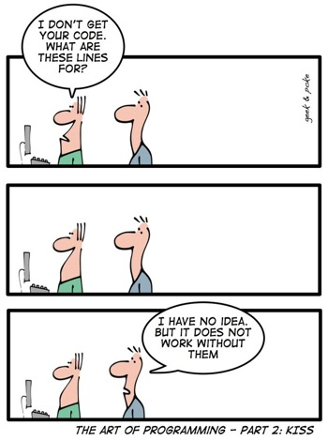
巨量資料產業實務個案 R 101
曾意儒 助理教授
長庚大學 資訊管理學系

Slide 2
Outlines
Why R?
R Programming

Slide 3
Why R?

Slide 4
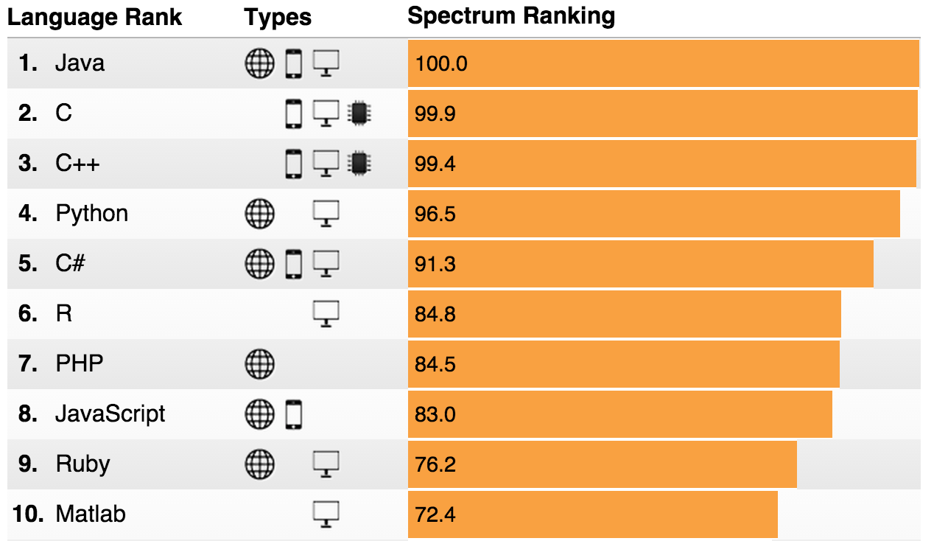
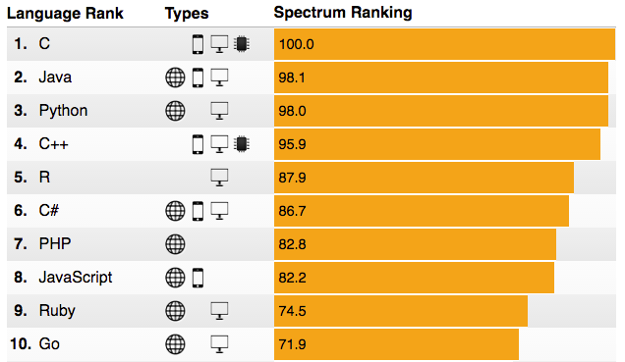
R 5th Place in IEEE Language Rankings
2015
2016
http://spectrum.ieee.org/computing/software/the-2016-top-programming-languages

Slide 5
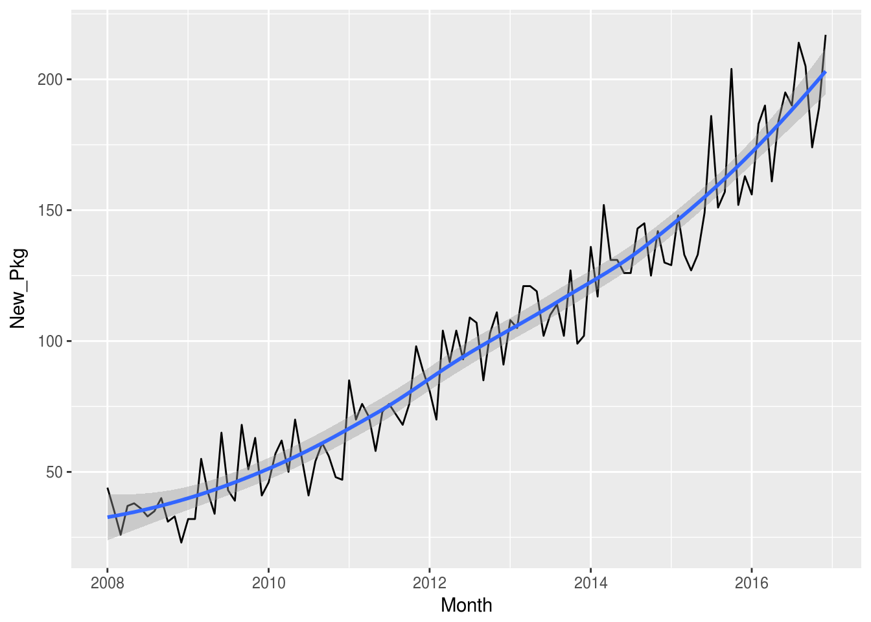
More Than 10,000 Packages!
Standing on the shoulders of giants - Hal R. Varian, Google
To load data
To manipulate data
To visualize data
To model data
To report results
For spatial data
For time series and financial data
To write high performance R code
To write your own R packages
https://www.rstudio.com/rviews/2017/01/06/10000-cran-packages/
https://support.rstudio.com/hc/en-us/articles/201057987-Quick-list-of-useful-R-packages

Slide 6
R statistics,
SAS statistics, and
python statistics Job Trends
@indeed.com
SAS ↓
R & python ↑
https://www.indeed.com/jobtrends/q-R-statistics-q-SAS-statistics-q-python-statistics.html

Slide 7
R的起源
S Language
John Chambers @ Bell’s Lab, 1976
R Language
Ross Ihaka, Robert Gentleman @ University of Auckland, 1993
2000 R 1.0.0

Slide 8
R Programming
搭配 http://yijutseng.github.io/DataScienceRBook/

Slide 9
軟體安裝
R
https://www.r-project.org/
RStudio
IDE for R
https://www.rstudio.com/
詳細安裝步驟
http://yijutseng.github.io/DataScienceRBook/install.html

Slide 10
Course Materials
課程相關資料
https://github.com/yijutseng/CGMH_R
網頁投影片: xx.html
可列印/複製程式碼: xx.md
搭配電子書
http://yijutseng.github.io/DataScienceRBook/
上課用資料
https://www.dropbox.com/s/27ofk62ekn4cbk2/Data.zip

Slide 11
Questions?

