Slide 1
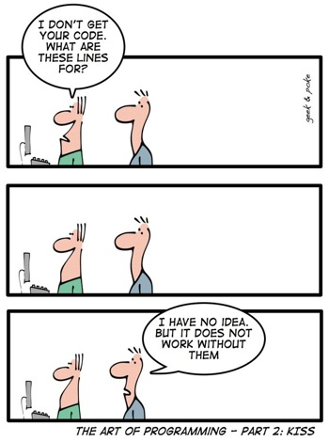
巨量資料產業實務個案 R 101
曾意儒 助理教授
長庚大學 資訊管理學系
https://sites.google.com/gap.cgu.edu.tw/emba-bigdata/

Slide 2
Outlines
Why R?
R Programming
軟體安裝
R 101
Data structure
If-else

Slide 3
Why R?

Slide 4
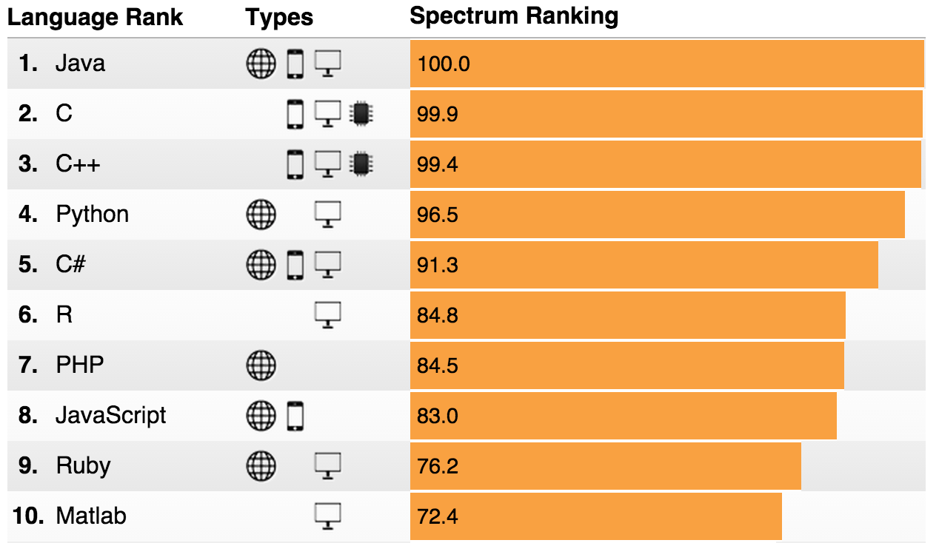
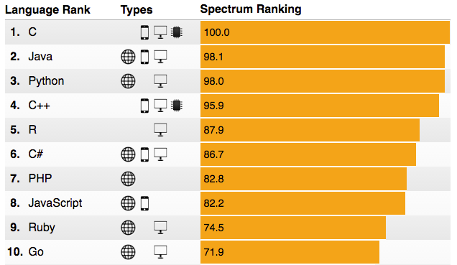
R 5th Place in IEEE Language Rankings
2015
2016
http://spectrum.ieee.org/computing/software/the-2016-top-programming-languages

Slide 5
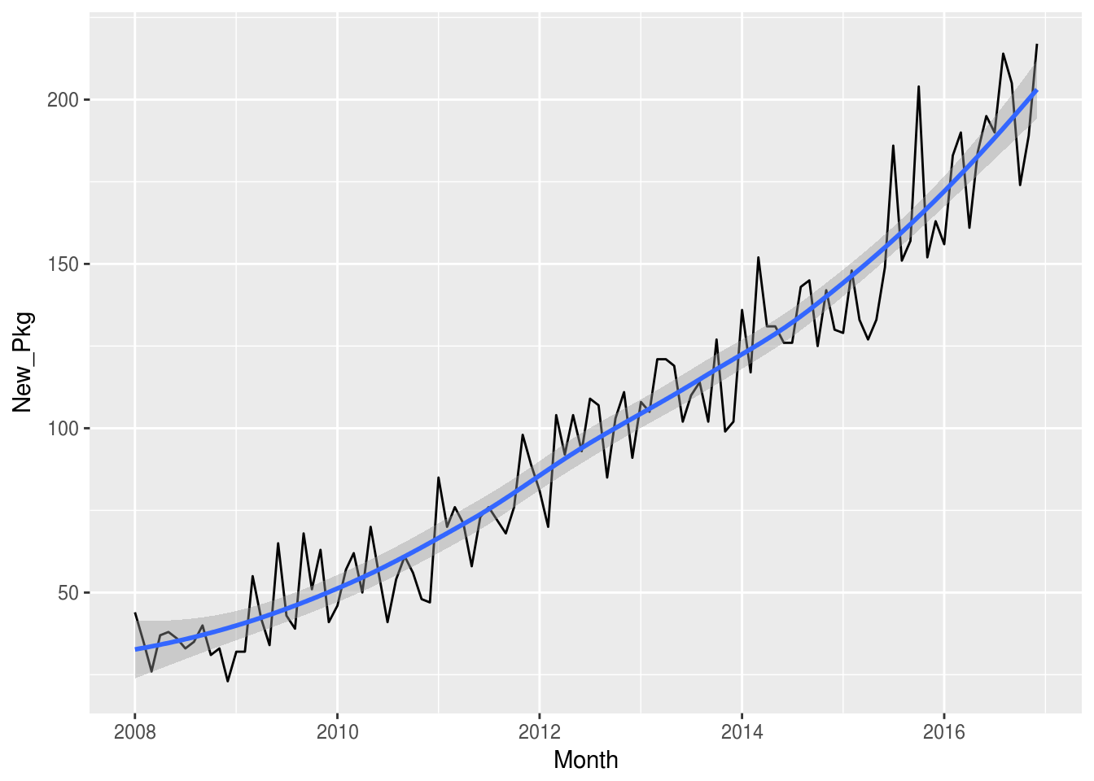
More Than 10,000 Packages!
Standing on the shoulders of giants - Hal R. Varian, Google
To load data
To manipulate data
To visualize data
To model data
To report results
For spatial data
For time series and financial data
To write high performance R code
To write your own R packages
https://www.rstudio.com/rviews/2017/01/06/10000-cran-packages/
https://support.rstudio.com/hc/en-us/articles/201057987-Quick-list-of-useful-R-packages

Slide 6
R statistics,
SAS statistics, and
python statistics Job Trends
@indeed.com
SAS ↓
R & python ↑
https://www.indeed.com/jobtrends/q-R-statistics-q-SAS-statistics-q-python-statistics.html

Slide 7
R的起源
S Language
John Chambers @ Bell’s Lab, 1976
R Language
Ross Ihaka, Robert Gentleman @ University of Auckland, 1993
2000 R 1.0.0

Slide 8
R Programming
搭配 http://yijutseng.github.io/DataScienceRBook/

Slide 9
軟體安裝
R
https://www.r-project.org/
RStudio
IDE for R
https://www.rstudio.com/
詳細安裝步驟
http://yijutseng.github.io/DataScienceRBook/install.html

Slide 10
Questions?

