Slide 1
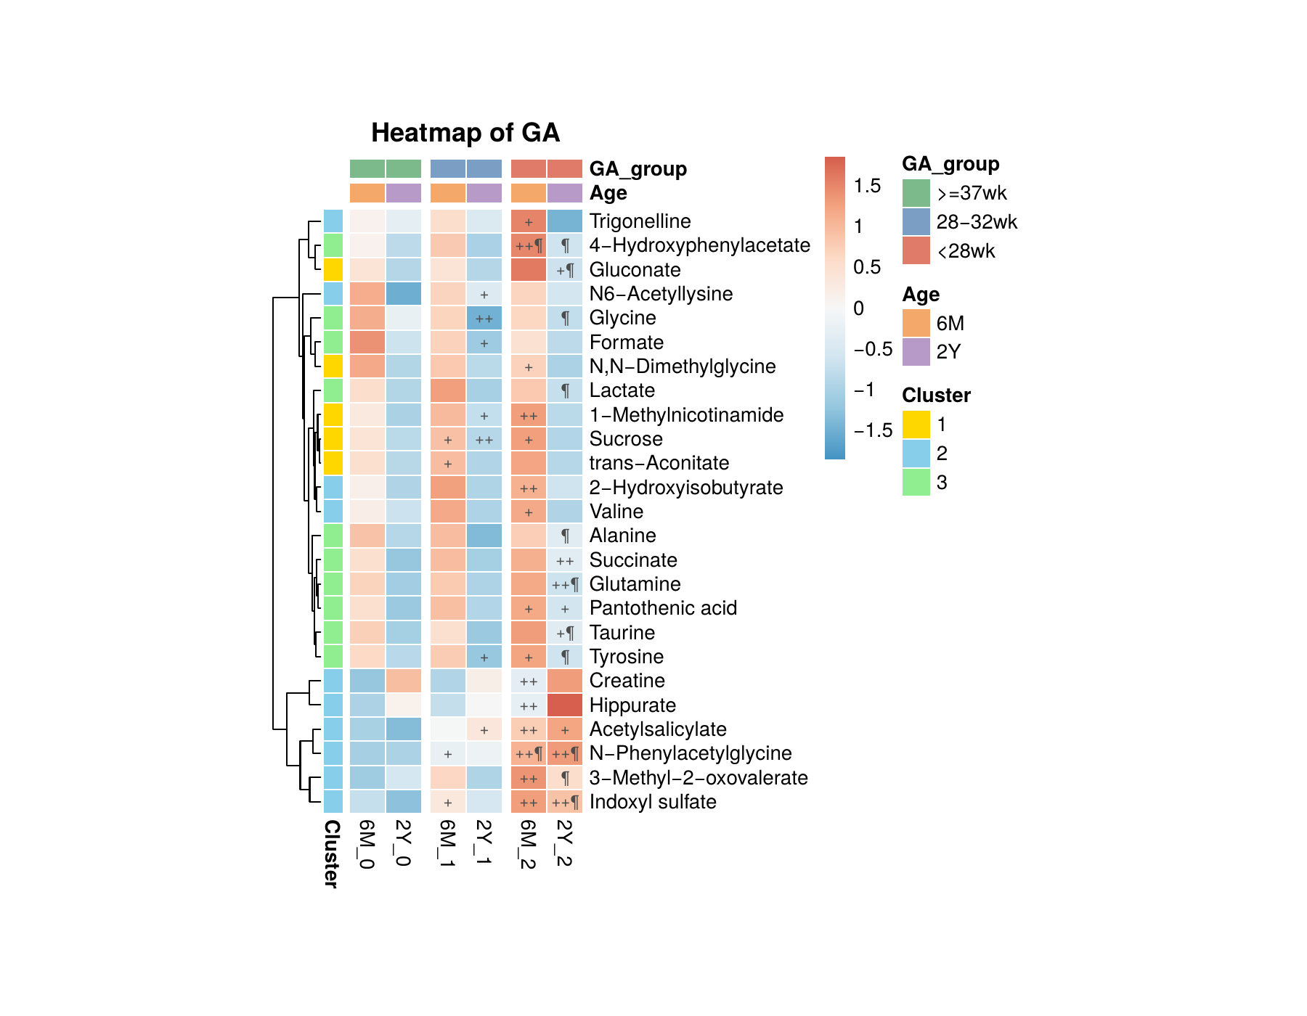
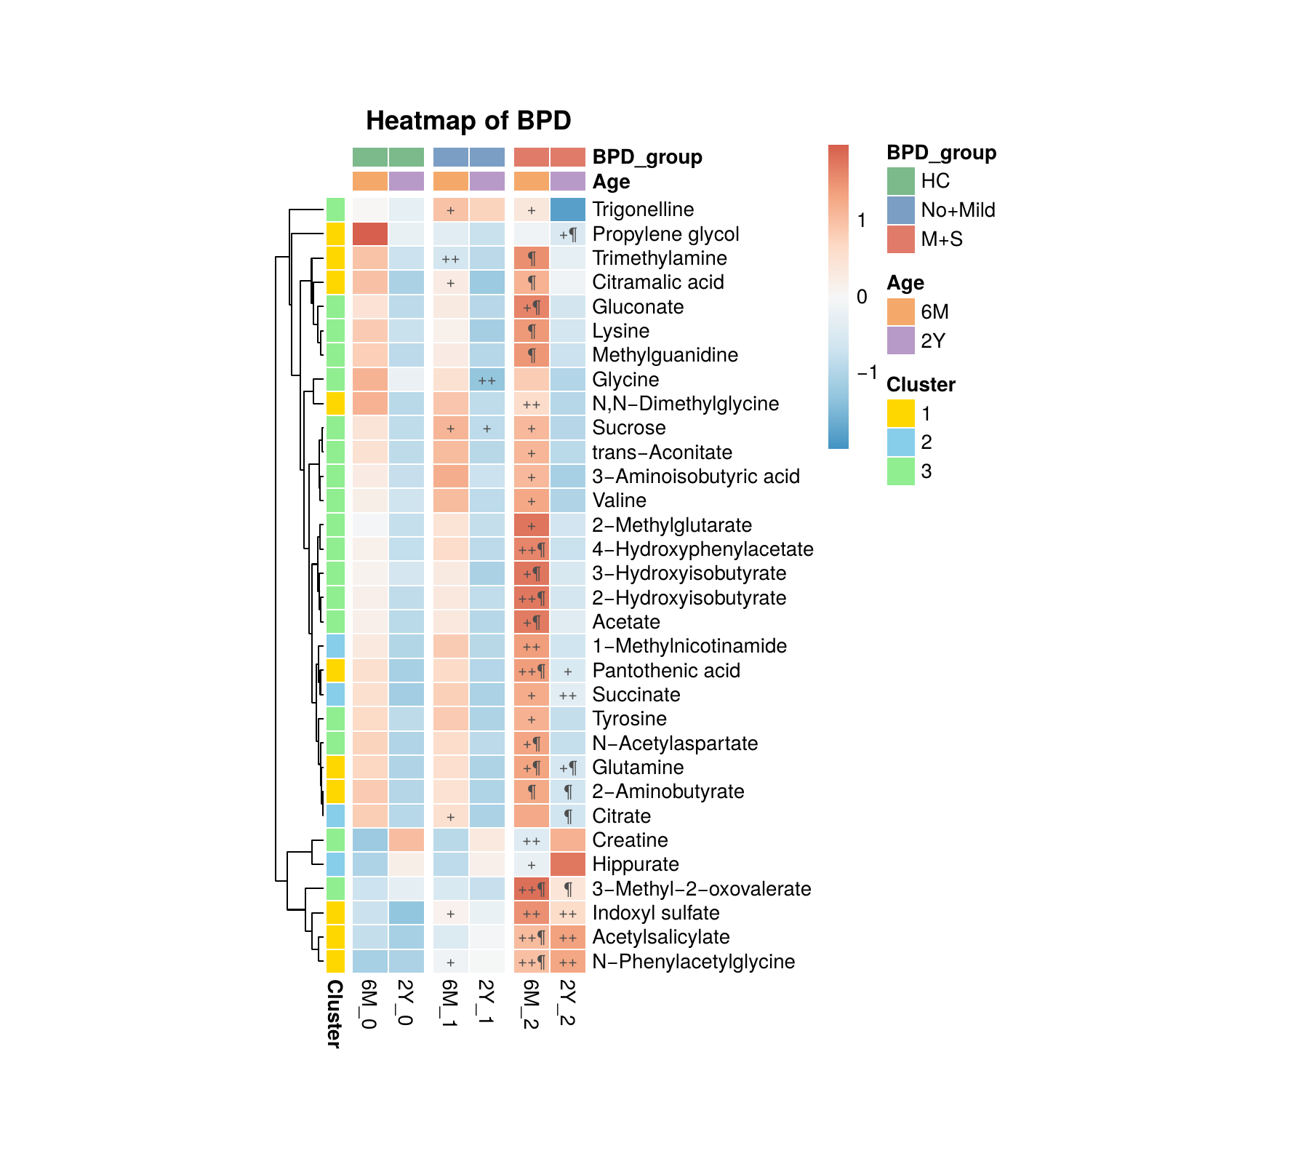
Longitudinal Urinary Metabolomics in Preterm Infants
Associated with Gestational Age and BPD Severity from 6 Months to 2 Years of Age
CGMH LINKOU
Meng-Han Chiang¹ │ Chih-Yung Chiu¹²*
¹Multi-omics Core Laboratory, Chang Gung Memorial Hospital at Linkou, Taoyuan, Taiwan
²Division of Pediatric Pulmonology, Department of Pediatrics, Chang Gung Memorial Hospital at Linkou, and Chang Gung University, Taiwan
*Corresponding author: pedchestIC@gmail.com │ Metabolomics 2026
INTRODUCTION
KEY FINDINGS
KEY FINDINGS (CONT.)
Bronchopulmonary dysplasia (BPD) is a chronic lung disease predominantly affecting preterm infants requiring mechanical ventilation or supplemental oxygen. Despite clinical improvement within the first two years, the longitudinal trajectory of urinary metabolic alterations — and their associations with gestational age (GA) and BPD severity — remains insufficiently characterized. This study identified urinary metabolomic profiles at 6 months (6M) and 2 years (2Y) of corrected age across GA and BPD severity groups using ¹H-NMR spectroscopy.
1 — Expanding metabolic burden
5 — Consistent biomarker panel
16 and 18 metabolites associated with GA, and 30 and 12 with BPD severity, at 6M and 2Y (P<0.05). Marked contraction of BPD-associated metabolites from 6M to 2Y suggests a shifting metabolic landscape despite clinical improvement.
N-PAG, indoxyl sulfate, acetylsalicylate, glutamine, pantothenic acid, and succinate were associated with GA and/or BPD at both 6M and 2Y — the most temporally consistent metabolic alterations identified.
2 — Gut microbiome signature at 6M
6 — Persistent pathway disruption
3-MOV, 4-hydroxyphenylacetate, indoxyl sulfate, and N-PAG significantly elevated in GA<28 wk vs. full-term (P<0.001); also elevated in M+S BPD vs. HC (P<0.001), pointing to early gut dysbiosis in extremely preterm infants.
Alanine/aspartate/glutamate (FDR<0.05 at 6M) and glyoxylate/dicarboxylate metabolism remained enriched at both timepoints. Valine/leucine/isoleucine biosynthesis enriched at both 6M and 2Y, consistent with 3-MOV signal.
3 — Persistence and amplification to 2Y
TABLE 1 — DEMOGRAPHICS (GA GROUPS)
N-PAG and indoxyl sulfate remained elevated at 2Y with higher fold changes (N-PAG: 1.82 vs 1.76; indoxyl sulfate: 1.73 vs 1.57), suggesting metabolic divergence intensifies over time despite apparent clinical recovery.
Characteristic | ≥37 wk (n=50/40) | 28–32 wk (n=48/37) | <28 wk (n=41/38) | P
GA (wk) | 39.1±0.8 / 39.0±0.9 | 30.7±0.9 / 30.8±0.9 | 26.1±1.4 / 26.2±1.3 | <0.001
Birth wt (g) | 3136±348 / 3147±385 | 1352±276 / 1374±224 | 782±205 / 772±183 | <0.001
Body wt (kg) | 7.9±0.8 / 12.3±1.6 | 7.8±1.4 / 11.4±1.7 | 7.0±1.5 / 10.6±1.5 | 0.003 / <0.001
BMI (kg/m²) | 17.2±1.1 / 16.0±1.3 | 17.7±2.4 / 15.6±1.4 | 16.5±1.8 / 14.9±1.4 | 0.019 / 0.002
Breastfed ≥6M (%) | 56.8 / 60.0 | 30.0 / 43.2 | 44.7 / 44.7 | 0.047 / 0.261
Sepsis (%) | 2.3 / 0.0 | 30.0 / 32.4 | 81.1 / 81.1 | <0.001
METHODS
4 — Complete metabolic overlap at 6M
Study Population:
All 16 GA-significant metabolites at 6M were also BPD-significant — zero GA-exclusive metabolites. Prematurity and BPD severity share an indistinguishable urinary metabolic signature at 6 months corrected age.
140 preterm (<32 wk) and full-term (≥37 wk) infants prospectively enrolled (2019 NICHD BPD criteria). 254 urine samples: 6M (n=139), 2Y (n=115).
Stratification:
GA: ≥37 wk (controls), 28–32 wk, <28 wk BPD: Healthy controls (HC), No+Mild BPD, Moderate+Severe (M+S) BPD
Values: mean±SD or % (6M / 2Y). Bold P < 0.05 is significant. GA, gestational age; BMI, body mass index.
¹H-NMR Processing:
Spectra processed via NMRProcFlow. Metabolites identified with Chenomx 8.1. Intensities normalized to urinary creatinine.
Statistics:
Kruskal-Wallis test • Mfuzz clustering • MetaboAnalyst pathway ORA (Fisher’s exact + Benjamini-Hochberg FDR)
Figure 1A. Urinary metabolites significantly associated with gestational age (GA).
Figure 1B. Urinary metabolites significantly associated with BPD severity.
PATHWAY ENRICHMENT ANALYSIS
CONCLUSIONS
Group | Pathway | Hits / Total | Raw P | FDR | Function
6M BPD only | Ala, Asp & Glu metabolism | 4 / 28 | <0.001 | <0.001 | Amino acid
6M BPD only | Glyoxylate & dicarboxylate metabolism | 3 / 32 | <0.001 | 0.023 | Carbohydrate
6M GA+BPD | Val/Leu/Ile biosynthesis | 2 / 8 | <0.001 | 0.063 | Amino acid
2Y GA only | Tyrosine metabolism | 2 / 42 | 0.017 | 0.792 | Amino acid
2Y GA only | Taurine & hypotaurine metabolism | 1 / 10 | 0.040 | 0.792 | Other AA
2Y GA+BPD | Ala, Asp & Glu metabolism | 2 / 28 | 0.004 | 0.223 | Amino acid
2Y GA+BPD | Glyoxylate & dicarboxylate metabolism | 2 / 32 | 0.006 | 0.223 | Carbohydrate
• Metabolic signatures of prematurity and BPD persist from 6M to 2Y and may intensify over time.
• Gut microbiome-derived metabolites (N-PAG, indoxyl sulfate) consistently elevated in extremely preterm and M+S BPD infants.
• Complete GA–BPD metabolic overlap at 6M followed by divergence at 2Y underscores evolving, BPD-specific dysregulation.
• Persistently enriched amino acid pathways implicate disrupted nitrogen metabolism beyond the acute BPD phase, with implications for biomarker identification and therapeutic intervention.
ORA: Fisher’s exact test, Benjamini-Hochberg FDR. Background: 800 KEGG human metabolic compounds. 6M GA only: all GA metabolites overlap BPD group. 2Y BPD only: too few metabolites for analysis.
REFERENCES
CONTACT
1. Jobe AH, Bancalari E. Bronchopulmonary Dysplasia. AJRCCM 2001;163(7):1723-9. 2. Higgins RD, et al. Defining Bronchopulmonary Dysplasia (NICHD Workshop). Pediatrics 2018;142(6). 3. Chong J, et al. MetaboAnalyst 5.0. Nucleic Acids Res 2021;49(W1):W388–W396. 4. Wishart DS, et al. HMDB 5.0. Nucleic Acids Res 2022;50(D1):D622–D631.
Chih-Yung Chiu, MD PhD Multi-omics Core Laboratory Chang Gung Memorial Hospital at Linkou Taoyuan, Taiwan pedchestIC@gmail.com

