Slide 1
Server
Client
Service Layer (WCF)
Biz Logic Layer
Data Access Layer
DB

Slide 2
Server
Client
IFoxBizService
Fox Biz Service (WCF Service)
Biz Logic Layer
Database
Data Access Layer
No Service Layer

Slide 3
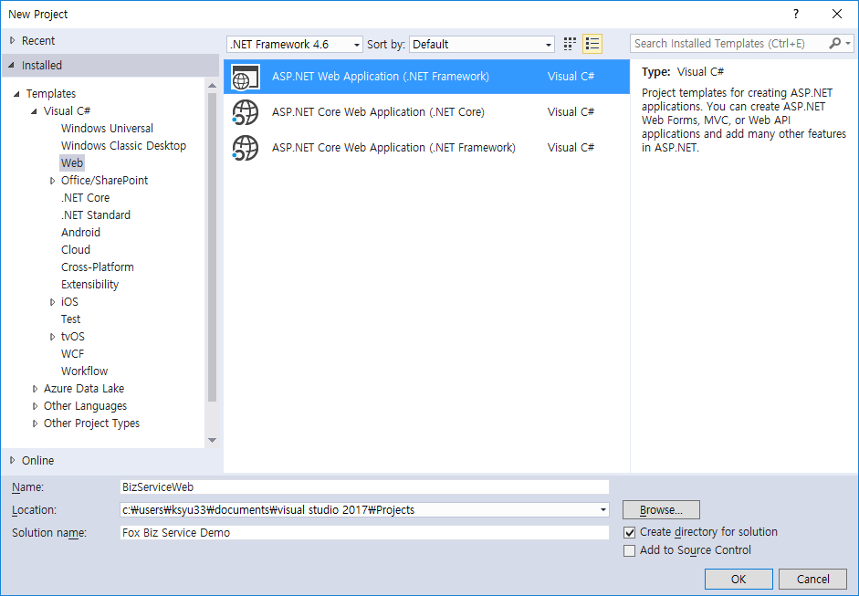

Slide 4
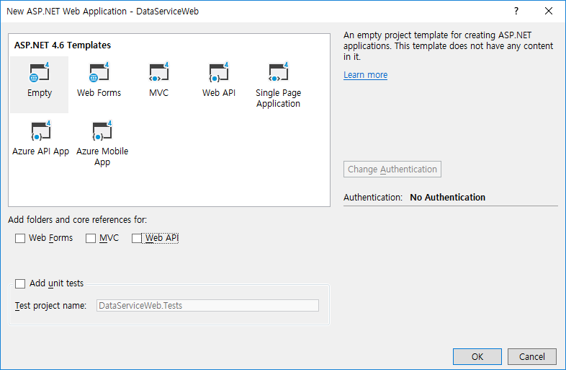

Slide 5


Slide 6
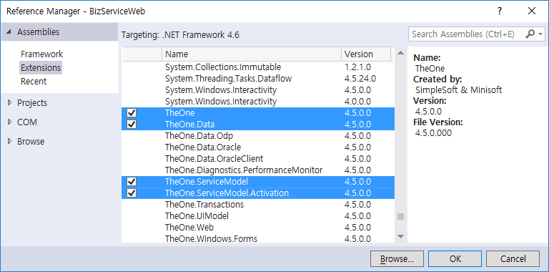

Slide 7
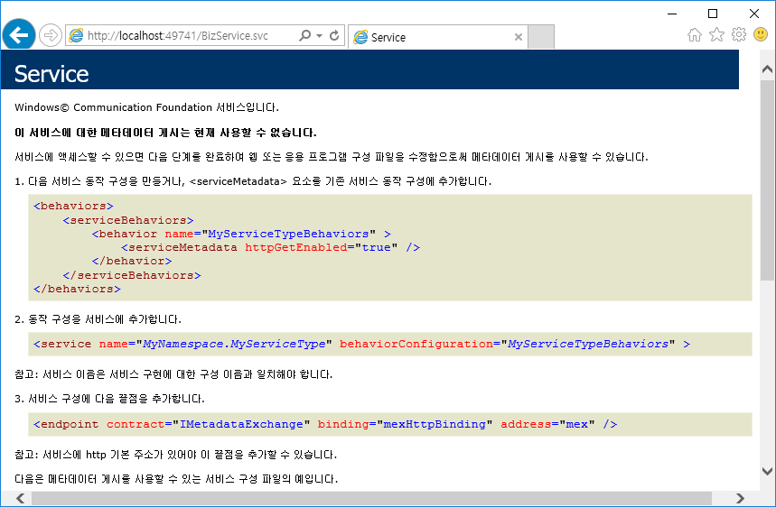

Slide 8
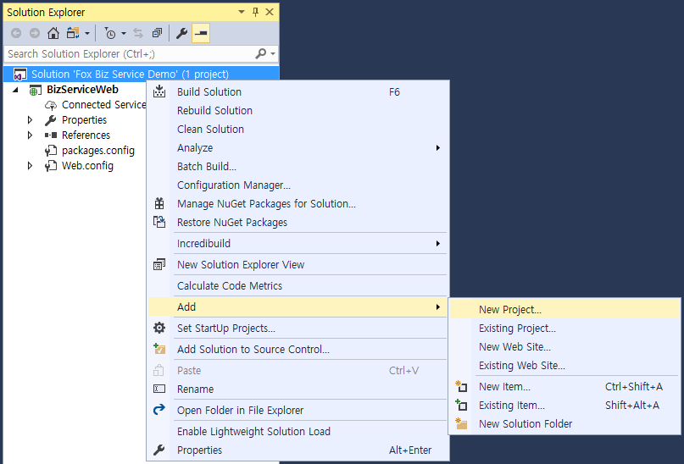

Slide 9
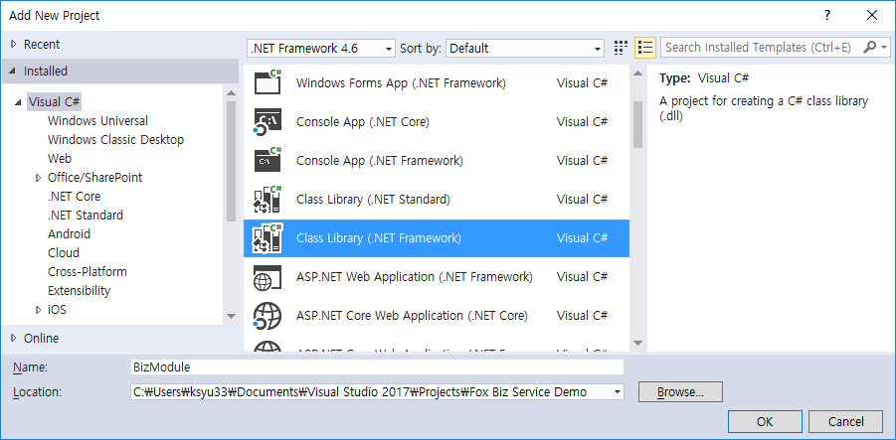

Slide 10
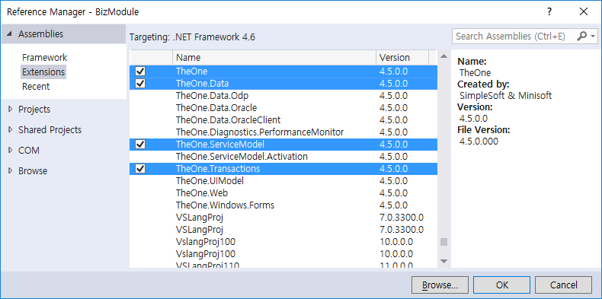

Slide 11
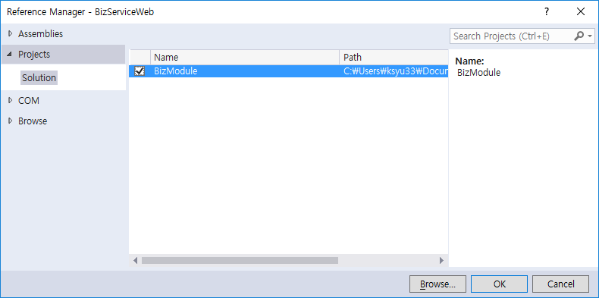

Slide 12
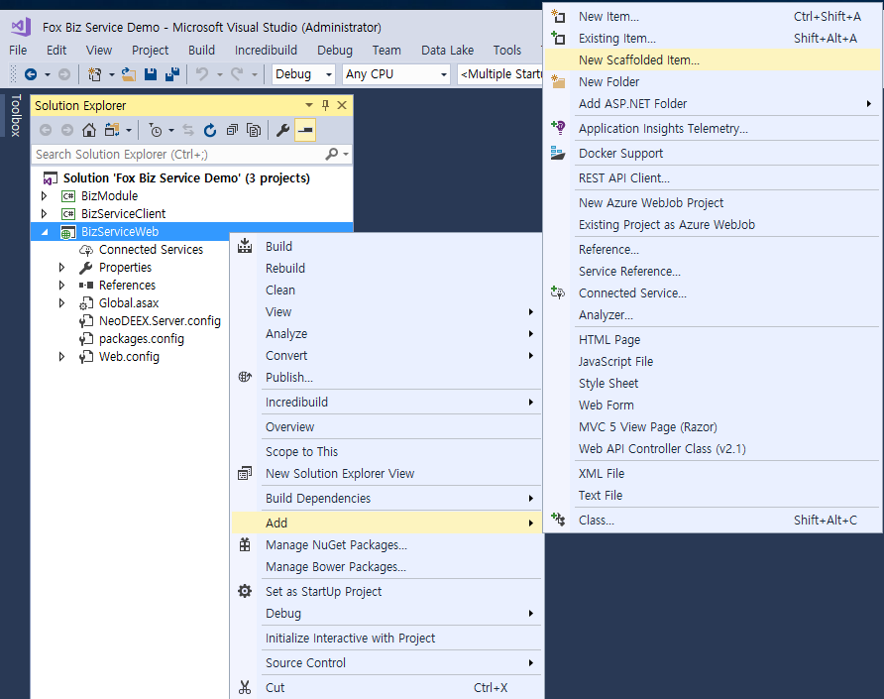

Slide 13
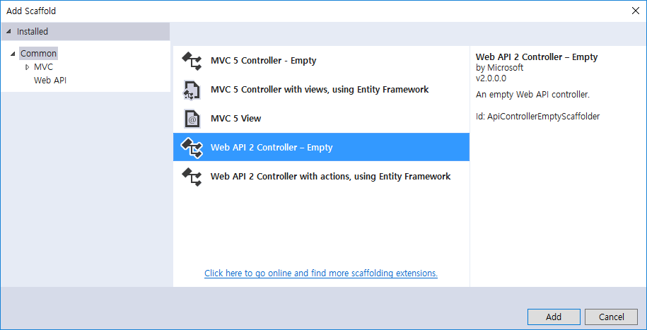

Slide 14


Slide 15
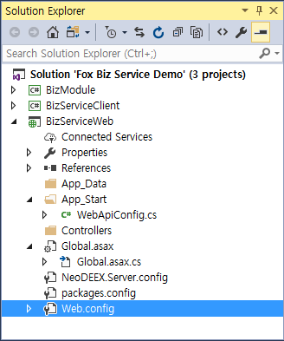

Slide 16
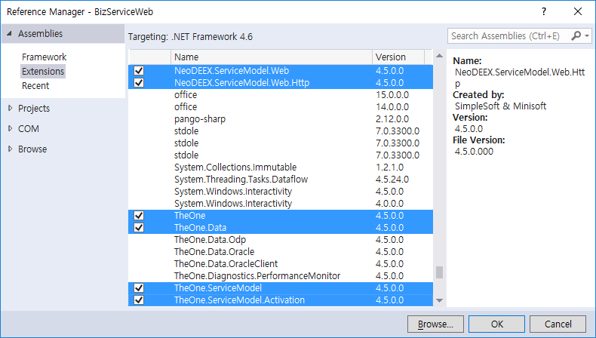

Slide 17
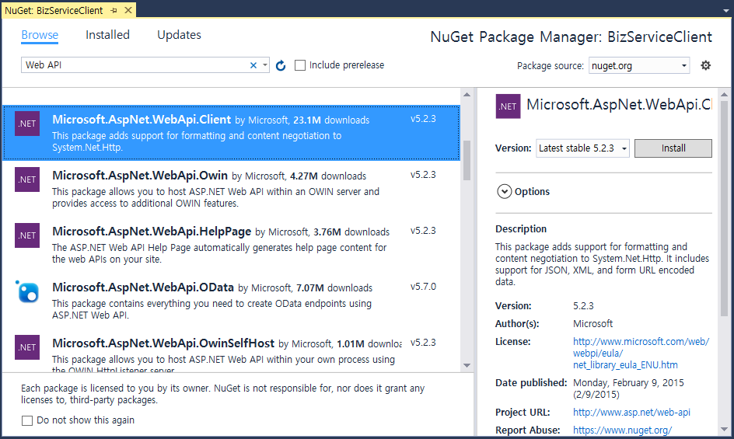

Slide 18
