Slide 1
Server
Client
Service Layer (WCF)
Biz Logic Layer
Data Access Layer
DB

Slide 2
Server
Client
IFoxDataService
Fox Data Service (WCF Service)
Database
Fox Query
(.foxml)
No Service Layer
No Biz Logic Layer
No Data Access Layer

Slide 3
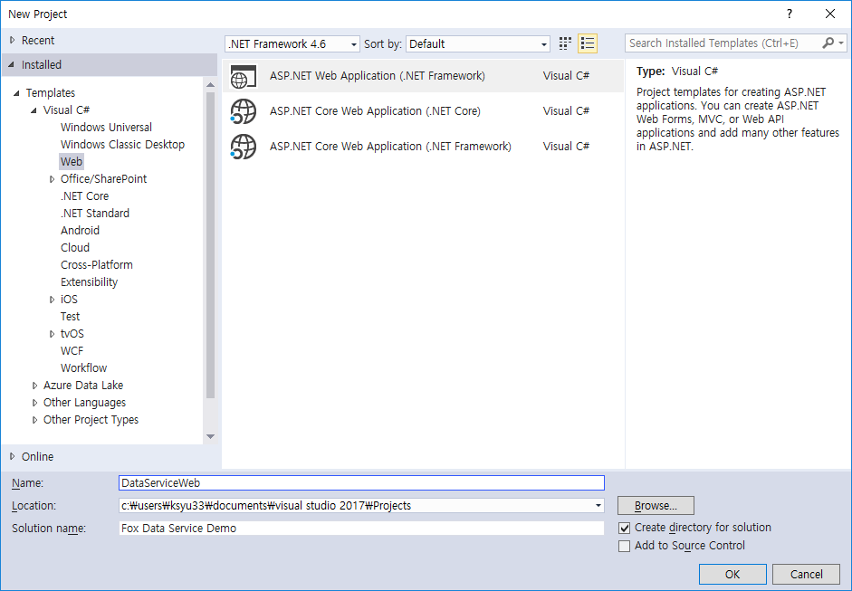

Slide 4
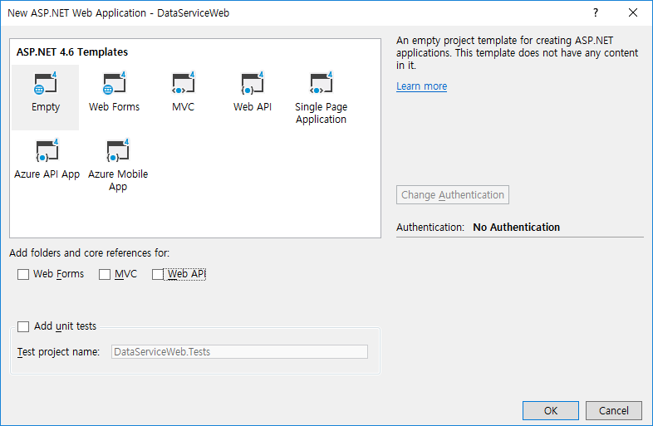

Slide 5


Slide 6
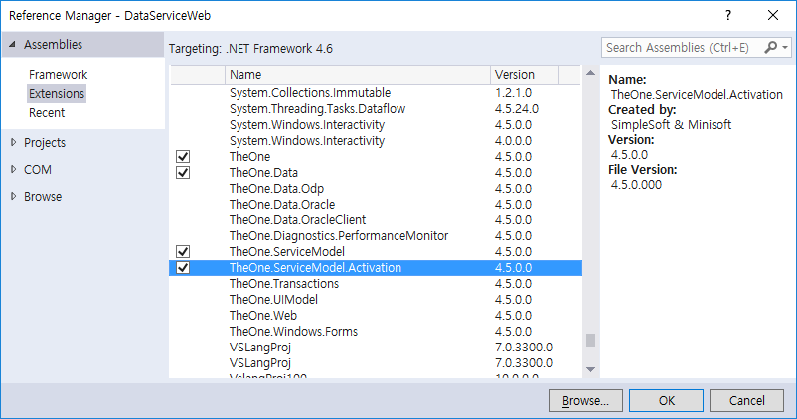

Slide 7
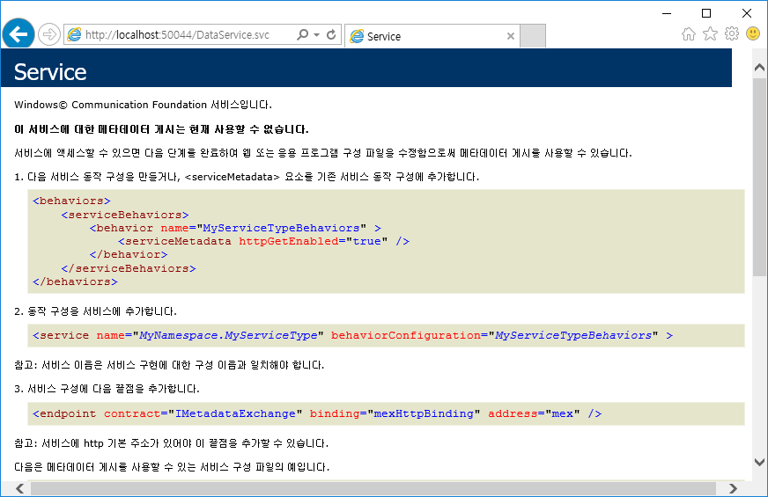

Slide 8
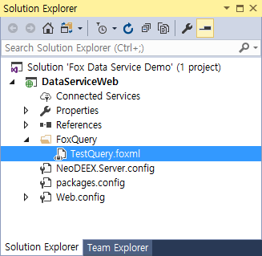

Slide 9
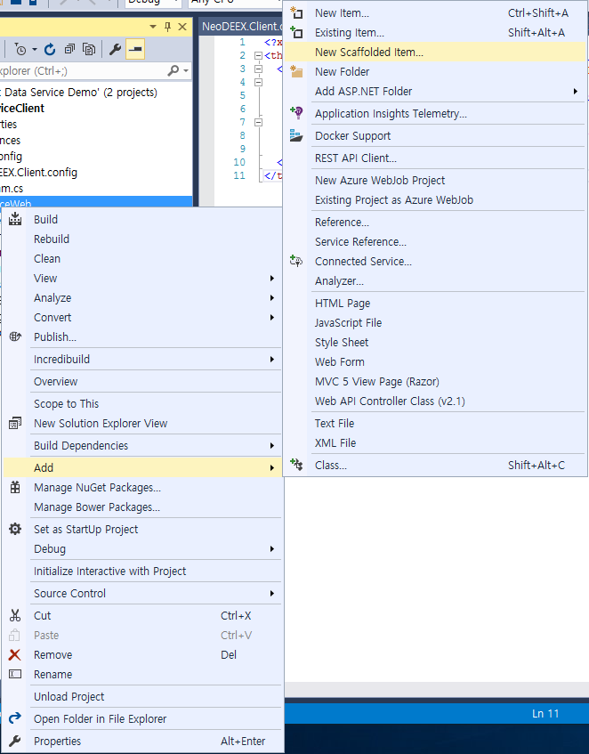

Slide 10
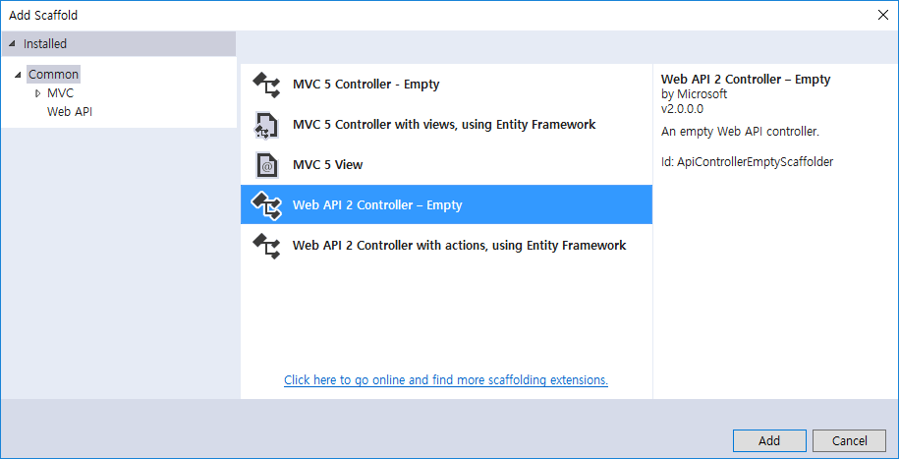

Slide 11
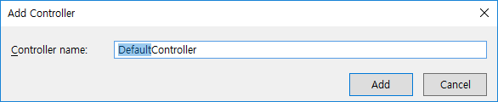

Slide 12
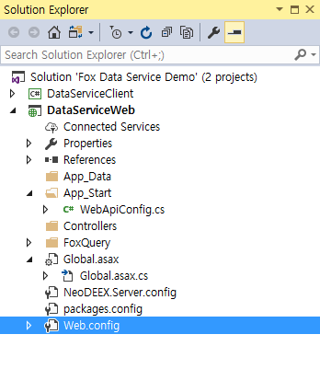

Slide 13
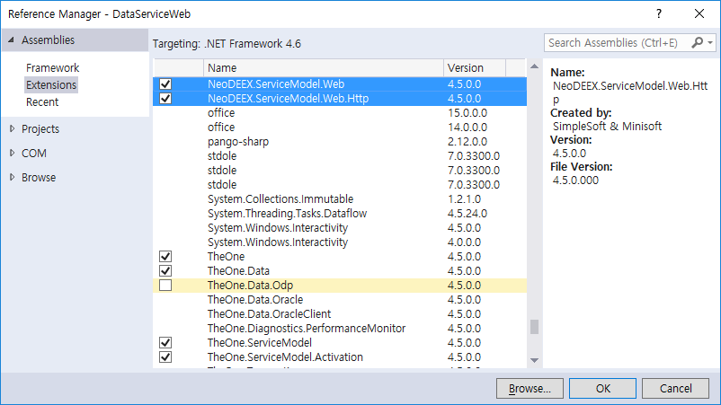

Slide 14
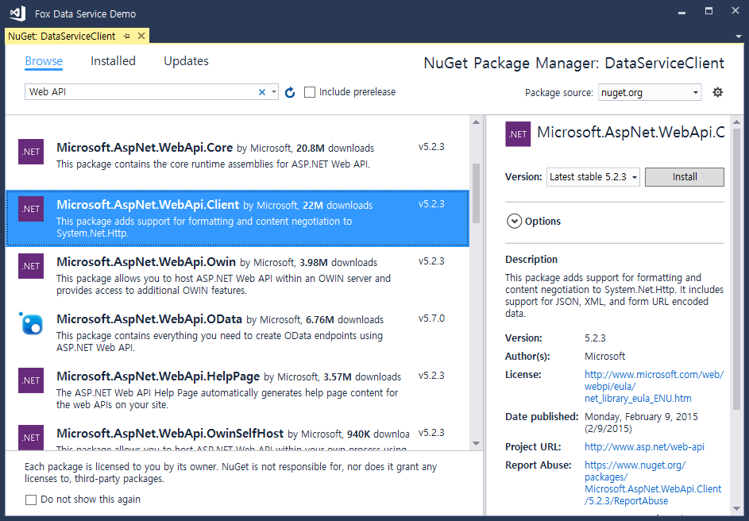

Slide 15
