Slide 1
Server
Service Layer (WCF)
Client
Fox Biz Service
(WCF/RESTful)
Biz Logic Layer
Database
Data Access Layer
Fox Data Service
(WCF/RESTful)
Fox Query
(.foxml)

Slide 2
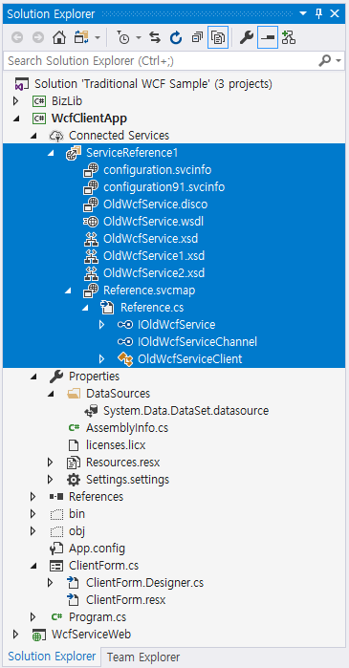

Slide 3
Client Module (EXE or DLL)
Web Application
Service
interface
WCF
Client Channel
WCF
Service configuration
Service
interface
Service class
app.config
Create
Configure
Collect info
web.config
NeoDEEX
Client Factory
NeoDEEX
Service Factory
Collect info
NeoDEEX
config
Collect info
Collect info
NeoDEEX
config
Collect info
Collect info
Reference
Interface
Library
Reference
Service interface

Slide 4
Client Module (EXE or DLL)
Web Application
Service
interface
WCF
Client Channel
WCF
Service configuration
Service
interface
Service class
app.config
Create
Configure
Collect info
web.config
NeoDEEX
Client Factory
NeoDEEX
Service Factory
Collect info
NeoDEEX
config
Collect info
Collect info
NeoDEEX
config
Collect info
Collect info
Reference
Interface
Library
Reference
Service interface

Slide 5
Client Module (EXE or DLL)
Web Application
Service
interface
WCF
Client Channel
WCF
Service configuration
Service
interface
Service class
app.config
Create
Configure
Collect info
web.config
NeoDEEX
Client Factory
NeoDEEX
Service Factory
Collect info
NeoDEEX
config
Collect info
Collect info
NeoDEEX
config
Collect info
Collect info
Reference
Interface
Library
Reference
Service interface

Slide 6
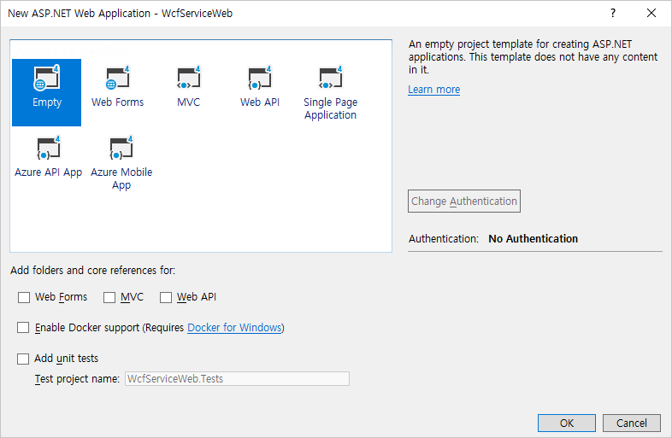

Slide 7
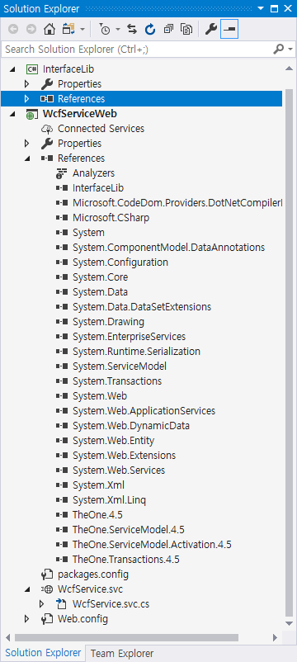

Slide 8
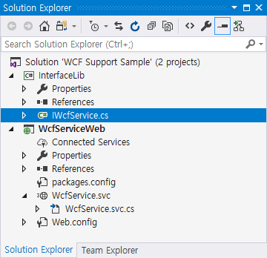

Slide 9
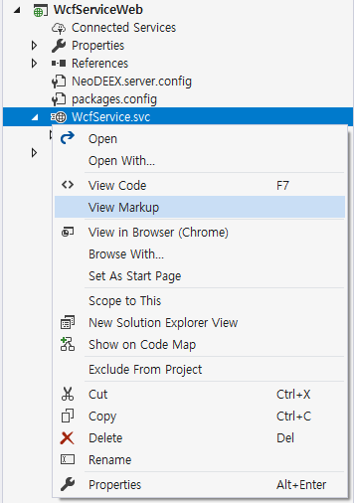

Slide 10
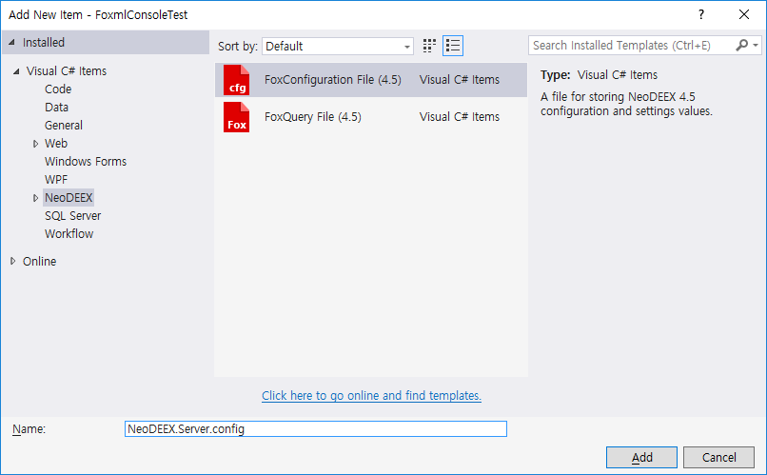

Slide 11
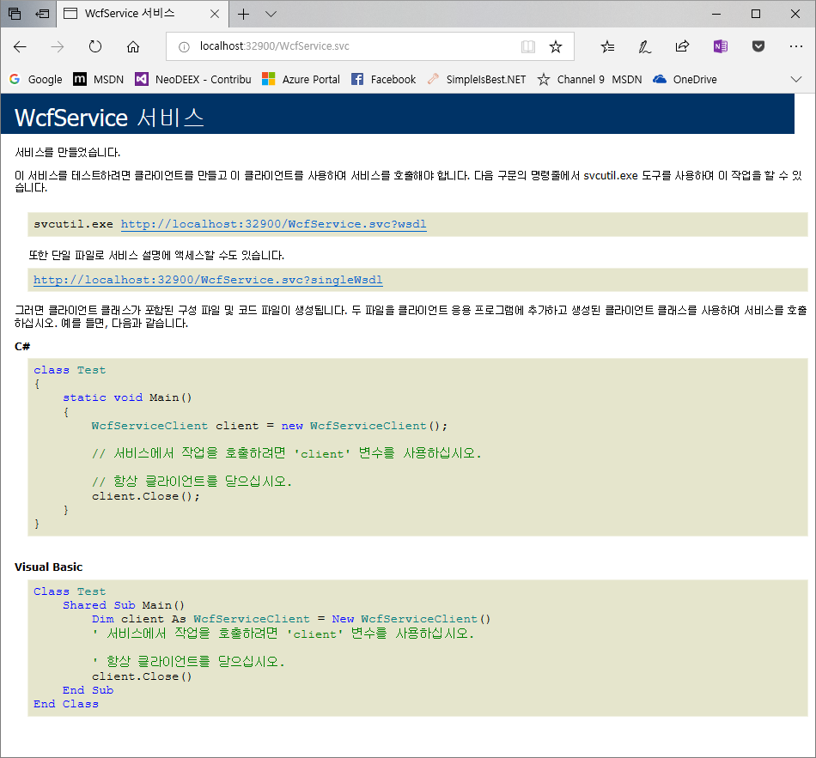

Slide 12
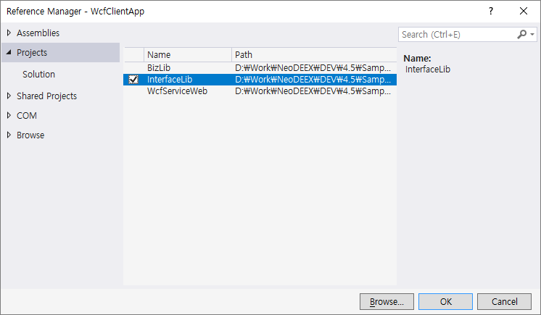

Slide 13
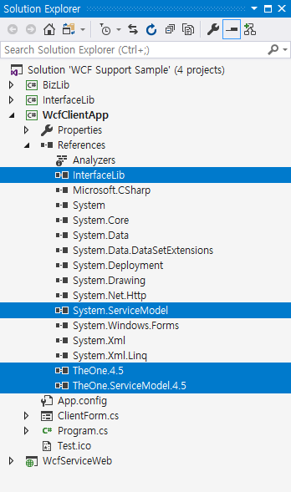

Slide 14
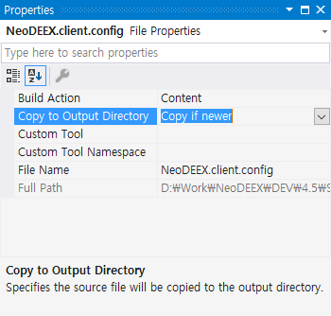

Slide 15
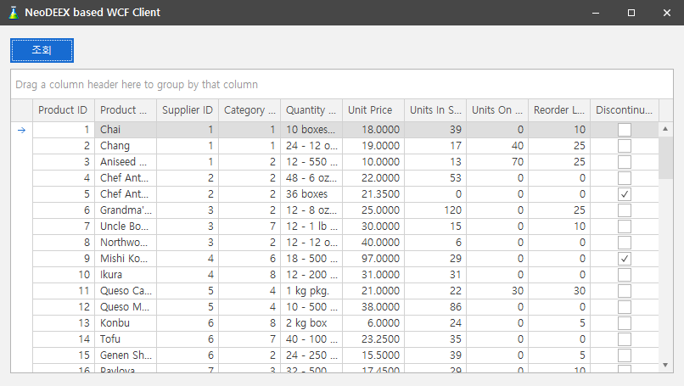

Slide 16
CreateChannel<IWcfService>("baseAddr", "WcfService3.svc", “Map1")
App.config(Web.config)
Name : defaultBinding BasicHttpBinding
Binding reference
NeoDEEX Configuration
Binding map reference
Binding Map
Name : otherBinding NetHttpBinding
Name: Map1
Binding: defaultBinding
Behavior: commonBehavior
Name : commonBehavior EndpointBehavior
Name: Map2
…
Endpoint Behavior reference (Service Behavior)
Name : otherBehavior EndpointBehavior
Final WCF Channel
Create Binding
BasicHttpBinding
Create Endpoint Behavior (Service Behavior)
EndpointBehavior

Slide 17
NeoDEEX Configuration
Address Map
Address map reference
Name: Addr1
http://localhost:18080/dev
Base address
Name: Addr2
https://dev.company.com/hr
CreateChannel<T>(“Addr1”, “relative/service.svc”)
Relative address
http://localhost:18080/dev/relative/service.svc
Final target address

Slide 18
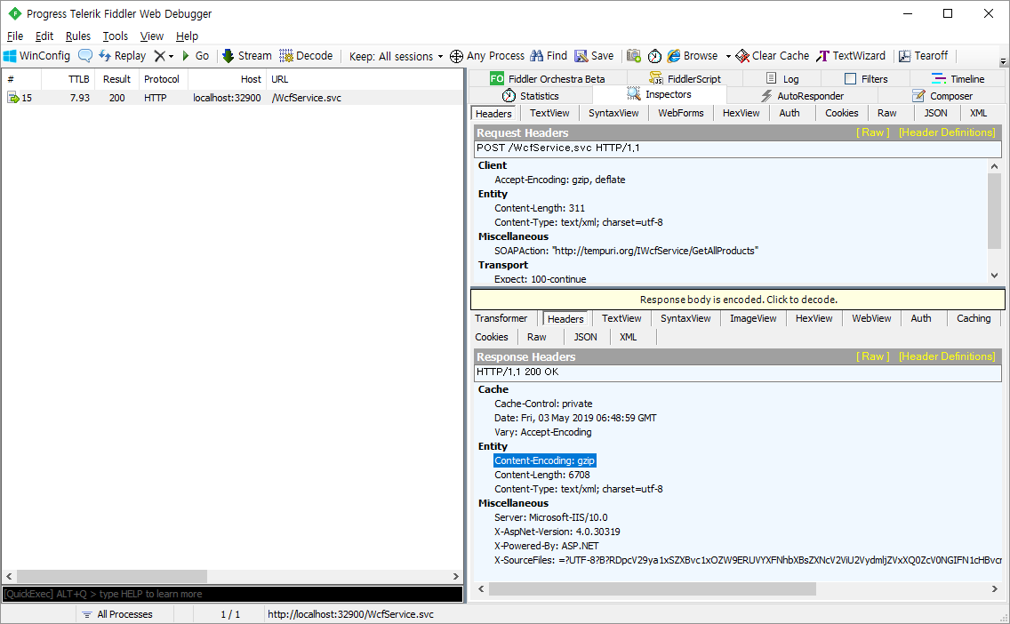

Slide 19
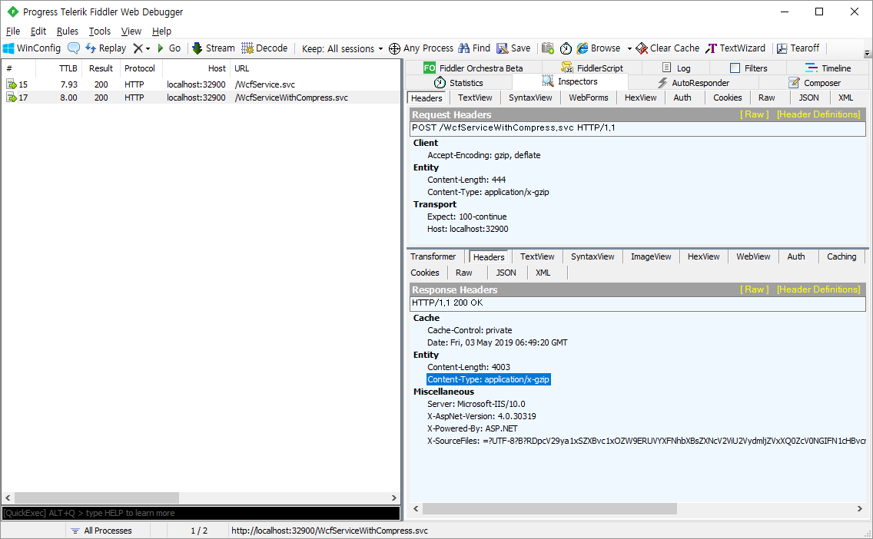

Slide 20
Server
Client
Service interface
WCF Service Class
Biz Logic Layer
Data Access Layer
DB

Slide 21
Service Endpoint
(*.svc file)

Slide 22
Server
Client
Service Layer (WCF/RESTful)
Biz Logic Layer
Data Access Layer
DB

Slide 23
Server
Client
IFoxDataService
Fox Data Service
Database
WCF/RESTful
Fox Query
(.foxml)

Slide 24
ExecuteDataSet
Client
Fox Data Service
FoxDataRequest
(QueryId: MyQuery.Select)
MyQuery.foxml
<statement Id=“Select”>
<text>
SELECT * FROM Table
</text>
<parameters>
…
</paramters>
</statement>
Executing SQL
FoxDataResponse
(with DataSet)

Slide 25
ExecuteDataSet
Client
Fox Data Service
FoxDataRequest
(QueryId: MyQuery.Select)
MyQuery.foxml
<statement Id=“Select”>
<text>
SELECT * FROM Table
</text>
<parameters>
…
</paramters>
</statement>
Executing SQL
FoxDataResponse
(with DataSet)
ExecuteNonQuery
Client
Fox Data Service
FoxDataRequest
(QueryId: MyQuery.Insert)
MyQuery.foxml
<statement Id=“Insert”>
<text>
INSERT INTO Table …
</text>
<parameters>
…
</paramters>
</statement>
Executing SQL
FoxDataResponse
(with AffectedRows & Output parameters)

Slide 26


Slide 27
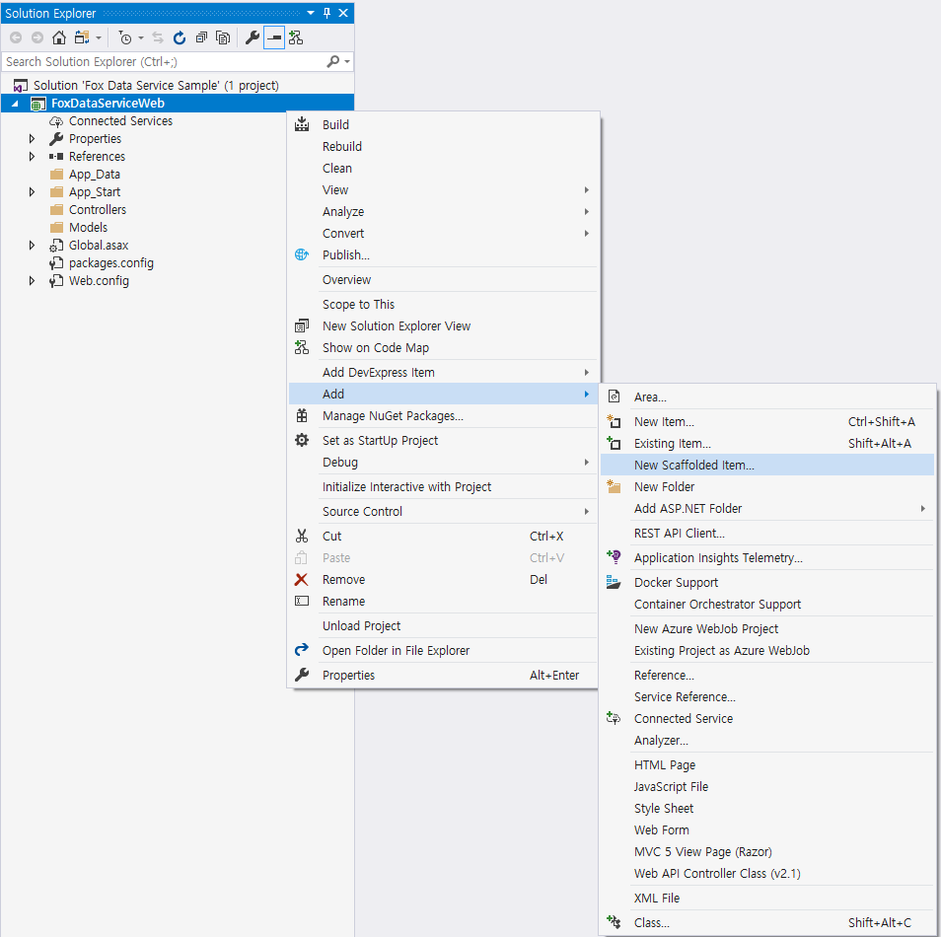

Slide 28
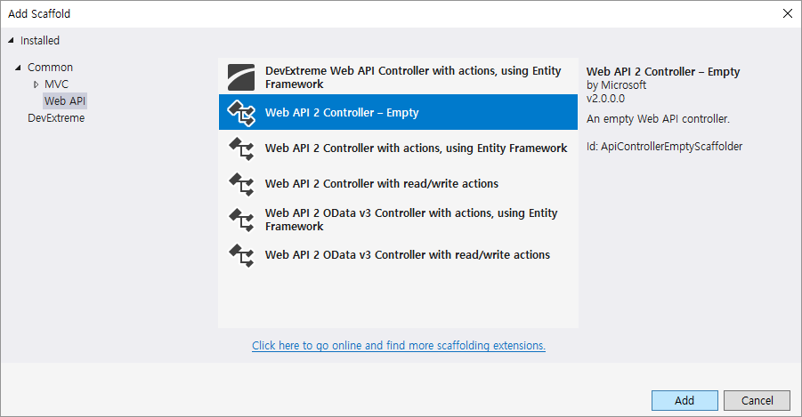

Slide 29
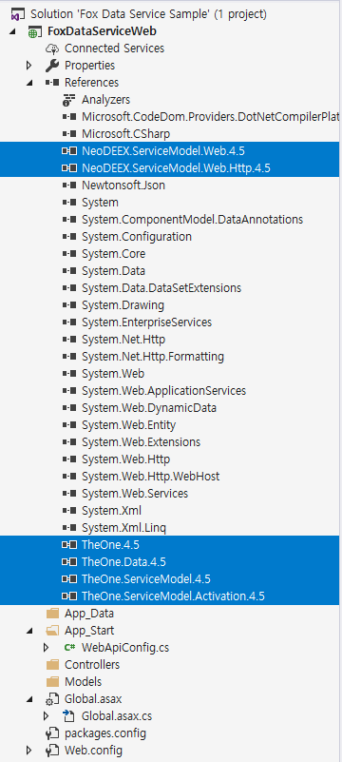

Slide 30
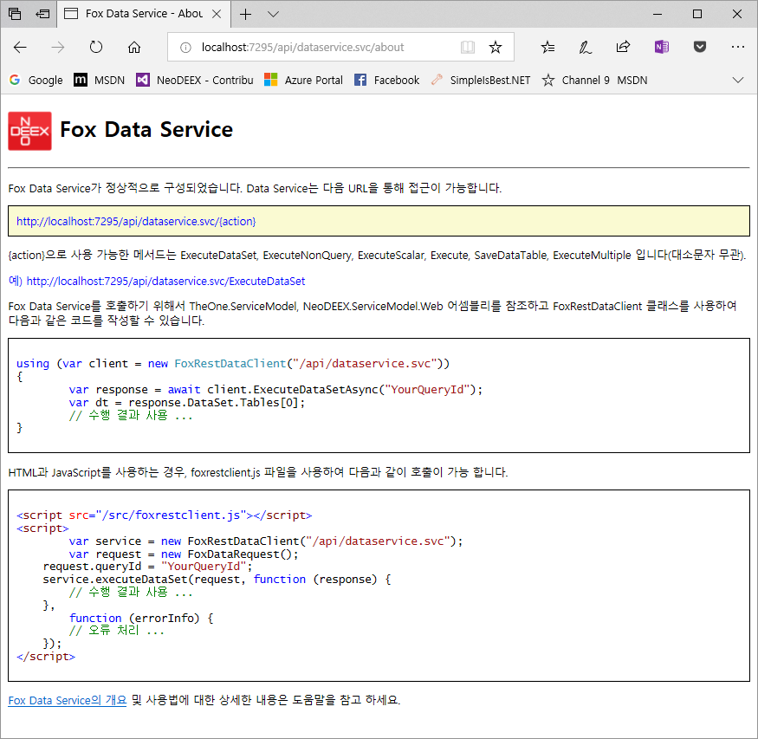

Slide 31
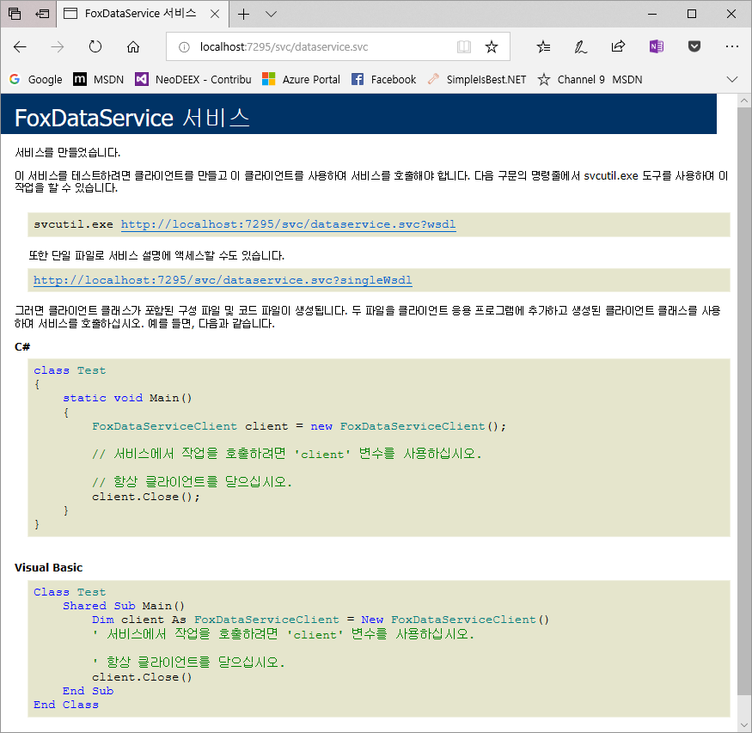

Slide 32
