Slide 1

Real Life Examples of
Game Theory
本講義感謝中研院經濟所陳恭平所長熱情提供
台南一中經濟學經典概論(二)
成大經濟系 林常青
ever@mail.ncku.edu.tw

Slide 2
Game theory is the study of mathematical models of strategic interaction among rational decision-makers.
Cooperative / non-cooperative games
Simultaneous / sequential
Perfect information / imperfect information
One shot (static)/ infinite long (dynamic) game

Slide 3




Normal Form Games
One-Shot.
Examples:
(1) Prisoner's Dilemma (2) Battle of the Sexes
(3) Matching Pennies (4) Chicken
 | C | D
C | -10, -10 | -30, 0
D | 0, -30 | -20, -20
 | A | B
A | 4, 2 | 0, 0
B | 0, 0 | 2, 4
 | H | T
H | 1, -1 | -1, 1
T | -1, 1 | 1, -1
 | C | D
C | 3, 3 | 1, 4
D | 4, 1 | 0, 0

Slide 4
Dominant Strategy and Equilibrium (Nash)
Dominant strategy: The best strategy to play regardless of others‘ strategies. (e.g., PD)
If a game has a dominant strategy for every player, then outcome is easy to predict.
Rarely in a game any player has a dominant strategy.
Nash equilibrium: An action profile from which no player can unilaterally change strategy and gains.
Pure strategy example: Battle of the Sexes, Chicken.
Mixed strategy: randomization over available strategies (e.g., in matching pennies).

Slide 5
Applications: liability rules
Benchmark case:
A motorist ( M ) and a pedestrian ( P ). M can potentially hit P and cause an accident. They can exercise care to reduce occurrence of accident. (Care = C; no care = N.)
Cost of accident: 100.
Cost of Care: 10.
Prob. accident: 1/10 if both exercise due care; otherwise 1.
Social optimum calculation:
Social optimum: ( C, C ).

Slide 6
Applications: liability rules
No liability Strict liability
Negligence Contributory negligence
Negligence and Contributory Negligence are efficient
 | N | C
N | -100, 0 | -100, -10
C | -110, 0 | -20, -10
 | N | C
N | 0, -100 | 0, -110
C | -10, -100 | -10, -20
 | N | C
N | 0, -100 | -100, -10
C | -10, -100 | -20, -10
 | N | C
N | -100, 0 | -100, -10
C | -10, -100 | -10, -20

Slide 7

Applications: liability rules
When care costs differ: ${ C}^{P}=10, { C}^{M}=85$
Social optimum: ( N, N ).
No Liability and Strict Liability are efficient.
 | N | C
N | -100, 0 | -100, -85
C | -110, 0 | -20, -85
 | N | C
N | 0, -100 | 0, -185
C | -10, -100 | -10, -95
 | N | C
N | 0, -100 | -100, -85
C | -10, -100 | -20, -85
 | N | C
N | -100, 0 | -100, -85
C | -10, -100 | -10, -95

Slide 8
範例: 電力公司 vs. 洗衣廠
電力公司（燒煤）獲利1000萬但會產生空氣汙染; 洗衣廠在無空氣汙染下獲利300萬, 但在汙染下只能獲利100萬。電力公司可花500萬裝置並維護除塵設施,洗衣廠可花100萬設置並維護無塵室。
 | 電廠不作為 | 電廠裝除塵設施
洗衣廠不作為 | (100, 1000) | (300, 500)
洗衣廠設無塵室 | (200, 1000) | (200, 500)

Slide 9
三種判決結果
判決一: 電力公司可任意汙染(駁回禁制令)
判決二: 電力公司須賠償洗衣店的損失
判決三: 洗衣店可依禁制令禁止電力公司汙染
不合作結果(判決一):
洗衣店裝無塵室(有效率!)
不合作結果(判決二):
洗衣店都得300; 不裝無塵室。電力公司賠200 (所以利潤為800), 不作為.

Slide 10
不合作結果(判決三):
使用禁制令: 洗衣店都得300; 不裝無塵室。電力公司花500 裝除塵設施(所以利潤為500)。
合作結果: 兩者合併下獲利最大，再分配。
最大獲益 1200。
判決一: 不會改變。
判決二: 洗衣店最少要得300, 電力公司最少要得800; 有 100 = 1200-(300+800) 的剩餘可分配。
判決三: 洗衣店最少要得300, 電力公司最少要得500; 有 400 = 1200-(300+500) 的剩餘可分配。

Slide 11
三個可能判決下的協議利潤(無交易成本下)
合作總值都為1200, 但分配以判決三對洗衣廠較為有利
 | 不合作 |  | 剩餘 | 合作=1200
 | 電力公司 | 洗衣廠 |  | 電力公司 | 洗衣廠
判決一 | 1000 | 200 | 0 | 1000 | 200
判決二 | 800 | 300 | 100
判決三 | 500 | 300 | 400

Slide 12
Application: Litigation
Example: An accident occurs which costs the victim ( V ) 100,000. Litigation cost for both victim and injurer ( I ) are 10,000.
I knows more than V about the value of p.
Suppose I is of two types: negligent or careful. The former is expected to prevail with prob 0.2, and the latter 0.8.
Only I knows his own type.
V believes that I is equally likely to be either.

Slide 13
Application: Litigation
Game form II: V makes take-it-or-leave-it offer:
R
( -90,000, 70,000 )
N
S
A
( -S , S )
V
R
( -30,000, 10,000 )
C
A
( -S , S )

Slide 14
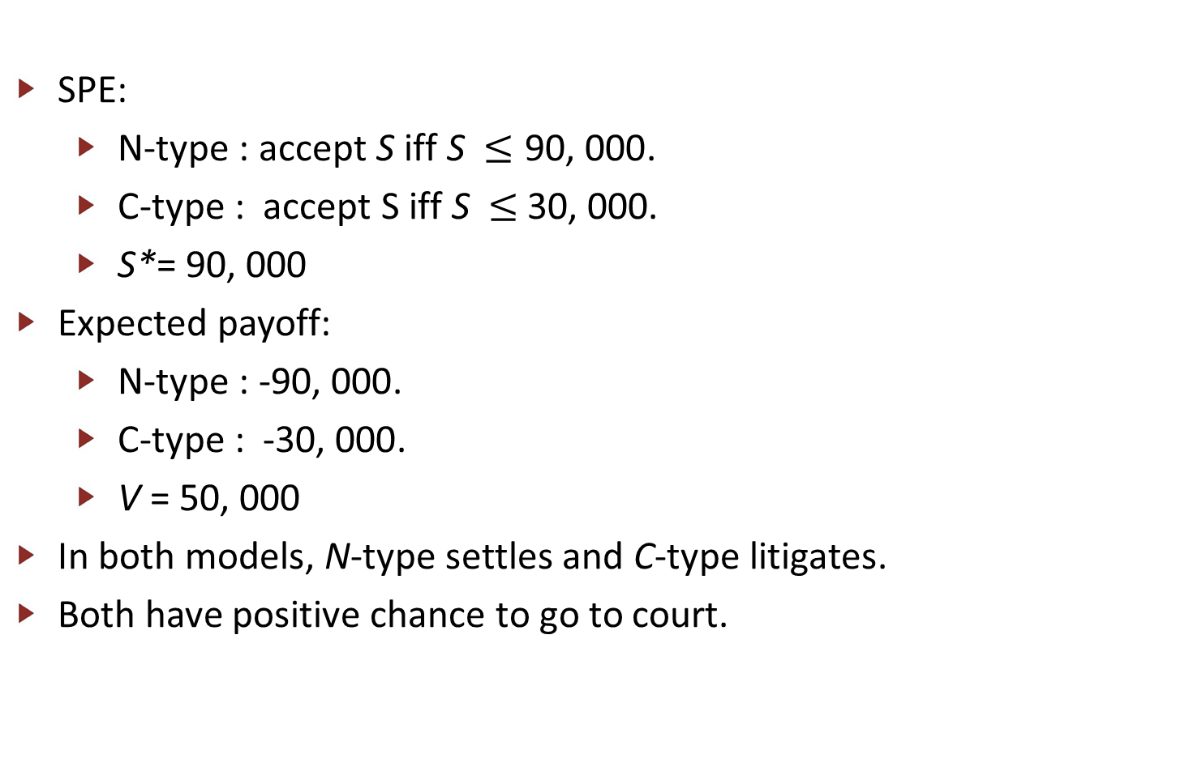
Application: Litigation
SPE:
N-type : accept S iff S $≤\text{9}\text{0}\text{,}\text{ 000}$.
C-type : accept S iff S $≤$30, 000.
S*= 90, 000
Expected payoff:
N-type : -$\text{90}\text{,}\text{ 000}$.
C-type : -$\text{3}\text{0, 000}$.
V = 50, 000
In both models, N-type settles and C-type litigates.
Both have positive chance to go to court.

Slide 15
Golden Balls: Split or Steal
https://www.youtube.com/watch?v=TKaYRH6E36U https://www.youtube.com/watch?v=S0qjK3TWZE8
https://www.youtube.com/watch?v=qBd1Hxvd00U (中文 0:41-2:12)
 | Split | Steal
Split | (0.5, 0.5) | (0, 1)
Steal | (1 , 0 ) | (0, 0)

