Slide 1
CS2100
Tutorial #4
Question 4
(Prepared by: Aaron Tan)

Slide 2
Critical Path Analysis
The Critical Path is the longest path from start to finish, indicating the minimum time necessary to complete the entire operation.
This path is critical as any delay along this path is going to delay the completion of the operation. Hence the critical path is the bottleneck route.
Applications in project management, allocation of resources, scheduling, etc.
a
b
c
Duration = a + b + c
Jobs in sequence/series
What is the critical path for this graph? What is its duration?
a
4
5
b
2
8
5
c
3
6
Duration = max(a,b,c)
5
Jobs in parallel
Critical path duration = 5 + 4 + 8 + 6 = 23

Slide 3
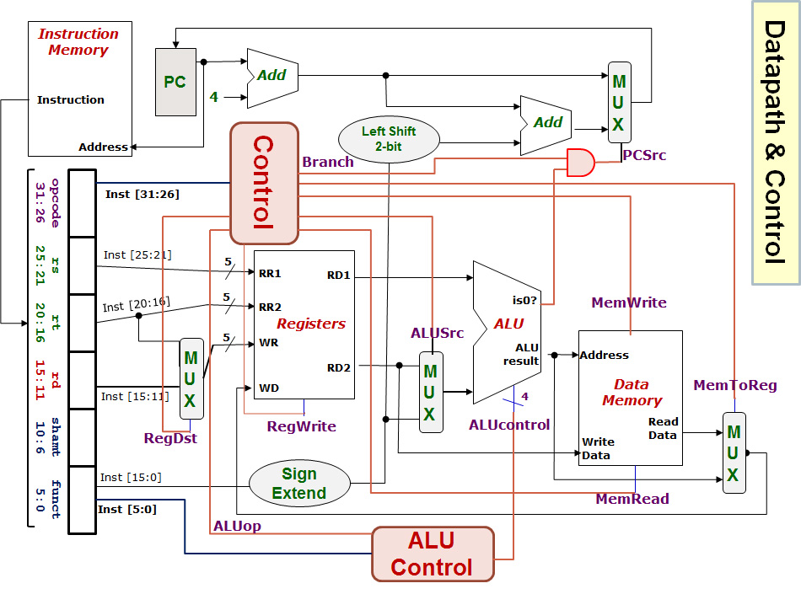
SUB instruction
Inst-Mem (400)
Reg.File (200)
MUX (ALUSrc)
(30)
ALU
(120)
MUX (MToR)
(30)
Reg.File
(200)
Control (100)
Q4(a)
Not on critical path
Inst-Mem
400ps
-------------
Adder
100ps
-------------
MUX
30ps
-------------
ALU
120ps
-------------
Reg-File
200ps
-------------
Data-Mem
350ps
-------------
Control/ALUControl
100ps
-------------
Lshft/Signext/AND
20ps
400+200+30+120+30+200 = 980ps
0
1
0
1
Data memory not needed.
0
1
0
1
1
0
Because WR is not needed at this moment.
Why is MUX (RegSrc) not included?

Slide 4
LW instruction
Inst-Mem (400)
Reg.File (200)
ALU
(120)
DataMem
(350)
MUX (MToR)
(30)
Reg.File
(200)
Control (100)
Q4(b)
Not on critical path
Inst-Mem
400ps
-------------
Adder
100ps
-------------
MUX
30ps
-------------
ALU
120ps
-------------
Reg-File
200ps
-------------
Data-Mem
350ps
-------------
Control/ALUControl
100ps
-------------
Lshft/Signext/AND
20ps
400+200+120+350+30+200 = 1300ps
0
1
0
1
Because Sign-extend and MUX(ALUSrc) are in parallel with Reg-File.
Reg-File = 200; Sign-ext + MUX = 20+30 = 50.
0
1
1
0
Why is MUX (ALUSrc) (and Sign-extend) not included this time?
MUX (RegSrc) not included. Same reason as (a).

