Slide 1

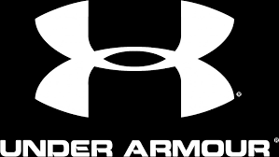
Jeffrey Page ID#23452751
Anthony Farrington ID#40002579
Jeremy Berube ID#40095330
William Guinaudie ID#40087207
Marcello Iannattone ID#40057661
Notes:
Welcome. Today we – myself (name group members) are going to discuss the case of Under Armor. A company at a difficult cross-roads in today’s environment.
I’m going to present our External Analysis of the Market and Anthony will present an internal analysis of Under Armor. Following that, he is going to discuss possible alternatives to the issues that will be brought up, as well as our recommendation to help solve their difficulties.

Slide 2
Main ISSUE IDENTIFICATION
Heavily relying on Performance to appeal to the market.
Neglecting Athleisure which holds the greatest market share.
Focusing on a niche market rather than the general market.
Choosing between Athleisure vs Performance.
Going Concern for the longevity of their brand.
Notes:
Under Armor manufactures and sells athletic performance clothing. As such they are singularly focused on this particular niche market. Because of this heavy reliance on sports performance apparel, they are neglecting the Athleisure market. A market which holds the greatest potential for the growth and longevity of the Under Armor brand.
The main issue… Under Armor needs to decide or choose really, if they’re going to enter the Athleisure trend or continue to focus strictly on performance based sports clothing.

Slide 3
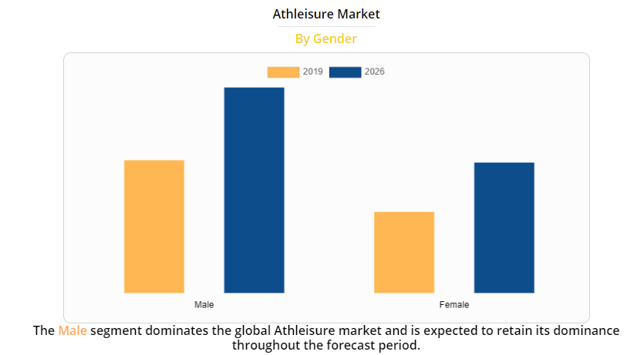
Horizontal analysis
EXTERNAL ENVIRONMENT:
What is Athleisure?
The trend of wearing athletic clothing as casual wear.
Economic
2018 – 155billion USD market 2026 Projections– 257billion USD
Demographic
Notes:
What is Athleisure? To put it simply, Athleisure is sports clothing with fashion and design in mind. Basically, Athleisure is the trend of wearing clothes that were originally designed for athletic workouts as casual wear. This trend has increased and is expected to continue as more and more people are working from home because of the global pandemic. The market generally includes includes footwear (sneakers) and apparel (yoga pants, tights, leggings, and shorts).
The Athleisure market has grown considerably from approximately 155 Billion USD in 2018. It is expected to grow even further. With estimates ranging anywhere from a conservative 257 billion USD to an aggressive 350 Billion USD by 2026.
Revenues from Athleisure apparel and footwear are primarily generate through sales to men. This trend is expected to continue.

Slide 4
Horizontal analysis
EXTERNAL ENVIRONMENT:
Sustainable Physical
Negative environmental effects due to materials used to make the clothing.
Sociocultural
The growth of the current Health and Fitness niche coupled with celebrities & athletes promotions benefits overall market growth.
Notes:
Beginning with the effects these new types of materials have on the environment we discuss the sustainability of the market. There have been concerns that some of the materials used in the manufacturing processes of Athleisure apparel have negative effects on the environment. More specifically the chemicals specifically formulated to make the clothing water and stain / grease resistant. The companies in this market space are constantly seeking ways to improve their products and reduce any detrimental effects on the environment.
From a sociocultural standpoint, more and more people are getting on the health and fitness band wagon; and interest and participation is various sports around the world is ever increasing. As such, athleisure products are continually promoted around the globe by using pro sports athletes and various celebrities to showcase and differentiate between competitor brands. Since consumers are more apt to purchase a product based on a connection with athletes and celebrities, companies in the athleisure segment spend large amounts of marketing dollars to promote their brands and increase sales of their products.

Slide 5
Horizontal analysis
EXTERNAL ENVIRONMENT:
Technological
Reduced Odours
Rapid Drying
Global
Sold Globally
Most Markets
Political & Legal
Varies between Countries
Notes:
Many of the materials used in athleisure reduce odors and help keep the wearer dry by moving sweat to the outer surface of the fabric. This process dubbed “sweat wicking” ensures that sweat doesn’t saturate the fabric, thus keeping odors from permeating it and promoting rapid drying. An additional feature of the materials used in athleisure includes stretchability, which ensures a more comfortable fit.
Athleisure is sold around the world in nearly every market.
Since athleisure is sold in nearly every country the companies must comply with all environmental and governmental regulations in effect for each individual country they manufacture and operate in. As do their suppliers and 3rd party manufacturers whom are all held contractually accountable to each individual companies standards and controls.

Slide 6
Horizontal analysis
COMPETITORS: NIKE
Facts
Incorporated in 1967
Annual sales 37.4 billion USD
75,400 employees.
Supplied by 122 footwear manufacturers over 12 countries & 329 apparel manufacturers over 38 countries.
Uses a vast majority of 3rd party suppliers.
Spends Heavily on Research and Development.
Spends significant amounts on patents and trademarks and vigorously pursues legal action against 3rd party infringement of their brand and/or intellectual property.
Notes:
NIKE, Inc’s principal business activity is the design, development and worldwide marketing and selling of athletic footwear, apparel, equipment, and accessories and services. NIKE is by far the largest seller of athletic footwear and apparel in the world with annual sales of $ 37.4 Billion USD.
Nike employs over 75,000 employees worldwide. They are supplied by 122 footwear factories located in 12 countries as well as 329 apparel factories located in 38 countries. Their principal materials used in the manufacturing process of their footwear products are a combination of natural and synthetic rubber, plastic compounds, nylon, and natural and synthetic leathers. The materials used in the apparel industry are a blend of natural and synthetic fibers, along with a combination of new and recycled threads. Some of the materials used are designed to wick moisture asway from the body, retain heat, and/or repel rain and snow.
Nike uses a vast number of 3rd party suppliers to manufacture their products and to ensure a steady supply of inventory on a global basis.
Nike spends a significant amount on research and development as they believe that technical innovation and quality control ensures the success of their products.
Additionally, they believe one of the keys to their success is their brand itself. Therefore they spend a significant amount on trademarks and patent. They also vigorously pursue legal action against 3rd party infringement to protect their brand image and intellectual property.

Slide 7
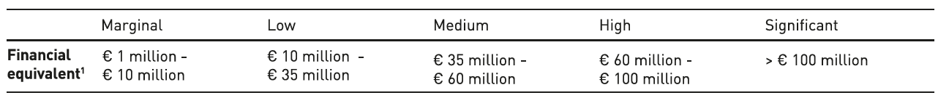
Horizontal analysis
COMPETITORS: ADIDAS
Facts
Sales Revenues 22,642 Billion USD
Adidas focuses heavily on risk management and heavily analyses risks and opportunities.
Notes:
With revenues of 19,844 Billion Euros (approximately 22,642 Billion USD$), Adidas is 2nd behind Nike in terms of revenue generation in the Athleisure market. A large portion of Adidas revenues (39% in 2020) comes from Asia and Latin America.
Adidas focuses heavily on risk management and spends a considerable amount of time and effort to analyze risks and opportunities. They have formed an internal risk and opportunity management process which helps them categorize risks into 5 categories. Ranging from Marginal 1-10M EUR to Significant >100M EUR. Each opportunity is assigned to an Executive within Adidas who is responsible for managing risk.
Above a chart taken from their 2020 annual report which identifies what they deem to be their primary risk categories.

Slide 8
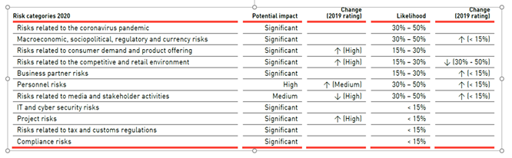
Horizontal analysis
COMPETITORS: ADIDAS
Below is a chart taken from their 2020 annual report which identifies what they deem to be their primary risk categories.
Notes:
This is a chart taken from their 2020 annual report which identifies what they deem to be their primary risk categories. From Risks related to the pandemic – which are deemed to be Significant and have a likelihood of occurring between 30-50% down to compliance risks which have a likelihood of <15% of occurring.

Slide 9
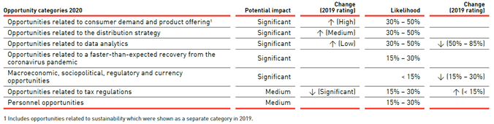
Horizontal analysis
COMPETITORS: ADIDAS
On the other side of the risk rewards, below is an overview of their opportunities.
Notes:
Again, they classify opportunities based on the potential impact to the business as well as the likelihood of it occurring.
One of their metrics are data analytics where they have been using technology and big data to identify changes in consumer spending and have sought insights into product creation, sales opportunities, and ways to reduce costs as well as to improve inventory management and procurement. All of which could potentially improve the overall financial outlook for the company.
Adidas also puts a special emphasis on compliance to ensure their brand and image is not compromised. This is categorized as one of their core competencies and ensures they remain competitive on a global scale. They have identified that most compliance violations tend to be behavioral and actively seek ways to reduce these.

Slide 10
Horizontal analysis
COMPETITORS: LULULEMON
Facts
Sales Revenue 1.1 billion USD 88% of sales in north America.
Focus on product innovation, technology, and science to improve the quality of their products and their fabrication processes.
In 2020 they have 491 operating stores.
Large percentage of sales are yoga pants.
Geared towards athletics but also fashionable for everyday use.
Notes:
Lululemon is a designer, distributor, and retailer of Athleisure apparel and accessories. They have a strong financial standing with over $1.1 Billion USD$ in cash on their balance sheet and are primarily focused on expansion into China, Asia Pacific, and the EMEA regions through a balanced strategic approach. Although expansion is a primary focus, approximately 88% of their sales were in North America in 2020.
They are also attempting to capture a greater share of the North American markets through their “sweatlife” strategy which promotes connecting and growing through physical activity. As with many of the other competitors in the Athleisure market, Lululemon has a focus on product innovation, technology, and science to improve the quality of their products and their fabrication processes.
They are well positioned for growth in the Athleisure market with a strong online presence and robust backend systems. They conduct their business through two channels: direct-to-consumer sales through a variety of e-commerce sites and mobile apps as well as company operated brick and mortar experiential stores. In 2020 their operations included 491 company operated stores.
Their clothing are geared towards both women and men, and while a large percentage of their apparel market includes yoga pants sold primarily to women, they continue to add to their product lines on a regular basis. They also focus on products that are not only geared towards athletics, but are also fashionable and for everyday use.

Slide 11
Transition slide
Notes:
Other competitors:Puma and Fila
Other competitors in the market include both Puma and Fila as well as several smaller Chinese and Asian firms. While both of these companies are primarily focused on footwear, they also do manufacture and sell athletic apparel.

Slide 12
Horizontal analysis
OPPORTUNITIES & THREATS
Opportunities for Growth:
Expansion into the rapidly expanding Athleisure market has the greatest potential for increasing market share. R&D into new clothing or footwear lines that offer improved performance. Additional partnerships with sports leagues in Europe and/ or Asia. A push into China and / or India through acquisition or strategic alliances would increase global market share due to their very large consumer markets.
Threats to current competitive advantage:
Threat of substituted products. Nike already producing similar clothing at similar prices. Lululemon has entered the footwear market. Lululemon already has more stores in the United States - Under Armor’s primary market. Nike, Lululemon, and Adidas all have plans in place to protect their image and brands. North American market is saturated.
Notes:
Opportunities for growth include: Expansion into the rapidly expanding Athleisure market – which has the greatest potential for increasing market share. R&D into new clothing or footwear lines that offer improved performance. Additional partnerships with sports leagues in Europe and / or Asia. A push into China and / or India through acquisition or strategic alliances would increase global market share due to their very large consumer markets.
Threat of substituted products. Nike already producing similar clothing at similar prices. Lululemon has entered the footwear market. Lululemon already has more stores in the United States - Under Armor’s primary market. Nike, Lululemon, and Adidas all have plans in place to protect their image and brands. North American market is saturated.

Slide 13
Transition slide
Notes:
And now Anthony will discuss the Internal Analysis of Under Armor as well as the alternatives to solving their problem and a recommendation.
Take it away Anthony!

Slide 14
Internal analysis
VALUE CHAIN: TANGIBLE RESOURCES
Financial Resources
Internal Funds/ Borrowing capacity: dropped over the past four years.
Physical Resources
~70% of business: North American market.
Location of their manufacturing plants: Outside of North America.
15 countries worldwide.
55% of production: China, Jordan, Vietnam and Malaysia.
2016 - Present Sales Revenue: $1.2 Billion to just over $900 Million in the North American market.
Share Price (since 2015): dropped ~50% from $51.31USD to $24.26 USD today.

Slide 15
internal analysis
VALUE CHAIN: TANGIBLE RESOURCES
Technological Resources
As a specialized performance apparel company, Under Armour patents most, if not all, of their new product. For example, their innovation allows them to claim ownership of the following:
Brassiere with storage compartment.
Eyeglass frames with dynamic vent.
Composite shoe soles.
Article of footwear with cooling features.
Article of thermally bonded ribbon structure and method of making.
Article of footwear with reconfigurable fastening system.
Organizational Resource
Methods and apparatus for coaching based on workout history.
Planning, Controlling, Coordinating: Designed for both market suppliers and competitors.
Decision making: Decentralized, informal manner.
Structure: Workers with large amounts of experience.

Slide 16
Internal analysis
VALUE CHAIN: INTANGIBLE RESOURCES
Human Resources
Besides managerial capabilities and organizational routines, the company holds unmatched knowledge and trust of their employees as the pioneers of athletic sportswear. With their many facilities and locations worldwide, Under Armour has about 16400 employees.
Innovation Resources
Their capacity to innovate is supported by their scientific capabilities and development of new fabrics and methods of weaving said fabrics. Ideas surrounding the research and development of better performing material drives their internal strategy towards growth. Under Armour continues to innovate, incorporating technically efficient fabrics for both warm-weather and cold-weather athletic performance.
Reputational Resources
This includes reputation with customers as well as suppliers. Brand name regarding perception of quality, durability and reliability is a large factor with Under Armour. Their focus is mainly based on athletic performance rather than style and appearance. Using professional athletes' endorsements such as Steph Curry, Tom Brady, and Lindsay Vaughan strengthen reputation with customers and gives future customers the idea of top-tier quality.

Slide 17
Internal analysis
VRIN: CAPABILITY TO PRODUCE HIGH QUALITY SPORTSWARE
Valuable:
Yes: Their years of research and development in the field gives them a competitive advantage in terms of quality of textiles and clothing technology.
Rare:
Yes: Not many providers focus on high quality items in terms of sportswear.
Inimitable:
No: If companies focus on raising their quality it is achievable to produce high quality sportswear.
Non-Substitutable:
No: Can be substituted with products of similar nature.

Slide 18
Internal analysis
VRIN: CAPABILITY TO PRODUCE HIGH QUALITY ATHLEISURE CLOTHING
Valuable:
Yes: Using their experience with high quality performance textiles, they can develop comfortable and stylish Athleisure clothing.
Rare:
Yes: Not many companies are able to provide high quality clothing.
Inimitable:
No: Is possible to imitate but will be costly to do so.
Non-Substitutable:
No: Easily substitutable if manufacturers sacrifice quality of the product.

Slide 19
Internal analysis
VRIN: UNDER ARMOUR CORE COMPETENCY
Capability to keep their product quality high & adaptive for all levels of youth as well as professionals.
Valuable:
Yes: Having a mixture of Comfort/Utility and Marketability to all ages provides high value.
Rare:
Yes: Rare because usually companies usually focus on only one of these aspects rather multiple at once.
Inimitable:
Yes: Although other companies like Nike and Adidas develop products for all ages, they fail to focus on providing niche performance products at a high quality.
Non-Substitutable:
Yes/No: It may be substituted but at the cost of lowering the quality of the products provided.

Slide 20
Alternative #1
RECOMMENDATION: EXPAND INTO THE ATHLEISURE MARKET
Pros
They will gain new market share by embracing the athleisure market.
Regain momentum for the Under Armour brand.
Athleisure is a growing trend with the market expected to grow ~84 billion USD in the next 5 years.
Widens the ability to provide a variety of products.
One-stop shop for Athleisure and performance clothing. (Increase foot traffic in retail stores)

Slide 21
Alternative #1
RECOMMENDATION: EXPAND INTO THE ATHLEISURE MARKET
Cons
Might affect their image of performance clothing.
Need to implement new marketing strategy to target Athleisure clothing consumers.

Slide 22
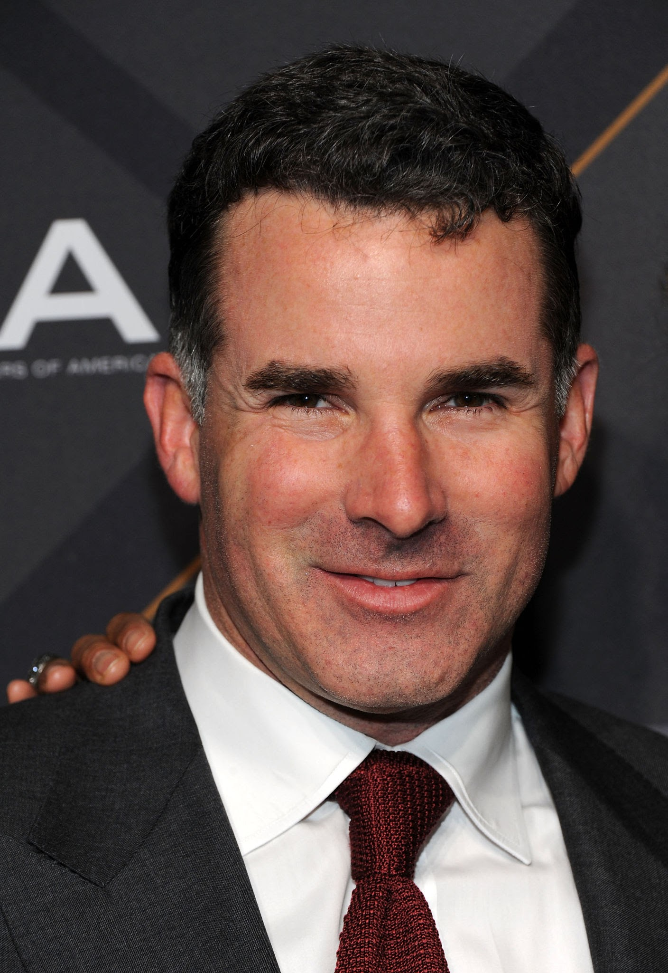
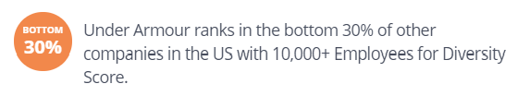
Alternative #2
Recommendation: Shake up the employees' team and brand image

Slide 23
Alternative #2
RECOMMENDATION: SHAKE UP THE EMPLOYEE’s TEAM
Pros
Workplace diversity is beneficial for employee retention.
Workplace diversity boosts the company’s reputation and brand.
Diversity in the workplace ensures a variety of different perspectives.
Workplace diversity leads to better decision-making results.

Slide 24
Alternative #2
RECOMMENDATION: SHAKE UP THE EMPLOYEE’s TEAM
Cons
Loss of more capable/qualified talent to meet diversity quotas.
Some employees might be unhappy with more diversity.
Possible difficulty to communicating strategy.

Slide 25
recommendation
Considering their larger competitors continue to diversify their product lines, we recommend Under Armour to do the same. Expanding into the Athleisure market and developing sports clothing that can be worn casually will strengthen their market share as well as their competitive advantage.

Slide 26

Questions?

Slide 27
References
Adidas 2020 Annual report
https://en.wikipedia.org/wiki/Athleisure#:~:text=Athleisure%20outfits%20can%20include%20yoga,up%20sweats%20and%20exercise%20clothing%22.
https://www.alliedmarketresearch.com/athleisure-market
https://www.alliedmarketresearch.com/athleisure-market
Lululemon 2020 10Q filling
Nike FY2020 10K (annual report)
“Patents Assigned to Under Armour, Inc.” JUSTIA Patents, 1 Apr. 2021, Patents Assigned to Under Armour, Inc.
Under Armor 2002 Annual report“Organizational Structure: Under Armour.” Organizational Structure Under Armour Utilizes a Functional Structure That They | Course Hero, Pensacola Christian College, 28 Mar. 2017, www.coursehero.com/file/p76fhi7/Organizational-Structure-Under-Armour.
“Under Armour, Inc.” Vault.com, 2021, www.vault.com/company-profiles/general-consumer-products/under-armour-inc.
“Under Armour Case: Generic Competitive Strategy.” Academic Mentor Online, 8 Aug. 2018, www.academicmentoronline.com/2018/08/under-armour-case-generic-competitive-strategy.

