Slide 1

Portfolio integration
INFT4000 (Neo lee, w0435748)

Slide 2
Portfolio integration
Role
Technologies
Learned

Slide 3

Role
I started the project because I would like to help to organize the reconciliation for a pre-primary teacher.
I made the portfolio for the project and I implement, test, debug and finish this project.

Slide 4
Technology (BOOTSTRAP)
Definition
“Bootstrap is the most popular CSS Framework for developing responsive and mobile-first websites.”
How to use
A renderer in the electron is working on the browser engine. It means that the electron app needs to use the html and the CSS, and the bootstrap is helping to make a more attractive app.
Source: https://www.w3schools.com/whatis/whatis_bootstrap.asp

Slide 5
Technology (JQuery)
Definition
“jQuery is a fast, small, and feature-rich JavaScript library. It makes things like HTML document traversal and manipulation, event handling, animation, and Ajax much simpler with an easy-to-use API that works across a multitude of browsers. With a combination of versatility and extensibility, jQuery has changed the way that millions of people write JavaScript.”
How to use
When I try to use the HTML DOM for dynamic features in the pages, I realized the pure javascript is a little bit tough for it and I applied the jQuery for this project. It is not easy to use it; however, it is very useful library with many third libraries.
Source: https://jquery.com/

Slide 6
Technology (knex with sqlite)
Definition
“Knex.js (pronounced /kəˈnɛks/) is a "batteries included" SQL query builder for Postgres, MSSQL, MySQL, MariaDB, SQLite3, Oracle, and Amazon Redshift designed to be flexible, portable, and fun to use. It features both traditional node style callbacks as well as a promise interface for cleaner async flow control, a stream interface, full featured query and schema builders, transaction support (with savepoints), connection pooling and standardized responses between different query clients and dialects.”
How to use
I cannot imagine I can build applications without a database because an application should store data somewhere. During the project, I made a ERD for the data and I used the SQLite for it, and I mixed the Knex and the SQLite in the Electron app. I am not familiar with the syntax of Knex and I struggled with a converting a SQL statement; however, it is a wonderful inferface tool for a database.
Source: http://knexjs.org/

Slide 7
Technology (Joi)
Definition
“The most powerful schema description language and data validator for JavaScript.”
How to use
I learned many technologies such as Electron, Express, React, and Laravel this semester. During the learning, I noticed the few things are always used. One of them is a validation tool and the Joi is one of the best validator. In this project, I used it once more and I am so happy with this tool because the result is always satisfied me.

Slide 8
learning
When I made the portfolio, I thought I know the Electron and other stuff well; however, after I started to make an app, it was not like that.
Through whole process of this project, it helped me to know many technologies and how to use it and how to solve the problem with those technologies.
If I start a work after graduating, I remember this process and utilize it.

Slide 9
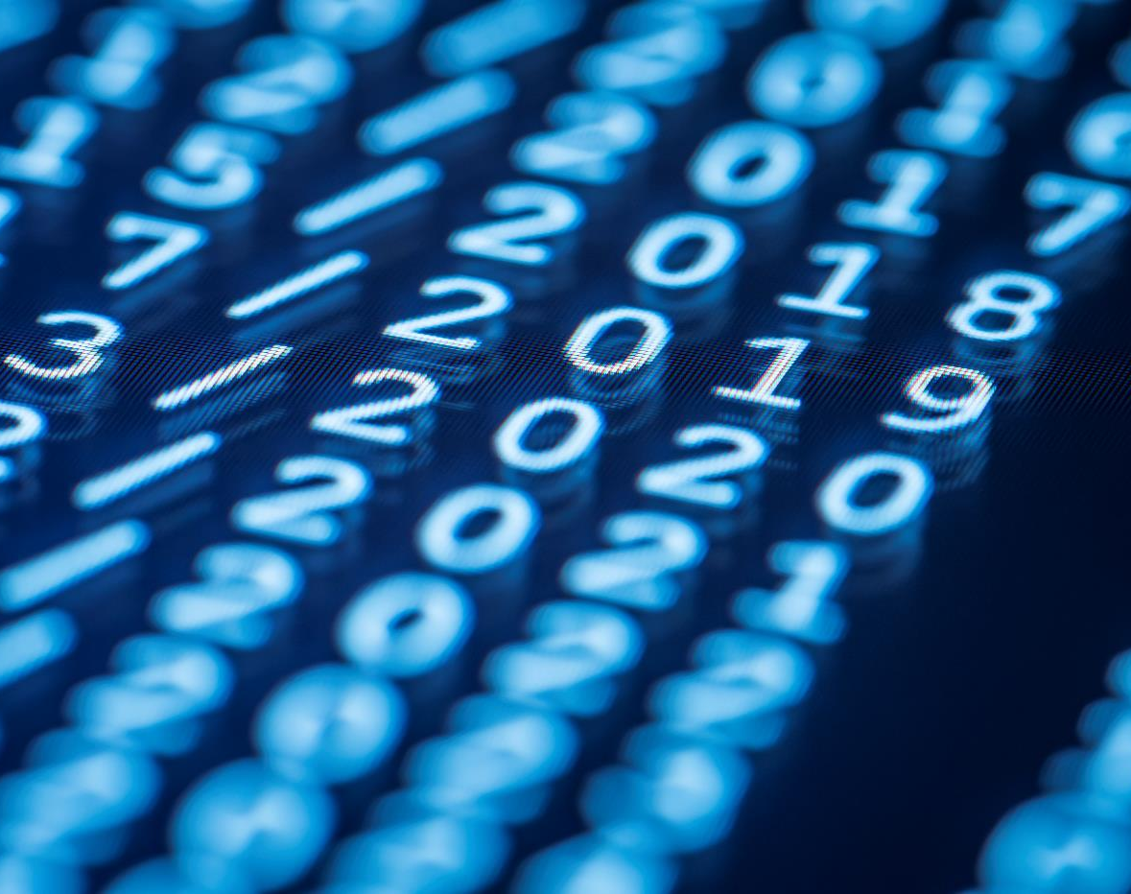
Thank You

