Slide 1
Studies of TDMI Analysis based on Simulation of IF Neurons
Kai Chen Feb. 2018

Slide 2
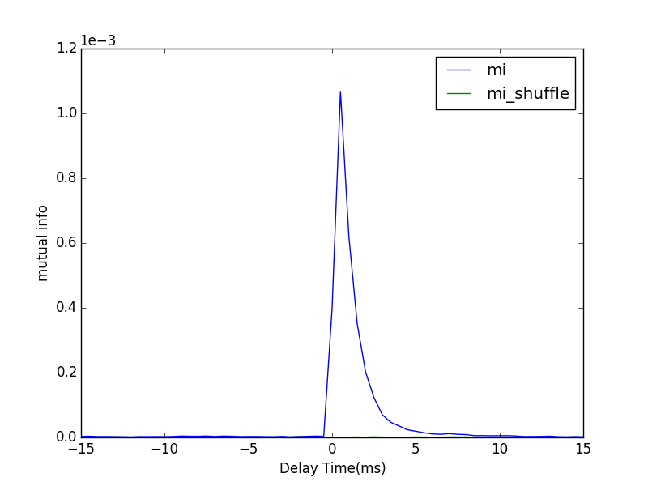
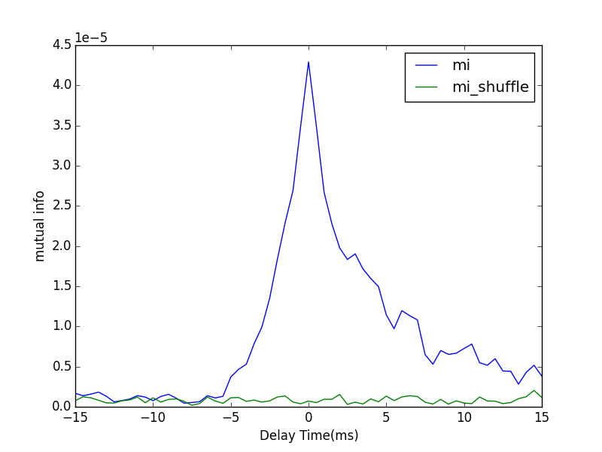
One-way Connection
Poisson Rate | 1.3 kHz | dt | 0.5 ms
S | 0.005 | #bins | 10
F | 0.005 | T | 10 mins
From 1 to 2
From 2 to 1

Slide 3
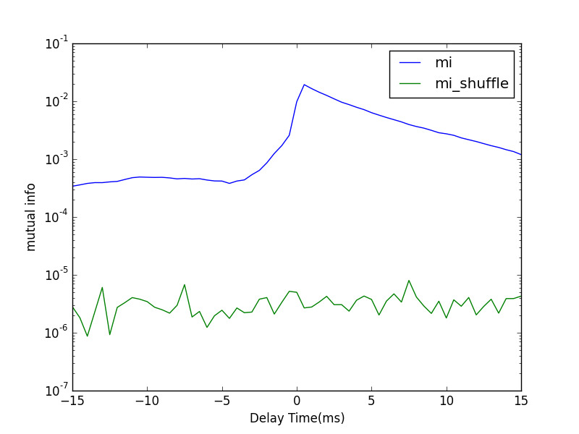
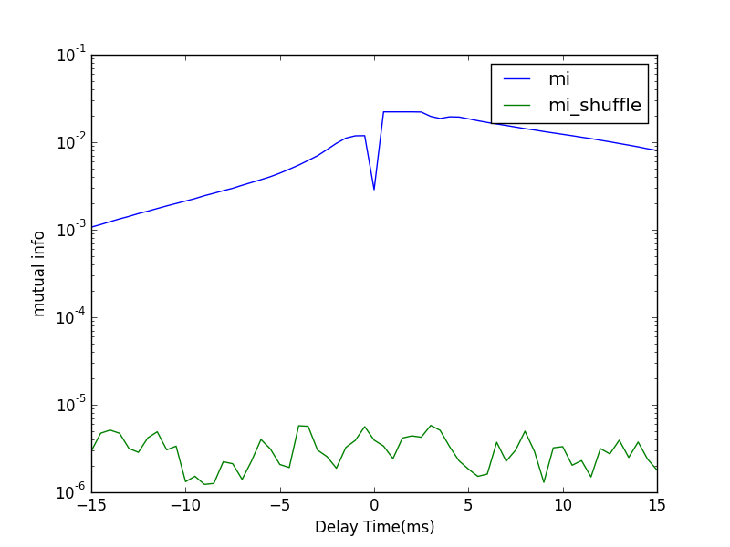
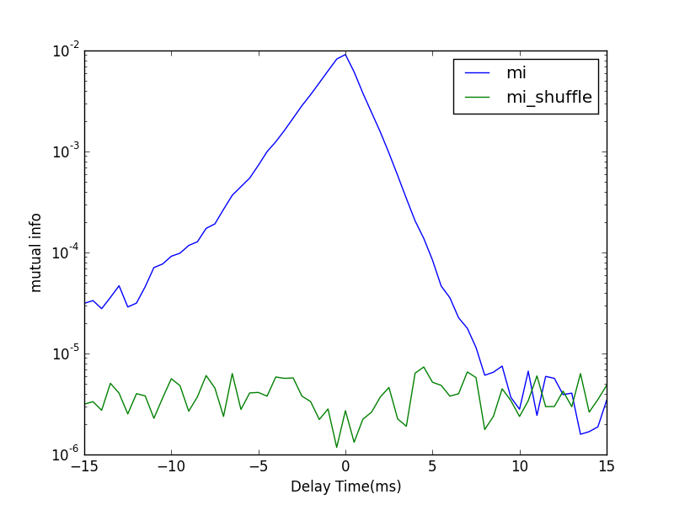

Slide 4
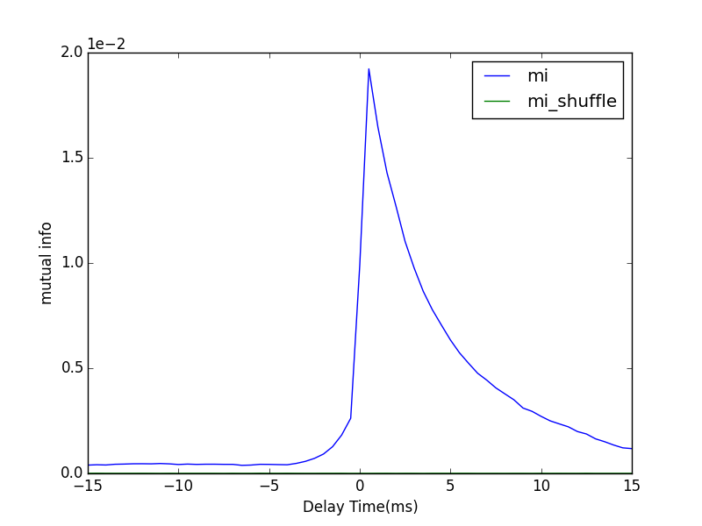
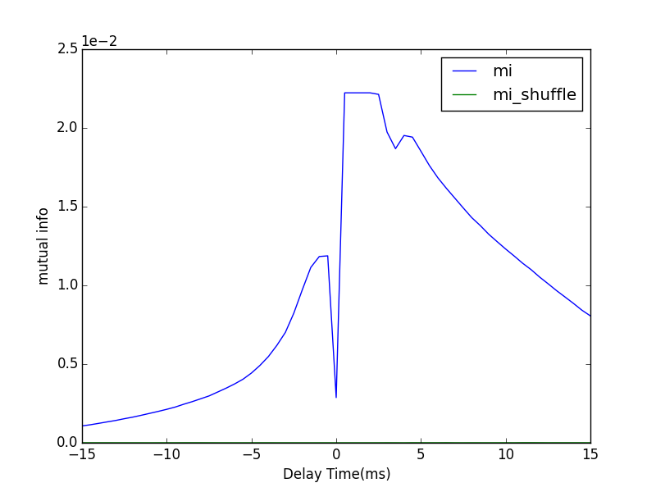
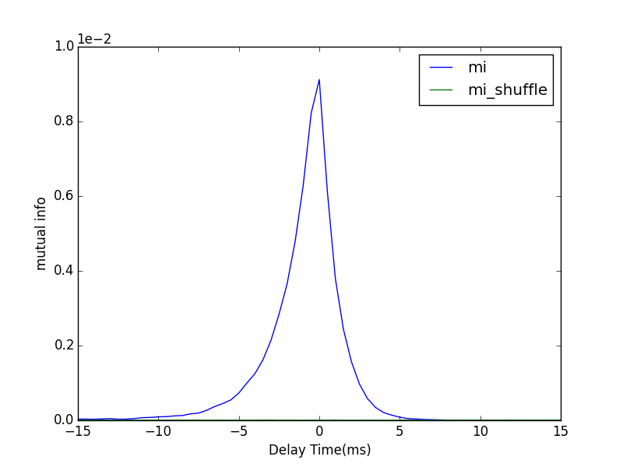

Slide 5
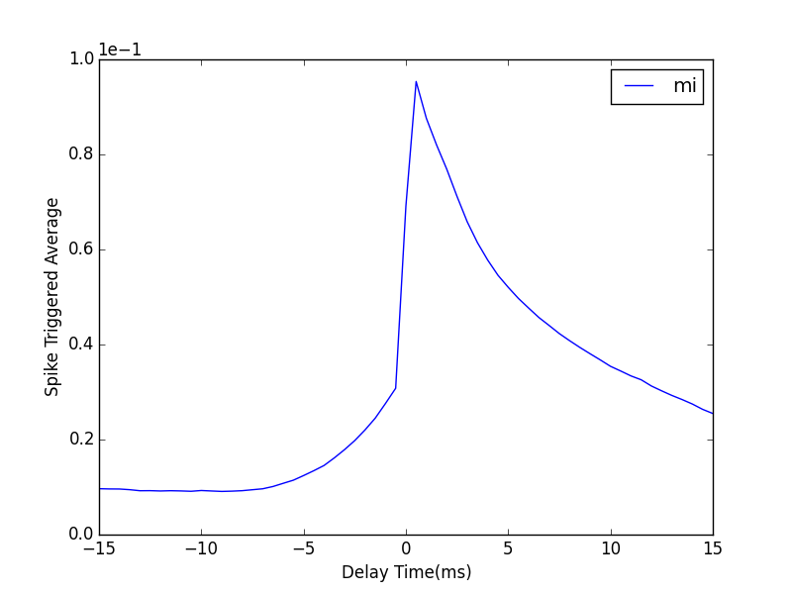
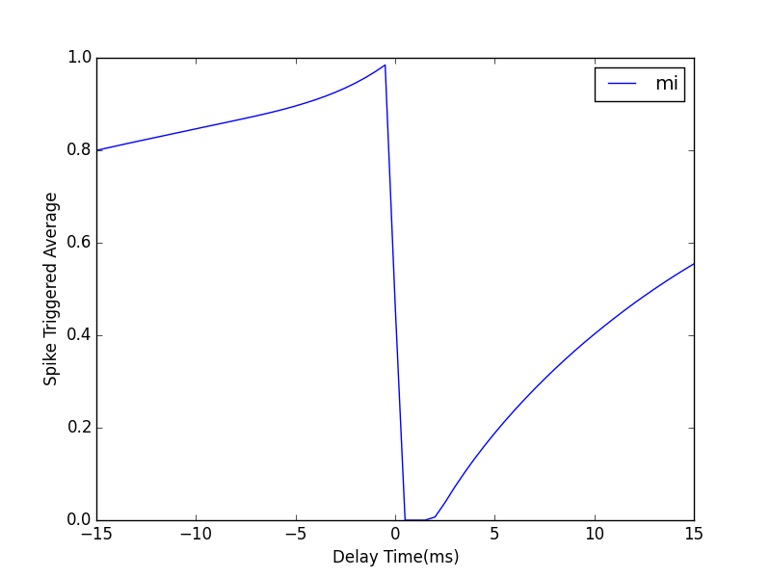
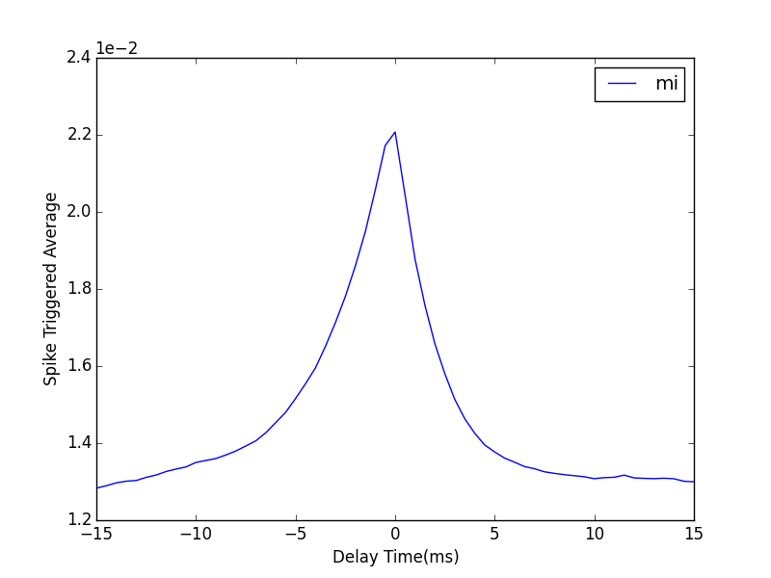

Slide 6
Neuronal Interaction layout
40 ms
current 1
spike 1
dt 0
2 ms
current 2
spike 2

Slide 7
Neuronal Interaction layout
current 1
current 1
spike 1
spike 1
current 2
current 2
spike 2
spike 2
2 ms

Slide 8
Neuronal Interaction layout
spike 1
spike 2
current 1
spike 1
current 2
spike 2
current 1
current 2

Slide 9
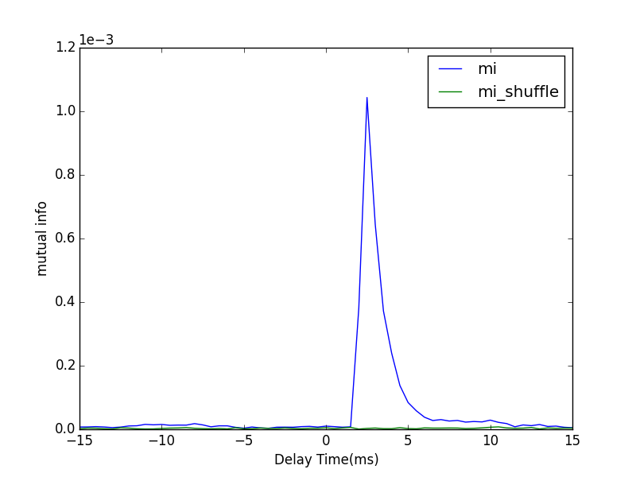
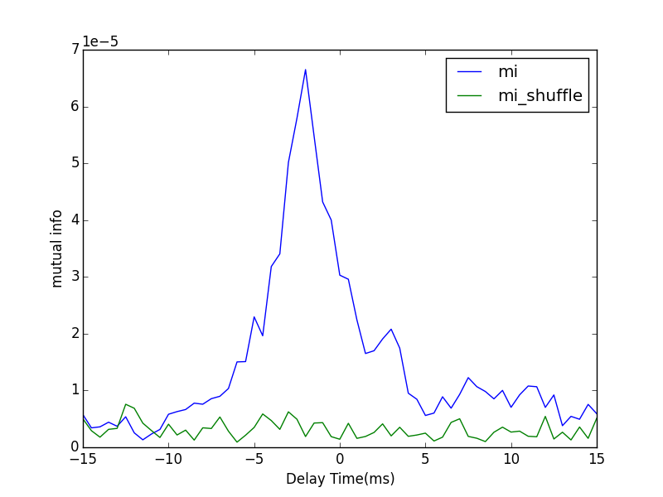
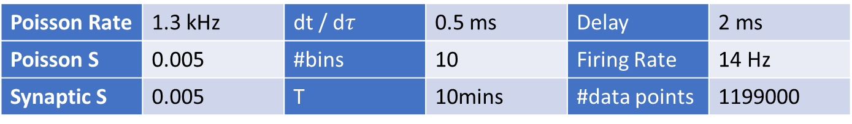
Poisson Rate | 1.3 kHz | dt / d$τ$ | 0.5 ms | Delay | 2 ms
Poisson S | 0.005 | #bins | 10 | Firing Rate | 14 Hz
Synaptic S | 0.005 | T | 10mins | #data points | 1199000
Spike 1 to Current 2
Spike 2 to Current 1

Slide 10
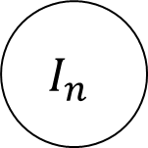

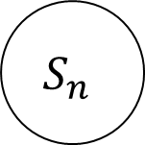
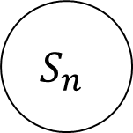


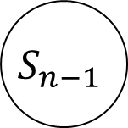

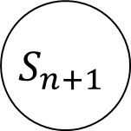

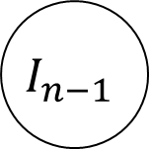
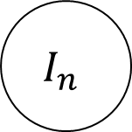
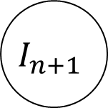

Mutual information calculation with different shifting scheme
$$S_{n−1}$$
$$S_{n}$$
$$S_{n+1}$$
$$S_{n}$$
$$τ<0$$
$$τ<0$$
$$τ=0$$
$$τ=0$$
$$τ>0$$
$$τ<0$$
$$I_{n}$$
$$I_{n−1}$$
$$I_{n}$$
$$I_{n+1}$$
Shifting spike train
Shifting current

Slide 11
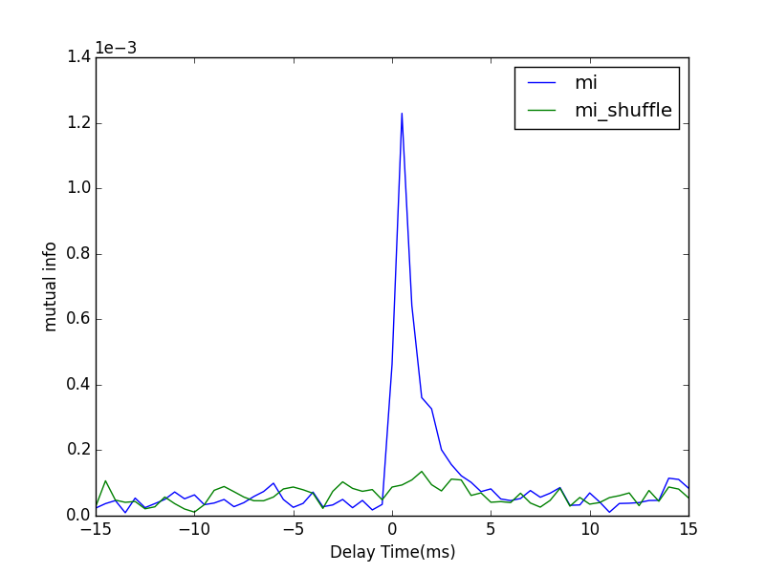
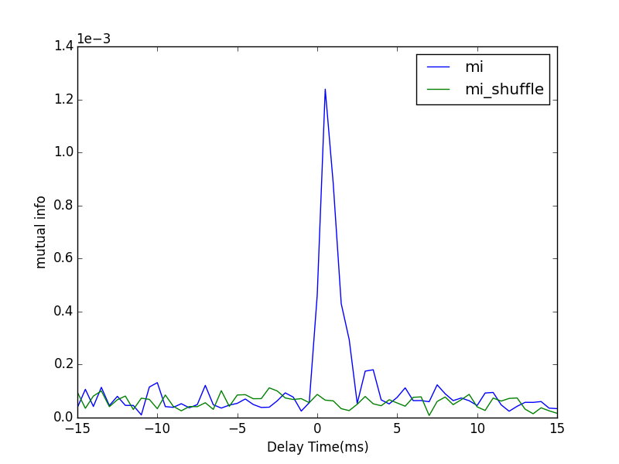
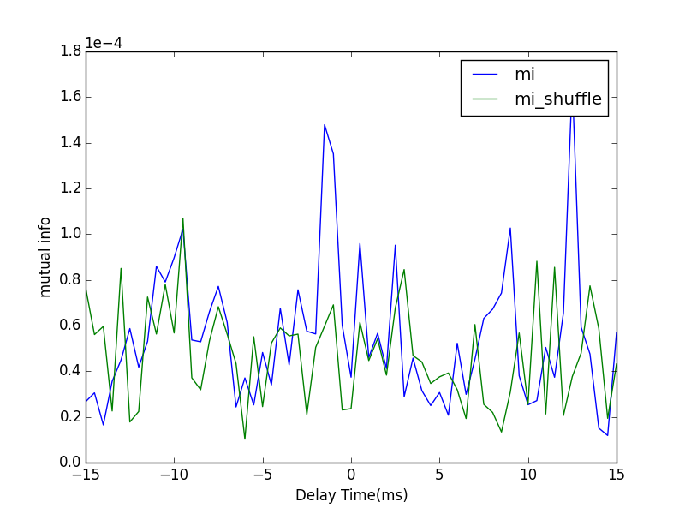
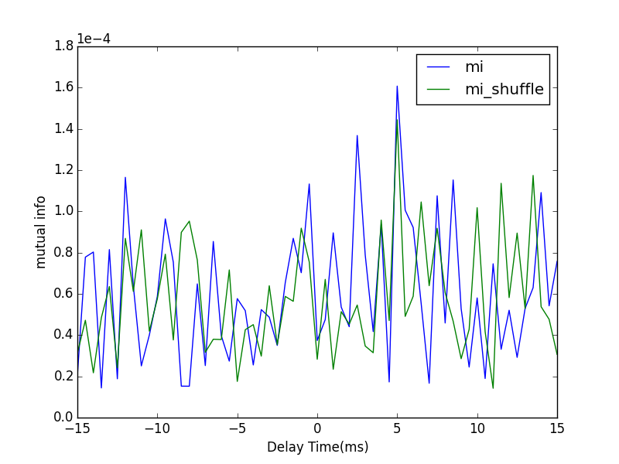
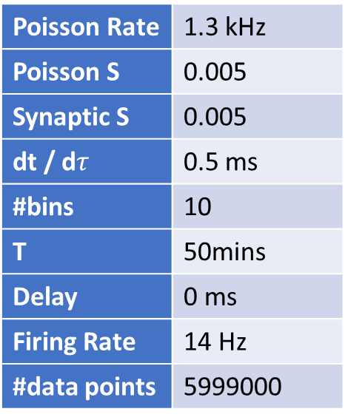
Shifting spike train
Shifting current
Mutual information calculation
with different shifting scheme
Poisson Rate | 1.3 kHz
Poisson S | 0.005
Synaptic S | 0.005
dt / d$τ$ | 0.5 ms
#bins | 10
T | 50mins
Delay | 0 ms
Firing Rate | 14 Hz
#data points | 5999000

Slide 12
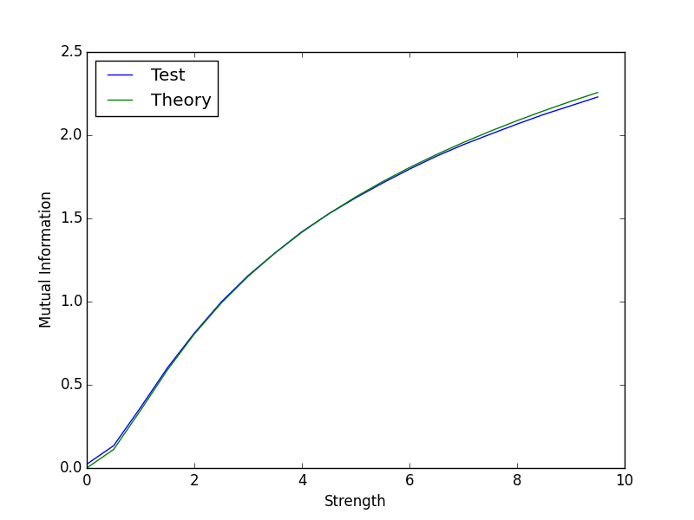
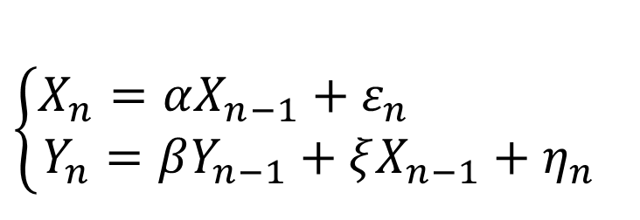
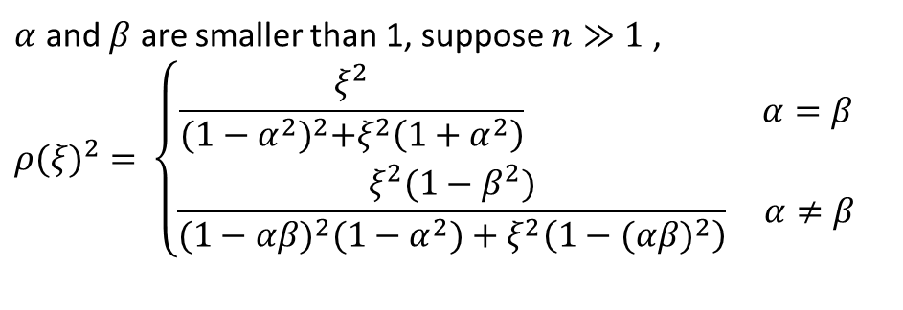



Mutual information of Gaussian random variables
$$\left\{\begin{aligned}X_{n}=αX_{n−1}+ε_{n} \\ Y_{n}=βY_{n−1}+ξX_{n−1}+η_{n}\end{aligned}\right.$$
$α=0.01，β=0.01$ #bin=50 T= 300000
$$I\left(X,Y\right)=−\frac{1}{2}log⁡(1−ρ^{2})$$
$$ρ=ρ\left(ξ,α,β\right)=\frac{Cov\left(X,Y\right)}{σ_{X}σ_{Y}}=\frac{E\left(XY\right)−μ_{X}μ_{y}}{σ_{X}σ_{Y}}$$
$α$ and $β$ are smaller than 1, suppose $n≫1$ ,
$${ρ(ξ)}^{2}=⁡\left\{\begin{aligned}\frac{ξ^{2}}{{(1−α^{2})}^{2}+ξ^{2}\left(1+α^{2}\right)} α=β \\ \frac{ξ^{2}(1−β^{2})}{{(1−αβ)}^{2}(1−α^{2})+ξ^{2}\left(1−{(αβ)}^{2}\right)} α≠β\end{aligned}\right.$$
#bins = 150 300000 trials

Slide 13


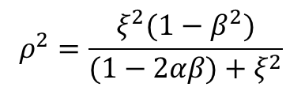





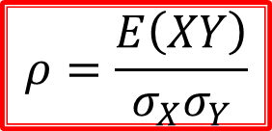


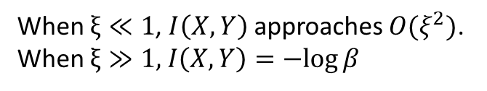


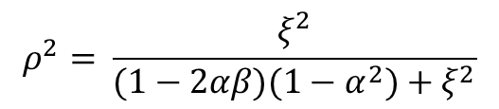


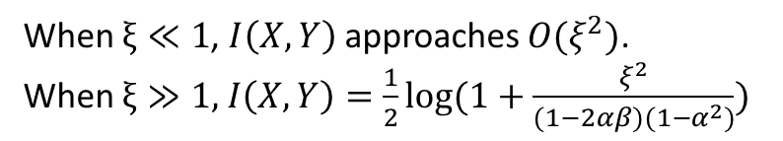

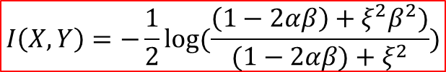


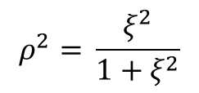
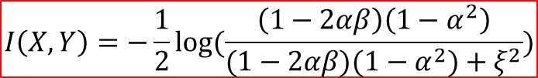
Mutual information of Gaussian random variables
$$ρ^{2}=\frac{ξ^{2}(1−β^{2})}{(1−2αβ)+ξ^{2}}$$
$$α$$
If $0<|α|≪|β|<1$, then,
$$α$$
$$X_{n−1}$$
$$X_{n}$$
$$X_{n+1}$$
$$I\left(X,Y\right)=−\frac{1}{2}log⁡(\frac{\left(1−2αβ\right)+ξ^{2}β^{2})}{(1−2αβ)+ξ^{2}})$$
$$ξ$$
$$ξ$$
When $ξ≪1$, $I\left(X,Y\right)$ approaches $O(ξ^{2})$.
When $ξ≫1,$ $I\left(X,Y\right)=−log⁡β$
$$β$$
$$β$$
$$Y_{n−1}$$
$$Y_{n}$$
$$Y_{n+1}$$
$$ρ^{2}=⁡\frac{ξ^{2}}{(1−2αβ)(1−α^{2})+ξ^{2}}$$
If $0<|β|≪|α|<1$, then,
$$ρ^{2}=⁡\frac{ξ^{2}}{1+ξ^{2}}$$
$$I\left(X,Y\right)=−\frac{1}{2}log⁡(\frac{\left(1−2αβ\right)\left(1−α^{2}\right)}{(1−2αβ)(1−α^{2})+ξ^{2}})$$
If $0<|α|, |β|≪1$, then,
$$I\left(X,Y\right)=\frac{1}{2}log⁡(1+ξ^{2})$$
When $ξ≪1$, $I\left(X,Y\right)$ approaches $O(ξ^{2})$.
When $ξ≫1,$ $I\left(X,Y\right)=\frac{1}{2}log⁡(1+\frac{ξ^{2}}{(1−2αβ)(1−α^{2})})$
$$ρ=\frac{E\left(XY\right)}{σ_{X}σ_{Y}}$$

Slide 14






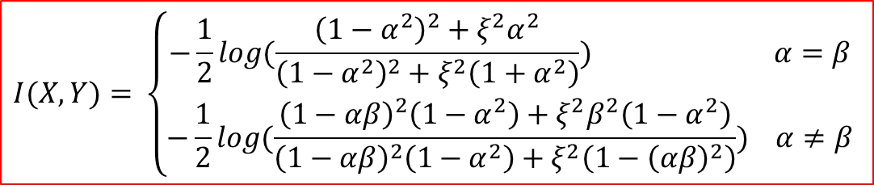



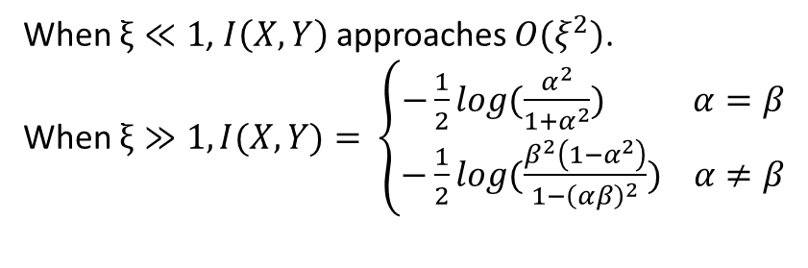




Mutual information of Gaussian random variables
If $\left|α\right|,\left|β\right|<1$, then,
$$α$$
$$I(X,Y)=⁡\left\{\begin{aligned}−\frac{1}{2}log⁡(\frac{{\left(1−α^{2}\right)}^{2}+ξ^{2}α^{2}}{{\left(1−α^{2}\right)}^{2}+ξ^{2}\left(1+α^{2}\right)}) α=β \\ −\frac{1}{2}log(\frac{{\left(1−αβ\right)}^{2}\left(1−α^{2}\right)+ξ^{2}β^{2}\left(1−α^{2}\right)}{{\left(1−αβ\right)}^{2}\left(1−α^{2}\right)+ξ^{2}\left(1−{\left(αβ\right)}^{2}\right)}) α≠β\end{aligned}\right.$$
$$α$$
$$X_{n−1}$$
$$X_{n}$$
$$X_{n+1}$$
$$ξ$$
$$ξ$$
$$β$$
$$β$$
When $ξ≪1$, $I\left(X,Y\right)$ approaches $O(ξ^{2})$.
When $ξ≫1,I(X,Y)=⁡\left\{\begin{aligned}−\frac{1}{2}log⁡(\frac{α^{2}}{1+α^{2}}) α=β \\ −\frac{1}{2}log(\frac{β^{2}\left(1−α^{2}\right)}{1−{\left(αβ\right)}^{2}}) α≠β\end{aligned}\right.$
$$Y_{n−1}$$
$$Y_{n}$$
$$Y_{n+1}$$
$$ρ=\frac{E\left(XY\right)}{σ_{X}σ_{Y}}$$

Slide 15

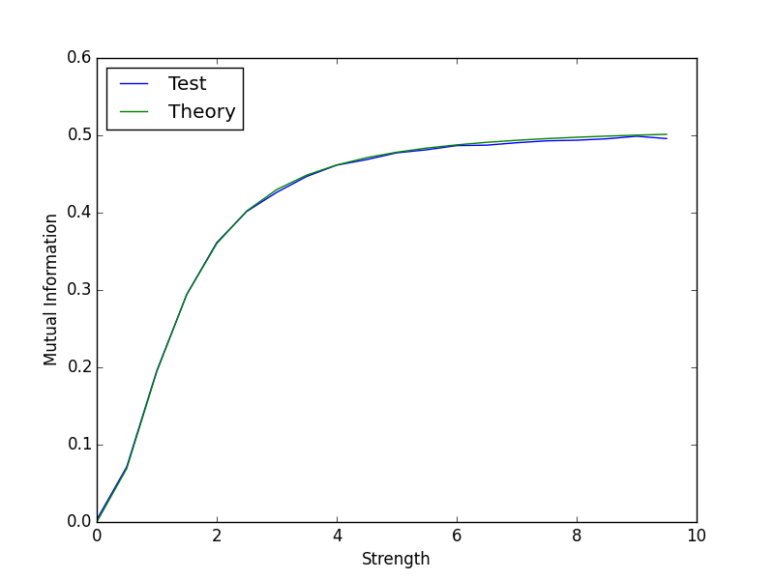
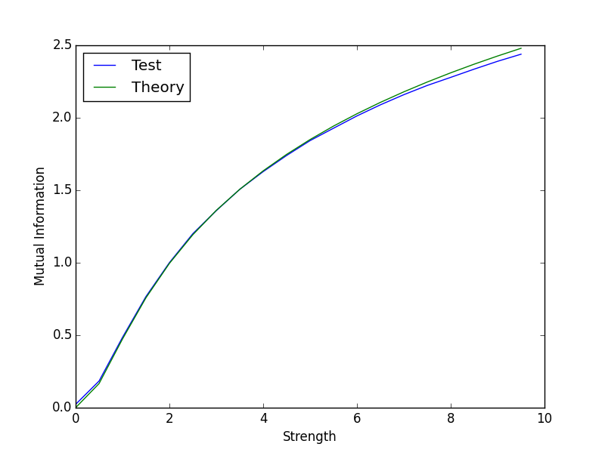
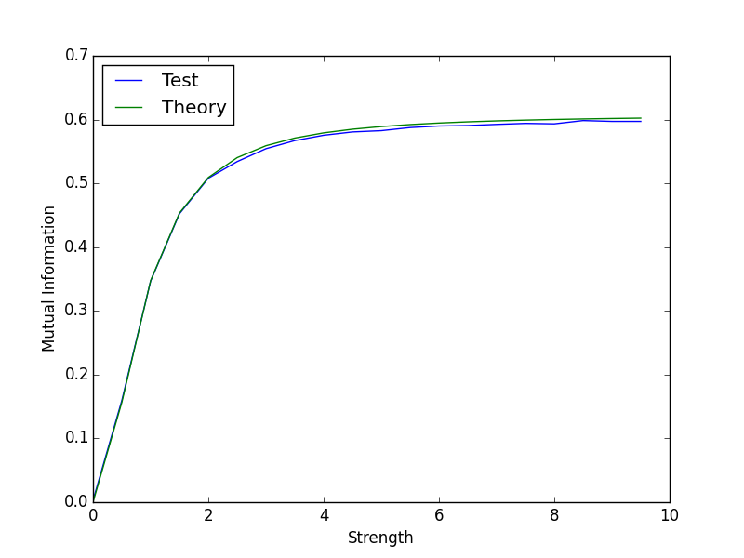




$α=0.01，β=0.01$ #bin=150 T= 300000
$α=0.01，β=0.6$ #bin=50 T= 300000
$α=0.6，β=0.01$ #bin=150 T= 300000
$α=0.5，β=0.6$ #bin=50 T= 300000

Slide 16
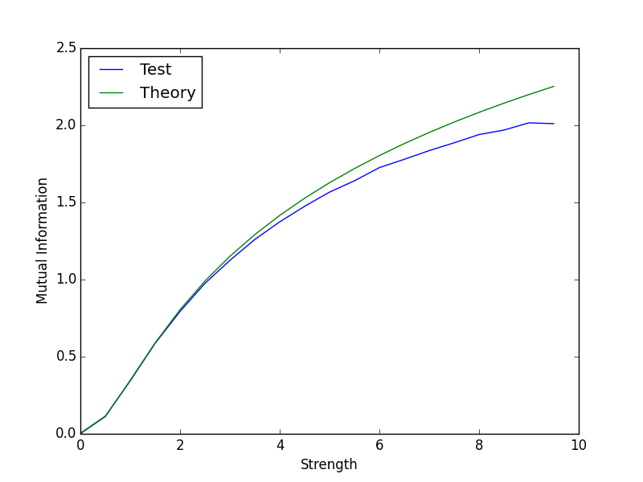
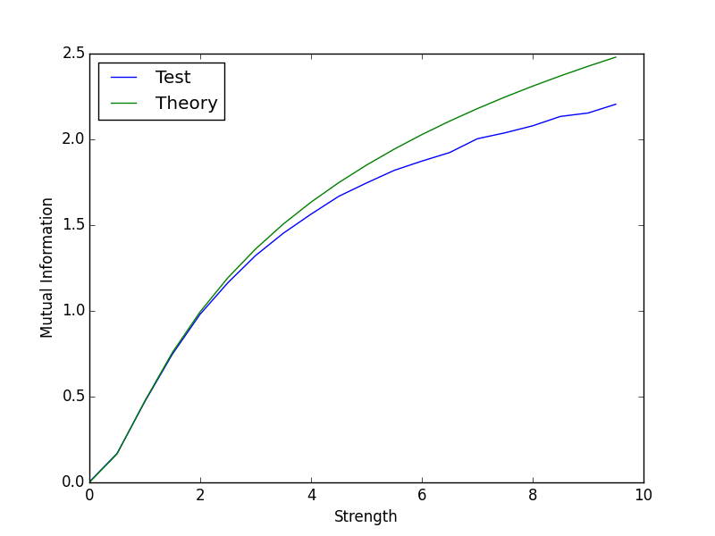




$α=0.01，β=0.01$ #bin=50 T= 300000
$α=0.01，β=0.01$ #bin=150 T= 300000
$α=0.6，β=0.01$ #bin=50 T= 300000
$α=0.6，β=0.01$ #bin=150 T= 300000

Slide 17
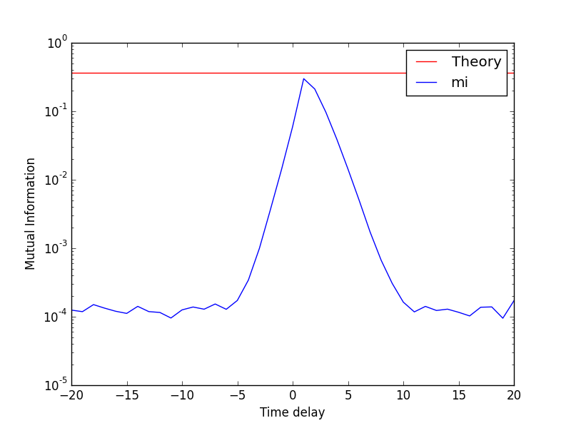
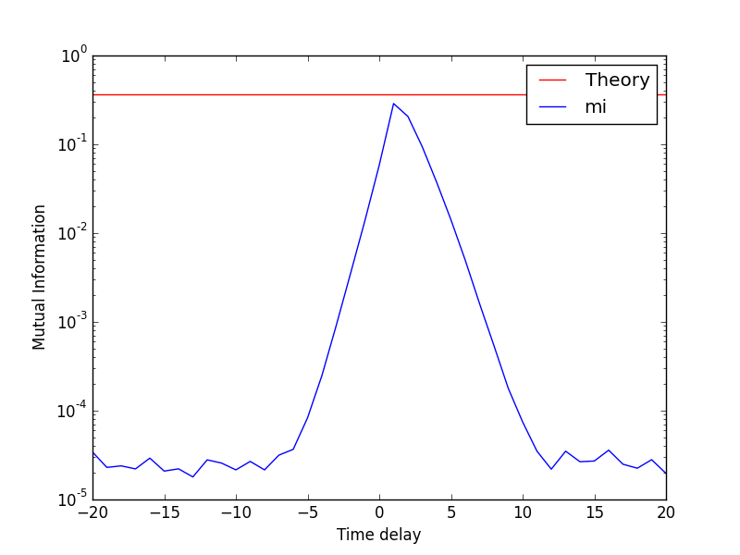
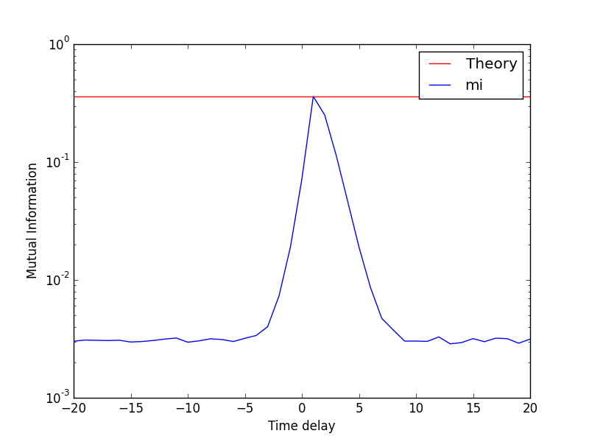
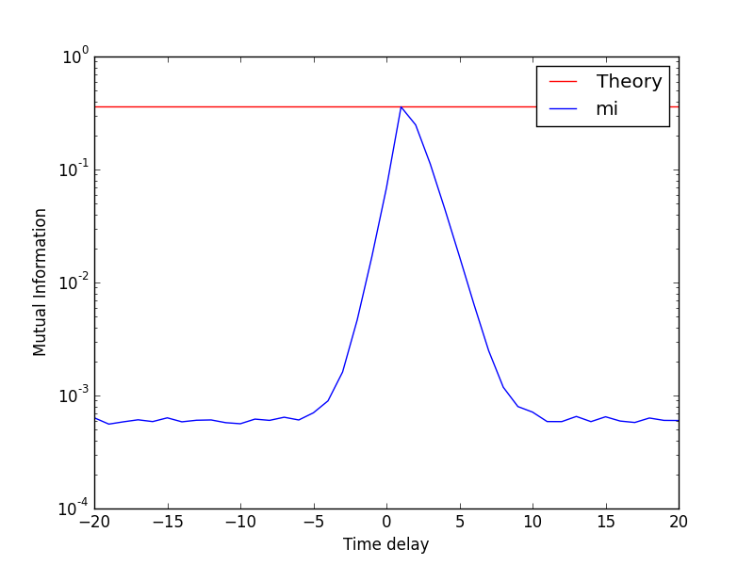
#trials = 300000
#trials = 1500000
#bins = 10
#bins = 50

Slide 18
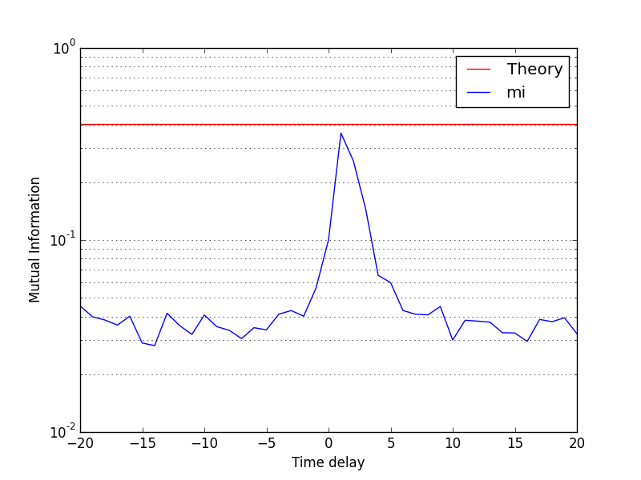






1k trials
10k trials
100k trials
$$α=β=0.5, ξ=1, \#bins=10$$
20 bins
25 bins
50 bins

Slide 19






Length of time series
1k ms
10k ms
100k ms
#bins=20
#bins=30
#bins=40

Slide 20


Shifting spike train
Shifting current

