Slide 1
Application of TDMI on Analyzing Neural Data(II)
Kyle Chen
May 23

Slide 2
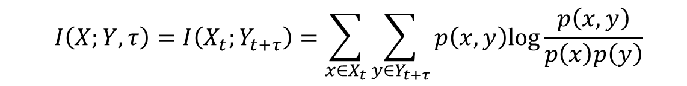
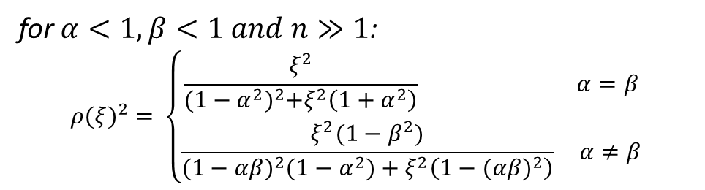
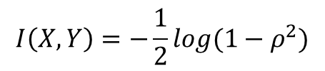
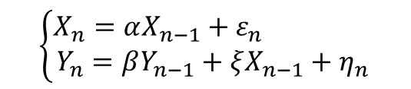
Review about last talk
Definition of entropy and (time-delayed) mutual information
$$I\left(X;Y,τ\right)=I\left(X_{t};Y_{t+τ}\right)=\sum_{x∈X_{t}}{\sum_{y∈Y_{t+τ}}{p\left(x,y\right)log\frac{p\left(x,y\right)}{p\left(x\right)p\left(y\right)}}}$$
TDMI between Gaussian random variables
$$\left\{\begin{aligned}X_{n}=αX_{n−1}+ε_{n} \\ Y_{n}=βY_{n−1}+ξX_{n−1}+η_{n}\end{aligned}\right.$$
for $α<1,β<1 and n≫1$:
$${ρ(ξ)}^{2}=⁡\left\{\begin{aligned}\frac{ξ^{2}}{{(1−α^{2})}^{2}+ξ^{2}\left(1+α^{2}\right)} α=β \\ \frac{ξ^{2}(1−β^{2})}{{(1−αβ)}^{2}(1−α^{2})+ξ^{2}\left(1−{(αβ)}^{2}\right)} α≠β\end{aligned}\right.$$
$$I\left(X,Y\right)=−\frac{1}{2}log⁡(1−ρ^{2})$$
TDMI analysis in two-neuron system
Mutual information estimation scheme
Fake signal in in-directed connected neural pairs

Slide 3
Outline
Mutual information estimation
Deviation of numerically calculated MI value away from true (theoretical) value
TDMI implies neuronal connecting pattern in networks :
The difference of magnitude of TDMI signal between different neuronal pairs
Fake signal in in-directed connected neural pairs
Numerical demo of TDMI analysis between spike train and local field potential

Slide 4
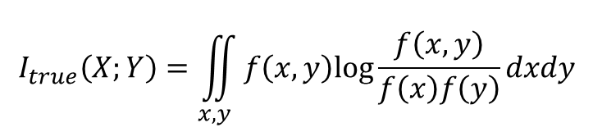
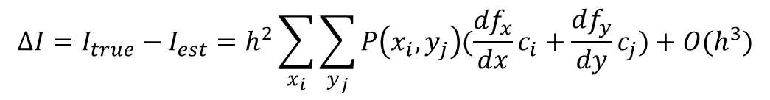
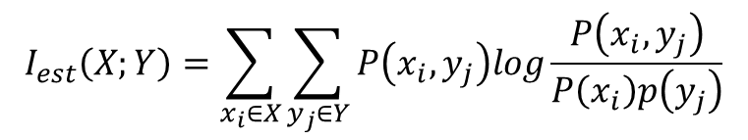
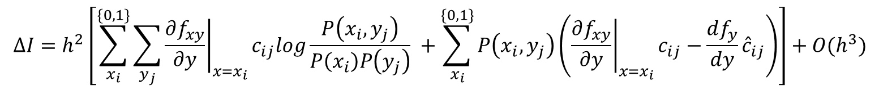
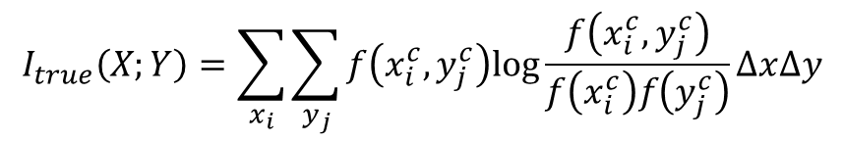
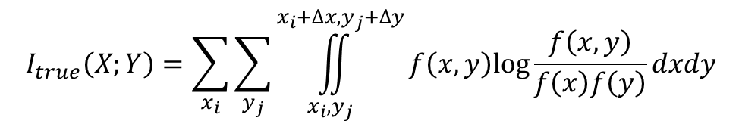
Mutual Information Estimation
$$I_{true}\left(X;Y\right)=\iint_{x,y}{f\left(x,y\right)log\frac{f\left(x,y\right)}{f\left(x\right)f\left(y\right)}dxdy}$$
$$I_{est}\left(X;Y\right)=\sum_{x_{i}∈X}{\sum_{y_{j}∈Y}{P\left(x_{i},y_{j}\right)log\frac{P\left(x_{i},y_{j}\right)}{P\left(x_{i}\right)p\left(y_{j}\right)}}}$$
Approximation
$$I_{true}\left(X;Y\right)=\sum_{x_{i}}{\sum_{y_{j}}{\iint_{x_{i},y_{j}}^{x_{i}+∆x,y_{j}+∆y}{f\left(x,y\right)log\frac{f\left(x,y\right)}{f\left(x\right)f\left(y\right)}dxdy}}}$$
$$I_{true}\left(X;Y\right)=\sum_{x_{i}}{\sum_{y_{j}}{f\left(x_{i}^{c},y_{j}^{c}\right)log\frac{f\left(x_{i}^{c},y_{j}^{c}\right)}{f\left(x_{i}^{c}\right)f\left(y_{j}^{c}\right)}∆x∆y}}$$
$$∆I=I_{true}−I_{est}=h^{2}\sum_{x_{i}}{\sum_{y_{j}}{P\left(x_{i},y_{j}\right)(\frac{df_{x}}{dx}c_{i}+\frac{df_{y}}{dy}c_{j})}}+O(h^{3})$$
For Gaussian case:
$$∆I=h^{2}\left[\sum_{x_{i}}^{\{0,1\}}{\sum_{y_{j}}{{\left.\frac{∂f_{xy}}{∂y}\right|}_{x=x_{i}}c_{ij}log\frac{P\left(x_{i},y_{j}\right)}{P\left(x_{i}\right)P\left(y_{j}\right)} }}+\sum_{x_{i}}^{\{0,1\}}{P\left(x_{i},y_{j}\right)\left({\left.\frac{∂f_{xy}}{∂y}\right|}_{x=x_{i}}c_{ij}−\frac{df_{y}}{dy}{\hat{c}}_{ij}\right)}\right]+O(h^{3})$$
For spike-LFP case:

Slide 5
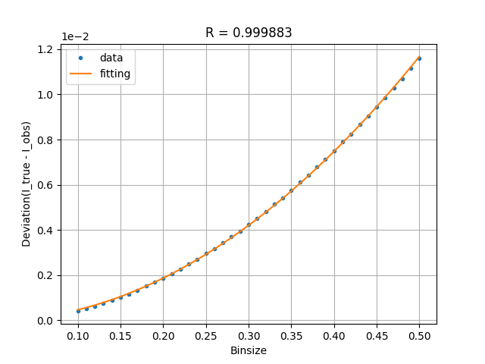
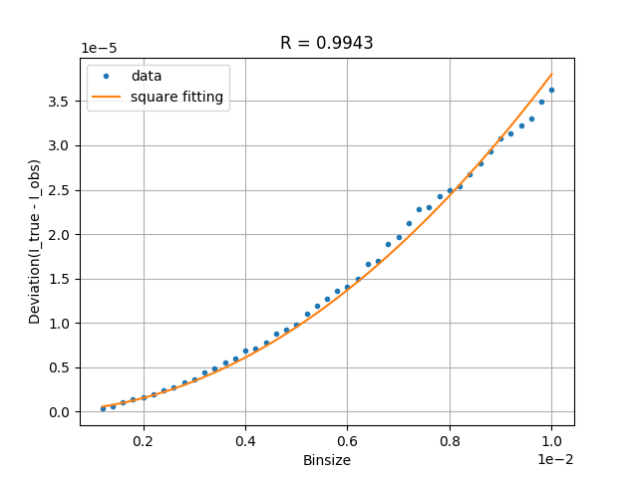
Mutual Information Estimation
Gaussian case
Spike-LFP case

Slide 6
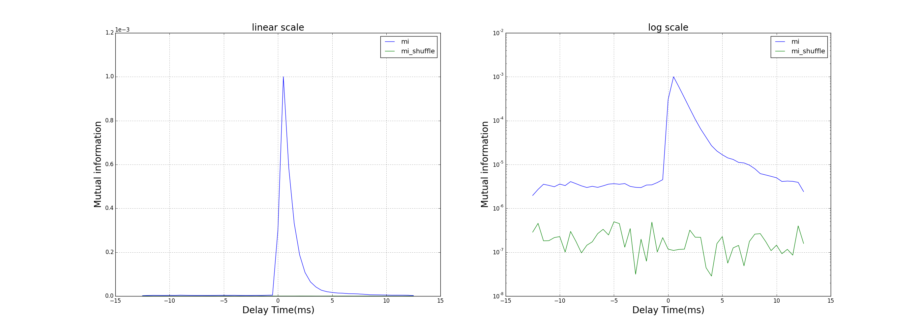
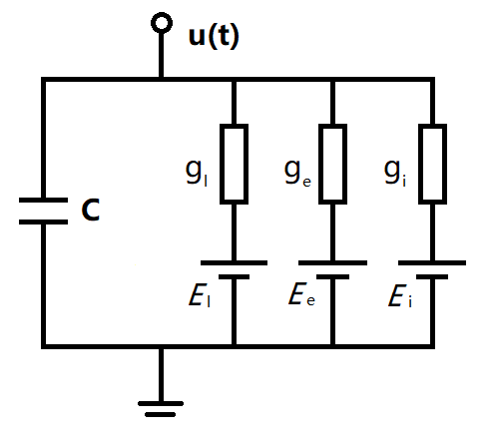

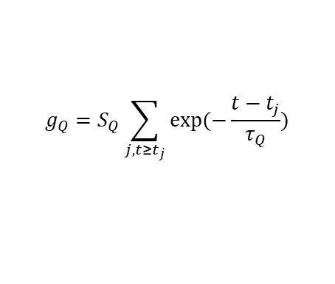

TDMI implies neuronal connecting pattern in networks
Previously: two neuron
0
1
Now: 100 neuron in a network
0
1
2
3
99
Conductance-based Integrate-and-fire model:
$$C\frac{dv}{dt}=−g_{l}\left(v−ε_{l}\right)−g_{Q}\left(v−ε_{Q}\right)$$
$$Q∈\left\{e,i\right\}$$
$$g_{Q}=S_{Q}\sum_{j, t≥t_{j}}{exp⁡(−\frac{t−t_{j}}{τ_{Q}})}$$
Network consisting 100 I&F neurons
Notes:
Poisson Rate=1.3kHz
S = 5e-3
F = 5e-3
dt = 0.5 ms
Binsize = 0.03

Slide 7
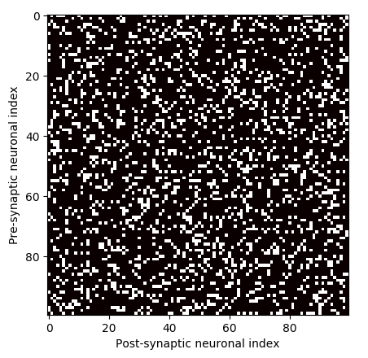

Network Setups
100 excitatory neurons
Connectivity probability(p):
Randomly connected by 20%
Homogeneous Poisson input rate($ν$):
1.3 kHz
Poisson strength(f):
5e-3 (Roughly 0.5mV EPSP for 15mV subthreshold range of voltage)
Refractory period = 2ms
Time constant of g = 2ms
Time delay of synaptic interactions = 0 ms

Slide 8
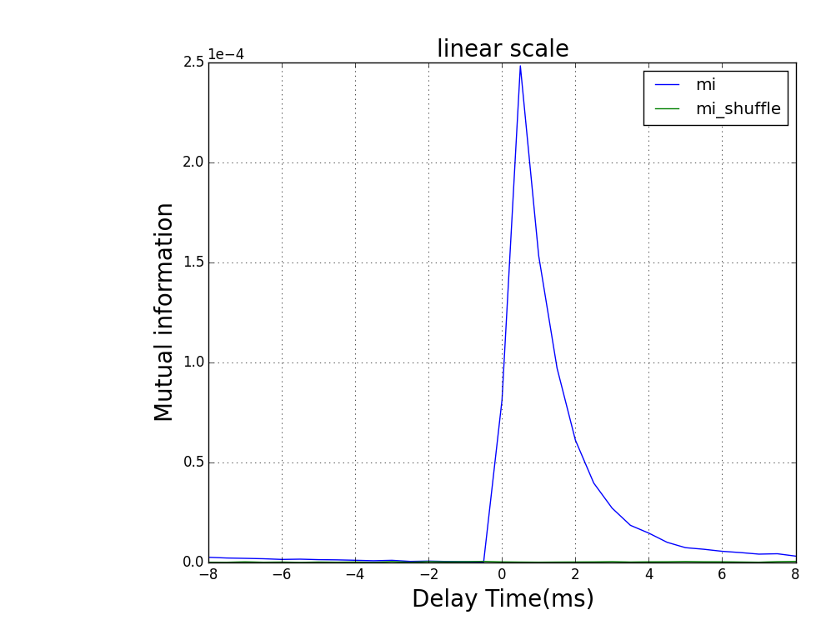
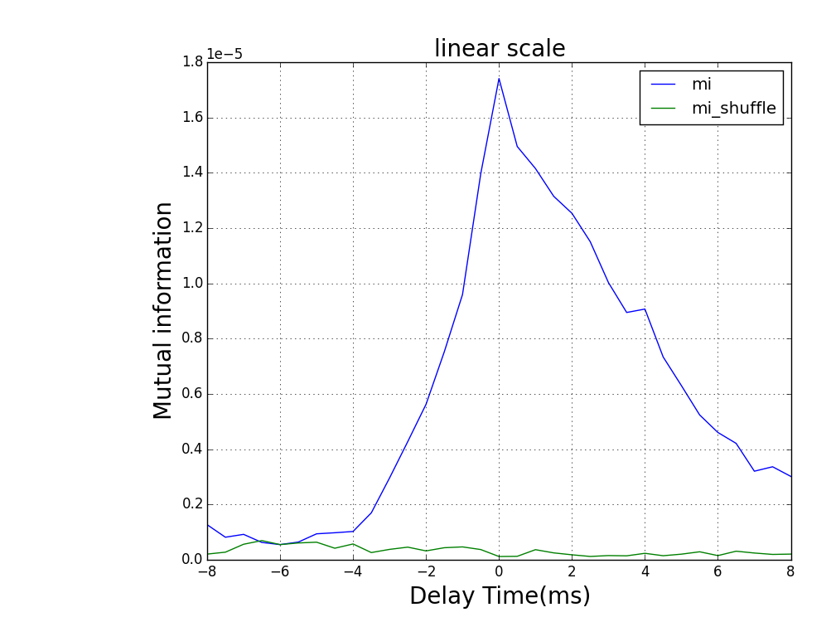
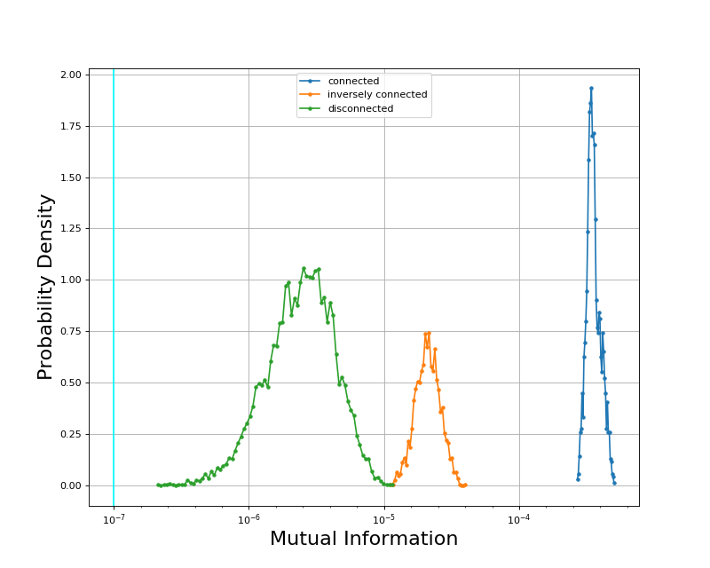
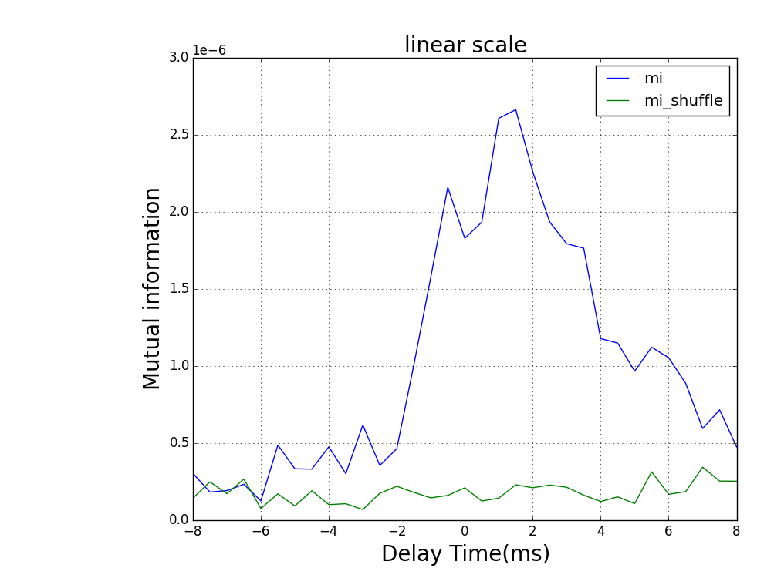
Maximum TDMI for neuronal pairs in network
Normal case
Parameters | Values
L | 1e7
Recording rate | 2 /ms
Binsize of LFP | 0.03
Effective #bins | 6-7
S | 2e-3 (0.2mV)
S = 2e-3(0.2mV) | L = 1e7 | Recording rate = 2/ms | Binning size of LFP = 0.03 (roughly 6-7 effective bins)

Slide 9





Neuronal Interaction layout
spike 1
spike 2
$${10}^{−4}$$
0
1
$${10}^{−4}$$
$${10}^{−2}$$
$${10}^{−2}$$
$${10}^{−5}$$
current 1
current 2

Slide 10
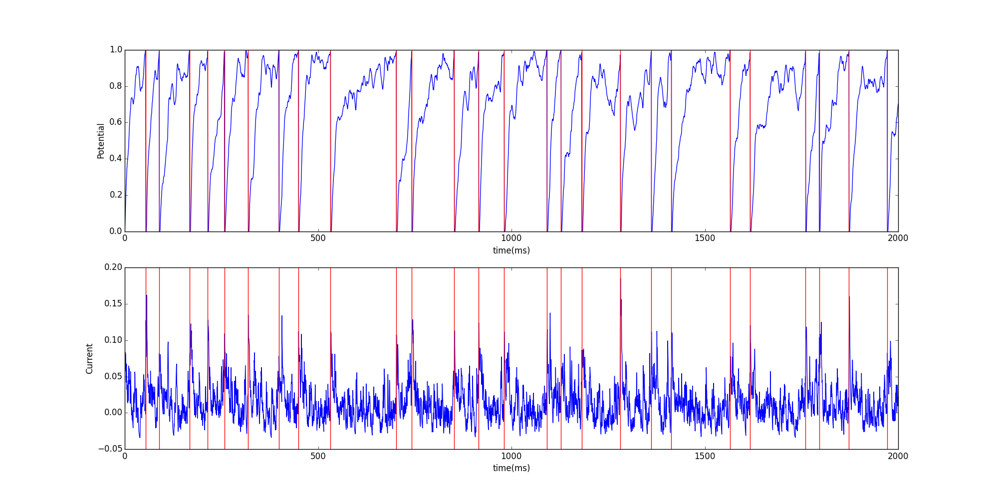
TDMI estimation with threshold scheme

Slide 11
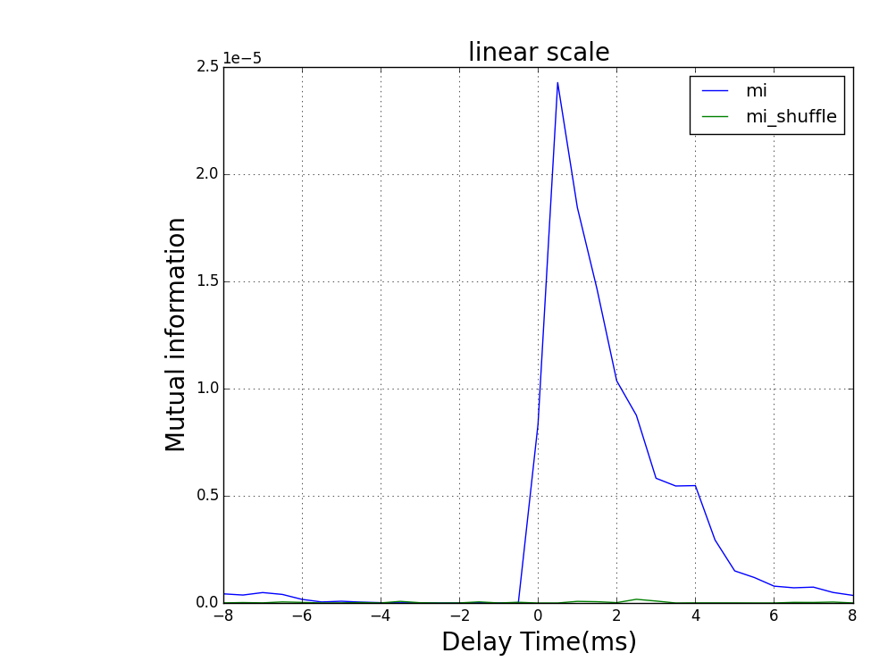
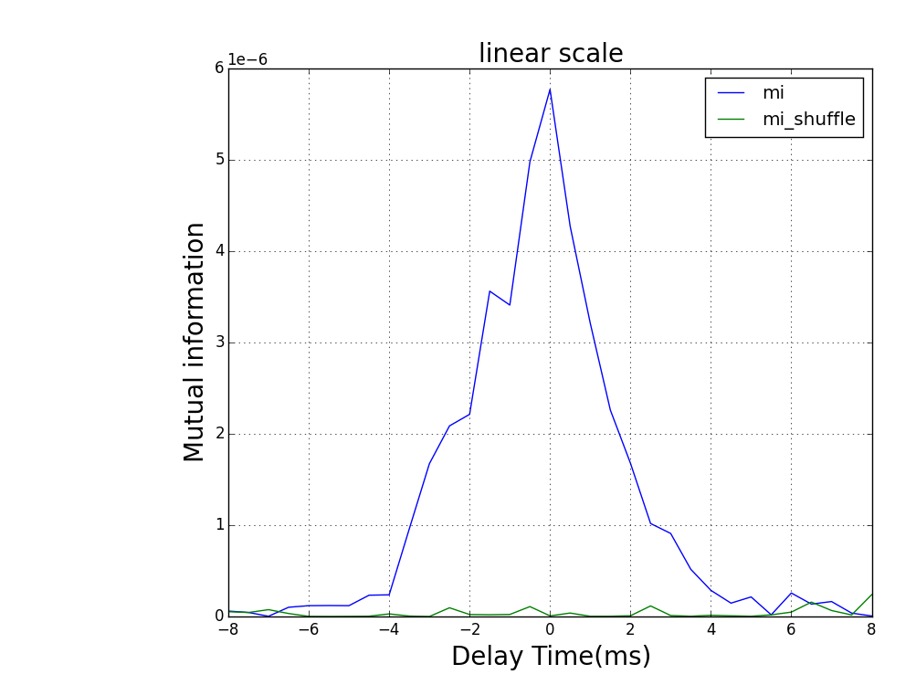
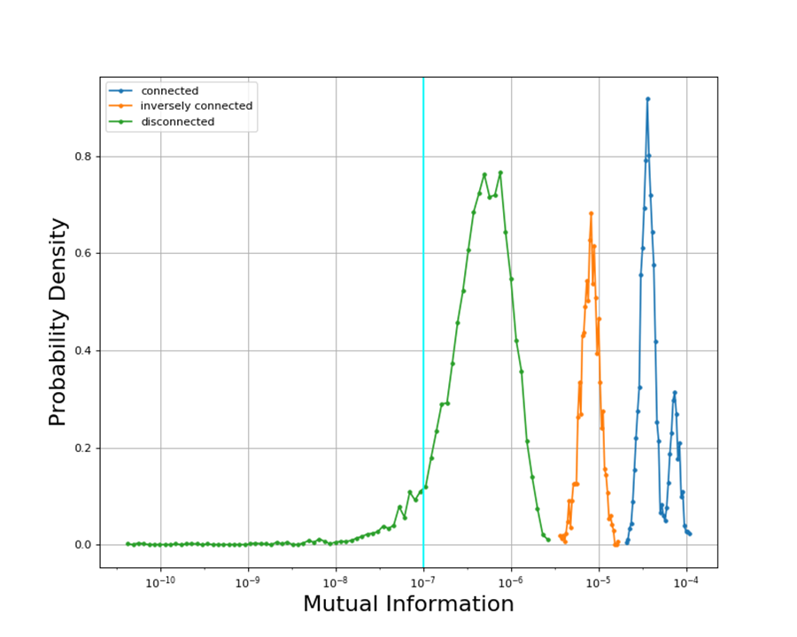
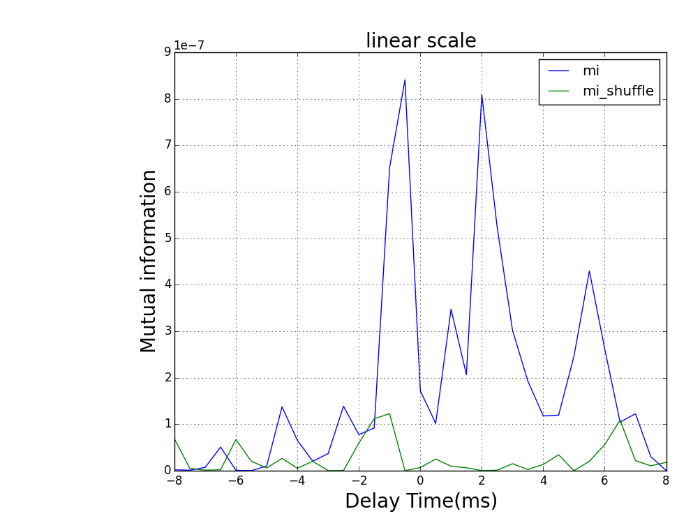
Maximum TDMI for neuronal pairs in network
Strong interaction case
Parameters | Values
L | 1e7
Recording rate | 2 /ms
Threshold | 0.1
Effective #bins | 2
S | 2e-3 (0.2mV)

Slide 12
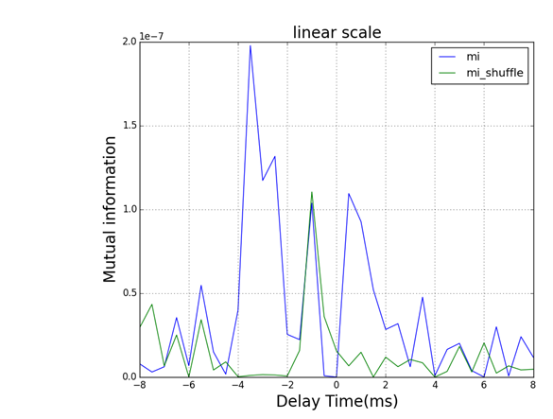
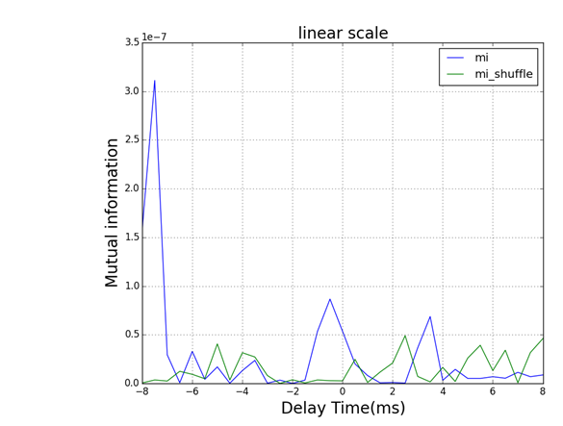
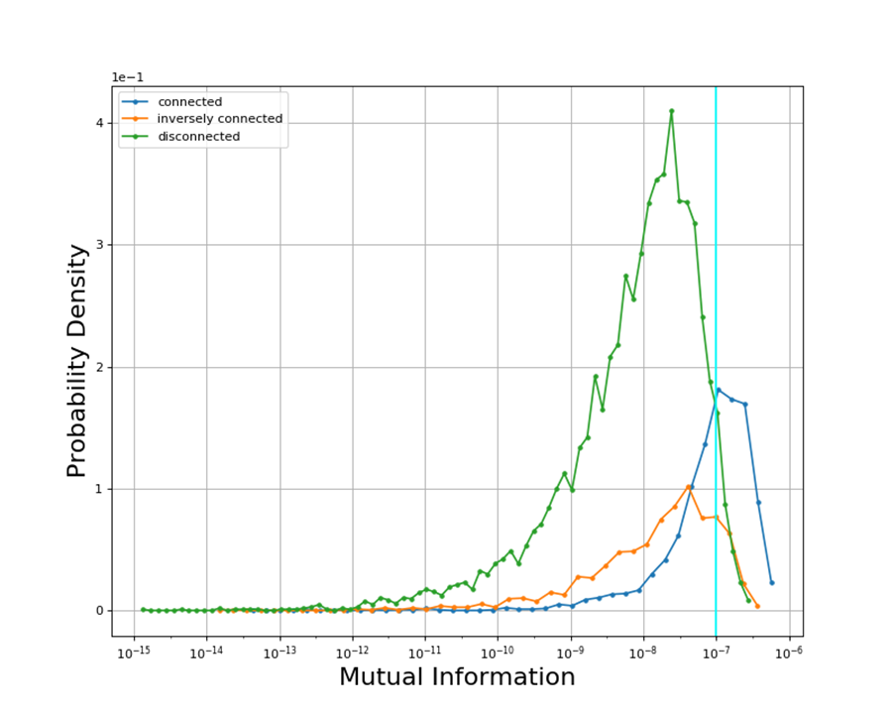
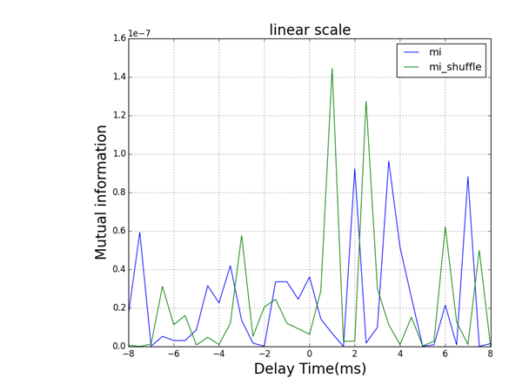
Maximum TDMI for neuronal pairs in network
Weak interaction case
Parameters | Values
L | 1e7
Recording rate | 2 /ms
Threshold | 0.1
Effective #bins | 2
S | 2e-4 (0.02mV)

Slide 13
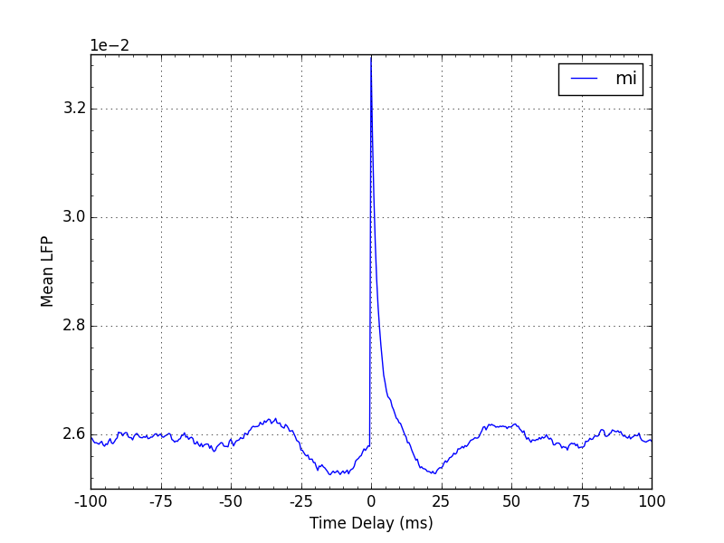
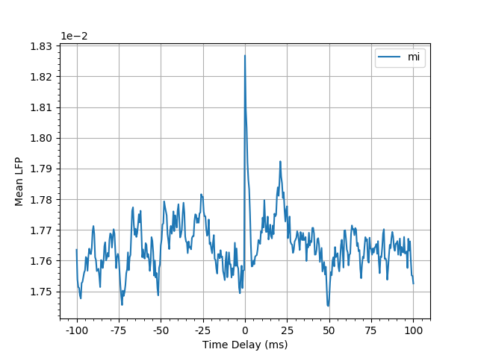
Spike triggered average
S = 2e-3 (0.2mV)
S = 2e-4 (0.02mV)

Slide 14
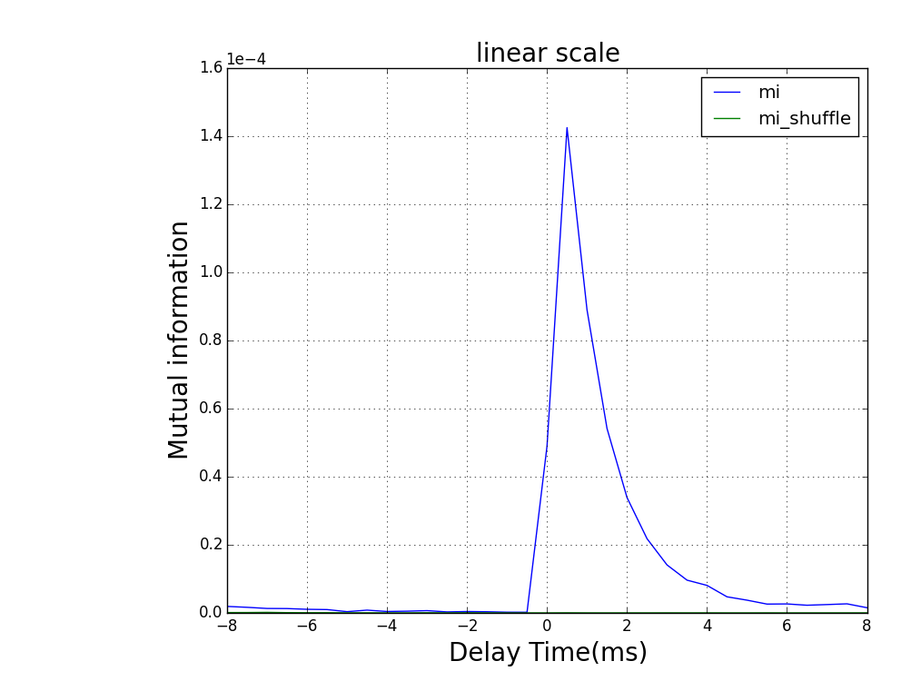
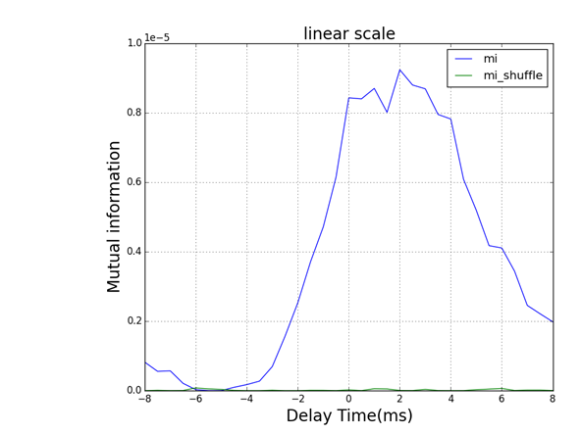
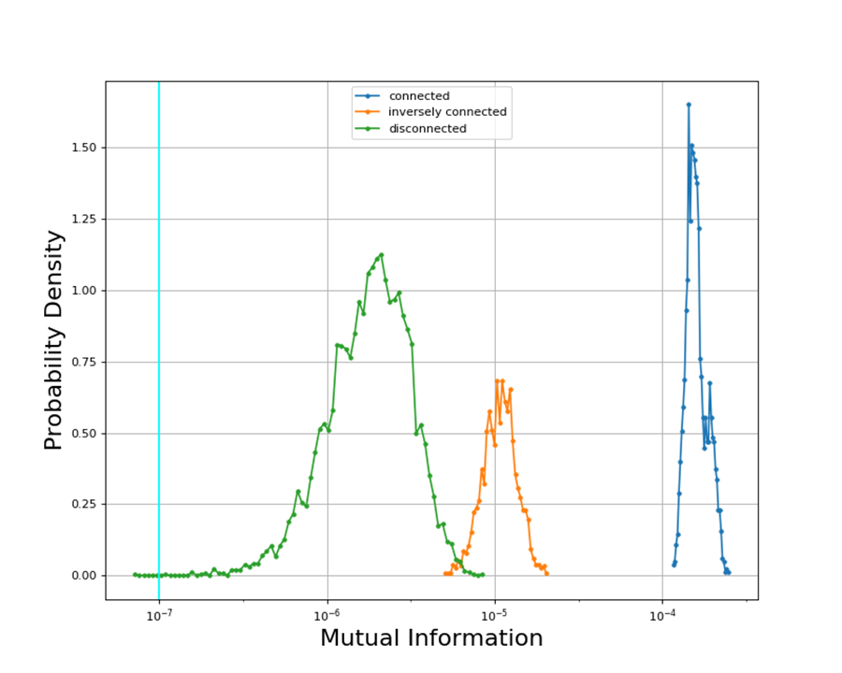
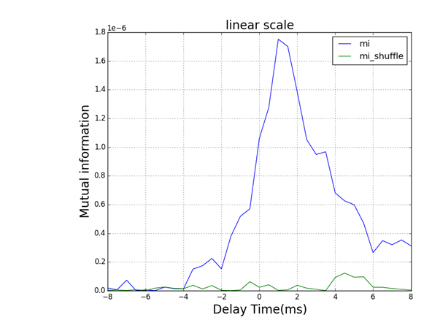
Maximum TDMI for neuronal pairs in network
Strong interaction case
Parameters | Values
L | 1e7
Recording rate | 2 /ms
Threshold | 0.0264
Effective #bins | 2
S | 2e-3 (0.2mV)

Slide 15
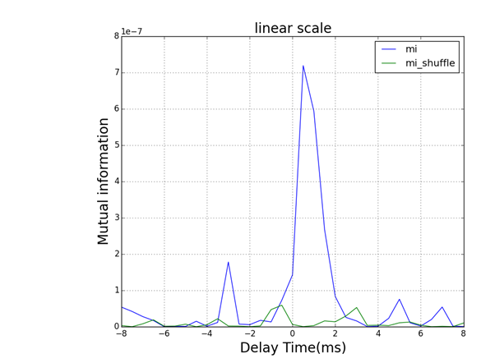
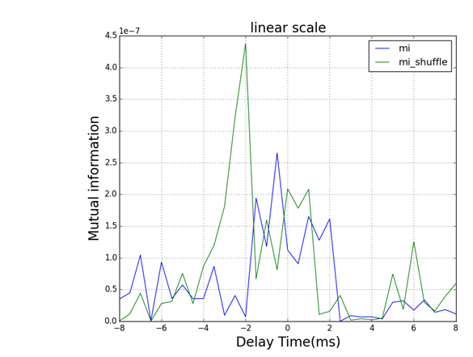
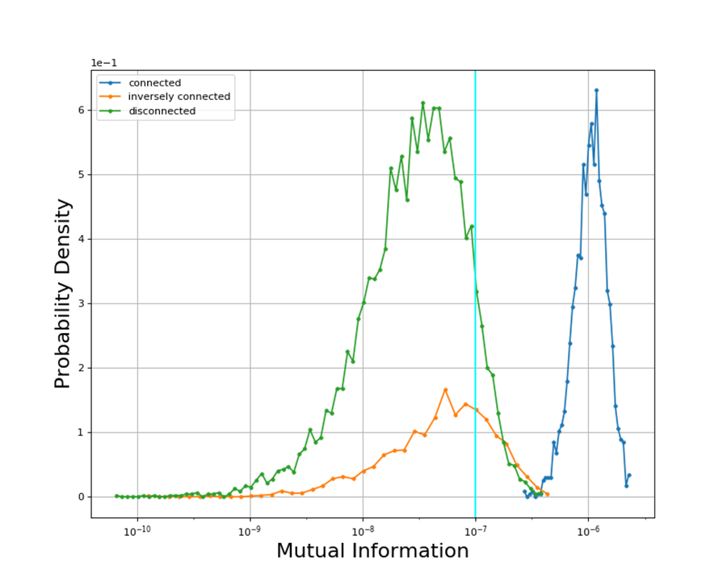
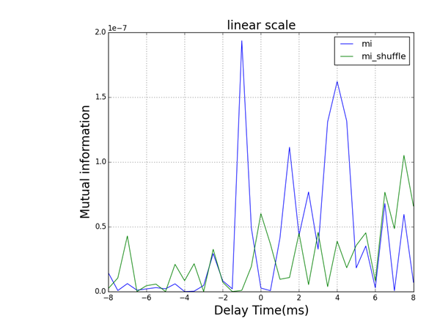
Maximum TDMI for neuronal pairs in network
Weak interaction case
Parameters | Values
L | 1e7
Recording rate | 2 /ms
Threshold | 0.018
Effective #bins | 2
S | 2e-4 (0.02mV)

Slide 16
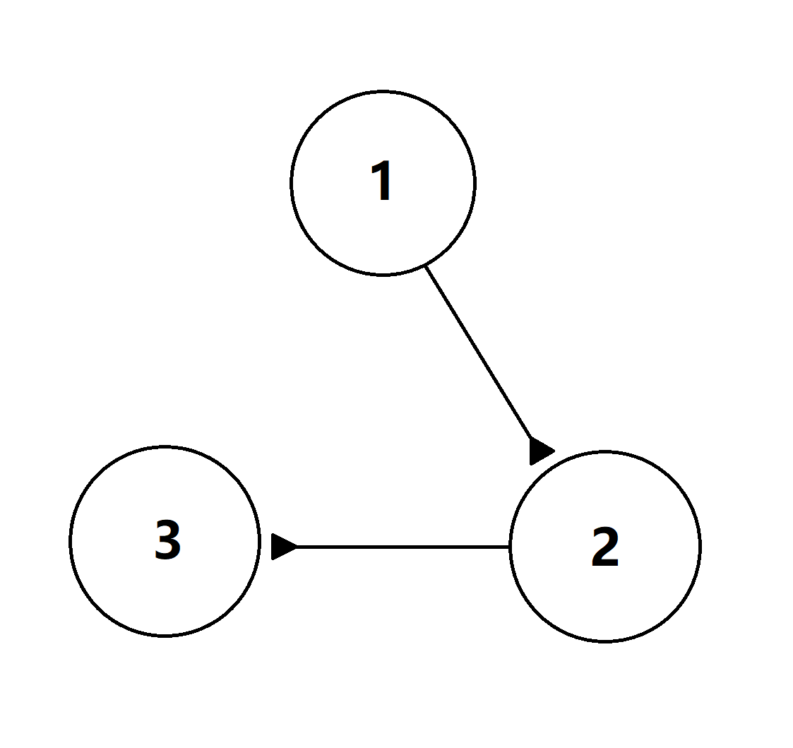
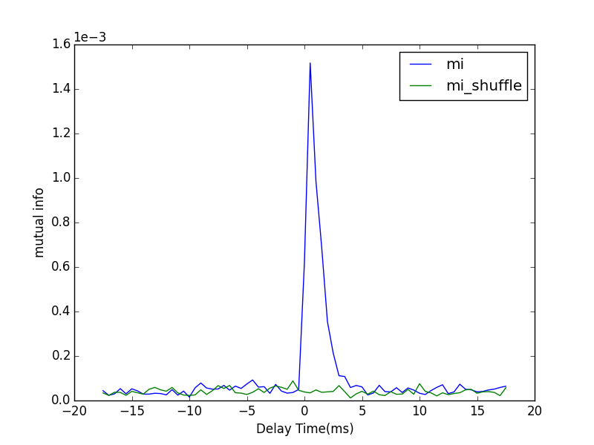
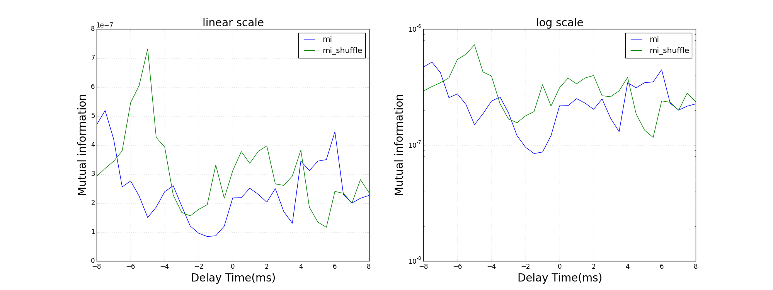
Three-neuron system
Poisson Rate | 1.5 kHz
S | 0.005
F | 0.005
Binsize | 0.03
L | 1e7
1to2
1to3

Slide 17
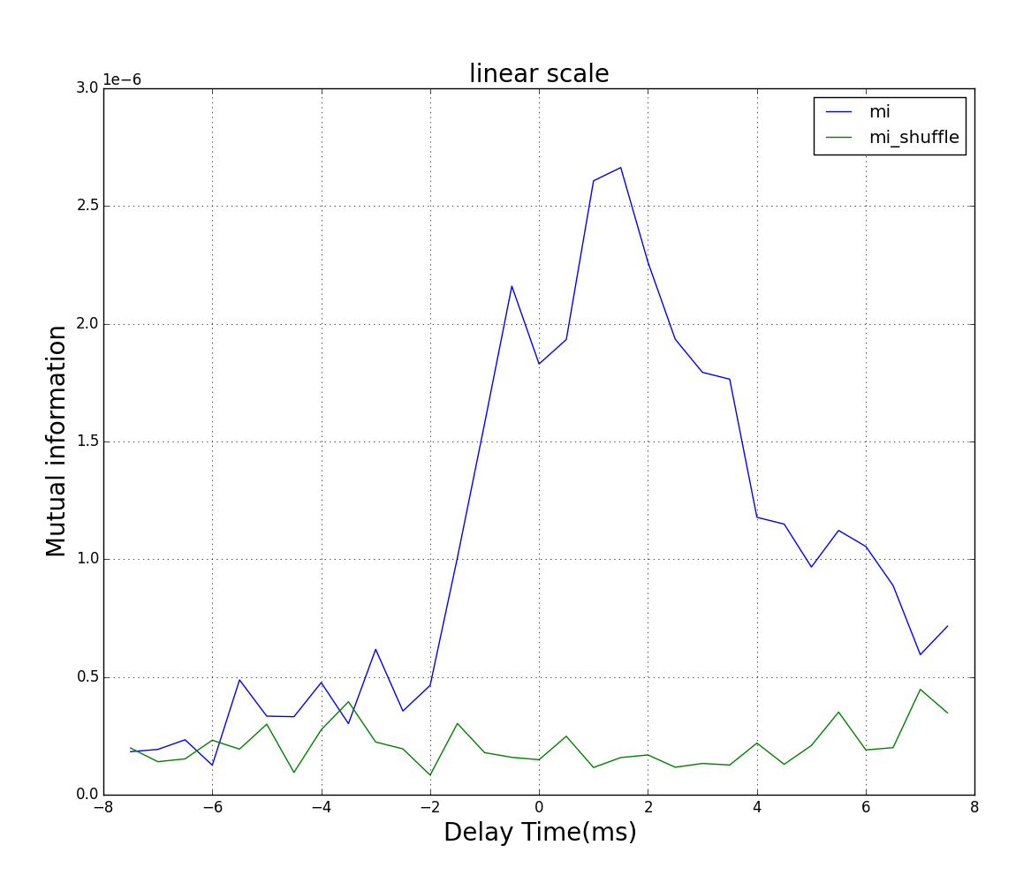
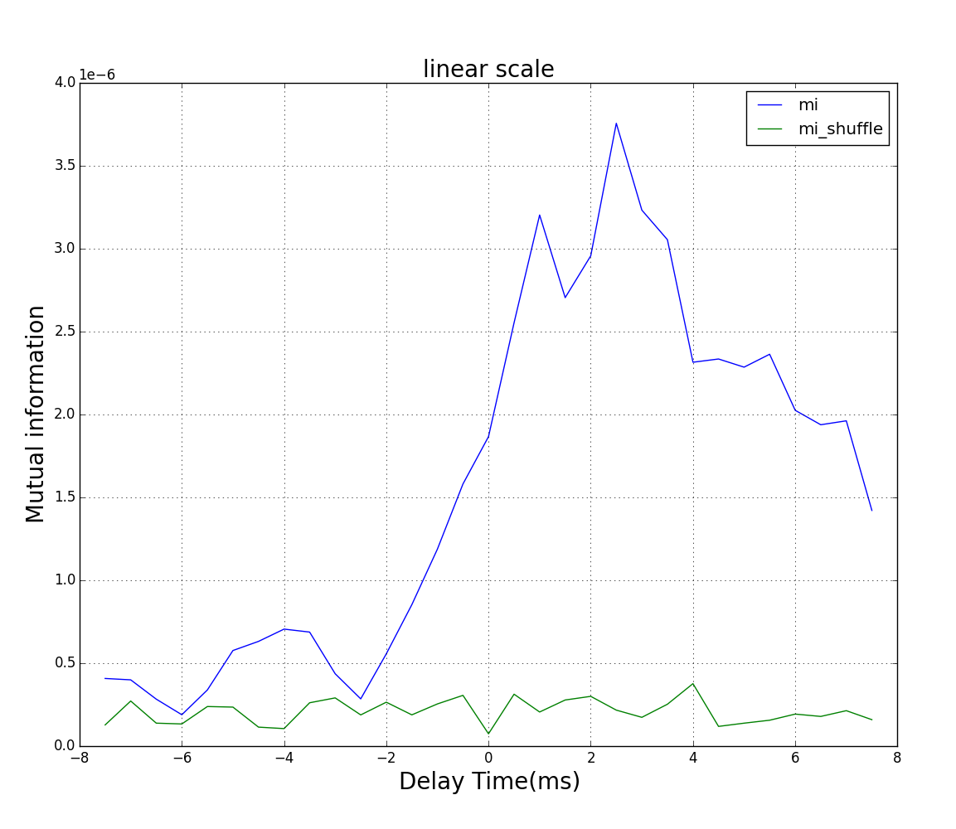
High-order neuronal pathway
#0 to #34
#0 to #89
# 2nd pathways = 4
# 3rd pathways = 55
# 2nd pathways = 6
# 3rd pathways = 74

Slide 18
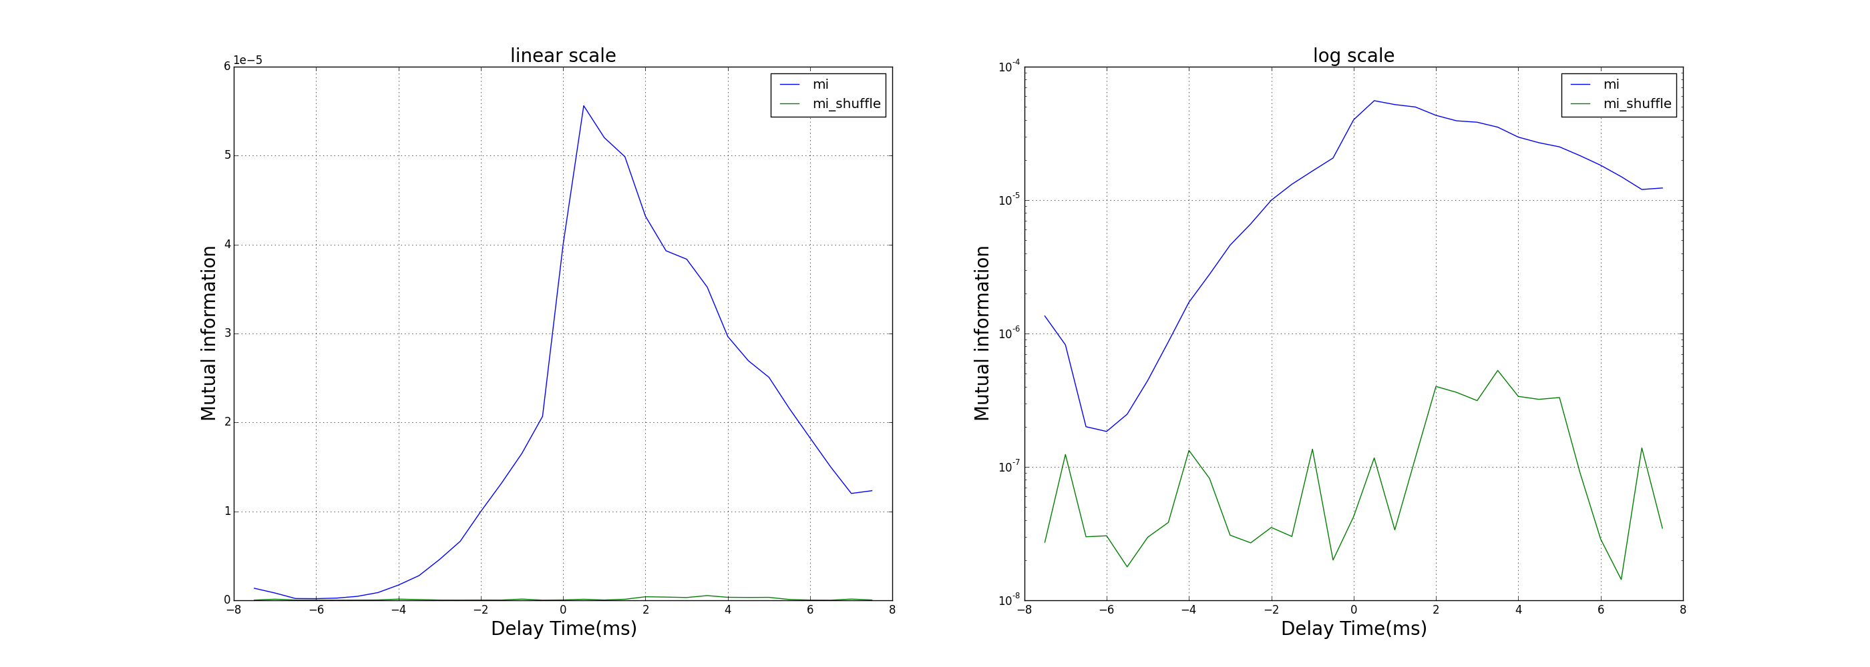
Numerical demo of TDMI analysis between spike train and local field potential

Slide 19
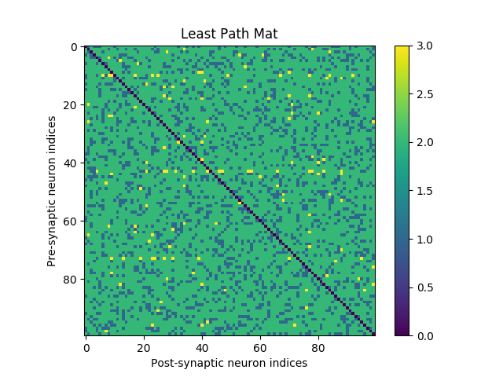
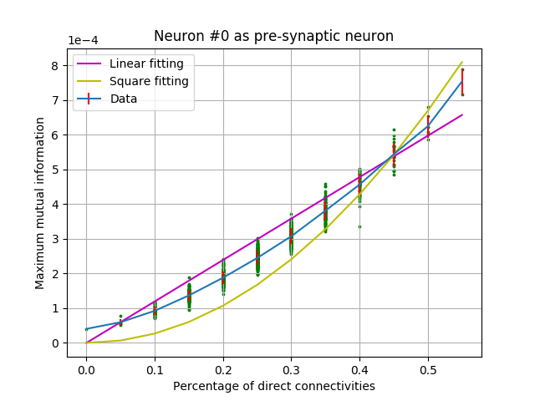
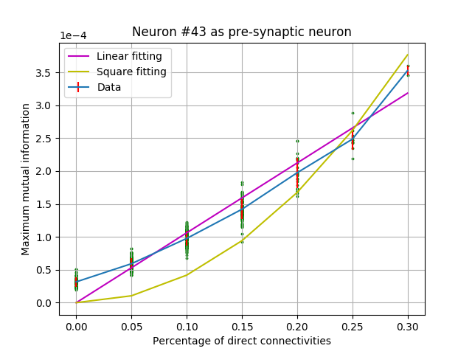
Numerical demo of TDMI analysis between spike train and local field potential

Slide 20




Questions to be answered
1
$$I(X;Y_{1}+Y_{2})$$
$$I\left(X;Y_{1}\right)+I(X;Y_{2})$$
0
LFP
2
1
$$I(X;Y)$$
$$I(X;F\left(Y\right)+G(Y))$$
0
3
2

Slide 21
Summary
Mutual information estimation
The error in MI estimation is quadratically proportional to the binning size h in LFP’s histogram.
TDMI implies neuronal connecting pattern in networks :
Direct connection can be inferred by the order of magnitude of maximum MI between neuronal pairs
Inversely direct connection can be inferred if the amount of data is sufficiently large.
Numerical demo of TDMI analysis between spike train and local field potential

Slide 22
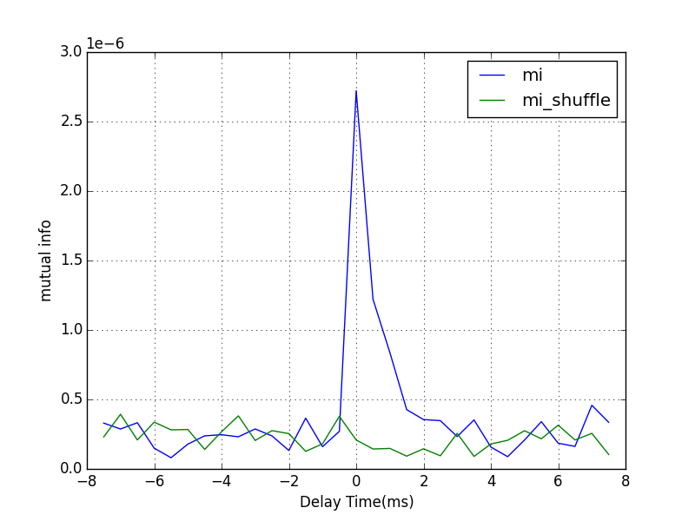


Parameters | Values
Total data length | 1e7
Recording rate | 2 /ms
Bin size in histogram of lfp | 0.03
Effective #bins | 6-7
Synaptic strength | 2e-4 (0.02mV)
Normal
case

Slide 23



Synaptic Strength
2e-3
Binsize
0.1
Effective
#bins = 2
Binsize
0.08
Binsize
0.03
Binsize
0.05

Slide 24



Synaptic Strength
2e-4
Binsize
0.1
Effective
#bins = 2
Binsize
0.08
Binsize
0.03
Binsize
0.05

