Slide 1
Studies of TDMI Analysis based on Simulation of IF Neurons
Kai Chen Feb. 2018

Slide 2
Paradigm of simulation
Poisson Driving
Poisson Driving
Conductance
Neuron 1
Spikes
Conductance
Neuron 2
Spikes
Synaptic Current
Synaptic Current

Slide 3
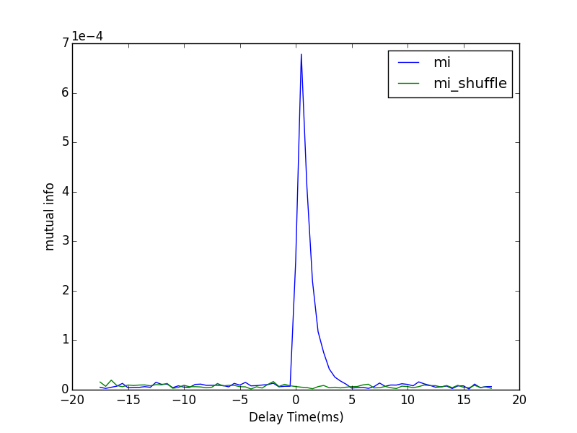
Sample Figure
The peak lying on the positive side of the graph indicates the same direction of neuronal information as the physical connection does.
dt | 0.5 ms
#bins | 10
Poisson Rate | 0.15kHz
Forward Strength | 0.05
Synaptic Strength | 0.005
T | 5 mins

Slide 4
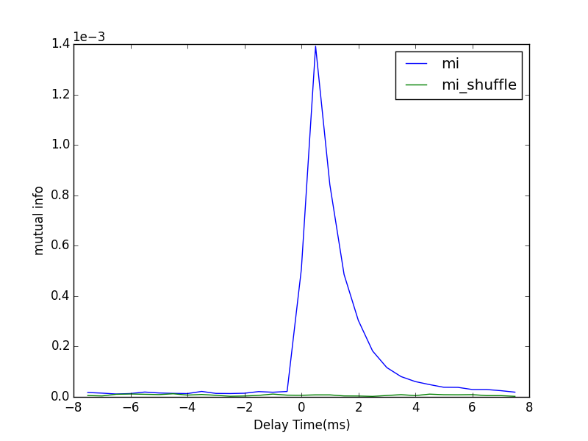
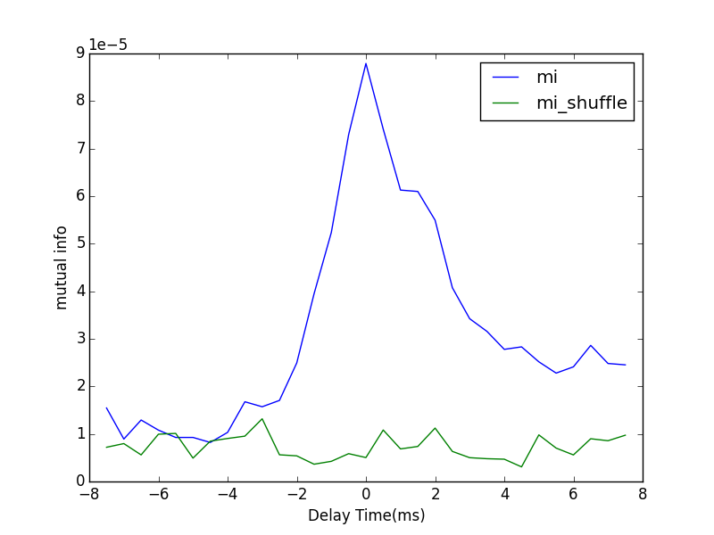
Mono-direction
Poisson Rate | 1.5 kHz
S | 0.005
F | 0.005
dt | 0.5 ms
#bins | 20
T | 10 mins
From 1 to 2
From 2 to 1

Slide 5
Neuronal Interaction layout
Poisson Driving
Poisson Driving
Conductance
Neuron 1
Spikes
Conductance
Neuron 2
Spikes
Correlated!
Synaptic Current
Synaptic Current
Synchronized?
?

Slide 6
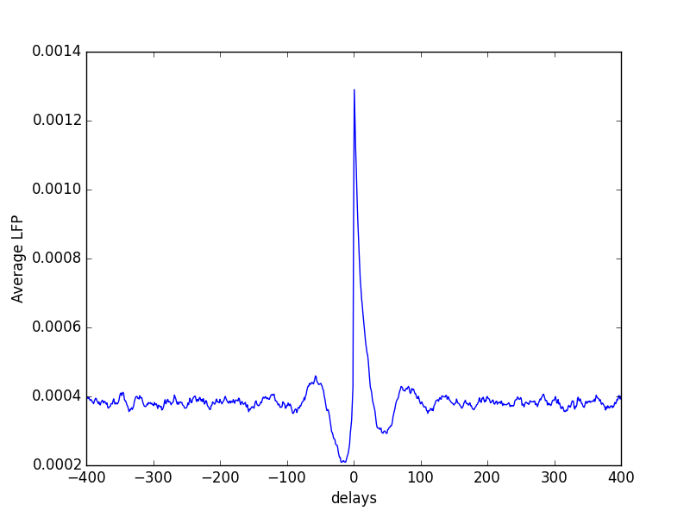
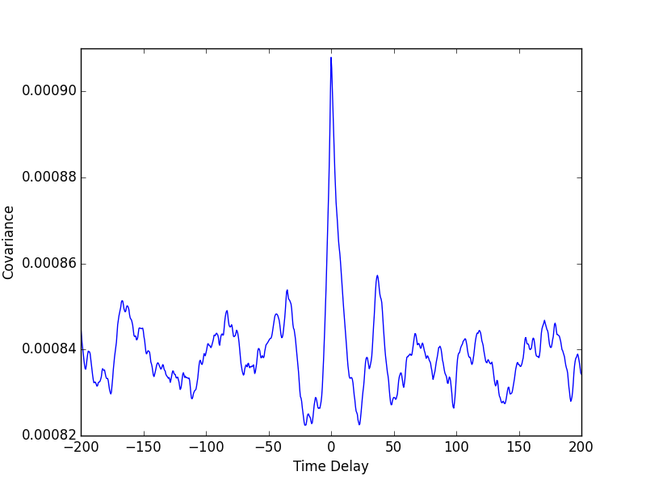
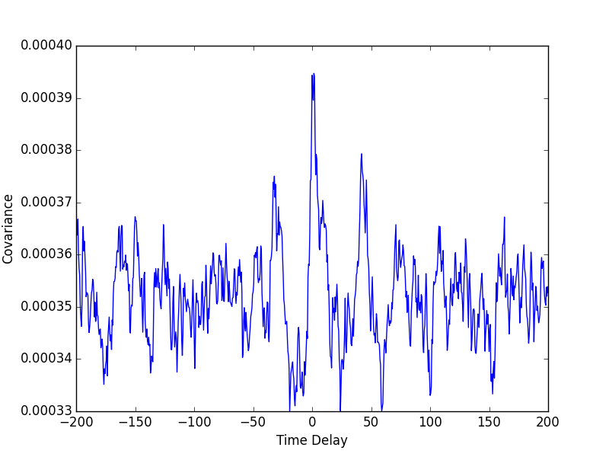
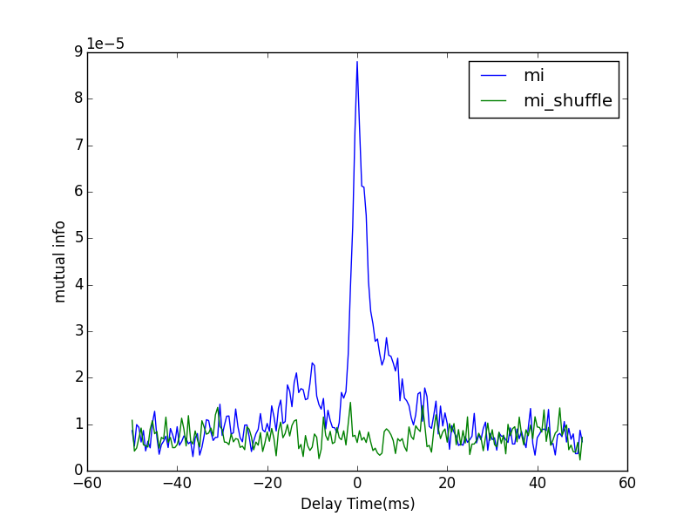
Poisson Rate | 1.5 kHz | dt | 0.5ms
S | 0.005 | #bins | 20
F | 0.005 | T | 10mins
Covariance
Covariance
Spike 2
to
Current 2
Current 2
to
Current 1
Covariance
Spike 2
to
Current 1
Mutual info
Spike 2
to
Current 1

Slide 7
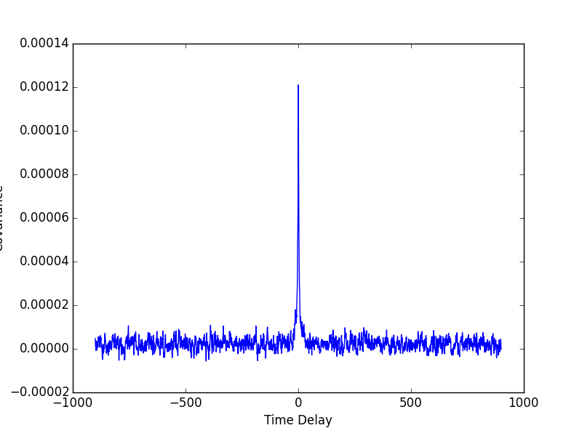
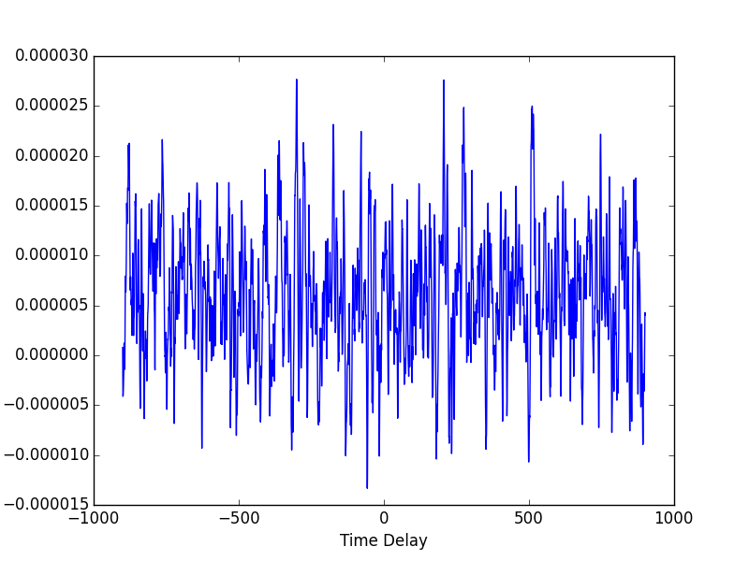
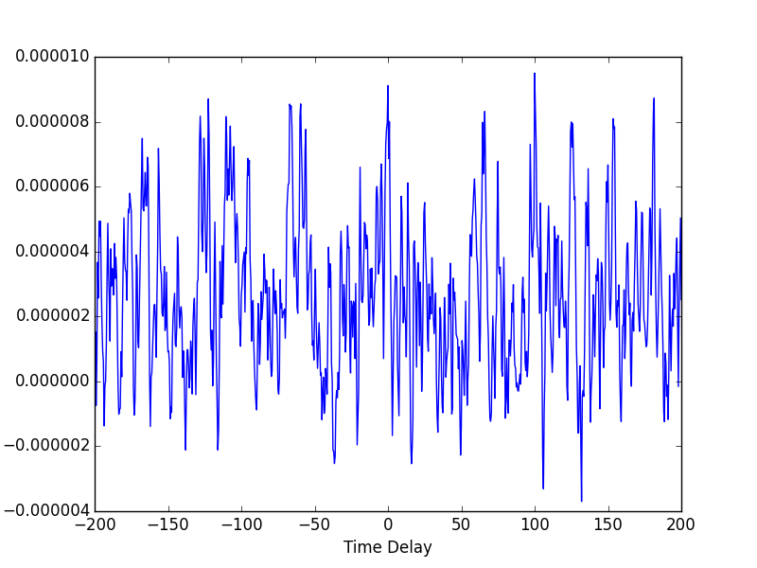
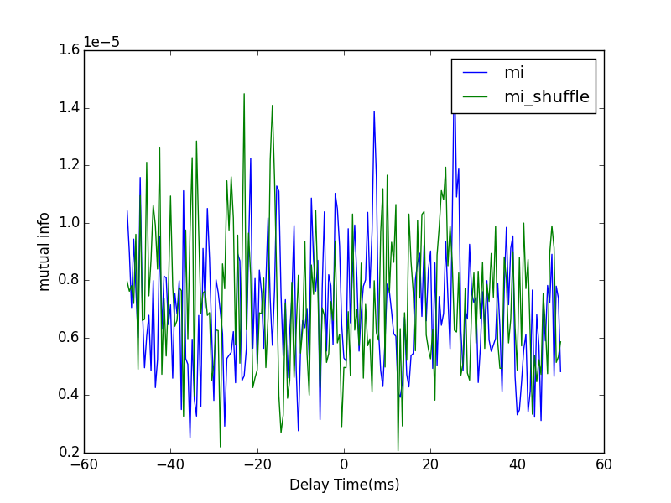
Poisson Rate | 0.1 kHz | dt | 0.5ms
S | 0.005 | #bins | 30
F | 0.030 | T | 10mins
Covariance
Covariance
Spike 2
to
Current 2
Current 2
to
Current 1
Covariance
Spike 2
to
Current 1
Mutual info
Spike 2
to
Current 1

Slide 8
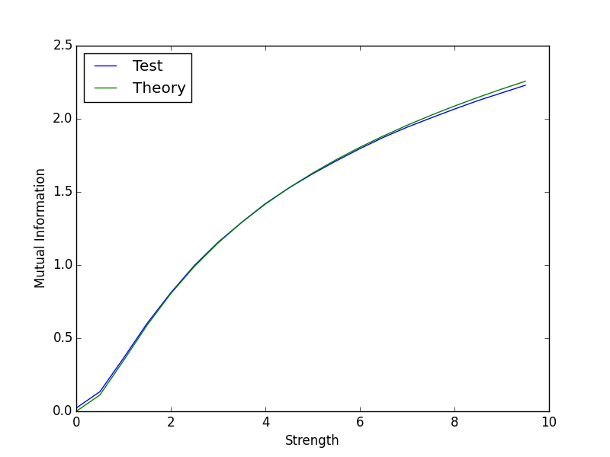
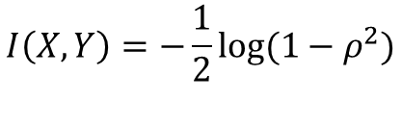




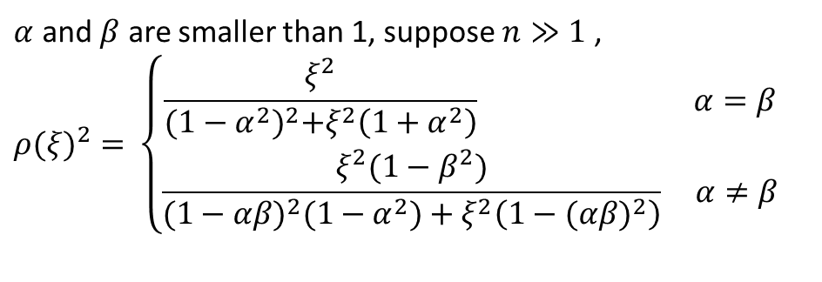

Mutual information of Gaussian random variables
$α=0.01，β=0.01$ #bin=50 T= 300000
$$X_{n}=αX_{n−1}+ε_{n}$$
$$Y_{n}=βY_{n−1}+ξX_{n−1}+η_{n}$$
$$I\left(X,Y\right)=H\left(X\right)+H\left(Y\right)−H(X,Y)$$
$$I\left(X,Y\right)=−\frac{1}{2}log⁡(1−ρ^{2})$$
$$ρ=ρ(ξ,α,β)$$
$α$ and $β$ are smaller than 1, suppose $n≫1$ ,
$${ρ(ξ)}^{2}=⁡\left\{\begin{aligned}\frac{ξ^{2}}{{(1−α^{2})}^{2}+ξ^{2}\left(1+α^{2}\right)} α=β \\ \frac{ξ^{2}(1−β^{2})}{{(1−αβ)}^{2}(1−α^{2})+ξ^{2}\left(1−{(αβ)}^{2}\right)} α≠β\end{aligned}\right.$$
#bins = 150 300000 trials

Slide 9
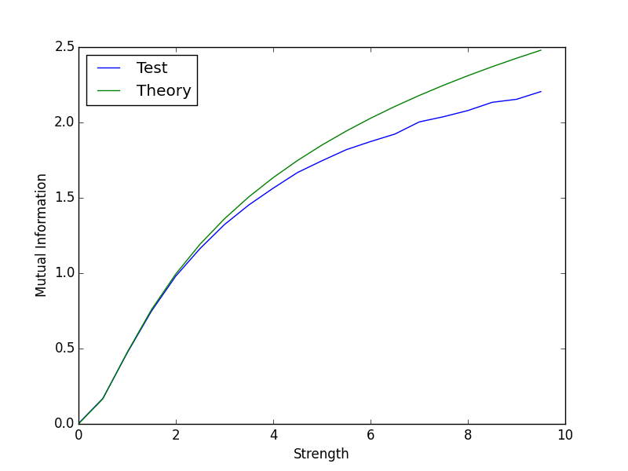
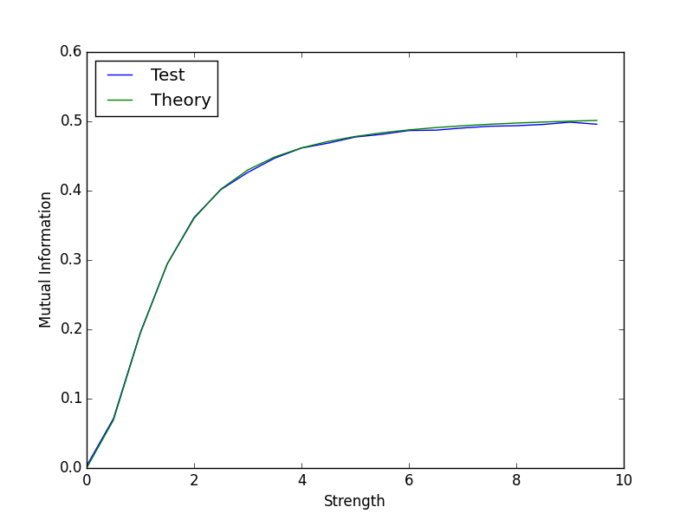
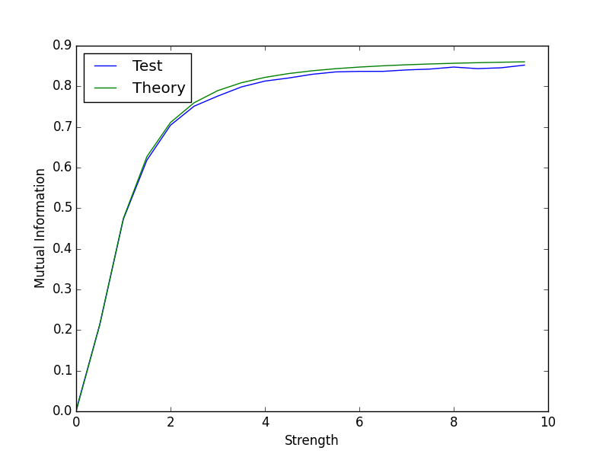
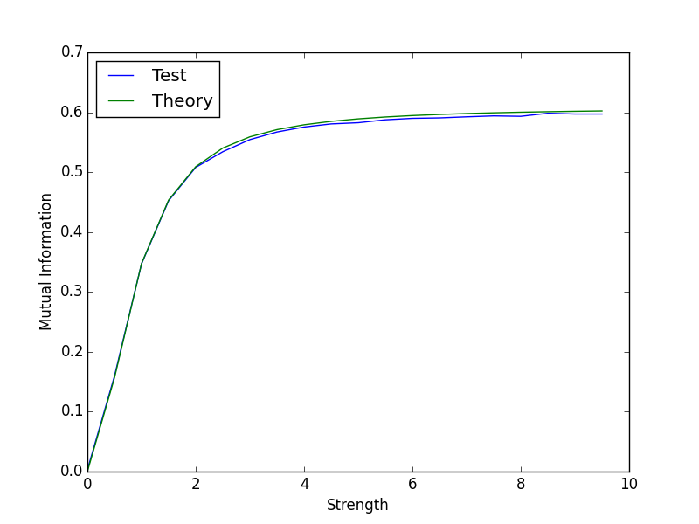




$α=0.6，β=0.01$ #bin=50 T= 300000
$α=0.01，β=0.6$ #bin=50 T= 300000
$α=0.6，β=0.5$ #bin=50 T= 300000
$α=0.5，β=0.6$ #bin=50 T= 300000

Slide 10
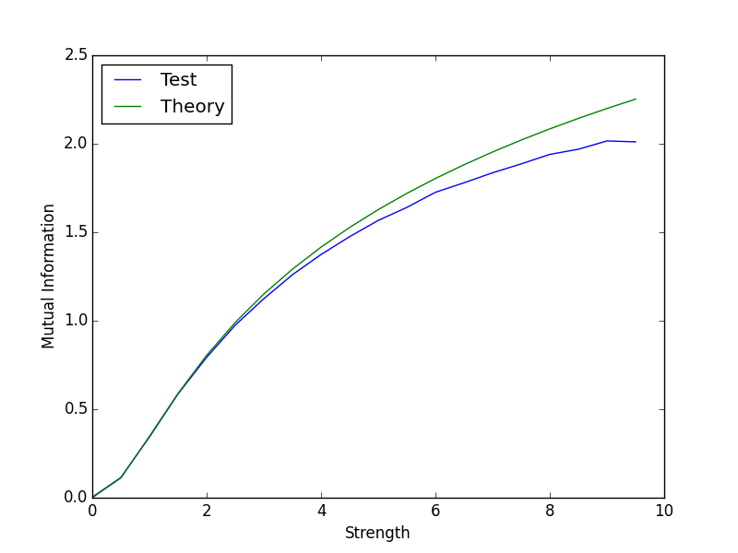

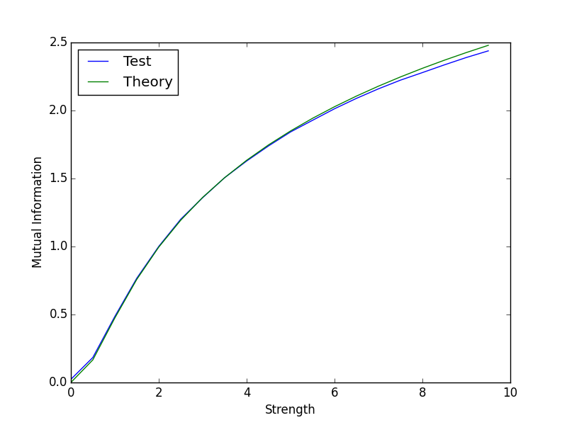




$α=0.01，β=0.01$ #bin=50 T= 300000
$α=0.01，β=0.01$ #bin=150 T= 300000
$α=0.6，β=0.01$ #bin=50 T= 300000
$α=0.6，β=0.01$ #bin=150 T= 300000

Slide 11
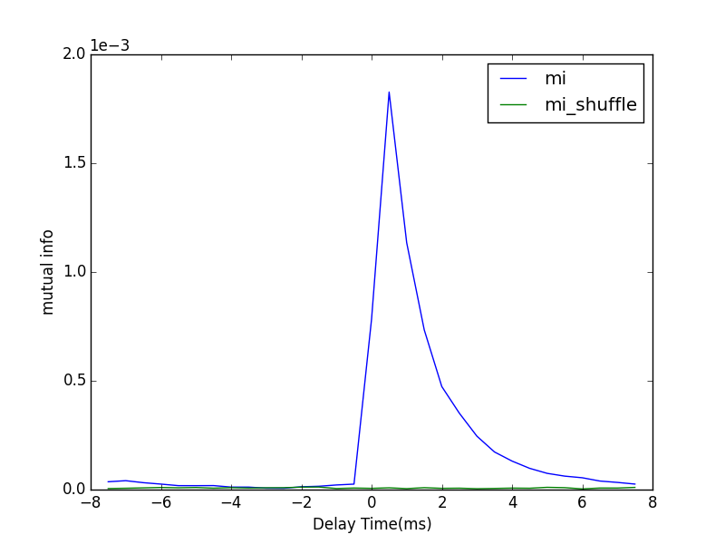
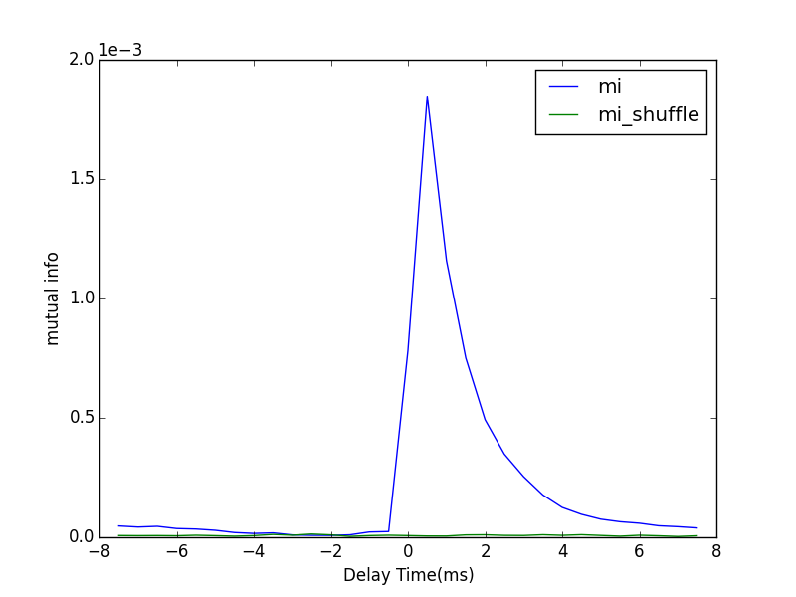
Bi-direction
Poisson Driving Rate | 1.5 kHz
Synaptic Strength | 0.005
Feedforward Strength | 0.005
From 1 to 2
From 2 to 1
dt = 0.5 ms
#bins = 20
T = 10 mins

Slide 12
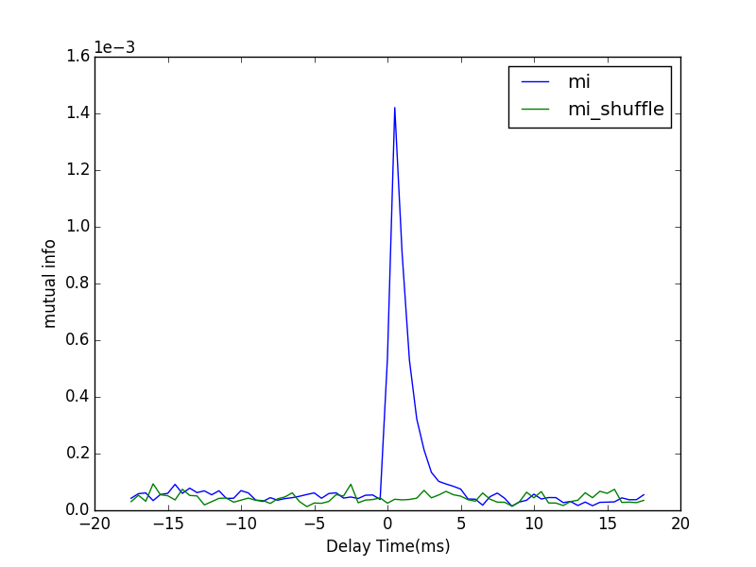
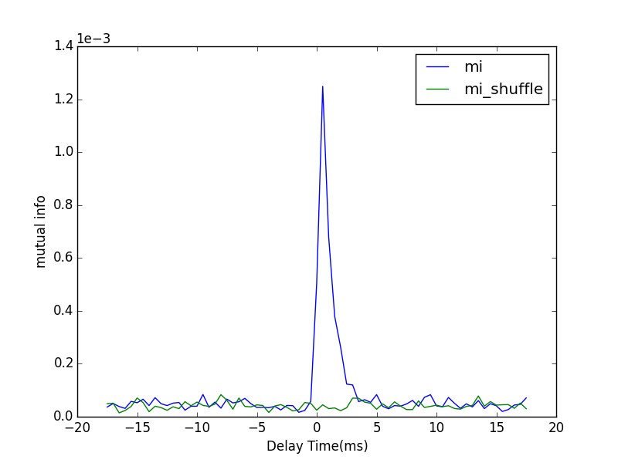
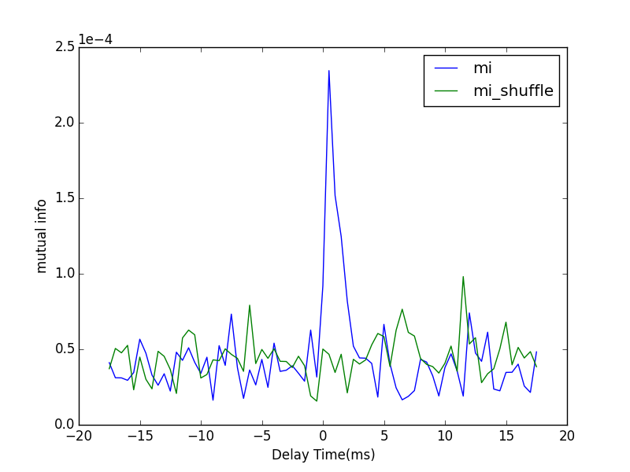
Robustness
Fix the product of Poisson driving rate and feedforward strength. Change the Poisson driving rate and investigate the change of mutual information pattern
1.5 kHz
0.15 kHz
0.1 kHz
dt | 0.5 ms
#bins | 20
T | 10 mins
Synaptic Strength | 0.005

Slide 13
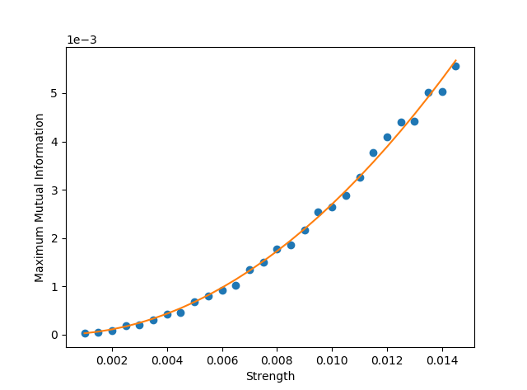
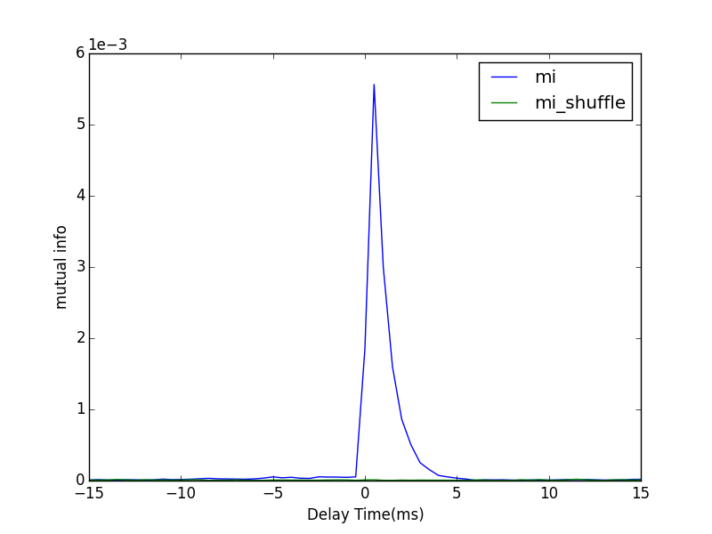
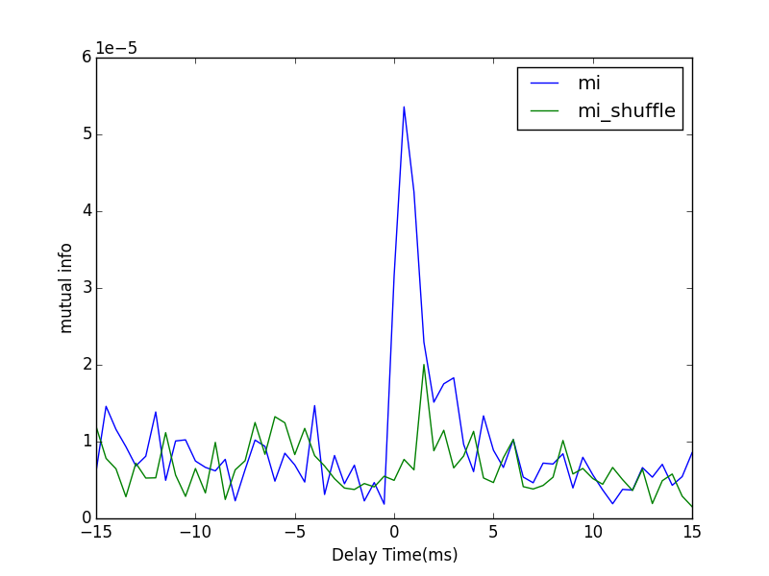
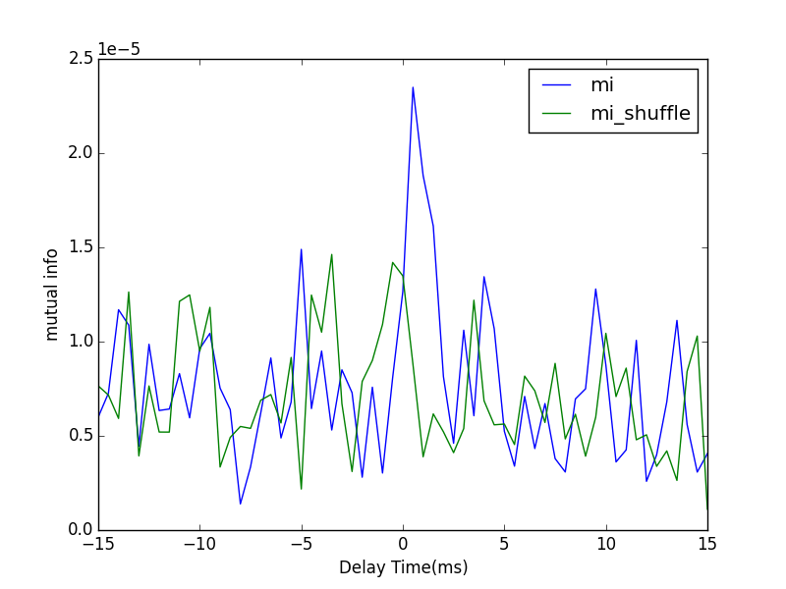

Direct calculation
Relation between synaptic strength and values of maximum mutual information
Synaptic strength ranging from 0.001 to 0.0145
Mean firing rate for presynaptic neuron is 25.5 Hz
Mean firing rate for postsynaptic neuron is ranging from 25.32 Hz to 28.06 Hz
dt | 0.5 ms
#bins | 10
T | 5 mins
$$MI=As^{2}$$

Slide 14
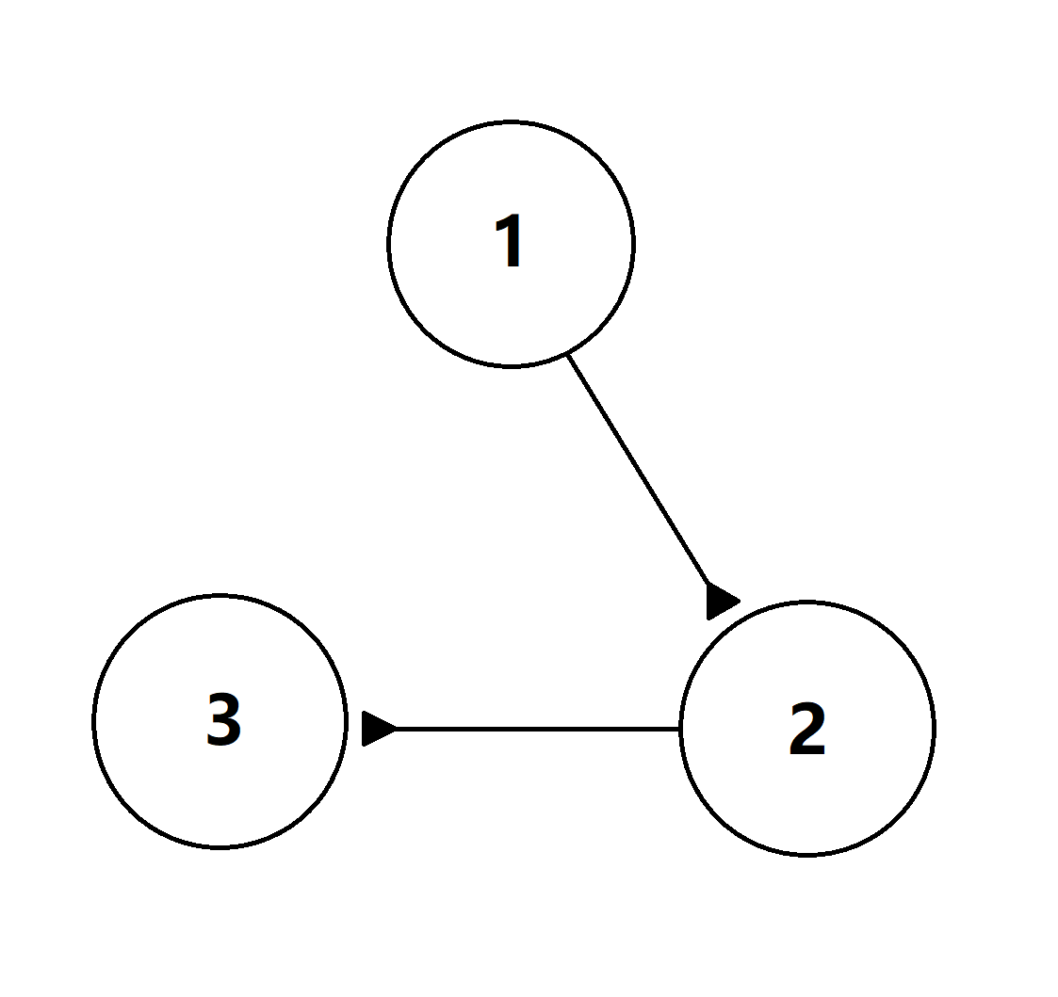
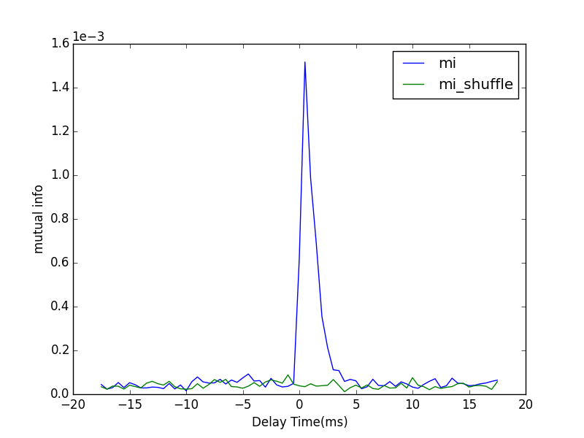
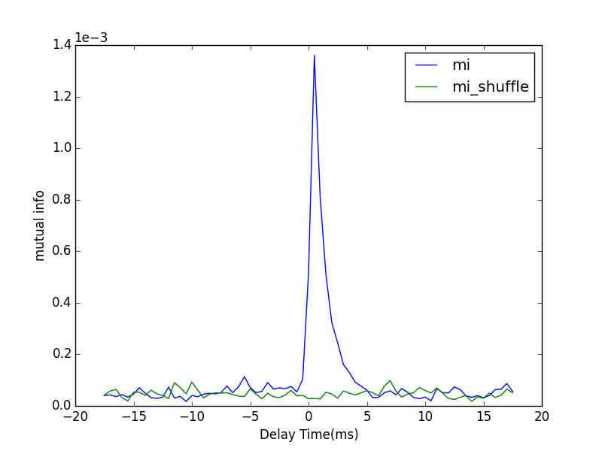
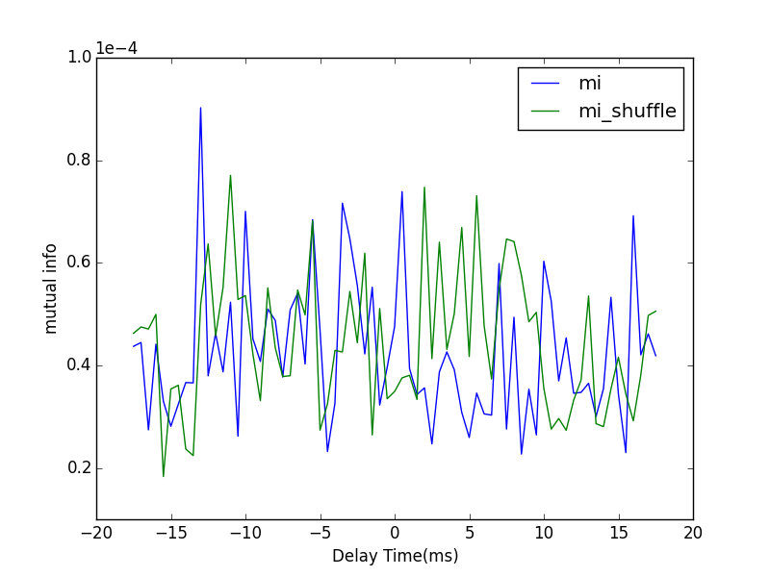
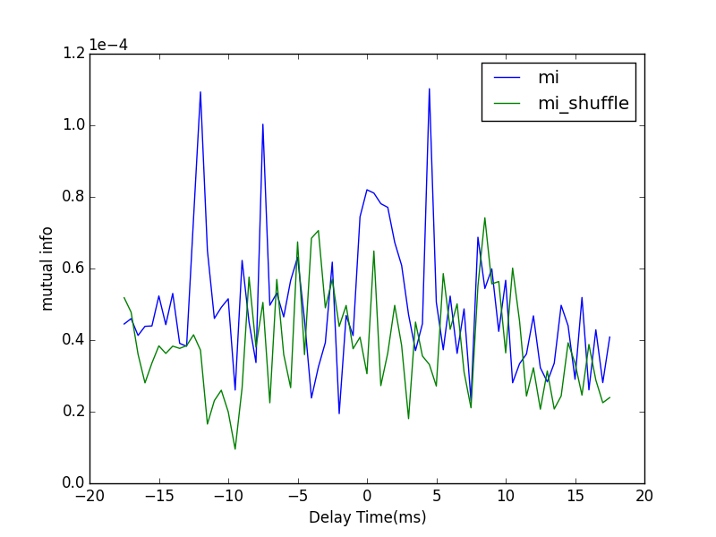
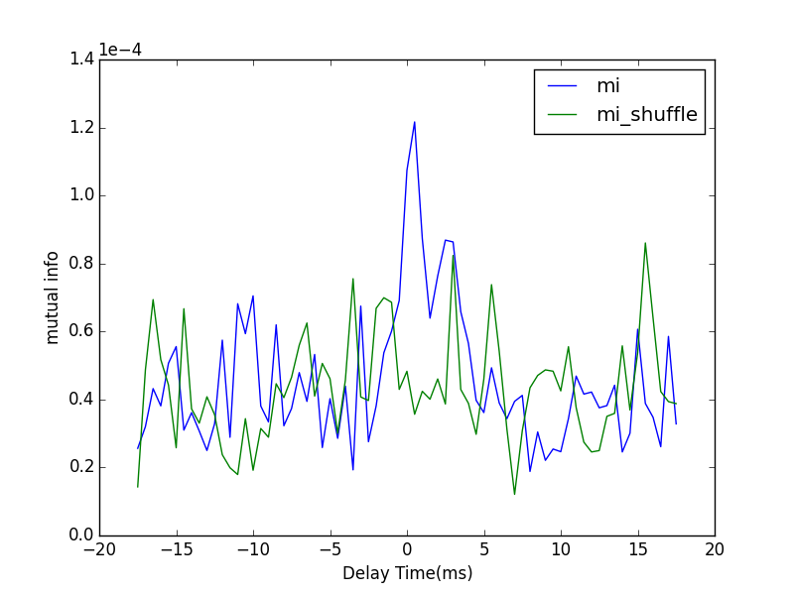
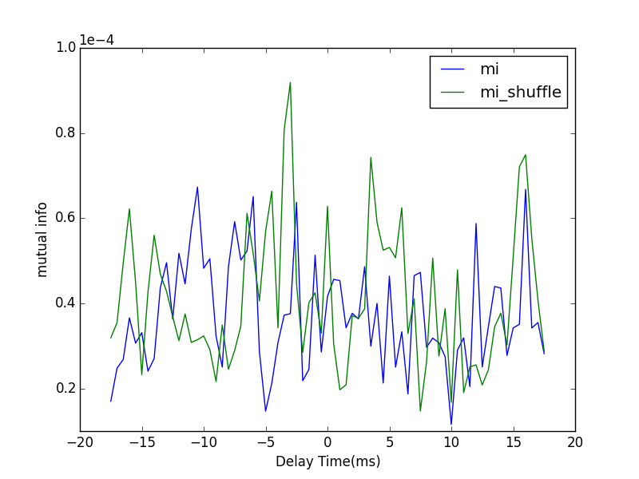
Triple-neuron system
1to2
2to3
1to3
2to1
3to2
3to1
Poisson Rate | 1.5 kHz
S | 0.005
F | 0.005
#bins | 20
T | 5 mins

