Slide 1


ROBOTIC ARM USING ARDUINO
Bangalore Institute of Technology
K.R. Road, V V Puram, Bangalore-560004
Department of Electronics and Communication Engineering
MINI-PROJECT PRESENTATION
Under the guidance of:
Presented by
Prof. NARAYANA SWAMY J.C
Associate Professor
Dept. of Electronics & Communication Engineering
BIT.
SANJEEV SREEDHAR (1BI19EC132)
SRIVATHSA S.V. (1BI19EC143)
SRIVATSA P. (1BI19EC144)
THAKSHAK S. NAKSHATRI (1BI19EC156)

Slide 2
INSTITUTE VISION AND MISSION
Vision
To establish and develop the Institute as the centre of higher learning, ever abreast with expanding horizon of knowledge in the ﬁeld of Engineering and Technology with entrepreneurial thinking, leadership excellence for life-long success and solve societal problems.
Mission
Provide high quality education in the Engineering disciplines from the undergraduate through doctoral levels with creative academic and professional programs.
Develop the Institute as a leader in Science, Engineering, Technology, Management and Research and apply knowledge for the beneﬁt of society.
Establish mutual beneﬁcial partnerships with Industry, Alumni, Local, State and Central Governments by Public Service Assistance and Collaborative Research.
Inculcate personality development through sports, cultural and extracurricular activities and engage in the social, economic and professional challenges.
Bangalore Institute of Technology
Dept. of ECE, BIT

Slide 3
DEPARTMENT VISION , MISSION, PEOs, PSOs
Vision
Imparting Quality Education to achieve Academic Excellence in Electronics and Communication Engineering for Global Competent Engineers.
Mission
• Create state of art infrastructure for quality education. • Nurture innovative concepts and problem solving skills. • Delivering Professional Engineers to meet the societal needs.
Bangalore Institute of Technology
Dept. of ECE, BIT

Slide 4
INSTITUTE VISION AND MISSION
PEOs
1. Prepare graduates to be professionals, Practicing engineers and entrepreneurs in the field of Electronics and communication engineering. 2. To acquire sufficient knowledge base for innovative techniques in design and development of tools and systems. 3. Capable of competing globally in multidisciplinary field. 4. Achieve personal and professional success with awareness and commitment to ethical and social responsibilities as an individual as well as a team. 5. Graduates will maintain and improve technical competence through continuous learning process.
PSOs
PSO1: The graduates will be able to apply the principles of Electronics and Communication in core areas.
PSO2: An ability to use latest hardware and software tools in Electronics and Communication engineering.
PSO3: Preparing Graduates to satisfy industrial needs and pursue higher studies with social-awareness and universal moral values.
Bangalore Institute of Technology
Dept. of ECE, BIT

Slide 5
Course Outcomes of Mini-Project
1 | Ability to carry-out literature review and define the problem.
2 | Ability to co-ordinate to work as a team member or a single member.
3 | Inculcate methods to use advance tools .
4 | Design analytical modeling and develop a systems
5 | Ability to equip analysis skills and interpretation.
6 | Enhance presentation skills, drafting and documentation of project work.
CO-PO Mapping Table
PO CO | 1 | 2 | 3 | 4 | 5 | 6 | 7 | 8 | 9 | 10 | 11 | 12 | PSO 1 | PSO 2 | PSO 3
1 | 3 | 2 | 2 |  |  | 1 |  | 1 | 1 | 1 |  |  | 2 | 2
2 | 3 | 2 | 2 |  |  | 1 |  | 1 | 1 | 1 |  |  | 2 | 2
3 | 3 | 2 | 2 |  | 3 |  |  | 1 | 1 | 1 |  |  | 2 | 2
4 | 3 | 2 | 2 |  | 3 | 1 |  | 1 | 1 | 1 |  |  | 2 | 2
5 | 3 | 2 | 2 |  | 3 | 1 |  | 1 | 1 | 1 |  |  | 2 | 2
6 | 3 |  |  |  | 3 |  |  | 1 | 1 | 1 | 2 |  | 2 | 2
Bangalore Institute of Technology
Dept. of ECE, BIT

Slide 6
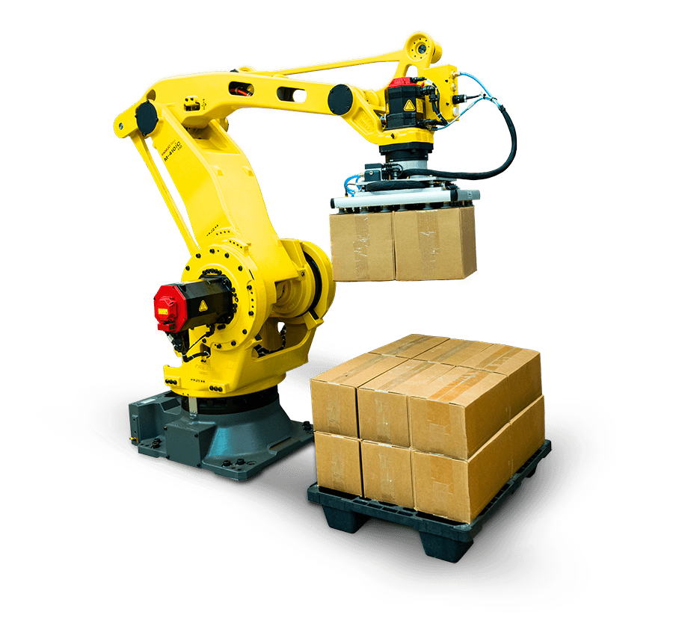
ABSTRACT
Android based robotic arm is designed to provide access to places where human presence must be avoided such as places with very low or very high atmospheric pressure, war zones and even biohazardous places. It can also be used for repetitive and cumbersome works like automobile painting, assembly work in manufacturing processes.
The system uses an Arduino Mega 2560 board that controls the movement robotic arm through Servo motors. The Arduino uno board is connected with a Bluetooth module for wireless connection of android device. An android app is used to provide commands to the robotic arm. This gives the user to work on particular task from a safe distance.
Bangalore Institute of Technology
Dept. of ECE, BIT

Slide 7
CONTENTS
Sl. No. | Title
1 | Introduction
2 | Literature Survey
3 | Objectives
4 | Methodology
5 | Implementation and Design
6 | Results and Observations
7 | Conclusions
8 | Future Work
9 | References
Bangalore Institute of Technology
Dept. of ECE, BIT

Slide 8
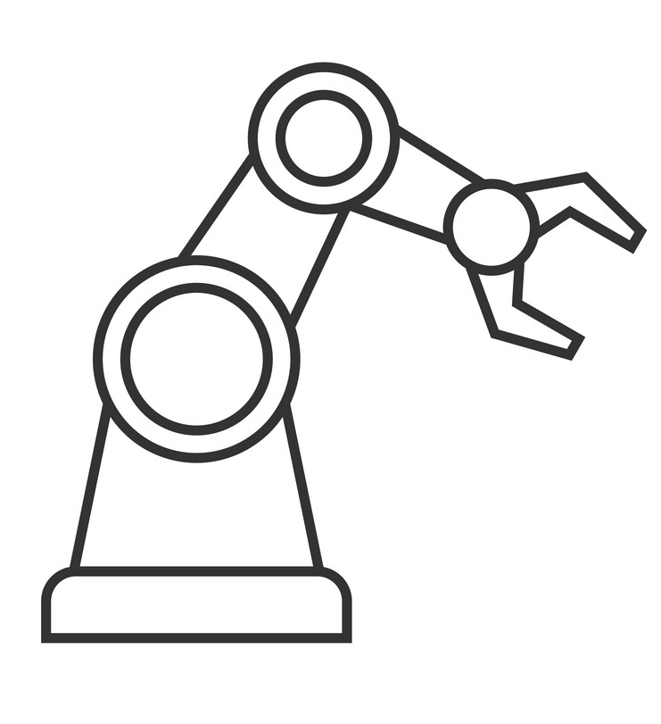
INTRODUCTION
A robotic arm is a type of mechanical arm, usually programmable, with similar functions to a human arm; the arm may be the sum total of the mechanism or may be part of a more complex robot.
Robotic Arm makes use of Actuators, Hydraulics, Servos or other related mechanisms to control the movements. These movements can be either pre-programmed or user-controlled depending on the needs put forth by the environment. Robotic arm is immensely used for industrial purposes as it allows precision controlled movements.
Arduino is an open-source electronics platform based on easy-to-use hardware and software. Arduino Boards are able to read inputs - light on a sensor, a finger on a button, or a Twitter message - and turn it into an output - activating a motor, turning on an LED, publishing something online. You can tell your board what to do by sending a set of instructions to the microcontroller on the board. To do so we use the Arduino programming language , and the Arduino Software (IDE).Thanks to its simple and accessible user experience, Arduino has been used in thousands of different projects and applications. The Arduino software is easy-to-use for beginners, yet flexible enough for advanced users. It runs on Mac, Windows, and Linux. Teachers and students use it to build low cost scientific instruments, to prove chemistry and physics principles, or to get started with programming and robotics
Bangalore Institute of Technology
Dept. of ECE, BIT

Slide 9
LITERATURE SURVEY
Many automated and advanced robotic arm system has been developed and found applications in industries for welding, material handling, painting, laser engraving, palletizing and assembly work. But these arms are either not controlled remotely or have fixed set of commands. To overcome this limitation an HC-05 Bluetooth module is used in accordance with Arduino Mega Microcontroller.
We have referred a few Research Papers and Articles to proceed further with our project. Some of them are listed below.
Bangalore Institute of Technology
Dept. of ECE, BIT

Slide 10
LITERATURE SURVEY
Journal Papers/Articles | Author/Publisher
“Introduction to Arduino Mega 2560” (2018, June 21). | Adnan Aqeel
“Survey of Robotic Arm and Parameters” Coimbatore, 2016. | Virendra Patidar and Ritu Tiwari
“Arduino Based Android Controlled Robotic Arm” ,2020, International Research Journal of Engineering and Technology (IRJET). | Ramkrishna Ghogre, Harshad Mehta, Ankit Khobragade, Ashutosh Tripathi
“Servo Motor Basics with Arduino” ,Last revision- May 2022. | Arduino
Bangalore Institute of Technology
Dept. of ECE, BIT

Slide 11
OBJECTIVES
To design a Robotic Arm that can perform operations such as pick and place the elements from source to destination.
To control the displacement and movement of robotic arm using Bluetooth Controller.
To implement robotic arm with two degrees of freedom.
Bangalore Institute of Technology
Dept. of ECE, BIT

Slide 12
METHODOLOGY
Sl. No. | Components Used | Quantity Used
1 | Arduino Mega | 1
2 | SG90 Servo Motor | 3
3 | HC-05 Bluetooth Module | 1
4 | Robotic arm | 1
5 | Connecting wires | -
6 | 12-volt battery | 1
7 | Android device with custom application installed | 1
Bangalore Institute of Technology
Dept. of ECE, BIT

Slide 13
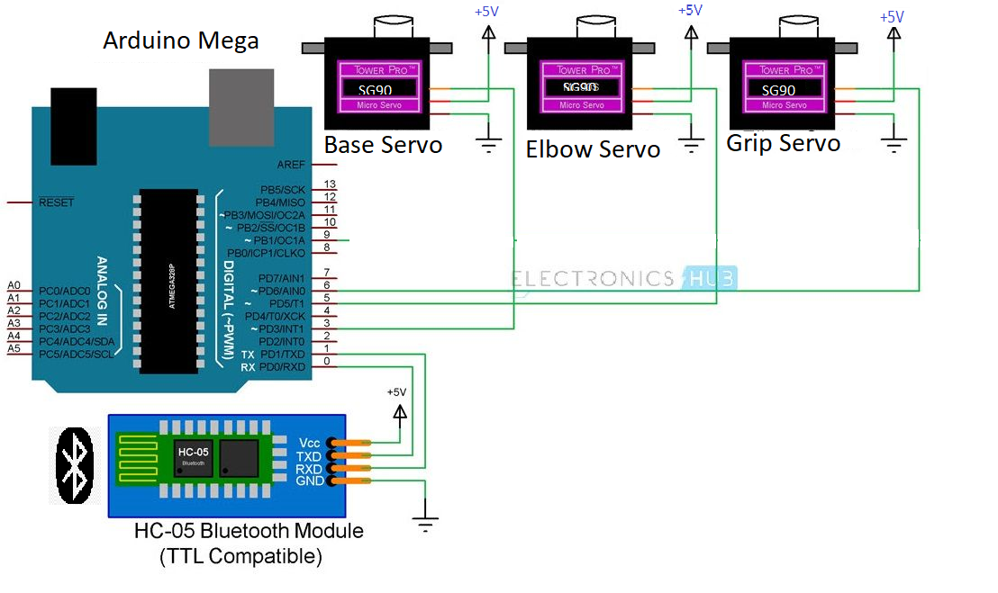
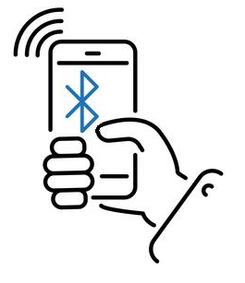
METHODOLOGY
Bangalore Institute of Technology
Dept. of ECE, BIT

Slide 14
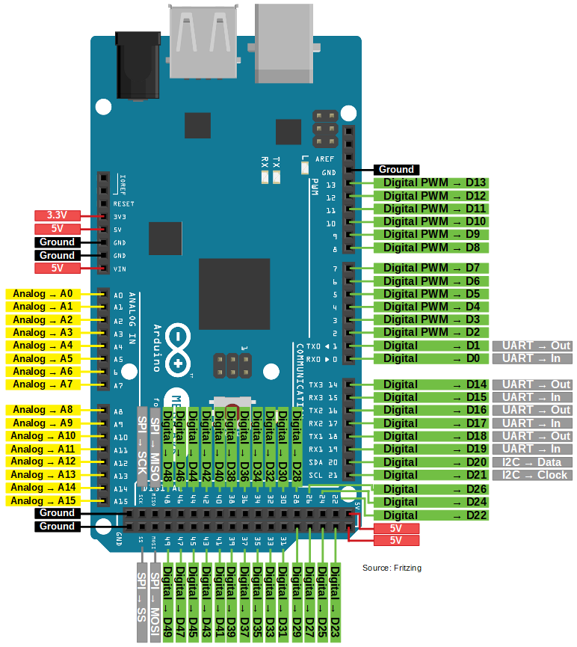
METHODOLOGY
Arduino Mega 2560
Arduino Mega 2560 is a microcontroller board based on the ATmega2560. It has 54 digital input/output pins (of which 15 can be used as PWM outputs), 16 analog inputs, 4 UARTs (hardware serial ports), a 16 MHz crystal oscillator, a USB connection, a power jack, an ICSP header, and a reset button. It contains everything needed to support the microcontroller; simply connect it to a computer with a USB cable or power it with a AC-to-DC adapter or battery to get started. The Mega 2560 board is compatible with most shields designed for the Uno and the former boards Duemilanove or Diecimila.
Bangalore Institute of Technology
Dept. of ECE, BIT

Slide 15
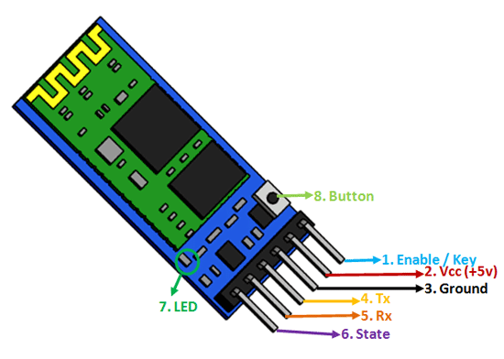
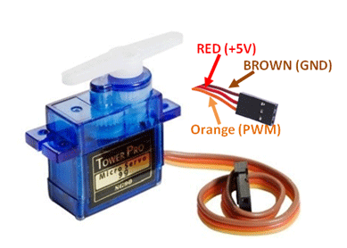
METHODOLOGY
Micro Servo SG90
Micro Servo Motor SG90 is a tiny and lightweight server motor with high output power. Servo can rotate approximately 180 degrees (90 in each direction)
Weight: 9 g
Dimension: 22.2 x 11.8 x 31 mm approx.
Stall torque: 1.8 kgf·cm
Operating speed: 0.1 s/60 degree
Operating voltage: 4.8 V (~5V)
HC-05 Bluetooth Module
HC-05 Bluetooth module works in 2.4GHz rangewith 3Mbps speed which helps in controlling the wireless robotic arm though a Bluetooth compatible android device.
Bangalore Institute of Technology
Dept. of ECE, BIT

Slide 16
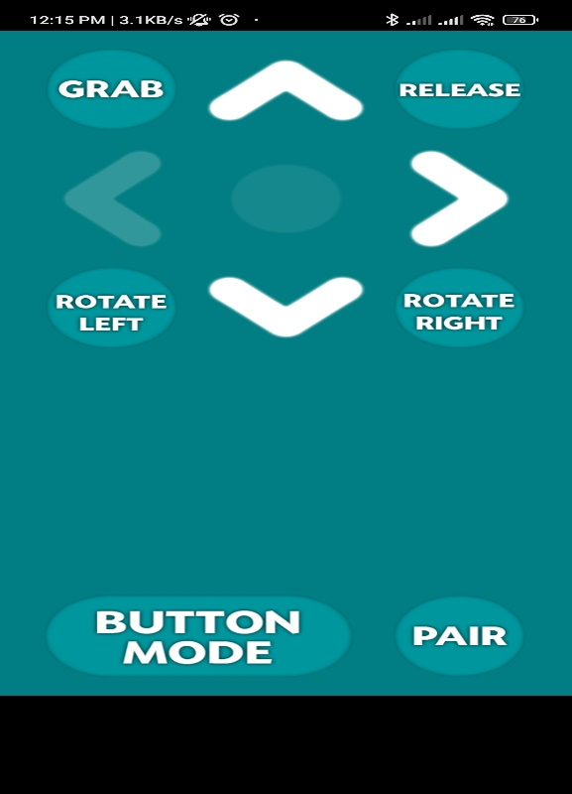
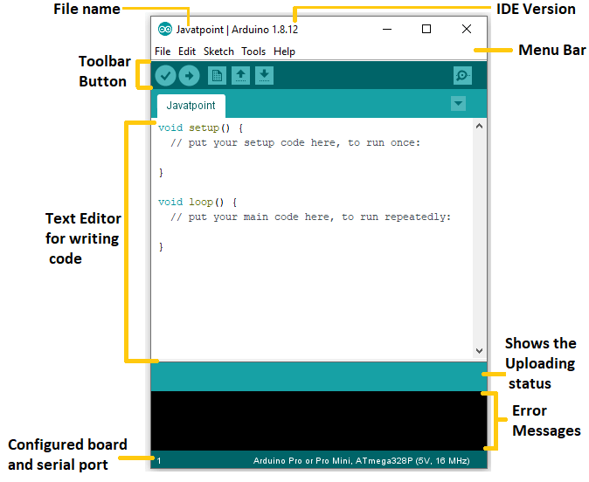
METHODOLOGY (2 PAGES)
Arduino IDE
The Arduino IDE is an open-source software, which is used to write and upload code to the Arduino boards. The IDE application is suitable for different operating systems such as Windows, Mac OS X, and Linux. It supports the programming languages C and C++. Here, IDE stands for Integrated Development Environment.
BlueSticks Controller
It is an Android App which used for interface between Smartphone and Arduino Controller.
Bangalore Institute of Technology
Dept. of ECE, BIT

Slide 17
IMPLEMENTATION & DESIGN
Bangalore Institute of Technology
Dept. of ECE, BIT

Slide 18
IMPLEMENTATION & DESIGN
The code is typed on Arduino IDE. Required Board, Ports and Libraries are set/imported.
The code is checked for any syntax errors/runtime errors.
Once the debugging is done, connect the circuit diagram as per pinout parameters in the code.
Connect to Smartphone via the aforementioned app.
Control the arm servos using the interface on smartphone.
Bangalore Institute of Technology
Dept. of ECE, BIT

Slide 19
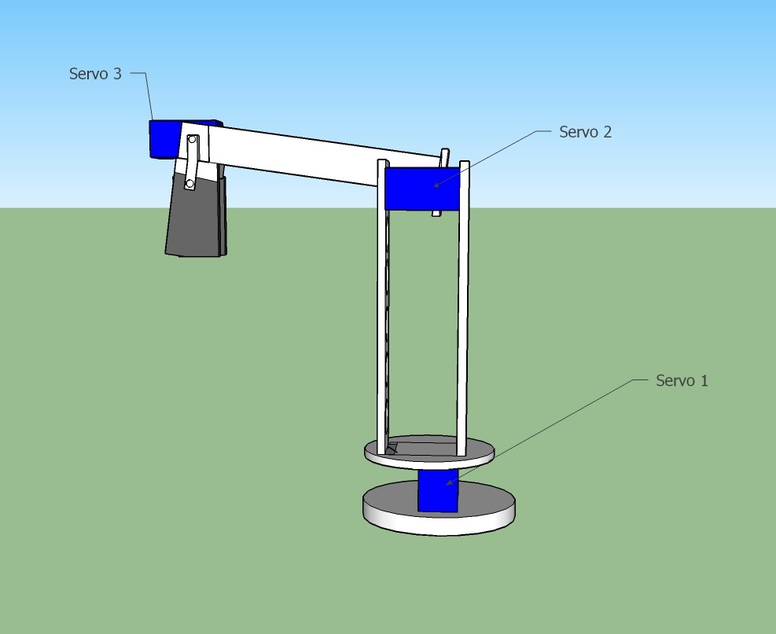
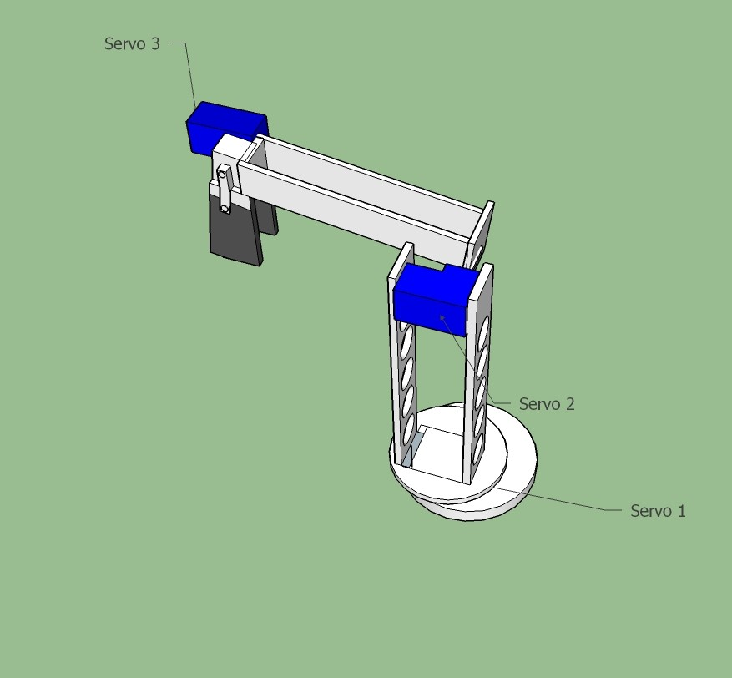
RESULTS & OBSERVATIONS
Base Servo
Bangalore Institute of Technology
Dept. of ECE, BIT

Slide 20
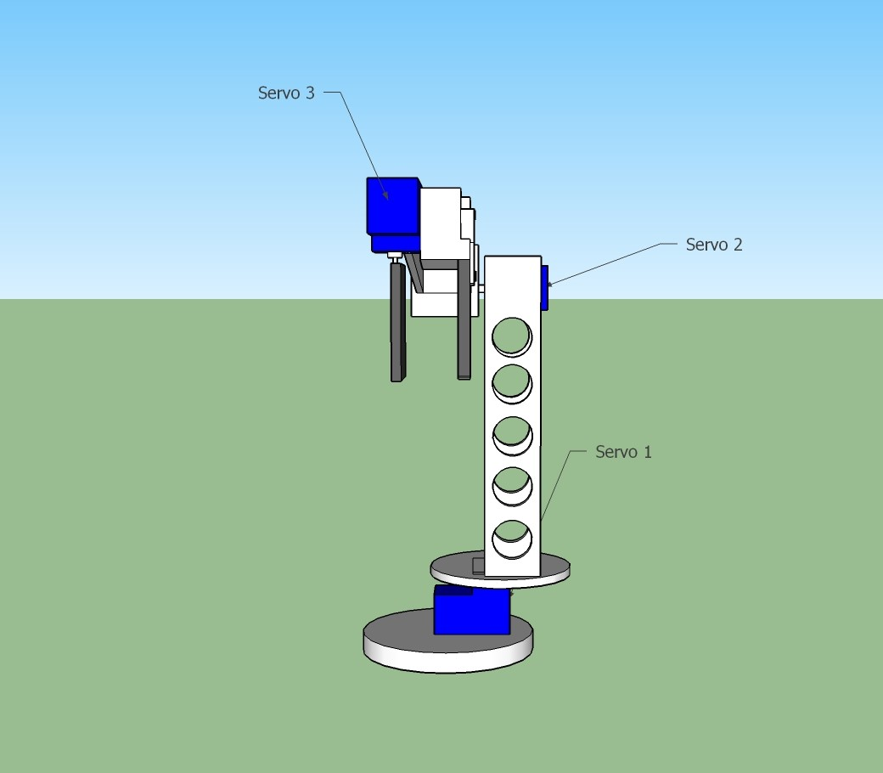
RESULTS & OBSERVATIONS
Bangalore Institute of Technology
Dept. of ECE, BIT

Slide 21
CONCLUSION
The hardware project has performed the basic operations of robotic arm as expected. The main problem to overcome in this project was to interface the Arduino Mega board with the android device via Bluetooth module. Android based robotic arm provides remote access to hard-to-reach places and with android based interface it comes under the category of user-friendly projects
Bangalore Institute of Technology
Dept. of ECE, BIT

Slide 22
FUTURE WORK
This project can be taken another notch upwards by replacing Bluetooth module with GSM module to increase the range .
A camera can be implemented along with Digital Image Processing Techniques to increase the applicability of the system.
A pedestal with wheels/axle can be used in synchronous with the existing arm system to demonstrate applications such as bomb defusal robot, farm-produce picking robot, etc.
Bangalore Institute of Technology
Dept. of ECE, BIT

Slide 23
REFERENCES
Aqeel, Adnan. (2018, June 21). Introduction to Arduino Mega 2560. Retrieved from https://www.theengineeringprojects.com/2018/06/introduction-to-arduino-mega-2560.html
V. Patidar and R. Tiwari, "Survey of robotic arm and parameters," 2016 International Conference on Computer Communication and Informatics (ICCCI), Coimbatore, 2016, pp. 1-6.
Ramkrishna Ghogre, Harshad Mehta, Ankit Khobragade, Ashutosh Tripathi, “Arduino Based Android Controlled Robotic Arm”, ”, 2020, International Research Journal of Engineering and Technology (IRJET).
Arduino, “Servo Motor Basics with Arduino”. Retrieved from https://docs.arduino.cc/learn/electronics/servo-motors
Bangalore Institute of Technology
Dept. of ECE, BIT

