Slide 1
Networking
Ethernet

Slide 2
Ethernet
LAN Standard
Original Ethernet Standard – 10 Mbps – Standard Ethernet
  10 Million bits per second
Fast Ethernet – 100 Mbps
  10 times faster than standard Ethernet
Gigabit Ethernet – 1 Gbps
  10 times faster than Fast Ethernet
10 Gigabit Ethernet – 10 Gbps

Slide 3
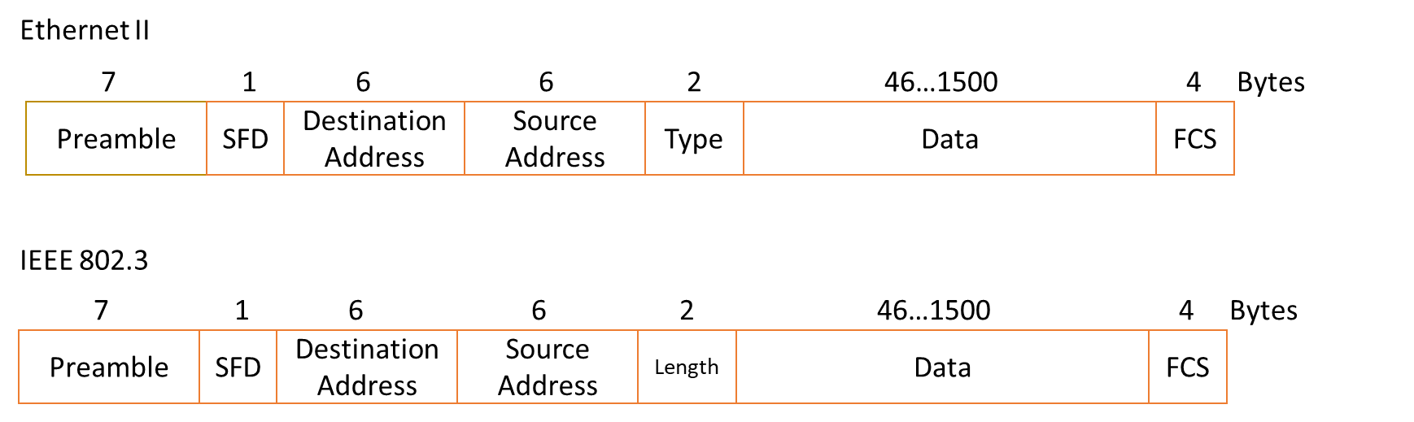
Ethernet Frame Format

Slide 4
Ethernet Frame Format
Preamble – 7 bytes, 56 bits, alternating pattern of 1’s and 0’s
  Tells the receiver a frame is coming
  Not considered to be formally part of the frame
Start of Frame Delimiter (SFD) – 1 byte. 8 bits, 10101011, signals the beginning of the frame
  Like the preamble, not considered part of the frame

Slide 5
Ethernet Frame Format
Destination address – 6 bytes, 48 bits, contains the physical address
  Also referred to as MAC (media access control) address or hardware address
  Built into the network card
  When a device sees its own address in the Destination Address field it picks up the frame and processes the contents
Source address – 6 bytes, 48 bits, contains the physical address of the sender

Slide 6
Ethernet Frame Format
Type – 2 bytes, 16 bits, indicates what exactly is in the data portion of the frame
  Ethernet II
Length – 2 bytes, 16 bits, indicates the size, in bytes of the data portion of the frame
  IEEE 802.3
Data – variable from 46 to 1500 bytes. Contains another protocol such as an IP packet or an ARP request/response
CRC – Cyclic Redundancy Check / FCS – Frame Check Sequence
  4 bytes, 32 bits included to detect errors in the frame

Slide 7
Addressing
Each device, PC, server, printer needs a Network Interface Card (NIC) to connect to the network
Each card has a Physical, Hardware, MAC address
  6 bytes, 48 bits
  Usually written in hex, with a colon :, period . Or dash – between each byte
    4A:30:10:21:10:1A = 4A30.1021.101A = 4A-30-10-21-10-1A
The first 3 bytes can be used to identify the manufacturer
  The last 3 bytes uniquely identifies the card

Slide 8
Address Types
Address can be
  Unicast – one device only – source addresses must be unicast
    Last bit in 1st byte is always 0₂ e.g. 4A.30.10.21.10.1A
  Multicast – group of devices
    Last bit in 1st byte is always 1₂ e.g. 47.30.10.21.10.1A
  Broadcasts – all devices
    All bits are 1₂ e.g. FF:FF:FF:FF:FF:FF
Destination addresses can be unicast, multicast or broadcast
Source address must be unicast

Slide 9
Access Control
Ethernet must control access to the transmission medium (cable)
  Shared medium – when a device wants to transmit there must be some procedure or protocol that is used to determine how the media is accessed
CSMA/CD – Carrier Sense Multiple Access with Collision Detection
  Devices listen (sense) before transmission but inevitably there will be collisions
    Must detect when a collision happens (collision detection)

Slide 10
Standard Ethernet
Old School diagram BUT CSMA/CD still applies today and this is easier for us to understand
Terminating resistor stop the signal reflecting back
Light and any electromagnetic signal travel at the speed of light (3 x 10⁸ m/s) in a vacuum
  An electrical conductor is not a perfect conductor and the signal propagates at about two thirds of the speed of light, which is approximately 2x10⁸ m/s.
The cable is passive and not active
  Passive means that it does not require power to operate
  So if a signal is placed on a conductor it will be sensed on all parts of that conductor
    Broadcast medium

Slide 11
CSMA/CD Operation
At time t₀, A wishes to transmit
  Listen, check the transmission medium for traffic, hears nothing, so transmits the frame 1 bit at a time.
At time t₁, A’s frame is travelling along the transmission media, 1 bit after another
  Host B has a frame to transmit, B listens to the transmission media, hears A’s frame and backsoff
  Host B doesn’t send, waits until A finishes and tries again

Slide 12
CSMA/CD Operation
At time t₂, C wishes to transmit
  Listen, check the transmission medium for traffic, hears nothing, because A’s transmission hasn’t reach C yet
  So, C transmits the frame 1 bit at a time.

Slide 13
CSMA/CD Operation
At time t₃, A’s transmission and C’s transmission will collide
  Both become garbled - corrupted

Slide 14
CSMA/CD Operation
Both A and C must detect the collision
To do this A and C must detect the garbled frames while still sending the frame
When a transmitting station detects a collision it will send out a “jam” signal and back off for a random time period
The jam signal prevents other host from initiating a transmission
This jam signal is a continuous stream of 1’s and 0’s, i.e., 1010101010101010……etc., or even 01010101010101…..
  In hex this is a continuous stream of A’s or 5’s

Slide 15
Collision Detection
In order to detect a collision a station must be transmitting at least long enough for the transmitted signal to reach the furthest end of the cable and back again
This is the reason there is a minimum frame length
  Count destination address + source address + type/length + min data + crc → 6 + 6 + 2 + 46 + 4 = 64
  Minimum Ethernet frame size is 64 bytes
If a device can send 10 Mbps (standard Ethernet), how long will it take to send 64 bytes

Slide 16
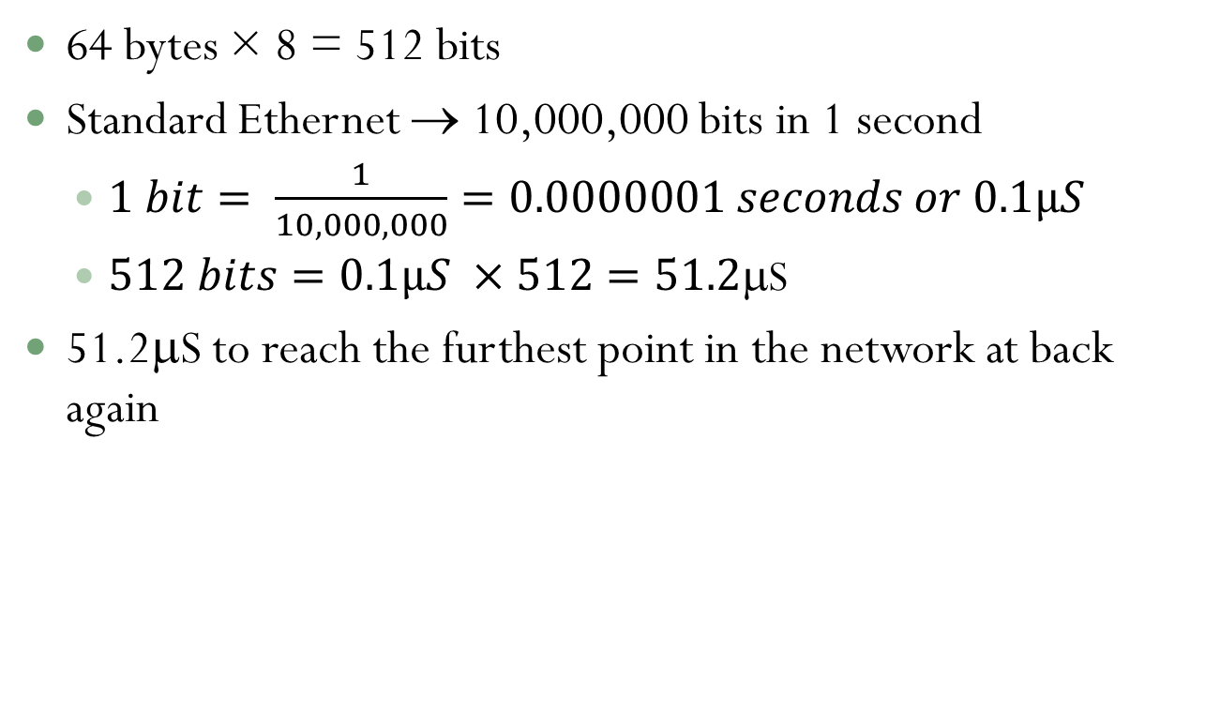
Maths
64 bytes × 8 = 512 bits
Standard Ethernet → 10,000,000 bits in 1 second
  $1 bit= \frac{1}{10,000,000}=0.0000001 seconds or 0.1µS$
  $512 bits=0.1µS ×512=51.2$S
51.2μS to reach the furthest point in the network at back again

Slide 17
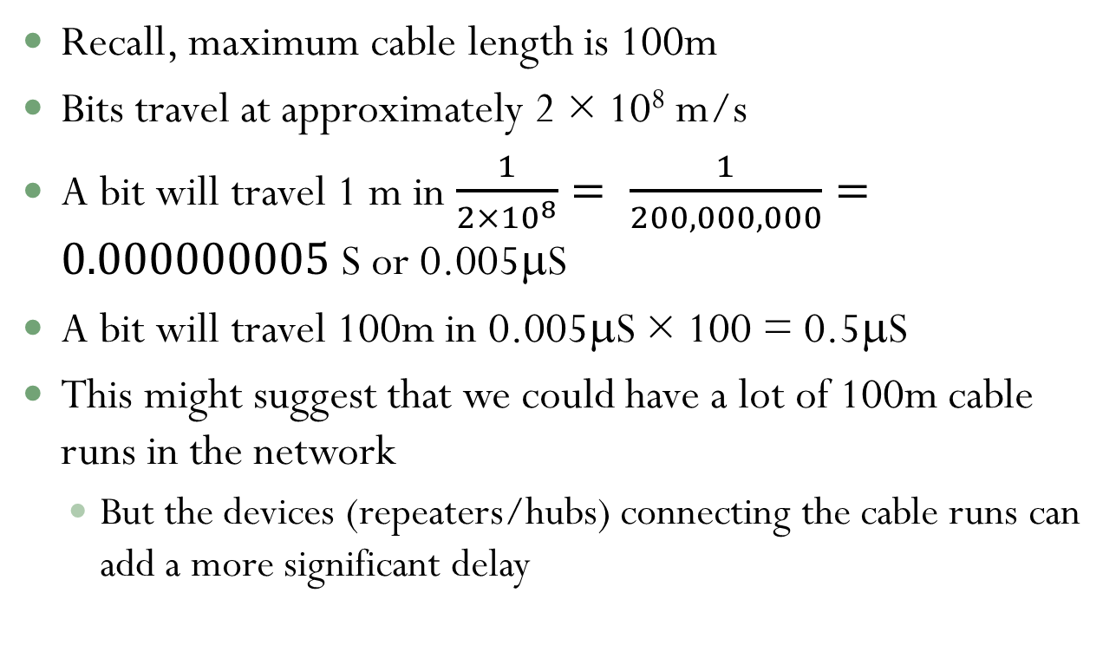
Maths
Recall, maximum cable length is 100m
Bits travel at approximately 2 × 10⁸ m/s
A bit will travel 1 m in $\frac{1}{2×{10}^{8}}= \frac{1}{200,000,000}=0.000000005$ S or 0.005μS
A bit will travel 100m in 0.005μS × 100 = 0.5μS
This might suggest that we could have a lot of 100m cable runs in the network
  But the devices (repeaters/hubs) connecting the cable runs can add a more significant delay

Slide 18
5-4-3-2-1 Rule
Limit to how many segments and repeaters there can be on the one network
There can be no more than 5 segments, 4 repeaters, only 3 segments can have hosts attached, 2 segments are inter-repeater links and it’s 1 collision domain.
A collision domain is the area where collisions happen and can be detected

Slide 19
Issues
If there are a lot of devices on a network then there can be significant delays before a device has an opportunity to transmit
There can be quite a lot of collisions, as the number of host on a network increases, the number of collisions and delays will also increase.
The designers of Ethernet say that the maximum utilisation that can be achieved is actually 37%

Slide 20
Fast Ethernet
Standard Ethernet – coaxial cable with a repeater or UTP with a hub (10Base-T)
UTP – CAT5 or CAT5e with a hub or a switch (100Base-T)
No change to frame format
No change to CSMA/CD
Time to transmit the smallest frame only 5.12μS
  Maximum network length 205m
  2 hubs, 5m apart

Slide 21
Gigabit Ethernet
1000Base-T (UTP)
Frame transmission, 0.512μS, network diameter 20m/25m
  Ok for backbone, interconnecting devices in the comms room
The original standard was 1000Base-CX and the medium used was twinaxial cable, which is like coax only it uses twin conductors as opposed to a single conductor in coax
To run to the desktop, one solution was to increase the minimum frame size to 512 bytes (enough) – wasteful
Alternative solution is to use switches and full duplex transmission

Slide 22
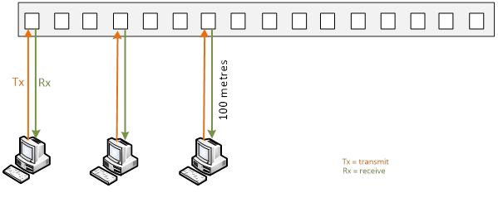
Full-Duplex
Switch

