Slide 1
Introduction to Networking
Switching

Slide 2
Hubs
Operate at the physical layer of the OSI model
  Retime & regenerate the signal
Increase the total number of devices and the total diameter of the network
Number must be limited to ensure that collisions are detected.
As Ethernet speed increases these limits are particularly problematic
Cannot filter network traffic
  Bits arriving at one port get sent out on all other ports

Slide 3
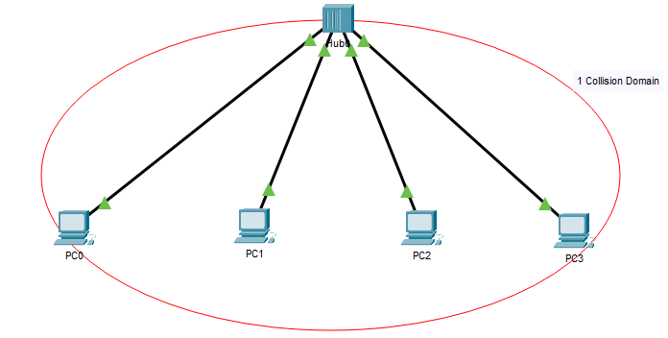
Hubs
1 Broadcast Domain

Slide 4
Switches
Data link layer network devices that connect network segments together
Intelligent devices that eliminate unnecessary traffic
Reduce the risk of collisions by dividing each segment into separate collision domains
Network component that receives incoming frames, stores them temporarily, and then sends them back out to another port
Filter network traffic by looking at the MAC address.

Slide 5
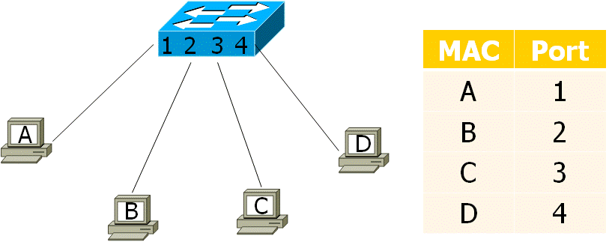
Switch Operation

Slide 6
MAC Address Table
The switch examines its MAC address table to make a forwarding decision for each frame.
  The MAC address table is also referred to as a content addressable memory (CAM) table.
When the switch is first turned on the MAC address table is empty.

Slide 7
MAC Address Table - Learning
The table is populated by examining the source MAC address and the incoming port number.
  If source MAC address is not in the table, it is added along with the incoming port number.
  If the source MAC address is already in the table, the switch updates the refresh timer for that entry
    300 seconds / 5 minutes
  If the source MAC address is already in the table but is mapped to a different port, the switch treats this as a new entry.
    The entry is replaced using the same MAC address but with the more current port number.

Slide 8
MAC Address Table - Forwarding
If the destination MAC address is a unicast address
  Look for the destination MAC address in the MAC address table.
    If the destination MAC address is found, the frame is forwarding out on the specified port.
    If the destination MAC address is not in the table, the switch will forward the frame out all ports except the incoming port.
      This is called an unknown unicast.
If the destination MAC address is a broadcast or a multicast, the frame is also flooded out all ports except the incoming port.

Slide 9
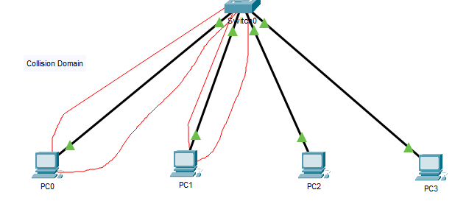
Switches
Switches
  Improved network performance
    Greater aggregate throughput
    Micro segmentation - collision domains
  Limited – 1 broadcast domain – broadcast storms
Notes:
See Lab 4 Switches
No collisions
Unicast traffic limited
Broadcast traffic goes everywhere

Slide 10
Switch Forwarding Methods
Switches use three kinds of frame-forwarding techniques
  Store-and-forward
  Cut-through
  Modified-cut-through
Each one has its own advantages and disadvantages.

Slide 11
Store and Forward
Completely store the incoming frame in internal buffers before sending it out on another port
Switch latency equal to an entire frame
  Could turn into a performance issue
Switch can verify the FCS/CRC before forwarding the frame on the outgoing interface
  Corrupted frames are dropped by the switch

Slide 12
Cut-through
Only examine a frame up to the destination address
Allows the frame to be forwarded almost immediately, resulting in very low switch latency
But bad frame will also be forwarded, since the CRC is not checked
Any frame arriving with a valid destination address will be forwarded
Cisco refers to this as Fast-Forward switching

Slide 13
Modified Cut Through
Fragment-free (Cisco) switching attempts to offer the best of both worlds by holding an incoming Ethernet frame until the first 64 bytes have been received.
If the frame is bad it can almost always be detected within the first 64 bytes of a frame, so a trade-off between switch latency and error checking is achieved
Switches act like a store-and-forward switch for shorter frames
For large frames, modified cut-through switches act like a cut-through switches.

Slide 14
Memory/Buffer Space
The Ethernet switch may use a buffering technique to store frames before forwarding them or when the destination port is busy because of congestion
There are 2 buffering space techniques:
  Port-based memory
  Shared memory

Slide 15
Port-Based Memory
Frames are stored in queues that are linked to specific incoming and outgoing ports.
A frame is transmitted to the outgoing port only when all the frames ahead in the queue have been transmitted.
Possible for a single frame to delay the transmission of all the frames in memory because of a busy destination port.
The delay occurs even if the other frames could be transmitted to an open destination port

Slide 16
Shared Memory
All frames are placed in a common memory buffer shared by all switch ports.
The amount of buffer memory required by a port is dynamically allocated.
The frames in the buffer are dynamically linked to the destination port.
  This means a frame can be received on one port and transmitted on another port, without moving it to a different queue.
Larger frames can be transmitted with fewer dropped frames.
  Important for asymmetric switching
    Different data rates on different ports

Slide 17
Duplex and Bandwidth Settings
The duplex and bandwidth settings must match between the switch port and the connected devices.
There are 2 types of duplex settings used for communication on an Ethernet network:
  Full-duplex → Both ends of the connection can send and receive simultaneously.
    Gigabit Ethernet ports operate in full-duplex only
  Half-duplex → Only one end of the connection can send at a time.
Auto-negotiation enables 2 devices to automatically negotiate the best speed and duplex capabilities.

Slide 18
10/100 Mbps Performance Issues
Duplex mismatch is one of the most common causes of performance issues on 10/100 Mbps Ethernet links.
It occurs when one port on the link operates at half-duplex while the other port operates at full-duplex.
  Can occur when one or both ports on a link are reset, and the auto-negotiation process does not result in both devices having the same configuration.
  Can occur when users reconfigure one side of a link and forget to reconfigure the other.
    Both sides of a link should have auto-negotiation on, or both sides should have it off.

Slide 19
Medium – Dependent Interface
MDI/MDIX (medium-dependent interface/MDI crossover)
Type of Ethernet port connection that uses twisted-pair cabling to link two networked devices.
  MDI devices transmit on pin 1 & 2, receive on pin 3 & 6
    End devices and routers
  MDIX devices transmit on pin 3 & 6, receive on pin 1 & 2
    Switches and hubs
A direct connection between a router and a host or between 2 switches would in the past require a crossover cable
Most devices now support the automatic medium-dependent interface crossover (auto-MDIX) feature
  Automatically detects the type of cable attached to the port and configure the interface accordingly

