Slide 1
Networking
Virtual Local Area Networks (VLANs)

Slide 2
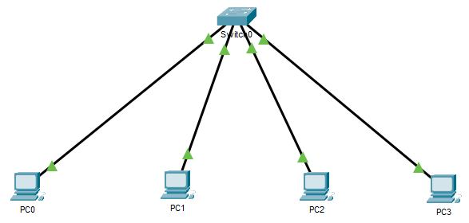
Broadcast Domain
1 Broadcast Domain

Slide 3
Virtual LAN
VLANs are created at Layer 2
  Virtual network(s) on top of a single physical network
Reduce broadcast traffic
  Each VLAN is a separate broadcast domain
Break up a switched network into smaller networks
  Devices within a single VLAN communicate with each other
  Don’t see traffic (broadcast) from other networks

Slide 4
VLANs
Segment networks based on function, team, or application
  Without regard for the physical location
  Example voice (VoIP) network
Each VLAN is considered a separate logical network
  Even if they share a switch
Any switch port can belong to any VLAN

Slide 5
VLAN Operation
Unicast, broadcast, and multicast packets are forwarded and flooded only to end devices within the VLAN
Packets destined for devices that do not belong to the VLAN must be forwarded through a device that supports routing
  Router / Layer 3 switch (multilayer switch)

Slide 6
VLAN
Each VLAN is a separate IP subnet
Creates a logical broadcast domain that can span multiple physical LAN segments (switches)
Improve network performance – less broadcasts
Notes:
See Lab 4 VLAN Routing

Slide 7
VLAN Benefits
Smaller broadcast domains
Better performance
Better security
  Limit impact of network issues or security breaches to a specific VLAN
Reduced cost
Better IT efficiency
More Flexibility
  Logical groups communicate as if they were on the same physical LAN
  Easier administration/network management – configure via software

Slide 8
Switchports
Access Ports – connect to an end device
  Assigned to one VLAN
Trunk ports – connect 2 switches or a switch and a router
  Carry traffic from all VLAN’s
  Traffic is tagged with the VLAN ID
  Protocol = IEEE 802.1Q (4 byte tag)
Notes:
See Lab 4 VLAN routing

Slide 9
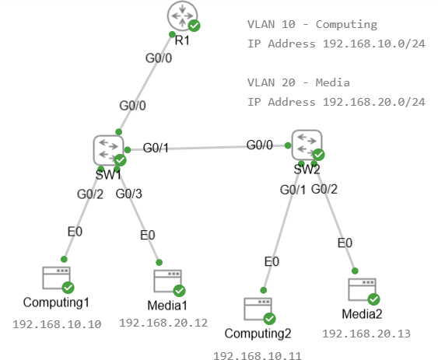
Trunk Port
Trunk Link
Trunk Link

Slide 10
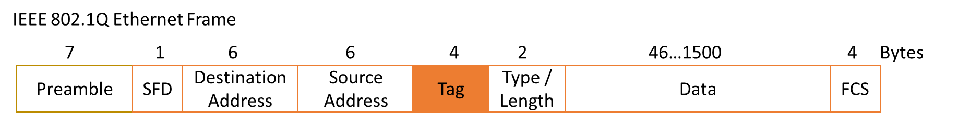
IEEE 802.1Q
Trunk ports/links carry traffic from all VLANs
Must keep VLAN traffic separate
  Identify/mark/tag frames from different VLANs
IEEE 802.1Q is an open standard trunking protocol
Adds a 32-bit/4-byte Tag field after the Source MAC address and before the Type/Length field to frames on a trunk link only

Slide 11
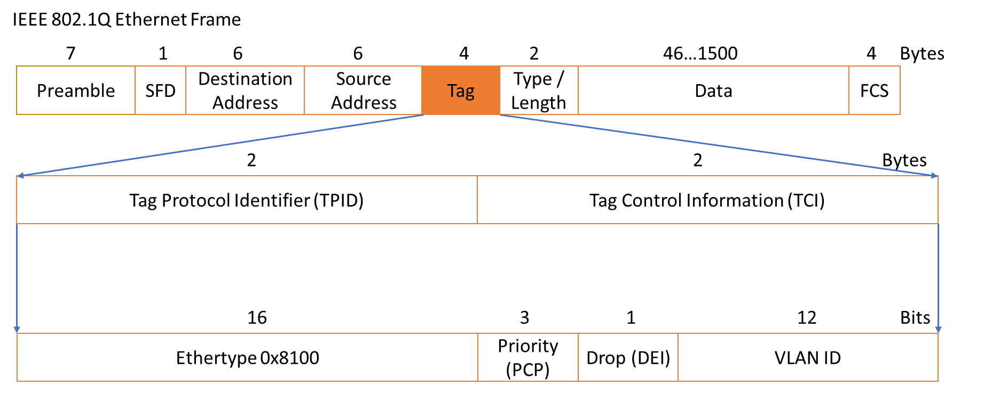
Tagged Frame Format

Slide 12
Tag Fields
Tag Protocol Identifier (TPID) → 16 bits, 2 bytes, set to 0x8100
  Same position as the Type/Length field in untagged frames
  Indicates the next field is TCI
Tag control information (TCI) →16 bits, 2 bytes, containing 3 sub-fields:
  Priority code point (PCP) 3 bits, class of service (CoS), used to prioritise different traffic
  Drop eligible indicator (DEI) 1 bit, used to indicate frames that can be dropped when/if congestion occurs
  VLAN ID 12 bits, indicates the VLAN to which the frame belongs
    0 and 4095 is reserved, allows up to 4094 VLANs

Slide 13
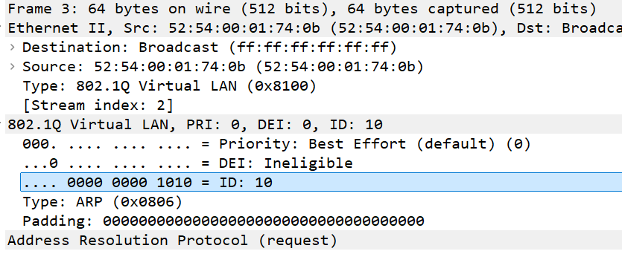
Tagged Frame

Slide 14
VLAN Types
Data VLAN
  User VLAN
  VLANs configured to separate user-generated traffic
  Isolated from other types of traffic such as voice or management

Slide 15
VLAN Types
Default VLAN – VLAN 1 (usually)
  All ports are initially assigned to by default
  The native VLAN is VLAN 1
  The management VLAN is VLAN 1
  VLAN 1 cannot be renamed or deleted

Slide 16
VLAN Types
Management VLAN
  Data VLAN configured specifically for network management traffic including SSH, Telnet, HTTPS, HTTP, and SNMP
  By default, VLAN 1 is configured as the management VLAN
  Best practice move away from VLAN 1

Slide 17
VLAN Types
Native VLAN
  A switch may also have to send untagged traffic across a trunk link
  Untagged traffic may be generated by a switch or come from legacy devices
  Untagged traffic is placed on the native VLAN
  The native VLAN on a Cisco switch is VLAN 1
    Move away from VLAN 1

Slide 18
VLAN Types
Voice VLAN
  A separate VLAN is needed to support Voice over IP (VoIP)
  VoIP traffic has different requirements to data:
    Guaranteed bandwidth to ensure voice quality
    Priority over other types of network traffic
    Re-routed to avoid congestion
    Delay of less than 150ms across the network

Slide 19
Assigning Membership to Network Devices
There are three general methods used to decide which VLANs each device should be assigned to:
  Port-based → each physical switch port is statically assigned to a VLAN, and any device connected to that port becomes part of the assigned VLAN.
  MAC address-based → VLAN membership is determined by the connected devices MAC address. Must configure a table to map each MAC address to a specific VLAN. More flexible if users are moving around.
  Protocol-based VLAN membership is assigned based on network protocols such as IP or VoIP

