Slide 1
Networking
Wireless Ethernet – IEEE 802.11

Slide 2
Introduction
What is wireless technologies?
  Transmission of information without the use of cables

Slide 3
Advantages
Mobility
Quick installation and deployment
Flexibility
Scalability
Cost savings

Slide 4
Issues with Wireless
Quality of transmission
Interference and noise
Capacity of the network
Security requirements
Effects of mobility

Slide 5
Affects of Mobility
Significant benefits for the end user
Challenges
  Hardware must become lighter, more robust and consume less power.
  The network interface and protocol must be adapted
  Applications must also adapt to varying levels and quality of service
  Security is a bigger issue, while end user authentication becomes harder to implement

Slide 6
Types of Wireless Systems
PAN – Cordless keyboard, headset
  IEEE 802.15 – Wireless Personal Area Networks – Wireless Specialty Networks (WSN) standards
    Bluetooth, Internet of Things, body area networks, wearables, …
LAN – WiFi
  IEEE 802.11
MAN – WiMax
  IEEE 802.16, LTE, 5G
WAN – Satellite phones, radio, TV, data communications

Slide 7
Industrial, Scientific, and Medical (ISM) Band
Initially reserved for non-communications uses of RF energy, such as microwave ovens, radio-frequency heating, and similar purposes
However, the most popular use of these bands is short-range low-power communications systems.
  Cordless telephones, wireless networks, and Bluetooth devices all use the ISM bands.
  ISM devices do not have regulatory protection against interference from other users of the band

Slide 8
ISM Bands
Frequency Range | Bandwidth | Centre Frequency | Availability
433.050 MHz - 434.790 MHz | 1.84 MHz | 433.920 MHz | Region 1 (Europe, Africa, Middle East) only and subject to local acceptance
902.000 MHz - 928.000 MHz | 26 MHz | 915.000 MHz | Region 2 (Americas, Pacific Islands, Greenland) only
2.400 GHz - 2.500 GHz | 100 MHz | 2.450 GHz
5.725 GHz - 5.875 GHz | 150 MHz | 5.800 GHz

Slide 9
Wired/Wireless Differences
Characteristics | 802.11 Wireless LAN | 802.3 Ethernet LAN
Physical Layer | Radio Frequency (RF) | Cable
Media Access | Collision Avoidance | Collision Detection
Availability | Anybody with a radio NIC in range of the wireless network | Cable connection required
Signal Interference | Yes | N/A
Regulation | Additional regulation by local authorities | IEEE Standard

Slide 10
Wired/Wireless Differences (Cont’d)
AP/Switch
Battery power issues
Wireless network devices may not detect a collision
  Actively avoid collisions
Different frame format
More privacy/security issues

Slide 11
Wireless Standards
IEEE 802.11 → 1997, 1 to 2 Mbps
IEEE 802.11a → 1999, 5GHz, 54 Mbps → Wifi 2
IEEE 802.11b → 1999, 2.4 GHz, 11 Mbps → Wifi 1
IEEE 802.11g → 2003, 2.4 GHz, 54 Mbps → Wifi 3
IEEE 802.11n → 2009, 2.4 & 5 GHz, 150/300/600 Mbps, MIMO → Wifi 4
IEEE 802.11ac → 2014, 1.3/ 3.5 Gbps → Wifi 5
IEEE 802.11ax → 2019, IoT, sensors, low battery usage, better range, 9.6 Gbps → Wifi 6
IEEE 802.11be → 2024, 2.4, 5 & 6 GHz, 30Gbps → Wifi 7

Slide 12
Wireless Standards & Certification
Standards ensure interoperability
Internationally, the 3 key organizations influencing WLAN standards are:
  ITU-R regulates allocation of RF bands
  IEEE specifies how RF is modulated to carry information
  Wi-Fi Alliance ensures that vendors make devices that are interoperable

Slide 13
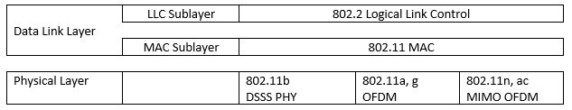
MAC Specification

Slide 14
MAC Challenges
Multiple frame types
Security
Susceptibility to noise
Hidden node problems

Slide 15
RF Link Quality
Wired  assume that transmitted frames have been received correctly
Radio  unlicensed spectrum = interference + noise
Wireless devices assume there will be interference
  Use positive acknowledgements
  All transmitted frames must be acknowledged

Slide 16
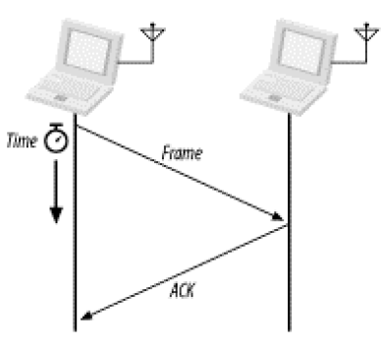
Atomic Operation
802.11 makes sure that atomic sequences are not interrupted by other stations sending frames
Lock out contention

Slide 17
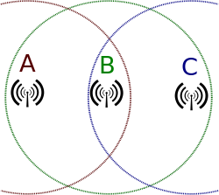
Hidden Nodes Problem
A is transmitting to B
C is out of range of A so it won’t hear A’s transmission
C thinks medium is free and transmits – collision
A & C are hidden from each other

Slide 18
CSMA/CA
Wireless = shared medium  deal with collisions
IEEE 802.3 uses CSMA/CD
  Won’t work in 802.11 because of hidden nodes
Wireless nodes may not be able to detect collisions
  If collisions can’t be detected they must be avoided
CSMA/CA uses a physical and virtual carrier sense mechanism

Slide 19
Virtual Carrier Sense
Nodes wishing to transmit must first send a RTS
The receiving station responds with a CTS
The RTS & CTS contain a network allocation vector (NAV) which indicates the amount of time the medium is reserved for
  NAV = data frame + ACK + interframe spaces
All stations in the range of the RTS & CTS learns about the medium reservation
  How does this help with the hidden node problem?

Slide 20
Virtual Carrier Sense
Stations countdown from NAV to 0
While NAV ≠ 0, the medium is busy
When NAV = 0, the medium is idle

Slide 21
RF Link Quality
Wired  assume that transmitted frames have been received correctly
Radio  unlicensed spectrum = interference + noise
Wireless devices assume there will be interference
  Use positive acknowledgements
  All transmitted frames must be acknowledged

Slide 22
Atomic Operation
802.11 makes sure that atomic sequences are not interrupted by other stations sending frames
Lock out contention

Slide 23
Hidden Nodes Problem
A is transmitting to B
C is out of range of A so it won’t hear A’s transmission
C thinks medium is free and transmits – collision
A & C are hidden from each other

Slide 24
CSMA/CA
Wireless = shared medium  deal with collisions
IEEE 802.3 uses CSMA/CD
  Won’t work in 802.11 because of hidden nodes
Wireless nodes may not be able to detect collisions
  If collisions can’t be detected they must be avoided
CSMA/CA uses a physical and virtual carrier sense mechanism

Slide 25
Frame Types
Management frames  Used for joining and leaving a wireless cell. Management frame types include association request, association response, and reassociation request
Control frames  Used to acknowledge when data frames are received.
Data frames  Frames that contain data.

Slide 26
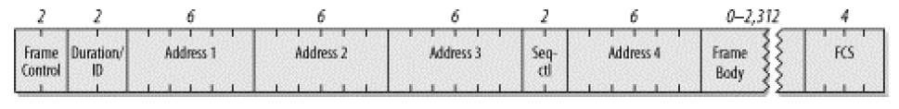
Frame Format
4 address fields – not all used
No preamble (physical layer), no length or type field (LLC)

Slide 27
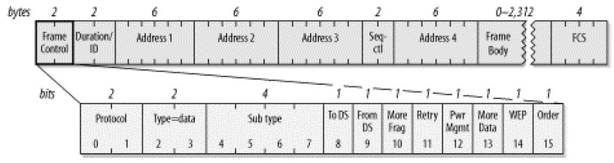
Frame Control

Slide 28
ToDS / FromDS
 | To DS=0 | To DS=1
From DS=0 | All management and control frames. Data frames within an IBSS (never infrastructure data frames) | Data frames transmitted from a wireless station in an infrastructure network
From DS=1 | Data frames received for a wireless station in an infrastructure network. Data frames on a "wireless bridge"

Slide 29
Duration/ID
Bit 15 = 0 → NAV in μs
Bit 0 - 14 = 0, Bit 15 = 1 → contention free period
Bit 14, 15 = 0 → PS-Poll frame, battery saving

Slide 30
Address Fields
Destination Address – final recipient
Source Address – original source
Receiver Address – next device
Transmitter Address – only used in wireless bridging, wireless interface transmitting the frame
BSSID Address – wireless interface on the AP

Slide 31
Address Field Usage
Function | ToDS | FromDS | Address 1 (RX) | Address 2 (TX) | Address 3 | Address 4
IBSS | 0 | 0 | DA | SA | BSSID | not used
To AP (infra.) | 1 | 0 | BSSID | SA | DA | not used
From AP (infra.) | 0 | 1 | DA | BSSID | SA | not used
WDS (bridge) | 1 | 1 | RA | TA | DA | SA

Slide 32
Sequence Control Field
2 byte → defragmentation and discarding duplicate frames
4-bit fragment number field and a 12-bit sequence number field
Each upper layer PDU is given a sequence number – modulo 4096
Fragments are assigned the same sequence number 1st fragment = 0
Retransmissions get the same sequence number

Slide 33
Frame Body
Maximum payload of 2,304 bytes
Increases to 2,312 bytes to accommodate WEP overhead
802.2 LLC headers use 8 bytes for a maximum network protocol payload of 2,296 bytes
On IP networks, Path MTU Discovery (RFC 1191) will prevent the transmission of frames with data fields larger than 1,500 bytes

Slide 34
FCS
Calculated over the entire frame – header + data
Same as 802.3 but must be recalculated by the AP since the headers change

