Slide 1
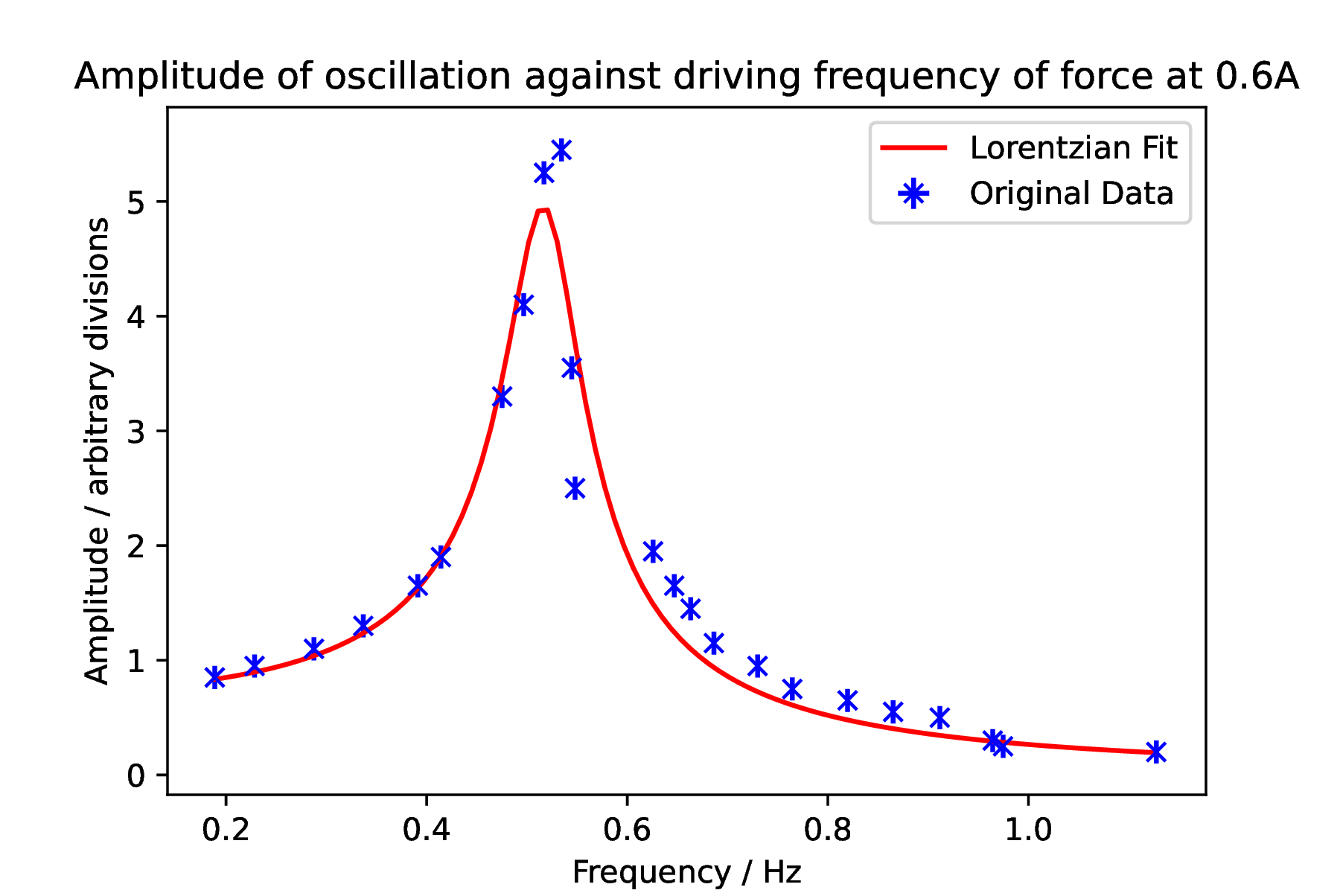


Resonance
From the resonance peak, the resonant angular driving frequency, $ω_{D}$, is $\left(3.26±0.02\right)$ rad s⁻¹.
Using the resonance shift equation (5), we get a value for the natural frequency of $\left(3.28±0.01\right)$ rad s⁻¹. This is lower than the predicted value from free oscillations [$\left(3.33±0.01\right)$ rad s⁻¹].
A resonance curve with Lorentzian fit for a damping current of 0.6 A. The peak falls at $\left(0.519±0.004\right)$ Hz.

