Slide 1
Efficient Implementation of Multi-Center Potential Models in Molecular Dynamics with Cuda
Andreas Kirsch
Notes:
Based on MarDyn
Kai Orend’s “Numerische Aspekte bei Molekulardynamik-Simulationen - Beschleunigung durch Graphikkarten” http://www5.in.tum.de/pub/orend2010.pdf

Slide 2
Molecule Interactions
One molecule can be made up of multiple sites
Different potentials possible for the sites: Lennard-Jones, Charges, Dipoles
Interactions need to be calculated between all molecule pairs
Simplification: use a cutoff radius to reduce the number of interactions
Result: Linked Cell Algorithm

Slide 3
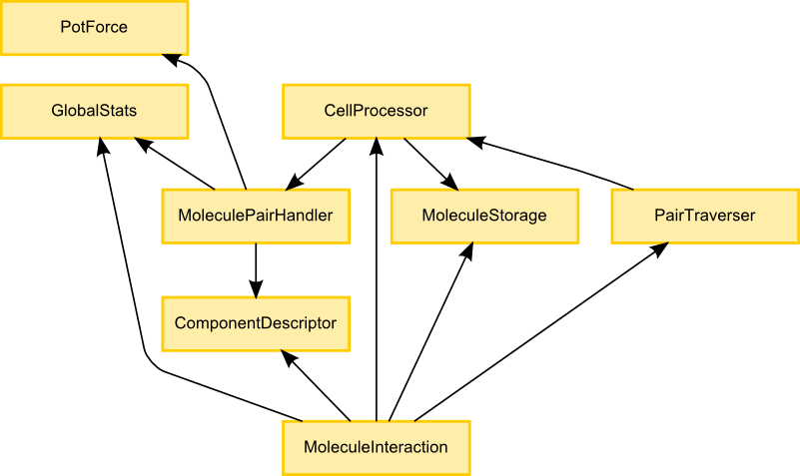
Modules and Dependencies

Slide 4
CUDA Architecture
See the CUDA Programming Guide..
Notes:
Draw a CUDA architecture diagram to explain thread blocks and warp blocks

Slide 5
Performance (lj2d1)
Notes:
Explain thread block and warp block processor

Slide 6
Performance (lj1)

Slide 7
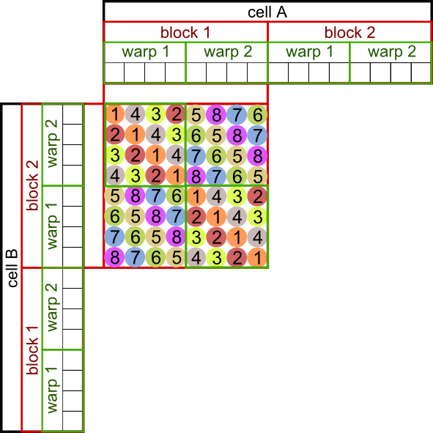
Thread Block Cell Processor
Notes:
Fixed thread block size for all cells -> not good for sparse domains
Only useful for high densities

Slide 8
Warp Block Cell Processor
Dynamic scheduler
Jobs queue
No instruction-level synchronization
Memory-level synchronization (via spin locks)
Notes:
Draw diagram that shows how WBCP works
(describe) dynamic job scheduling

Slide 9
Optimizations
Shared memory cache Shared memory results differ for TBCP and WBCP
Constant memory Constant memory was a good idea
Non-interleaved storage Non-interleaved storage failed because of temporarily sparse access patterns (more cache misses with non-interleaved data)
Notes:
Shared memory cache
Shared memory results differ for TBCP and WBCP
Constant memory
Constant memory was a good idea
Non-interleaved storage
Non-interleaved storage failed because of temporarily sparse access patterns (more cache misses with non-interleaved data)
TODO: fully interleaved molecule storage

Slide 10
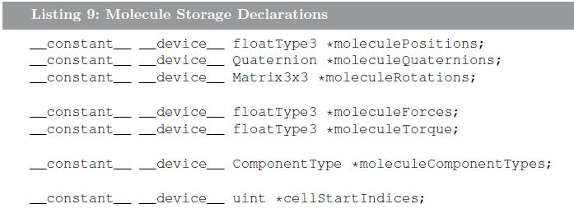
Optimizations
Notes:
Shared memory cache
Shared memory results differ for TBCP and WBCP
Constant memory
Constant memory was a good idea
Non-interleaved storage
Non-interleaved storage failed because of temporarily sparse access patterns (more cache misses with non-interleaved data)
TODO: fully interleaved molecule storage

Slide 11
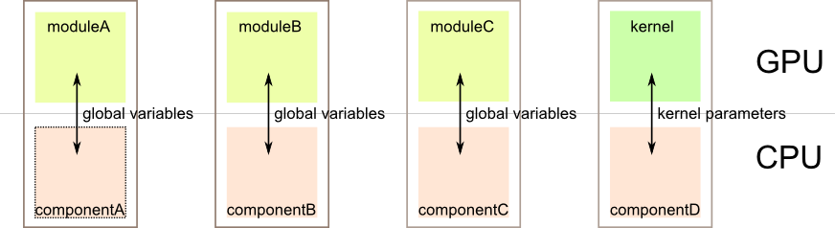
Implementation
Notes:
Global constant variables to avoid kernel parameters
Heavy use of template parameters to link modules together and keep things interchangable
----! CUDA/C++ still sucks for fast, modular code
3 source code iterations during the project

Slide 12
Implementation
Global constant variables to avoid kernel parameters
Heavy use of template parameters to link modules together and keep things interchangable
CUDA/C++ still sucks for fast, modular code
3 source code iterations during the project

Slide 13
Interesting Papers
Better performance at lower occupancy http://www.cs.berkeley.edu/~volkov/volkov10-GTC.pdf
Demystifying GPU microarchitecture through microbenchmarking http://www.stuffedcow.net/research/cudabmk
CudaDMA: Optimizing GPU Memory Bandwidth via Warp Specialization http://www.stanford.edu/~mebauer/pdfs/cudadma-sc11.pdf

Slide 14
Interesting Bugs & Facts
Constructors can be evil (for shared memory objects)
Too many nested, inlined loops confuse the compiler: __noinline__ to the rescue!
__syncthreads() should be called __syncwarps()!
PTX assembly has more “features”
Notes:
PTX reduction and enhanced synchronization instructions

Slide 15
Lessons learned
Benchmark early and benchmark often!
Write down expectations and how to verify them before implementing anything
Iterate multiple times and throw away old code

Slide 16
Thank You!

