Slide 1
Efficient Implementation of Multi-Center Potential Models in Molecular Dynamics with Cuda
Andreas Kirsch
Notes:
Based on MarDyn
Kai Orend’s “Numerische Aspekte bei Molekulardynamik-Simulationen - Beschleunigung durch Graphikkarten” http://www5.in.tum.de/pub/orend2010.pdf

Slide 2
Molecule Interactions
Notes:
One molecule can be made up of multiple sites
Different potentials possible for the sites: Lennard-Jones, Charges, Dipoles
Interactions need to be calculated between all molecule pairs
Simplification: use a cutoff radius to reduce the number of interactions
Result: Linked Cell Algorithm

Slide 3
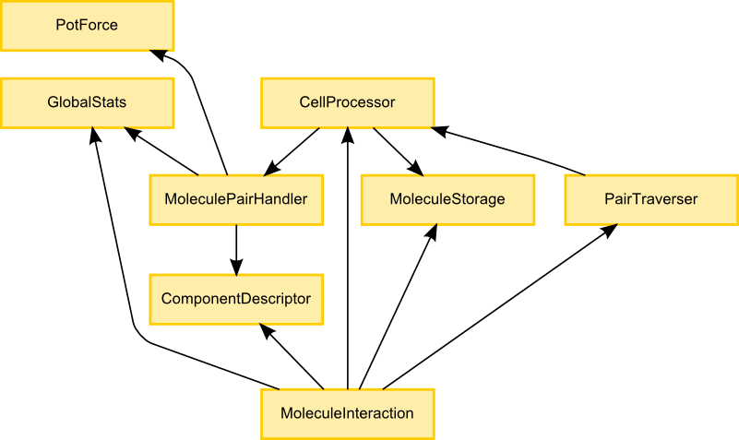
Modules and Dependencies

Slide 4
CUDA Architecture
Notes:
Draw a CUDA architecture diagram to explain thread blocks and warp blocks

Slide 5
Performance (lj2d1)
Notes:
Explain thread block and warp block processor

Slide 6
Performance (lj1)

Slide 7
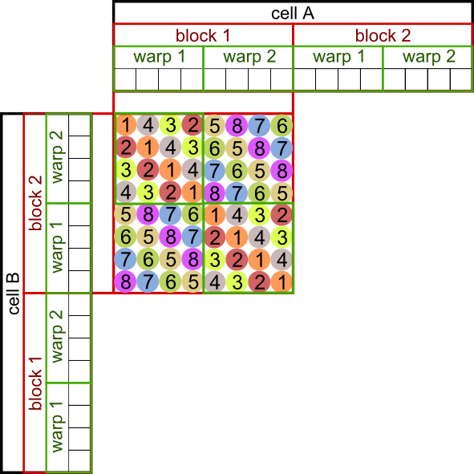
Thread Block Cell Processor
Notes:
Fixed thread block size for all cells -> not good for sparse domains
Only useful for high densities

Slide 8
Warp Block Cell Processor
Notes:
Dynamic scheduler
Jobs queue
No instruction-level synchronization
Memory-level synchronization (via spin locks)
Draw diagram that shows how WBCP works
(describe) dynamic job scheduling

Slide 9
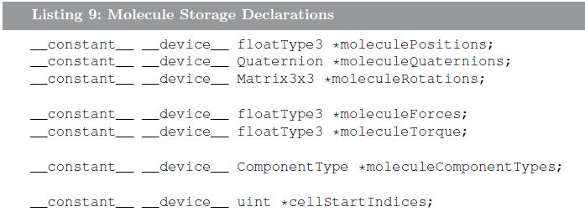
Optimizations
Notes:
Shared memory cache
Shared memory results differ for TBCP and WBCP
Constant memory
Constant memory was a good idea
Non-interleaved storage
Non-interleaved storage failed because of temporarily sparse access patterns (more cache misses with non-interleaved data)
TODO: fully interleaved molecule storage

Slide 10
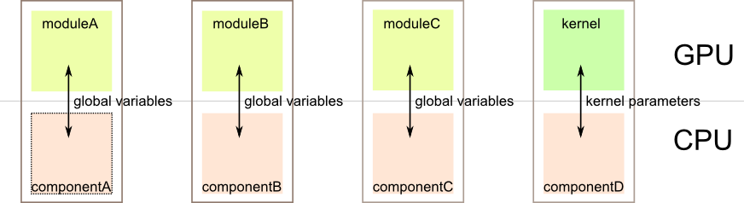
Implementation
Notes:
Global constant variables to avoid kernel parameters
Heavy use of template parameters to link modules together and keep things interchangable
----! CUDA/C++ still sucks for fast, modular code
3 source code iterations during the project

Slide 11
Interesting Papers
Better performance at lower occupancy http://www.cs.berkeley.edu/~volkov/volkov10-GTC.pdf
Demystifying GPU microarchitecture through microbenchmarking http://www.stuffedcow.net/research/cudabmk
CudaDMA: Optimizing GPU Memory Bandwidth via Warp Specialization http://www.stanford.edu/~mebauer/pdfs/cudadma-sc11.pdf

Slide 12
Interesting Bugs & Facts
__noinline__
__restrict__
__syncthreads() should be called __syncwarps()
Notes:
Constructors can be evil (for shared memory objects)
Too many nested, inlined loops confuse the compiler: __noinline__ to the rescue!
__syncthreads() should be called __syncwarps()!
PTX assembly has more “features”
PTX reduction and enhanced synchronization instructions

Slide 13
Lessons learned
Notes:
Benchmark early and benchmark often!
Write down expectations and how to verify them before implementing anything
Iterate multiple times and throw away old code

Slide 14
Thank You!

