Slide 1
State of the Touch:
Ubuntu on phones and tablets
with Jan Sprinz (@NeoTheThird) at Ubucon Europe 2019

Slide 2
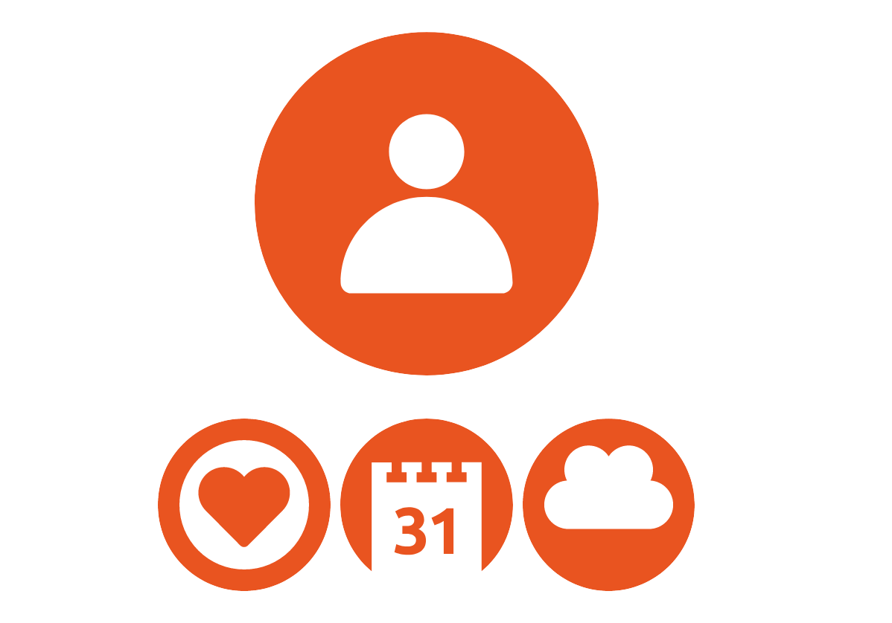
About me
Jan Sprinz, 22, studies CompSci and PolSci at LMU Munich and spends most of his time awake flashing phones with Ubuntu Touch. Member of the UBports Foundation’s first Board of Directors.
e-mail: jan@ubports.com
github: github.com/neothethird
gitlab: gitlab.com/neothethird
twitter: @NeoTheThird
mastodon: @NeoTheThird@mastodon.social
telegram: @NeoTheThird

Slide 3
“Ubuntu Touch? I thought that was discontinued!”
Notes:
Notes to speaker

Slide 4
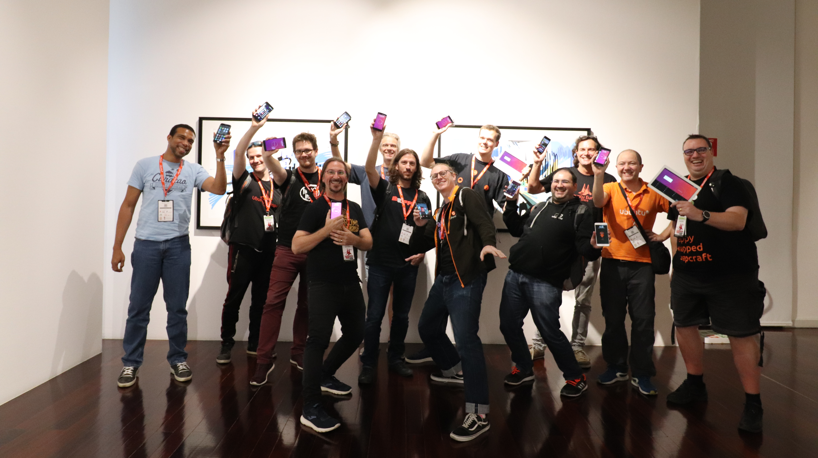
Background © Nerdzoom Media 2019

Slide 5
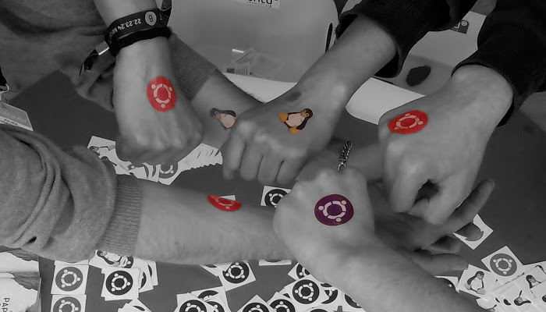
UBports Foundation
Background © Ubuntu-fr Community 2016

Slide 6
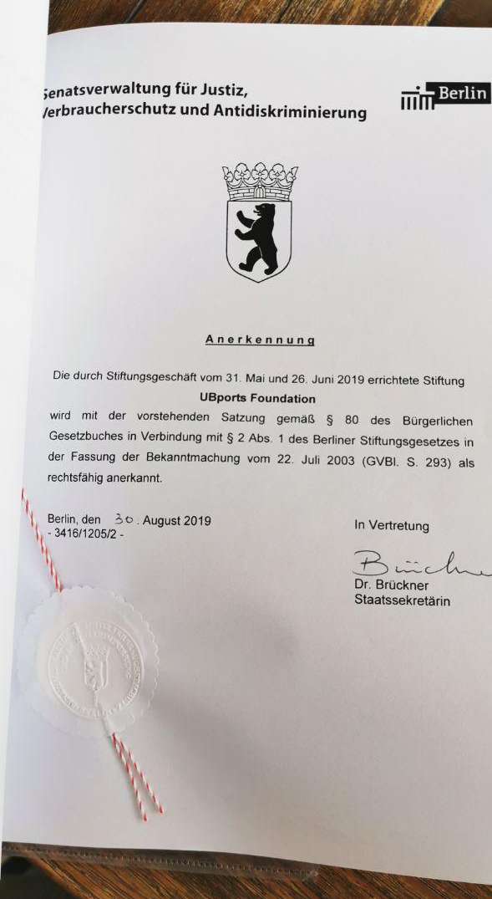
On August 30th, the UBports Foundation has officially been granted legal capacity by the Berlin senate
Background © Ubuntu-fr Community 2016

Slide 7
UBports Foundation
Board of Trustees
Background © Ubuntu-fr Community 2016

Slide 8
UBports Foundation
Board of Trustees
Membership Committee
Background © Ubuntu-fr Community 2016
elects
names members

Slide 9
UBports Foundation
Board of Trustees
Board of Directors
Membership Committee
Background © Ubuntu-fr Community 2016
elects
elects
names members

Slide 10
UBports Foundation
Board of Trustees
Advisory Board
Board of Directors
Membership Committee
Background © Ubuntu-fr Community 2016
elects
elects
names members

Slide 11
UBports Foundation
Sponsors
Board of Trustees
Advisory Board
Board of Directors
Membership Committee
Background © Ubuntu-fr Community 2016
elects
elects
names members

Slide 12




A big thank you!
… and to so many more donors on patreon, liberapay and paypal!

Slide 13

What‘s next?
1. Create a daily-driver-ready device
2. Improve compatibility
3. World dominance

Slide 14
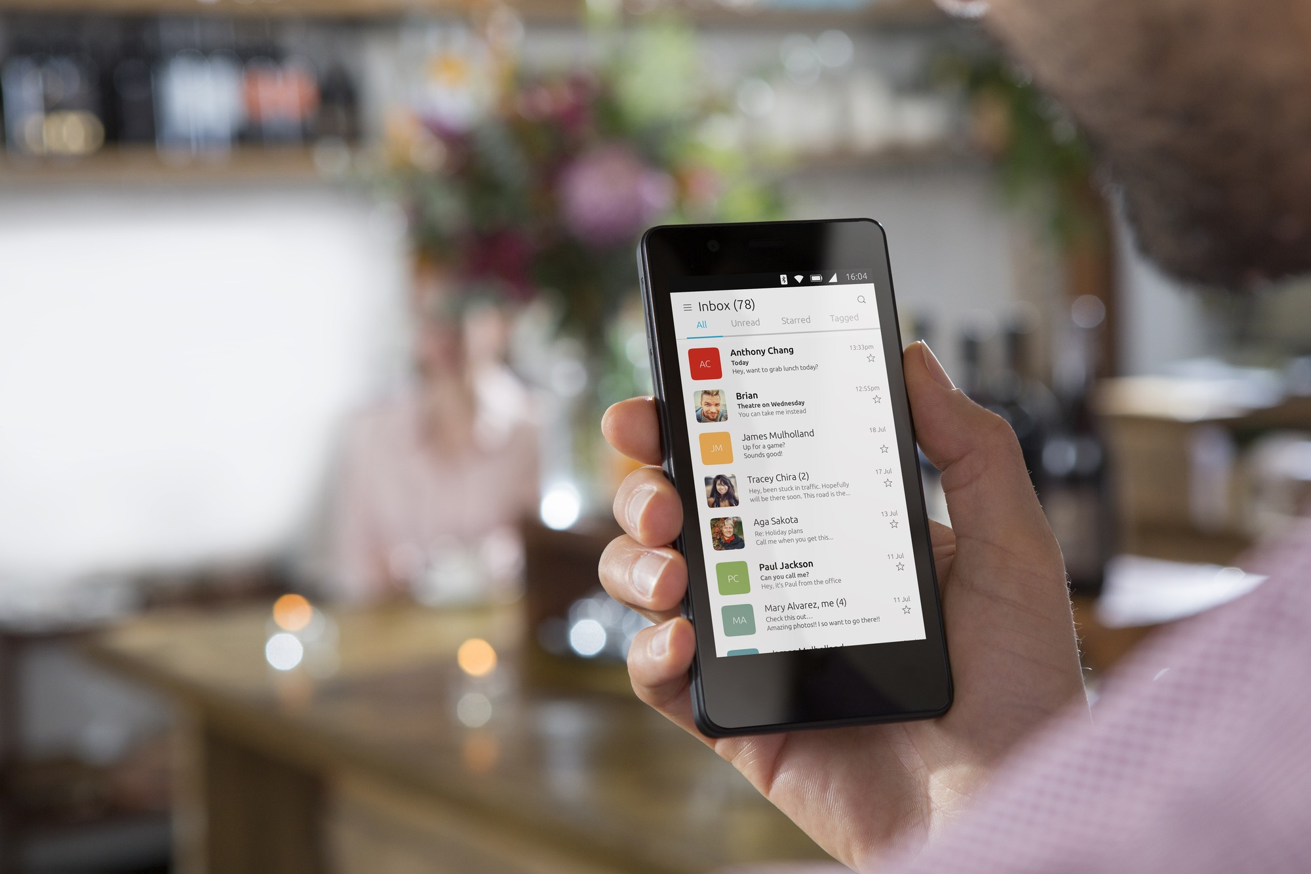
First: prepare a daily-driver-ready device
Background © Canonical Ltd.

Slide 15


Slide 16
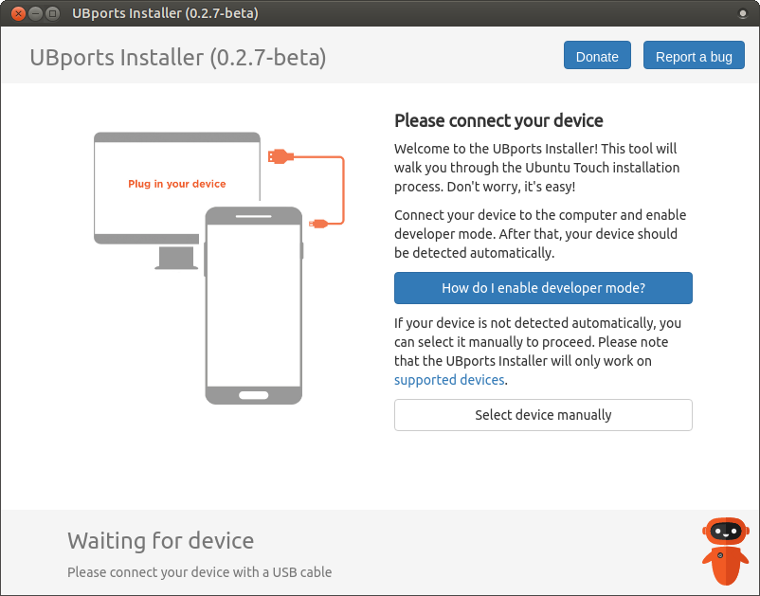
Make installation super easy

Slide 17
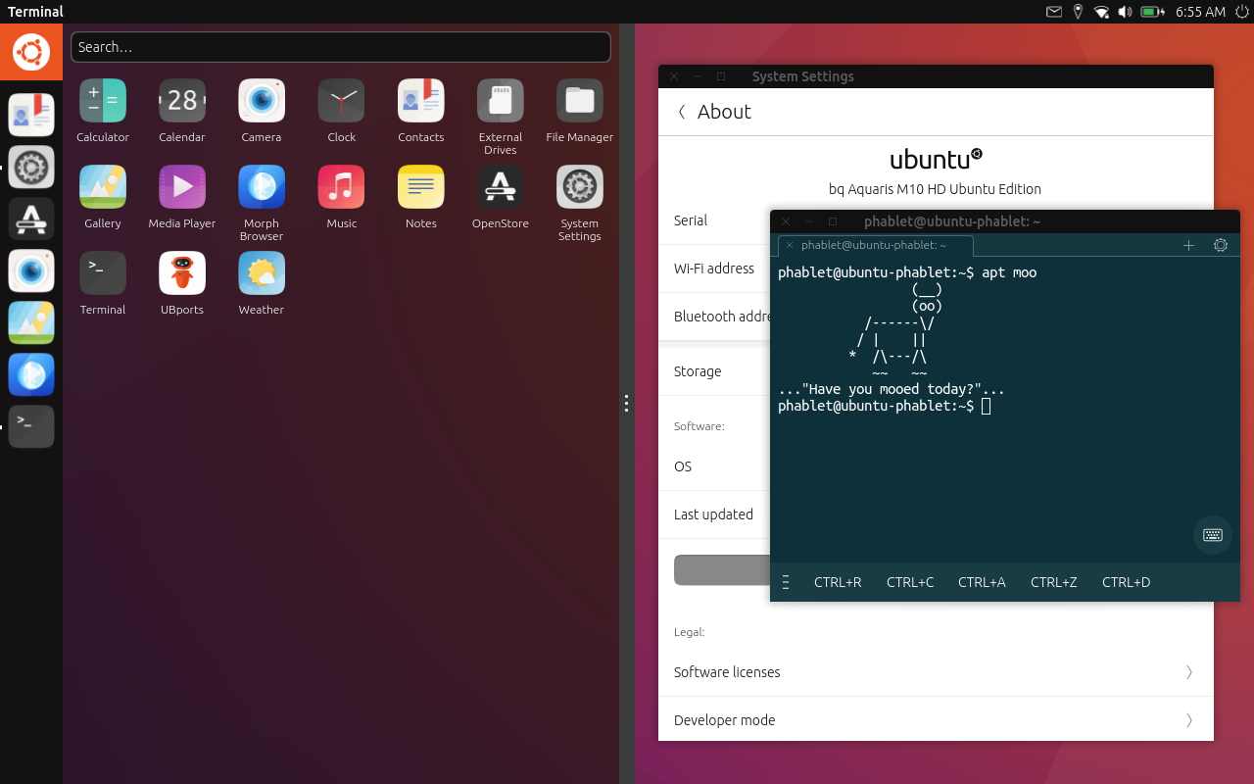
Unity 8

Slide 18
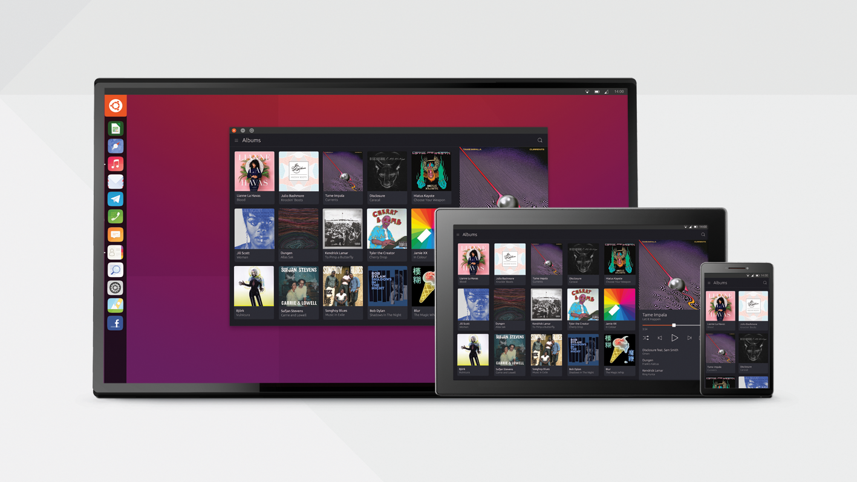
Step two:
compatibility and collaboration

Slide 19
Mir <3 Wayland
visit mir-server.io if you don‘t believe it ;)

Slide 20


Snap and Deb and maybe more?
...soonTM

Slide 21

UI toolkits

Slide 22
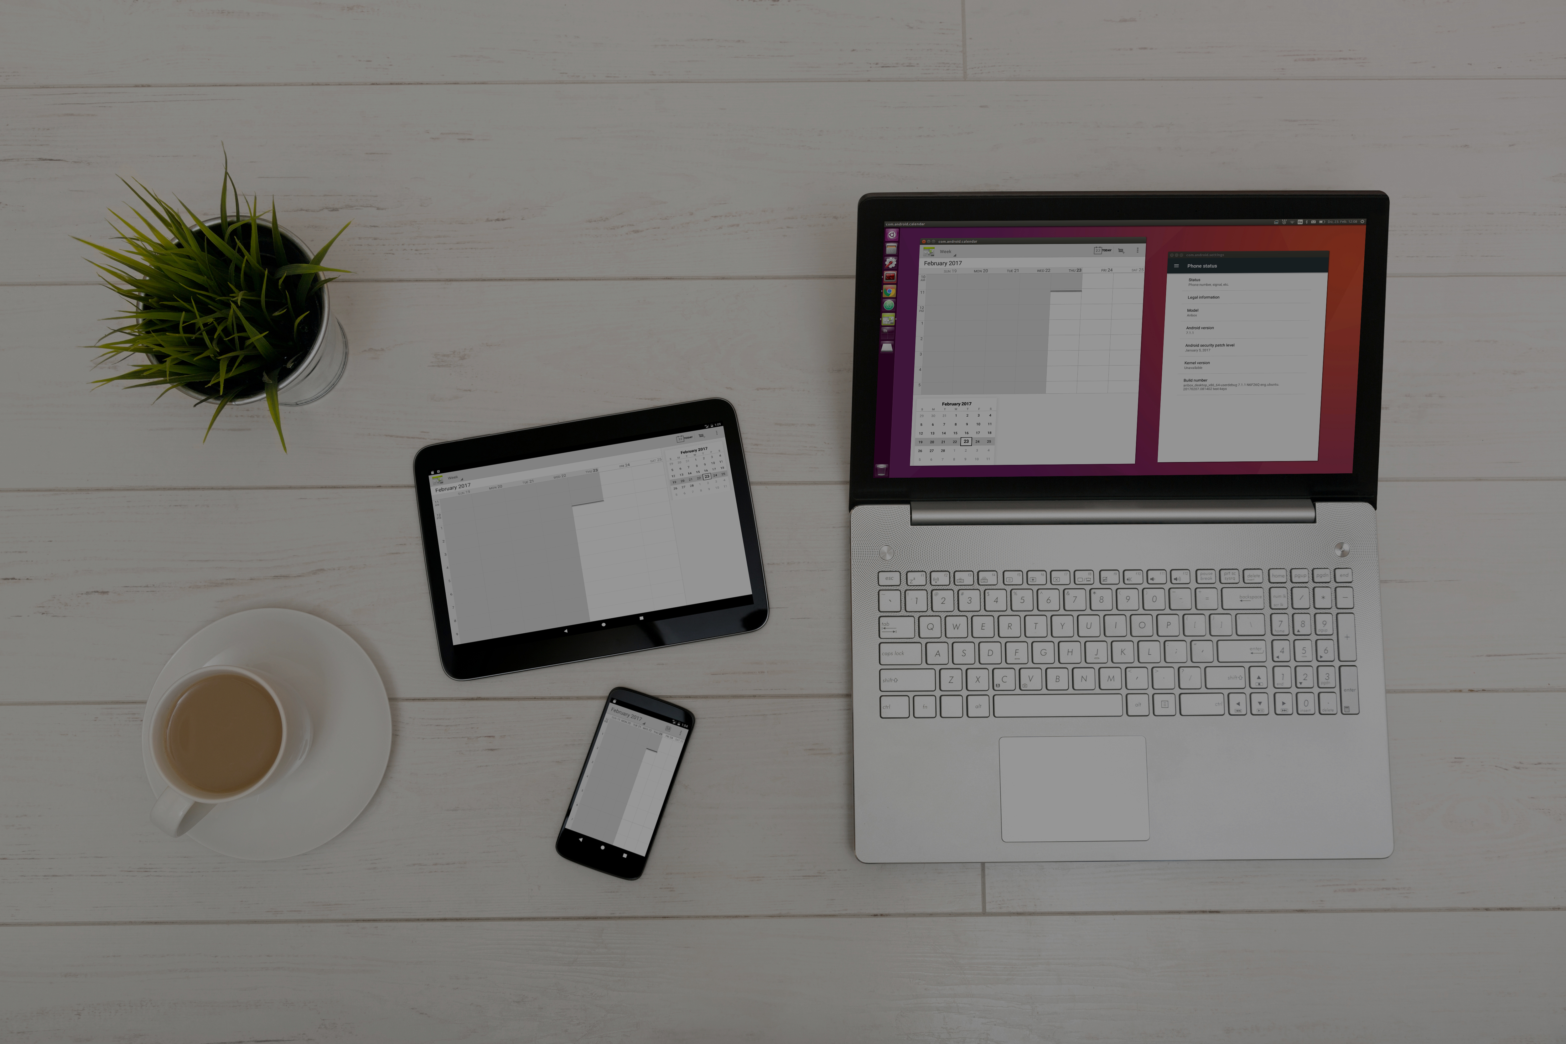
...soonTM
Anbox
Background © anbox.io

Slide 23

Finally: World dominance!

Slide 24
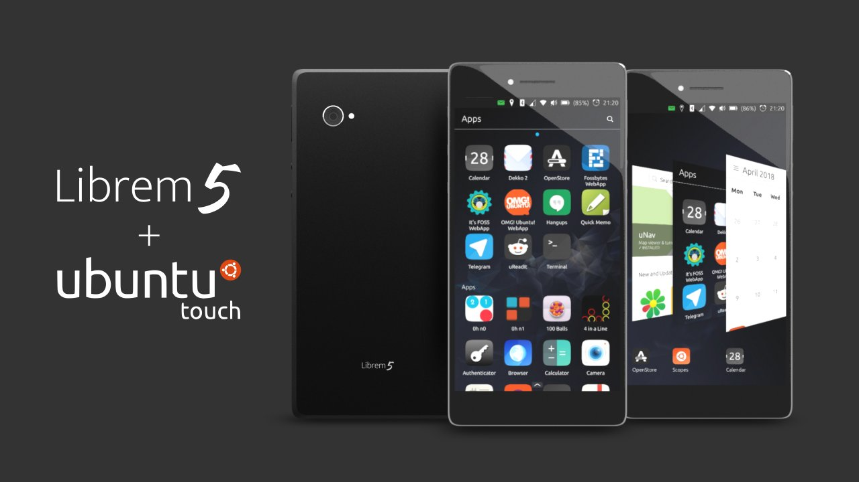
Background © Purism

Slide 25

Video © Marius Gripsgård

Slide 26
Before we go...
Questions?

Slide 28
ubuntu-touch.io ubports.com
State of the Touch – Ubuntu on phones and tablets
with Jan Sprinz (@NeoTheThird) at Ubucon Europe 2019

