Slide 1
Meet the
UBports Installer
with Jan Sprinz (@NeoTheThird) at Ubucon Europe 2019

Slide 2

About me
Jan Sprinz, 22, studies CompSci and PolSci at LMU Munich and spends most of his time awake flashing phones with Ubuntu Touch. Member of the UBports Foundation’s first Board of Directors.
e-mail: jan@ubports.com
github: github.com/neothethird
gitlab: gitlab.com/neothethird
twitter: @NeoTheThird
mastodon: @NeoTheThird@mastodon.social
telegram: @NeoTheThird

Slide 3
Why does flashing Android devices suck sooo bad?
Notes:
Notes to speaker

Slide 4
How to install android rom xyz
1. Somehow unlock your device (lol, good luck with that, btw)

Slide 5
How to install android rom xyz
1. Somehow unlock your device (lol, good luck with that, btw)
2. Download a bunch of files

Slide 6
How to install android rom xyz
1. Somehow unlock your device (lol, good luck with that, btw)
2. Download a bunch of files
3. Somehow set up adb and fastboot

Slide 7
How to install android rom xyz
1. Somehow unlock your device (lol, good luck with that, btw)
2. Download a bunch of files
3. Somehow set up adb and fastboot
4. Execute a bunch of adb and fastboot commands and pray you have copied them in the right order

Slide 8
How to install android rom xyz
1. Somehow unlock your device (lol, good luck with that, btw)
2. Download a bunch of files
3. Somehow set up adb and fastboot
4. Execute a bunch of adb and fastboot commands and pray you have copied them in the right order
5. Recycle your hard-bricked phone and buy the new iPhone “because I need something that works”

Slide 9
Okay, that’s terrible. But there’s got to be a better way...
Notes:
Notes to speaker

Slide 10
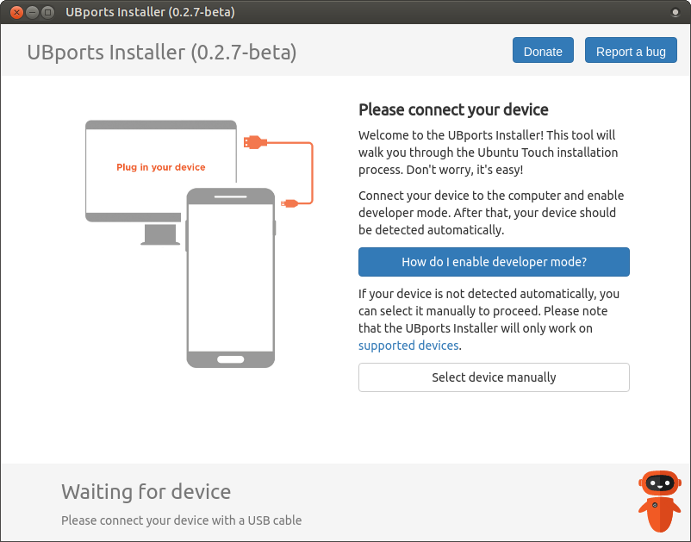
Meet the
UBports
Installer!
Notes:
Notes to speaker

Slide 11
It’s Electron.
(yes, yes, I know, I know)
Notes:
Notes to speaker

Slide 12
Notes:
Notes to speaker

Slide 13
How to get involved
github.com/ubports/ubports-installer
github.com/ubports/promise-android-tools
github.com/ubports/system-image-node-module

Slide 14
Before we go...
Questions?

Slide 15
Meet the
UBports Installer
with Jan Sprinz (@NeoTheThird) at Ubucon Europe 2019

