Slide 1
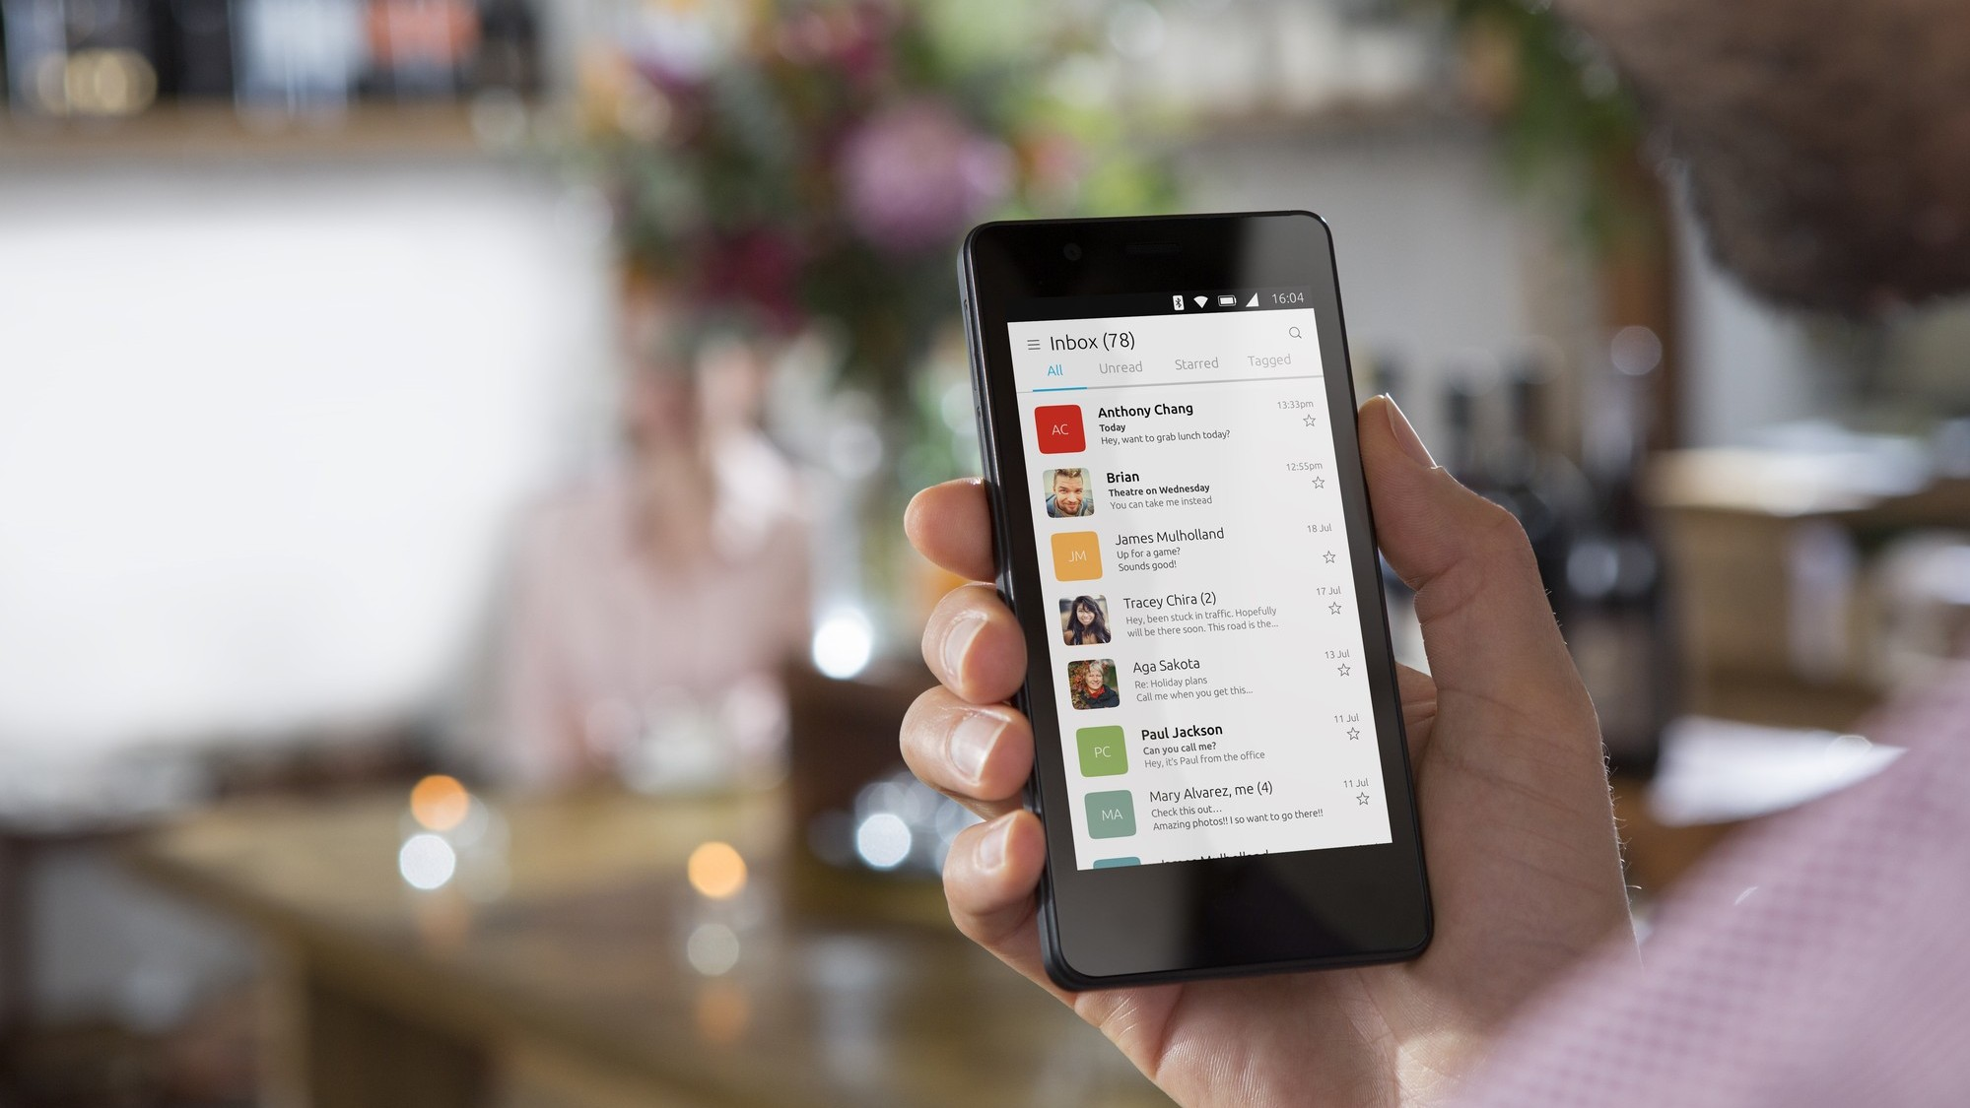
ubuntu touch
One year after the world ended
Ubuntu Touch today
Background © Canonical Ltd.

Slide 2
ubuntu touch
Let‘s start with a brief history of

Slide 3
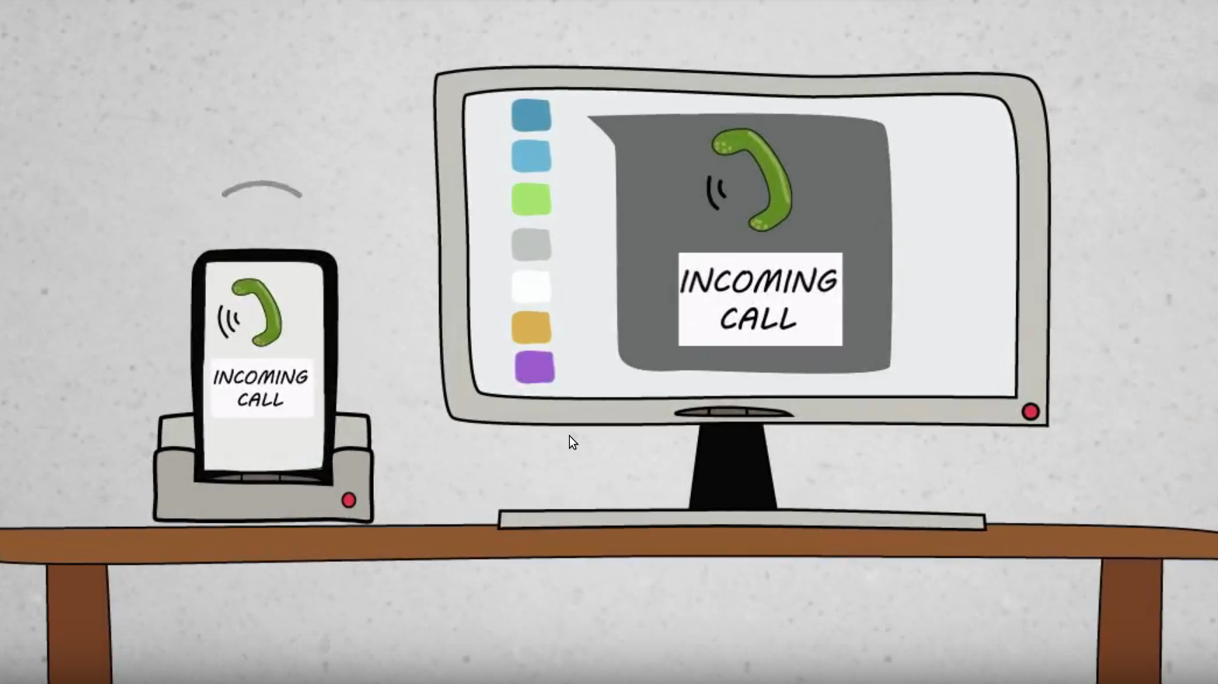
Source: https://youtu.be/iv1Z7bf4jXY

Slide 4
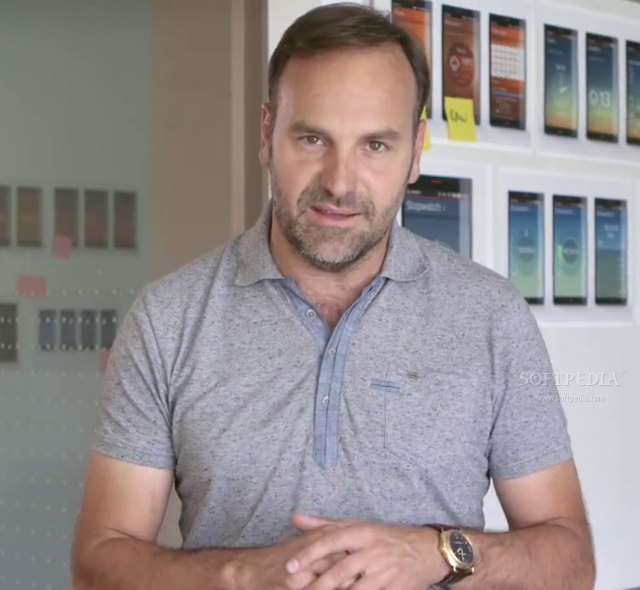
„Convergence is the future of computing, so we‘ve reshaped Ubuntu to combine the power of a desktop and the mobility of a smartphone on a single device.“
Mark Shuttleworth
Founder of Ubuntu and Canonical
22. July 2013
Source: https://www.indiegogo.com/projects/ubuntu-edge

Slide 5
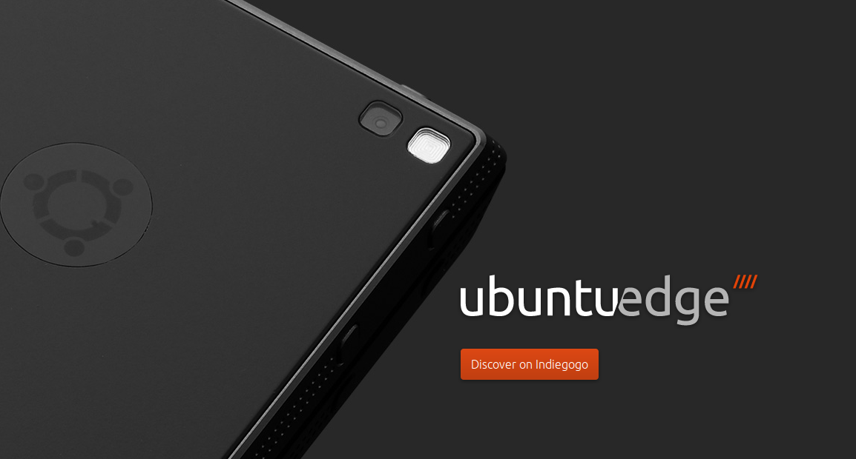
Background © Canonical Ltd.

Slide 6
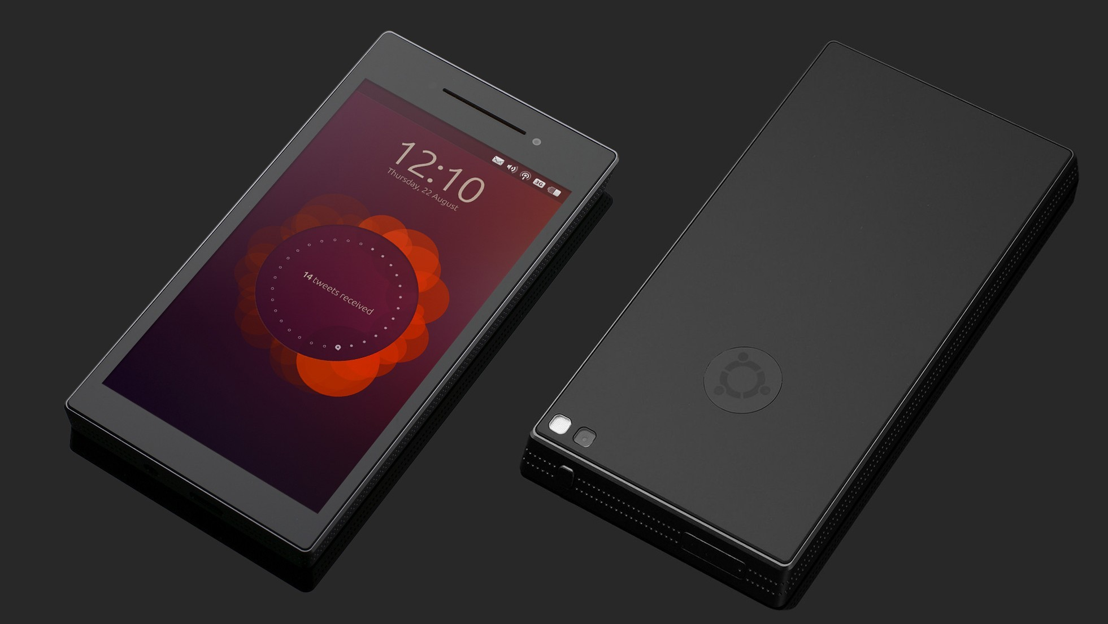
Background © Canonical Ltd.

Slide 7
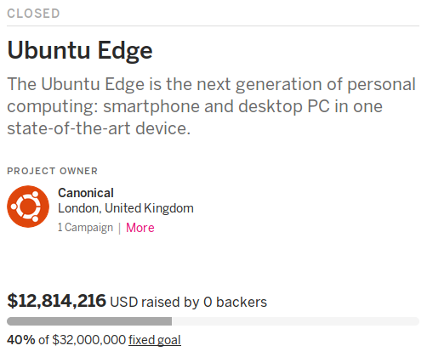

Slide 8
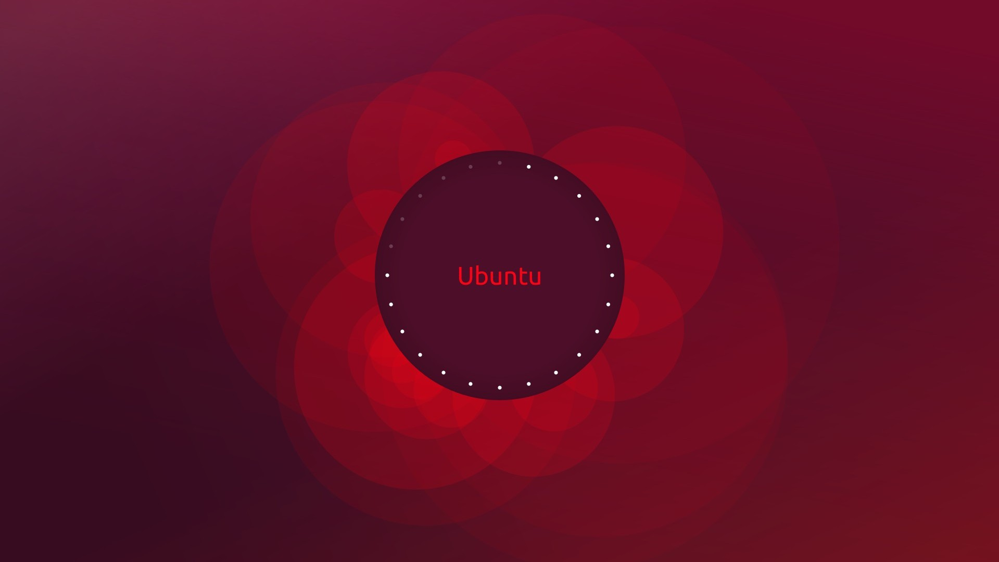

Slide 9
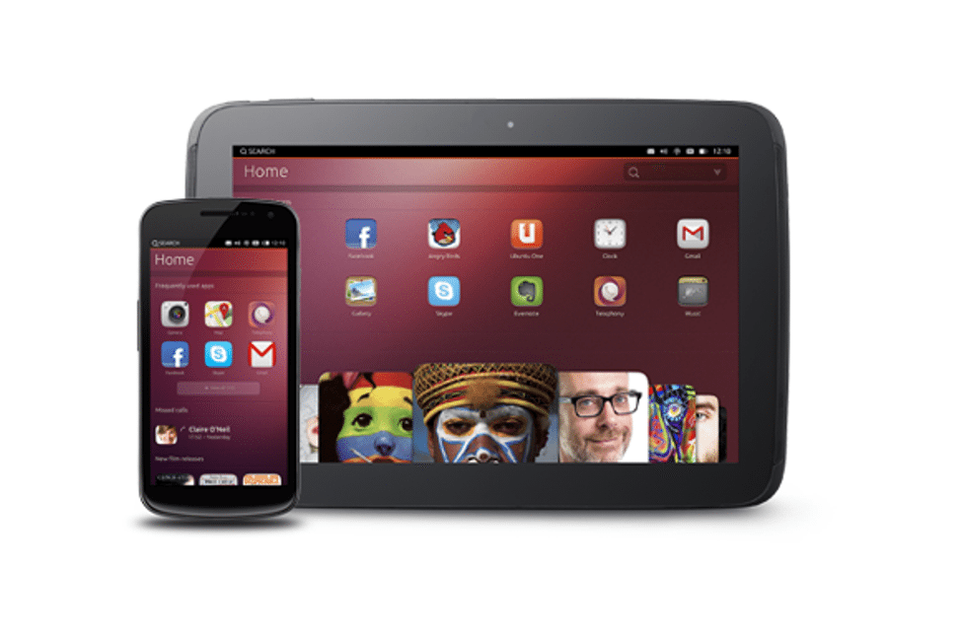

Slide 10
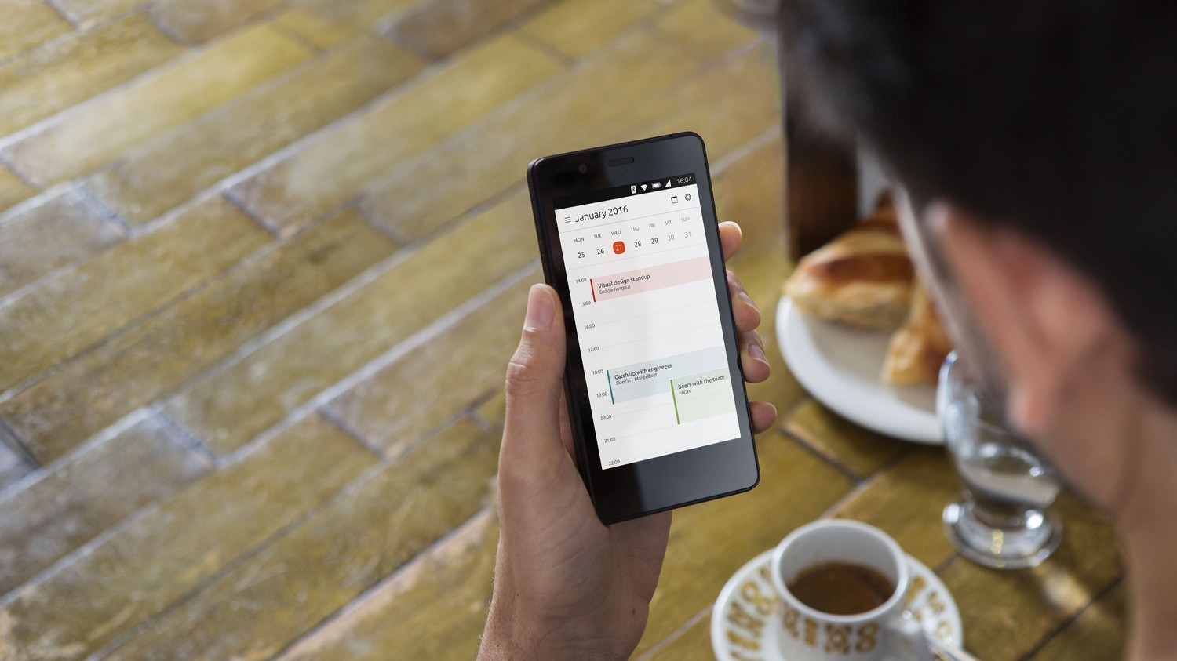
Background © Canonical Ltd.

Slide 11
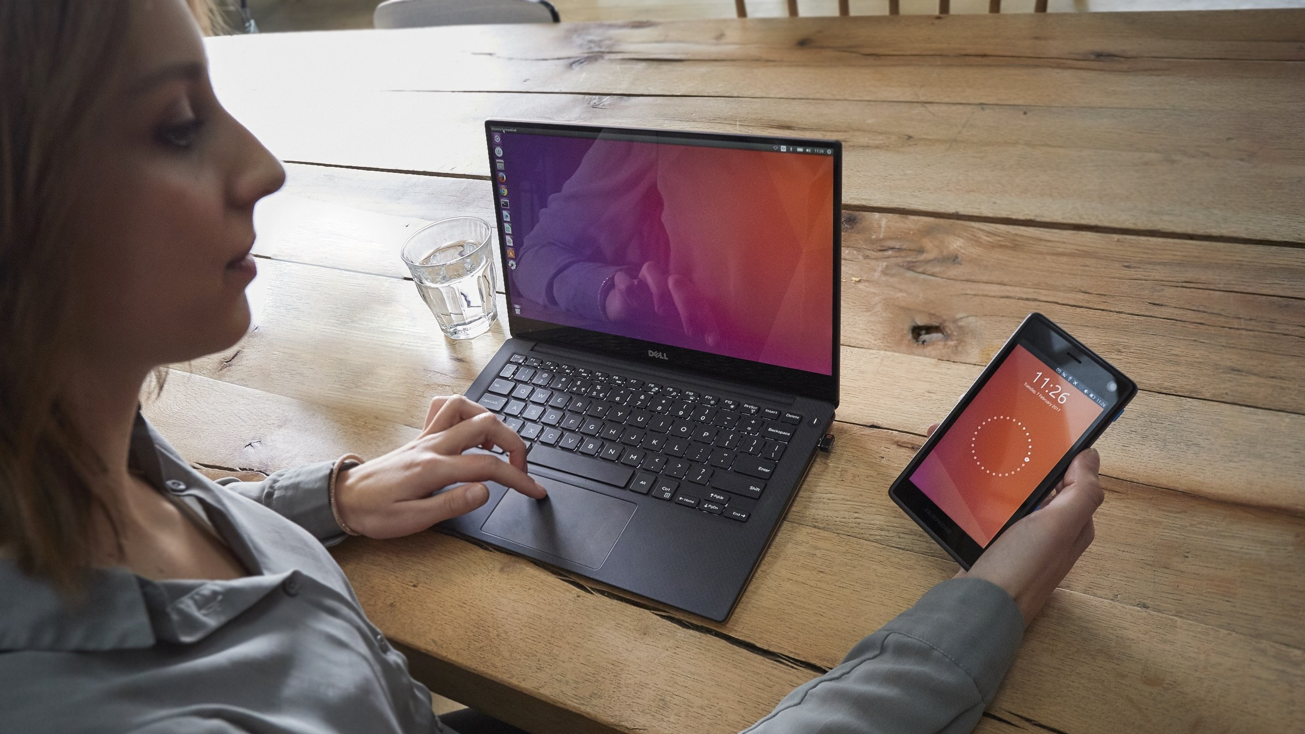
Background © UBports Communtiy

Slide 12
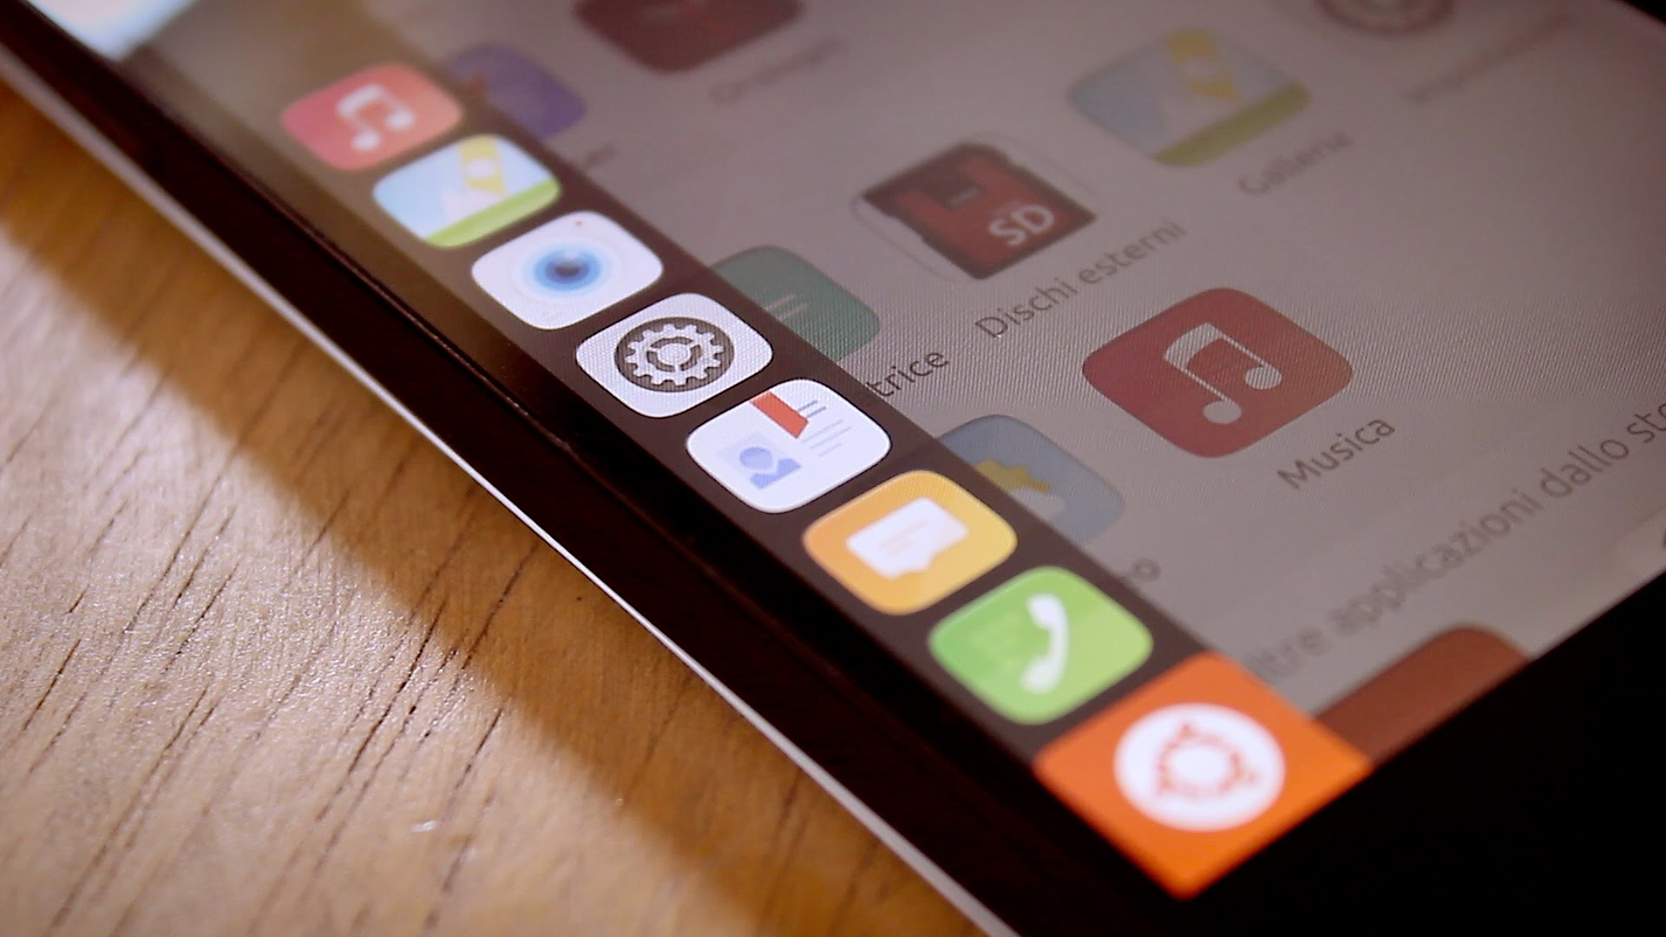
Background © GExperience

Slide 13
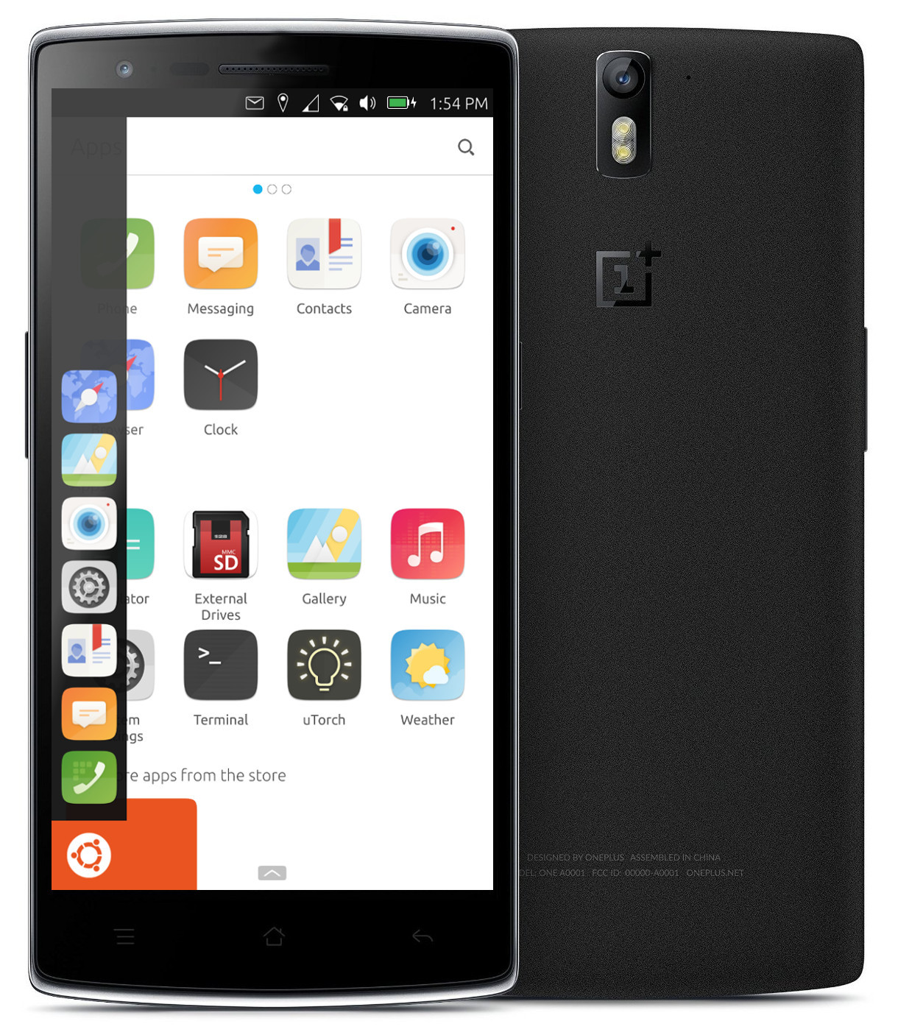

Slide 14
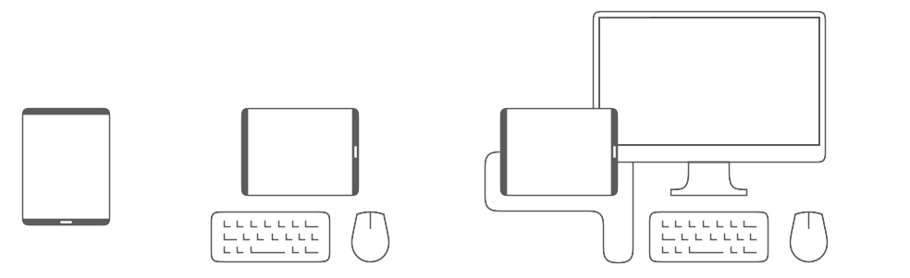
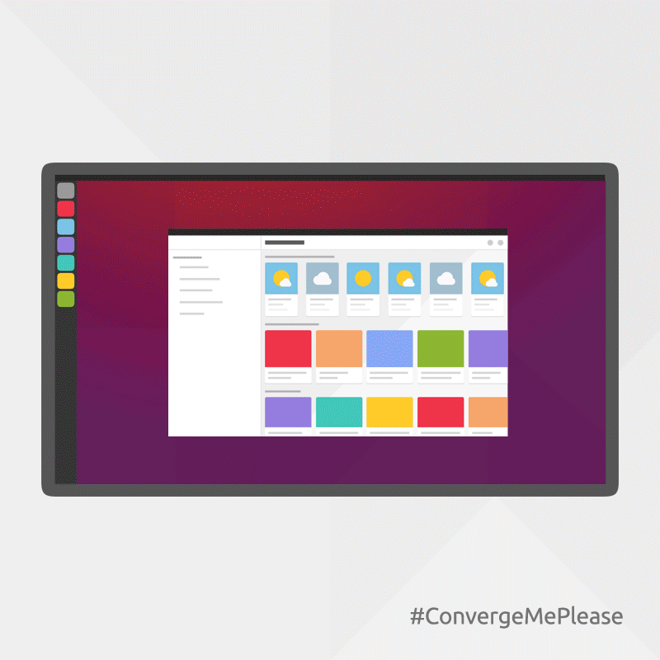
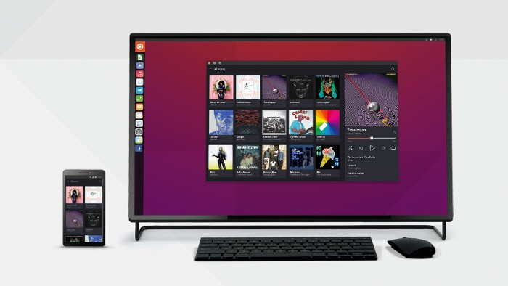
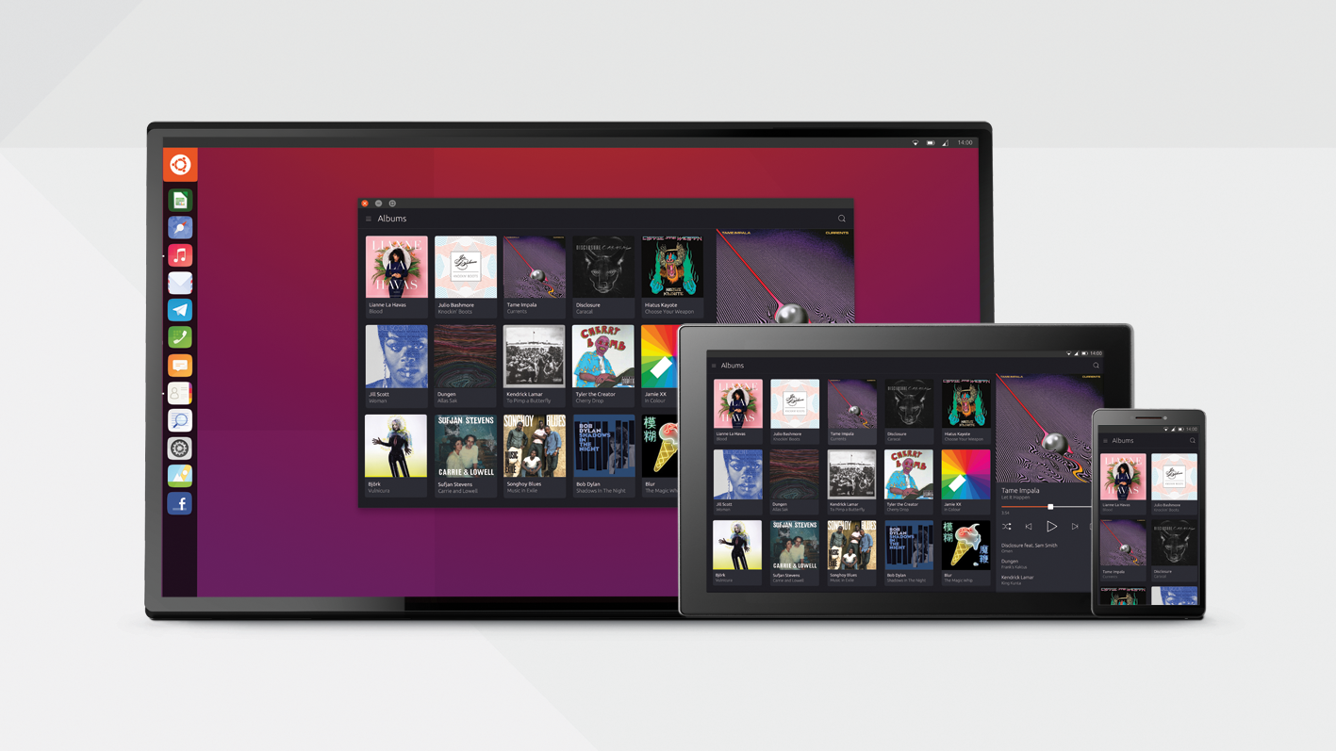
Images © Canonical Ltd.

Slide 15
Video by Phoenix Land Pirate

Slide 16
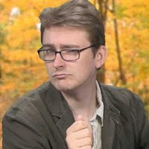
„Having LibreOffice and all these Linux applications on the go is kind of like a magical unicorn that farts rainbows.“
Bryan Lunduke
Linux blogger, Professional online troll
18. July 2016
Source: https://youtu.be/rFQFSxxyqwk

Slide 17
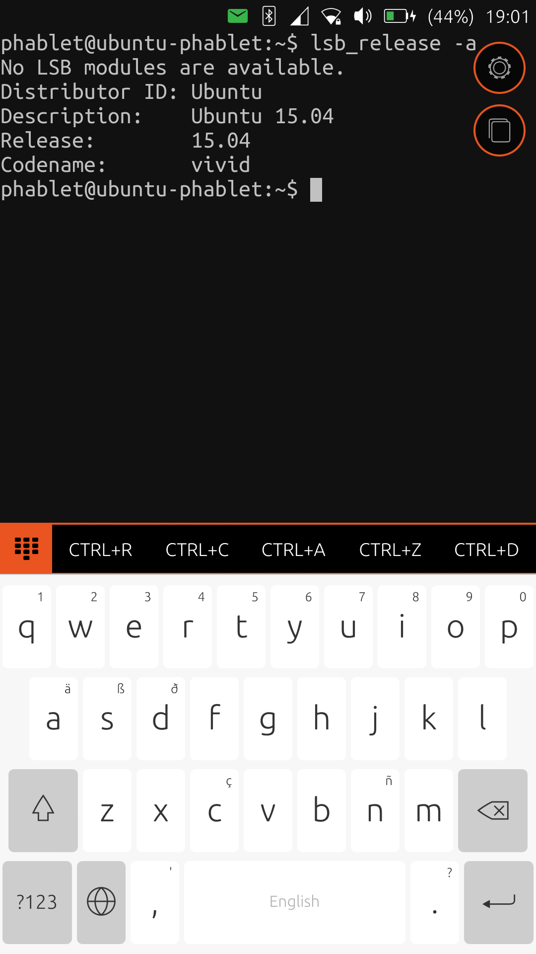
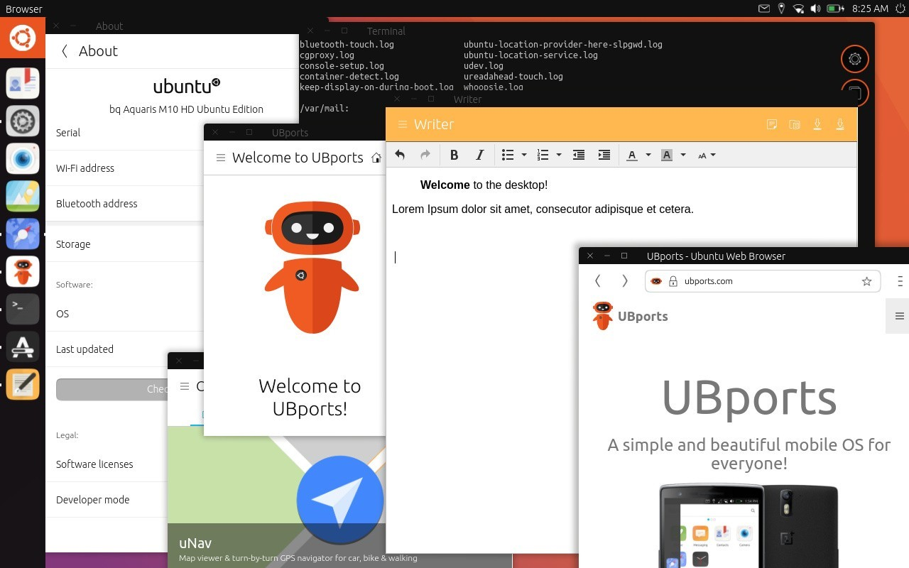

Slide 18
„I’m writing to let you know that we will
end our investment in Unity8, the phone
And convergence shell. We will shift our
default Ubuntu desktop back to GNOME
for Ubuntu 18.04 LTS.“
Mark Shuttleworth
Founder of Ubuntu and Canonical
5. April 2017
Source: https://insights.ubuntu.com/2017/04/05/growing-ubuntu-for-cloud-and-iot-rather-than-phone-and-convergence

Slide 19
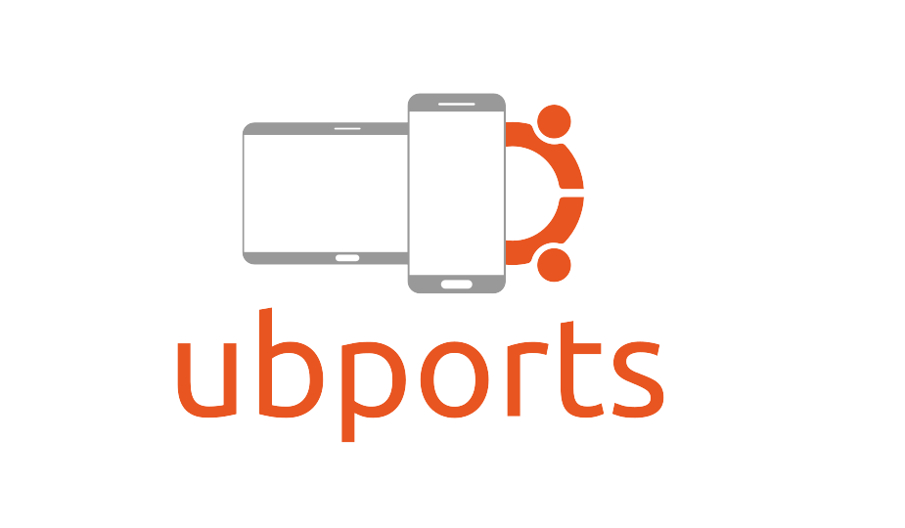
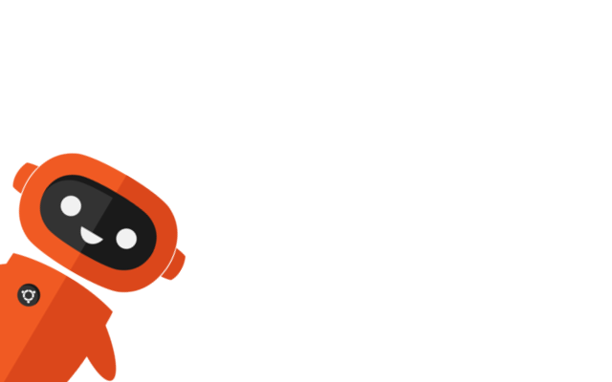

Slide 20
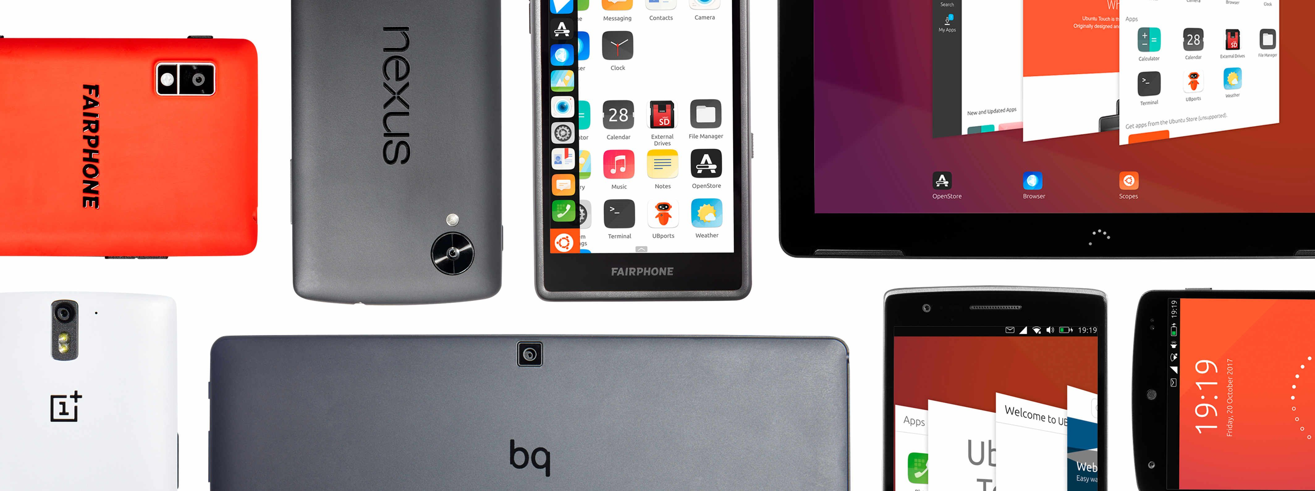

Slide 21
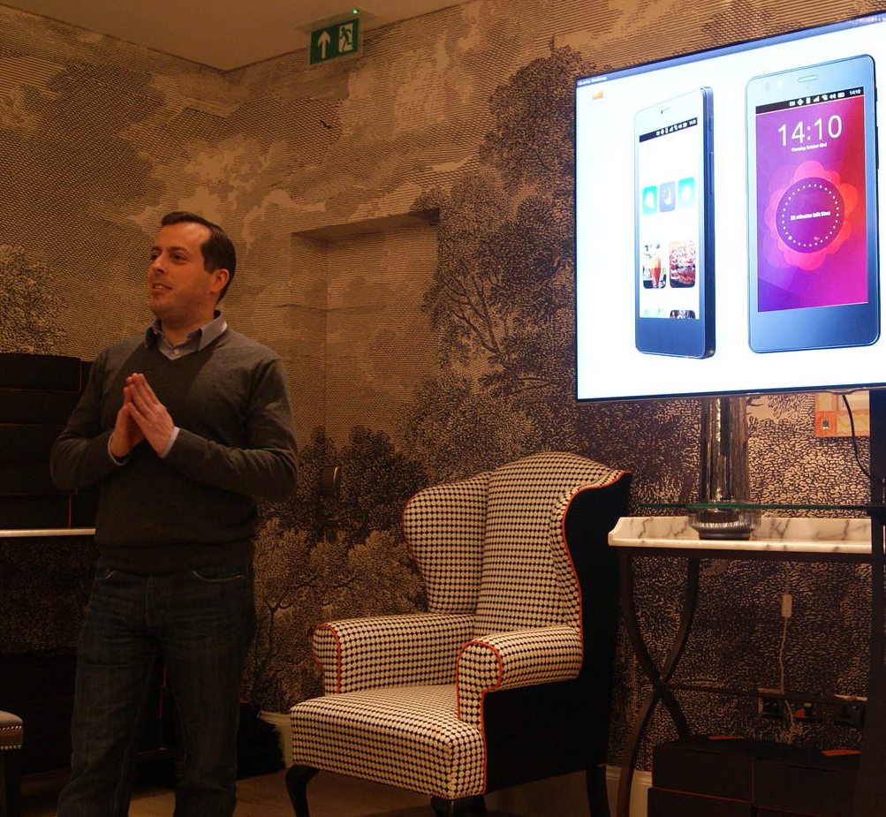
„No, I think there's a very very slim chance for that [Ubuntu Touch to be shut down]. We want people to love it. It will take a life of its own.“
Cristian Parrino
Head of the mobile-team at Canonical
11. Februar 2015
Source: https://svij.org/blog/2015/02/11/cristian-parrino-from-canonical-about-the-release-of-ubuntu-phone-and-future-plans/

Slide 22
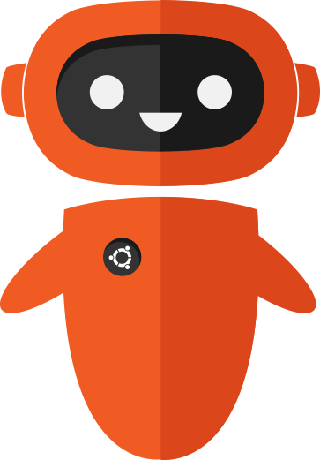
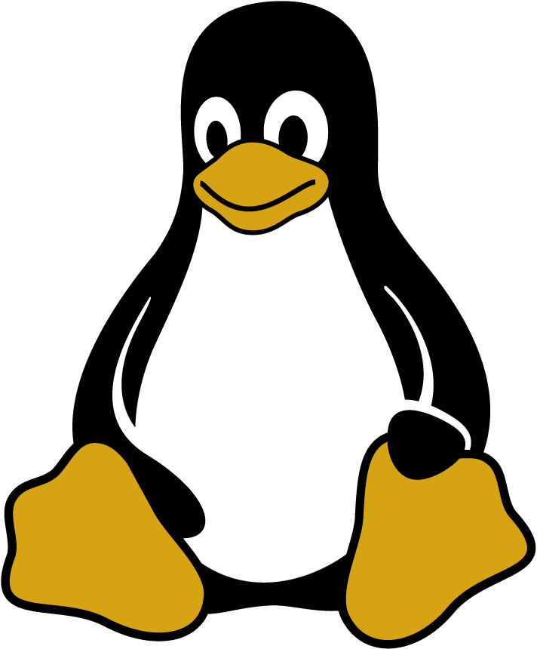
==

Slide 23
If I may interject for a moment…
...why „GNU/Linux“?

Slide 24
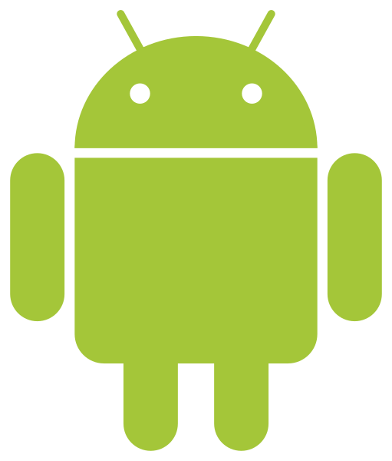
!=

Slide 25
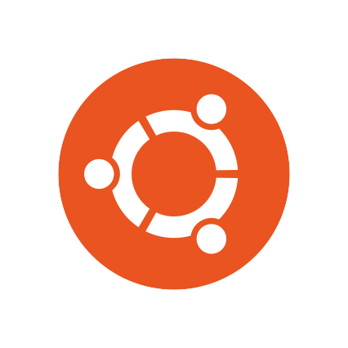
Userland
Apps
Unity 7
Compiz
Ubuntu
X11
glibc-driver
Linux-Kernel 4.x
proprietary
free
Hardware
BIOS

Slide 26
Userland
Apps
Unity 8
Mir/Wayland
Ubuntu Touch
in an ideal world
glibc-driver
Linux-Kernel 4.x
free
Hardware
BIOS

Slide 27
Userland
Java
Java
Java
Java
Java
SurfaceFlinger
Java
Java
Android
Java
bionic-driver
Linux-Kernel 3.x
proprietary
free
Hardware
Recovery..?
Bootloader..?

Slide 28
Userland
Apps
Unity 8
Mir/Wayland
Ubuntu Touch
In reality
Halium
standardized
Android container
Libhybris
Android
management
scripts
Linux-Kernel 3.x
bionic-driver
Hardware
Recovery..?
Bootloader..?

Slide 29
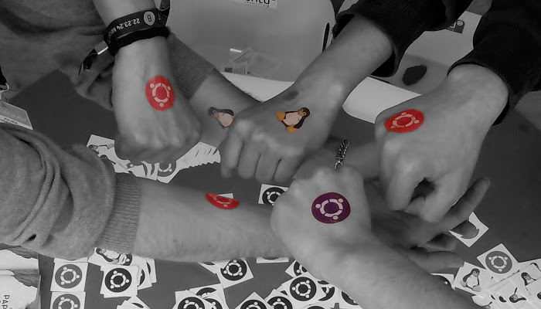
UBports Foundation
Background © Ubuntu-fr Community

Slide 30
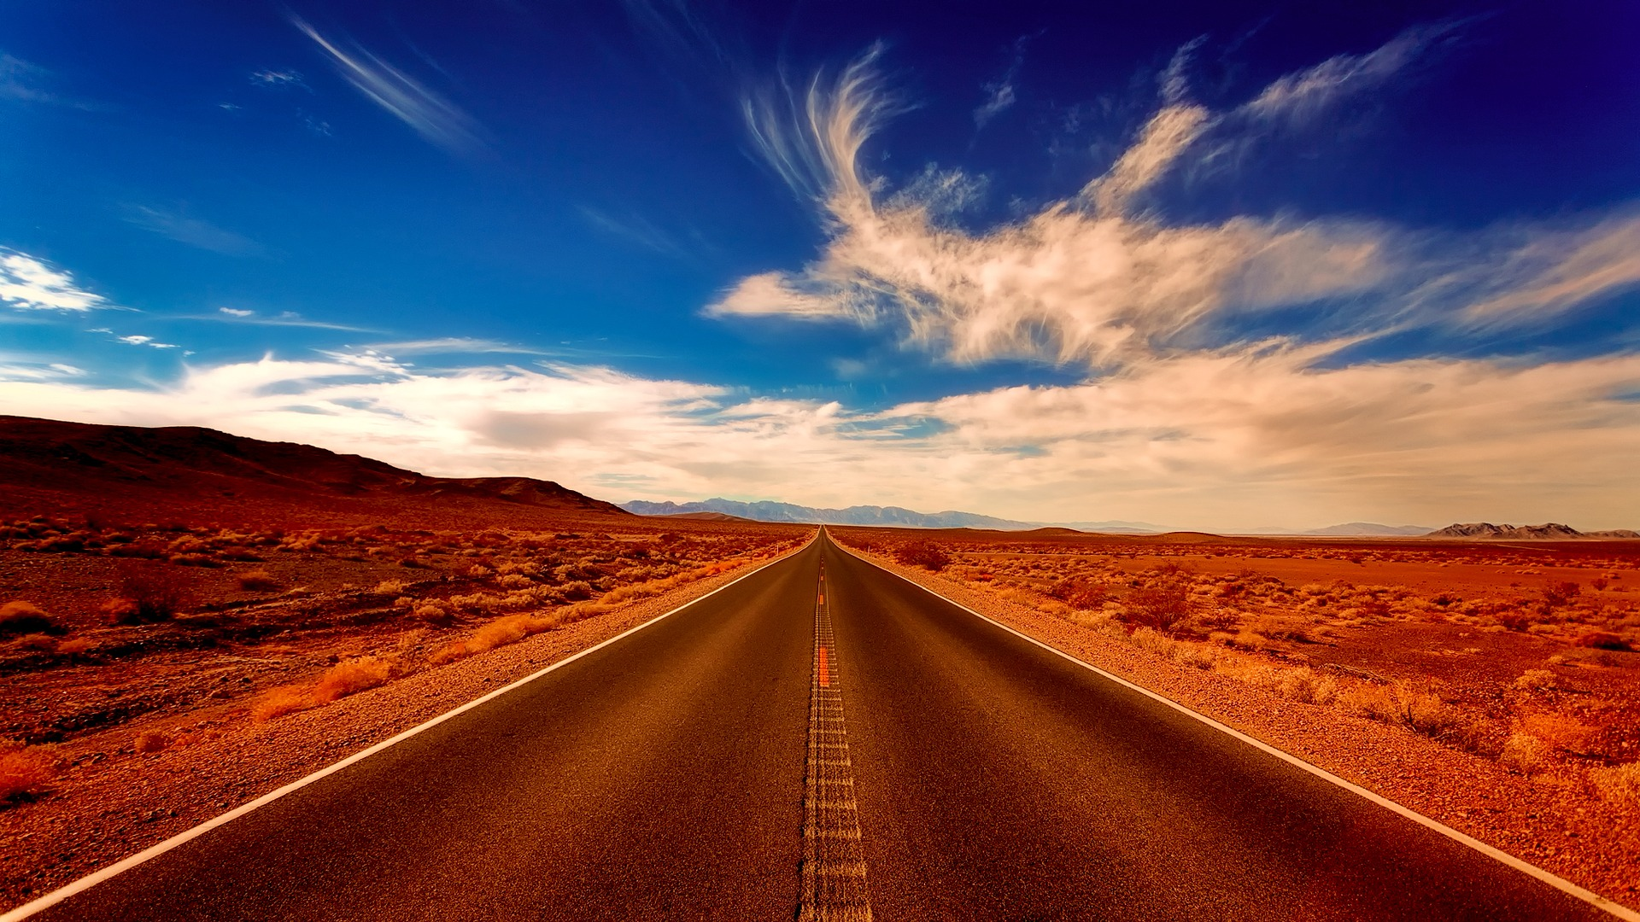
What‘s next?
1. Create a daily-driver-ready device
2. Improve compatibility
3. World dominance

Slide 31
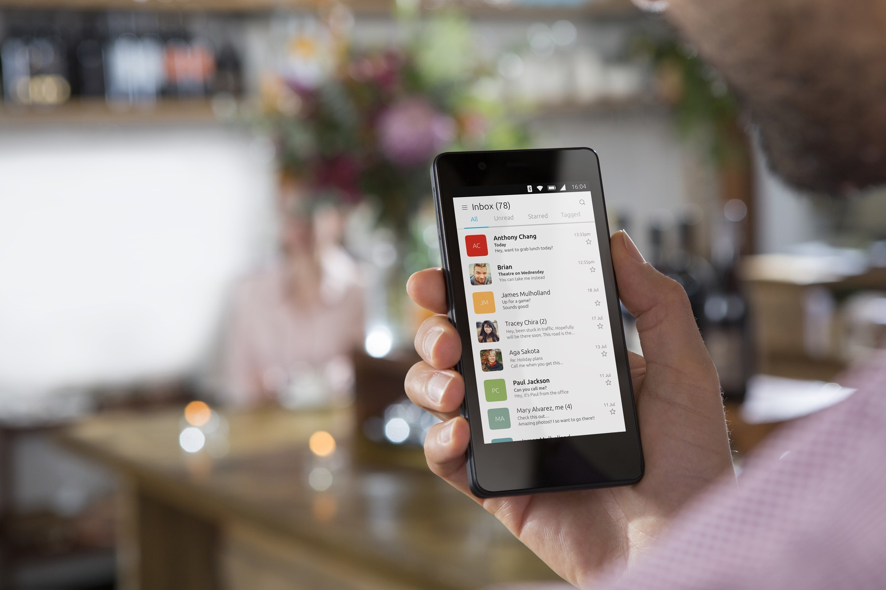
First: prepare a daily-driver-ready device
Background © Canonical Ltd.

Slide 32
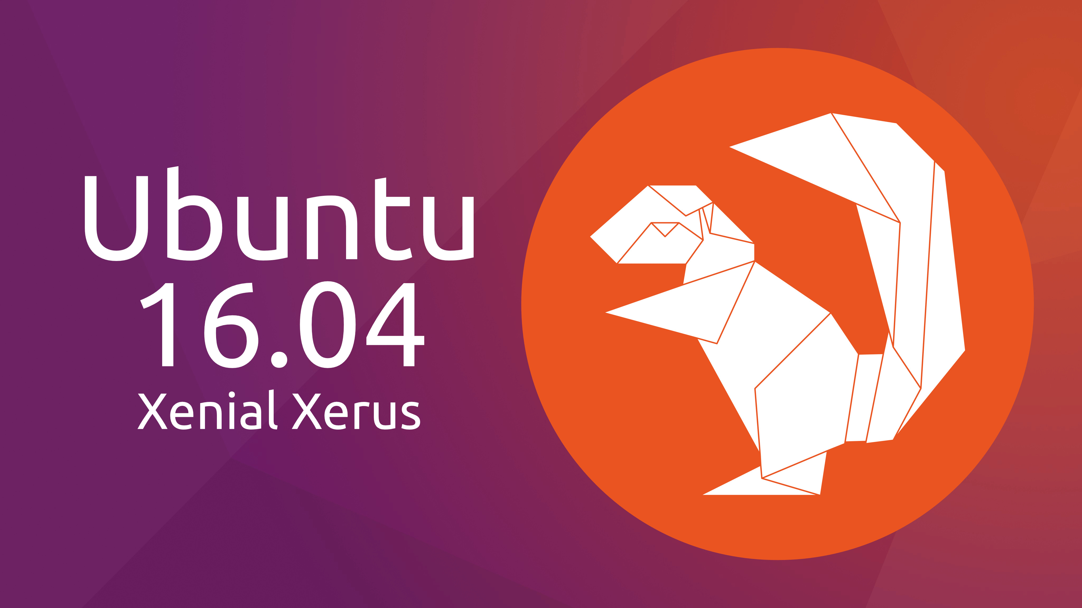

Slide 33
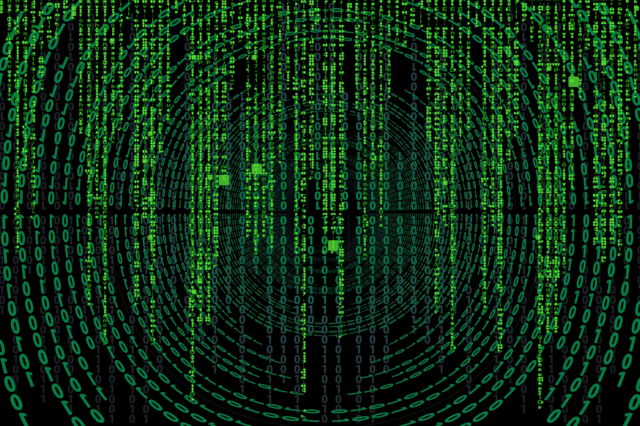
Resolve critical bugs

Slide 34
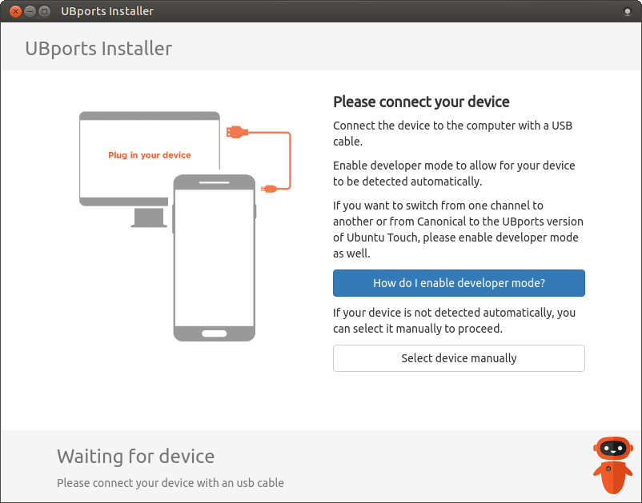
Make installation super easy

Slide 35
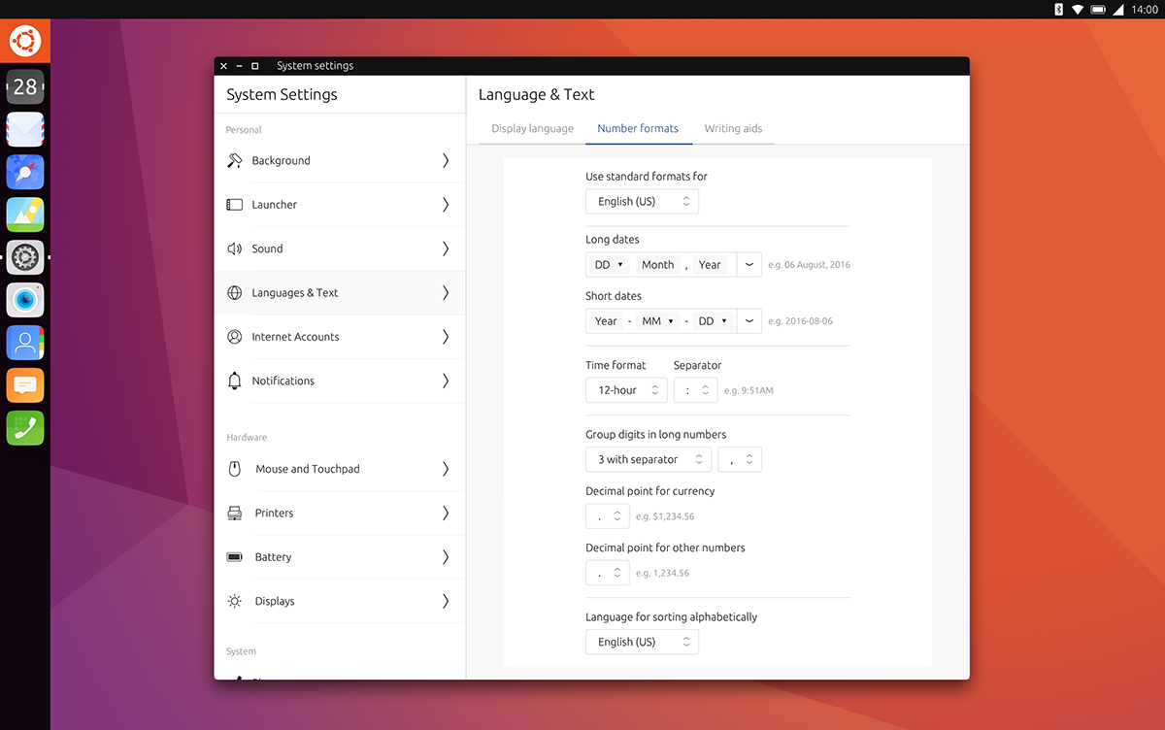
Unity 8

Slide 36
Step two:
compatibility and collaboration

Slide 37
Mir <3 Wayland
visit mir-server.io if you don‘t believe it ;)

Slide 38


Snap and Deb and maybe more?

Slide 39
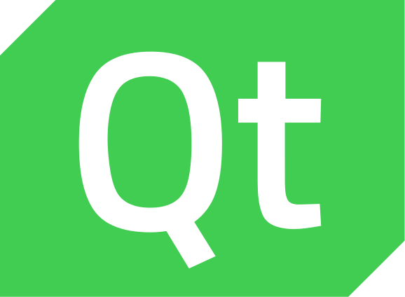
UI toolkits

Slide 40
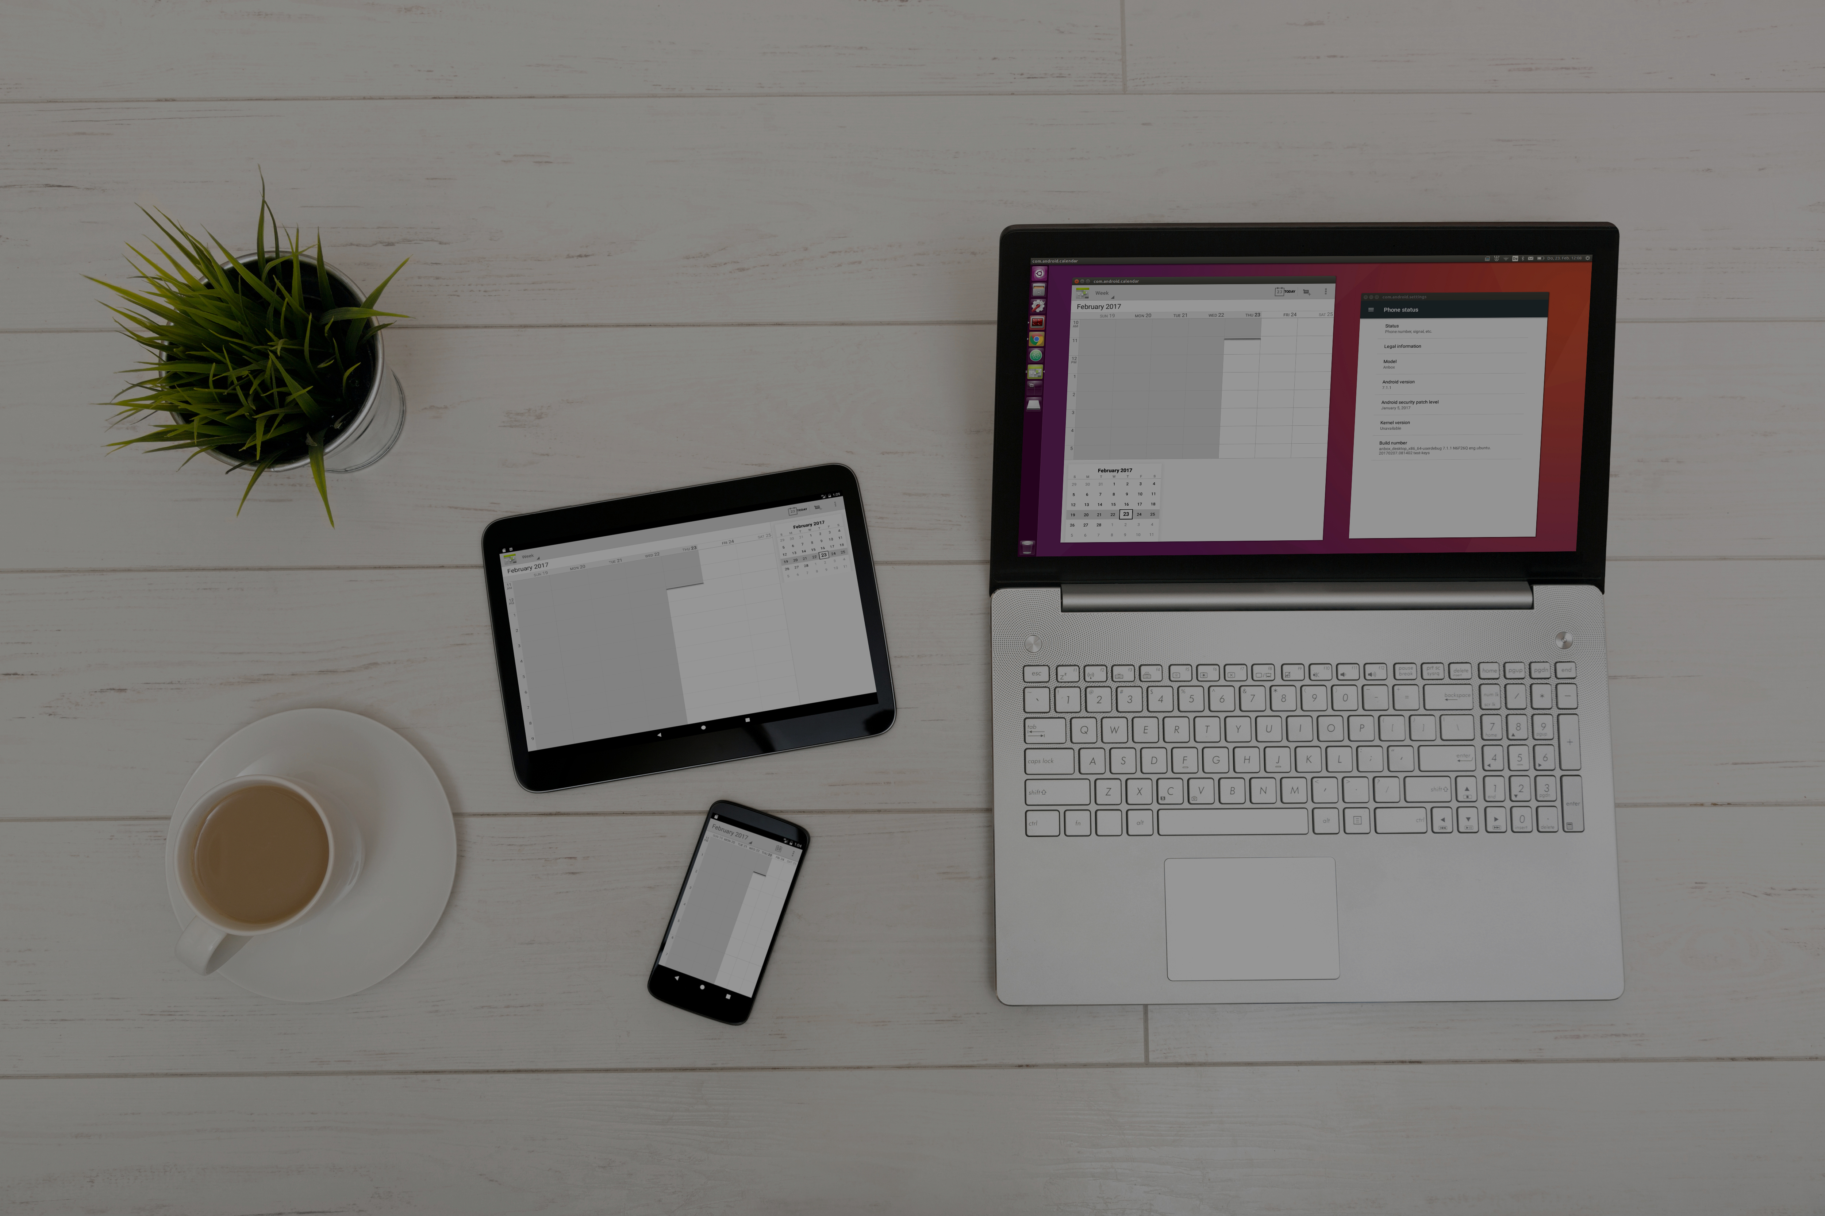
Anbox
Background © anbox.io

Slide 41
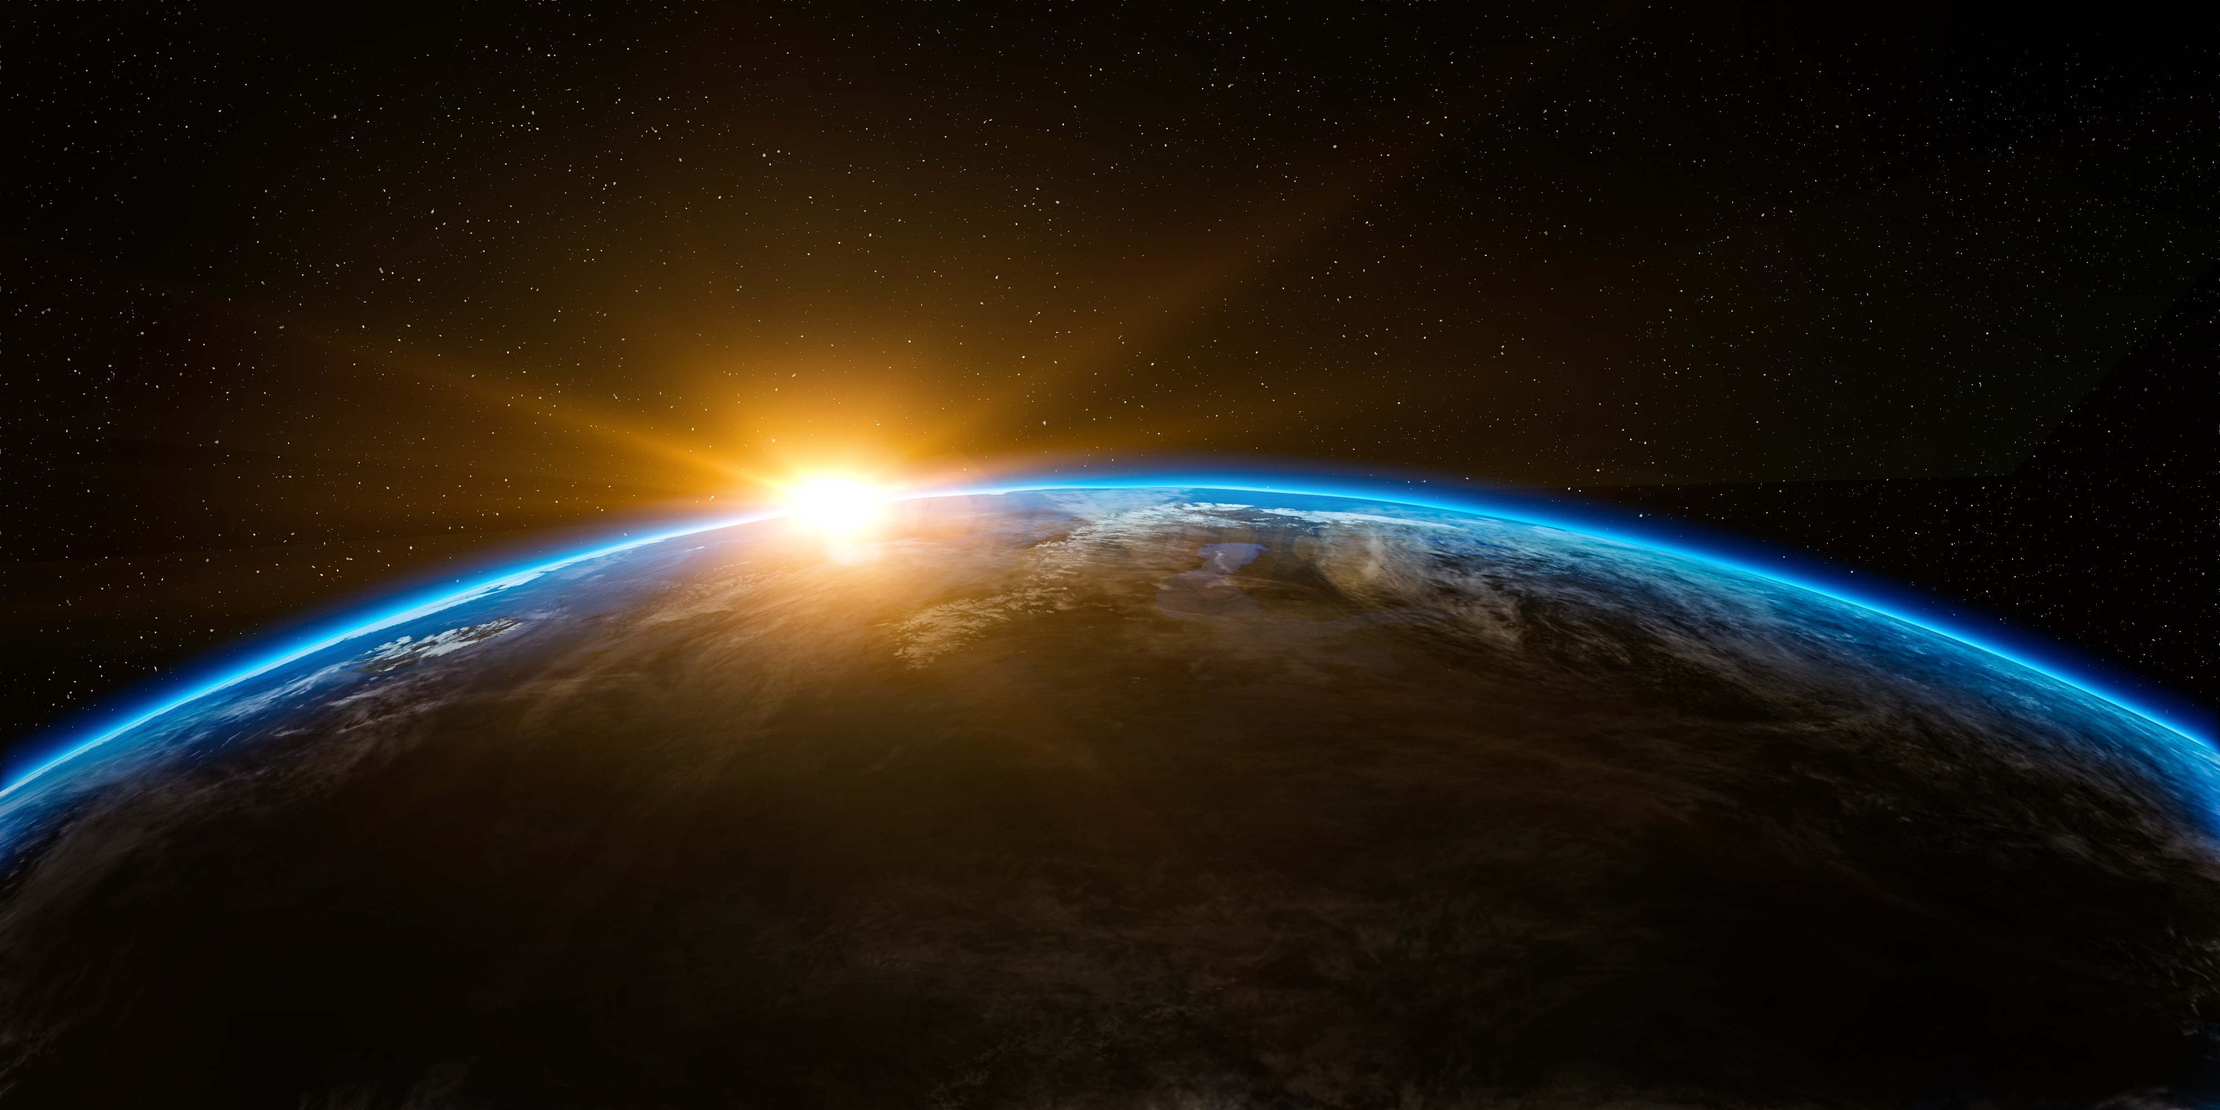
Finally: World dominance!

Slide 42
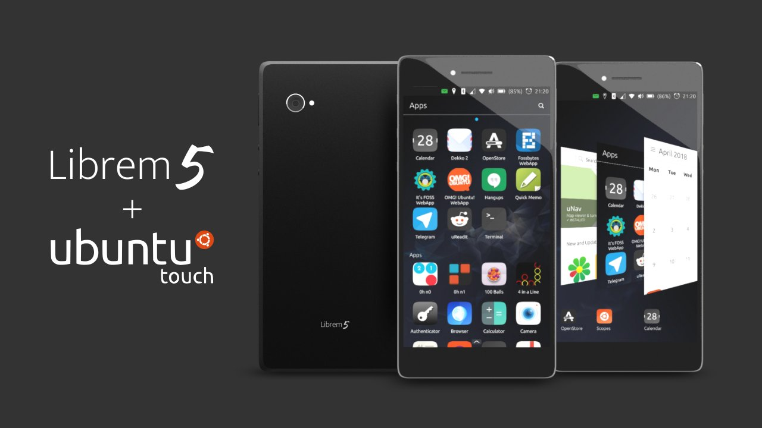
Background © Purism

Slide 43
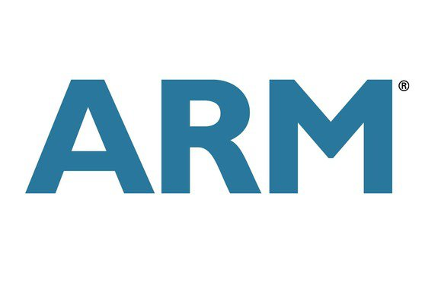
Use current business trends

Slide 44
Embrace the bazaar and unleash the power of FOSS
Background © Ubuntu-fr Community

Slide 45
What‘s next?
1. Create a daily-driver-ready device
2. Improve compatibility
3. World dominance

Slide 46
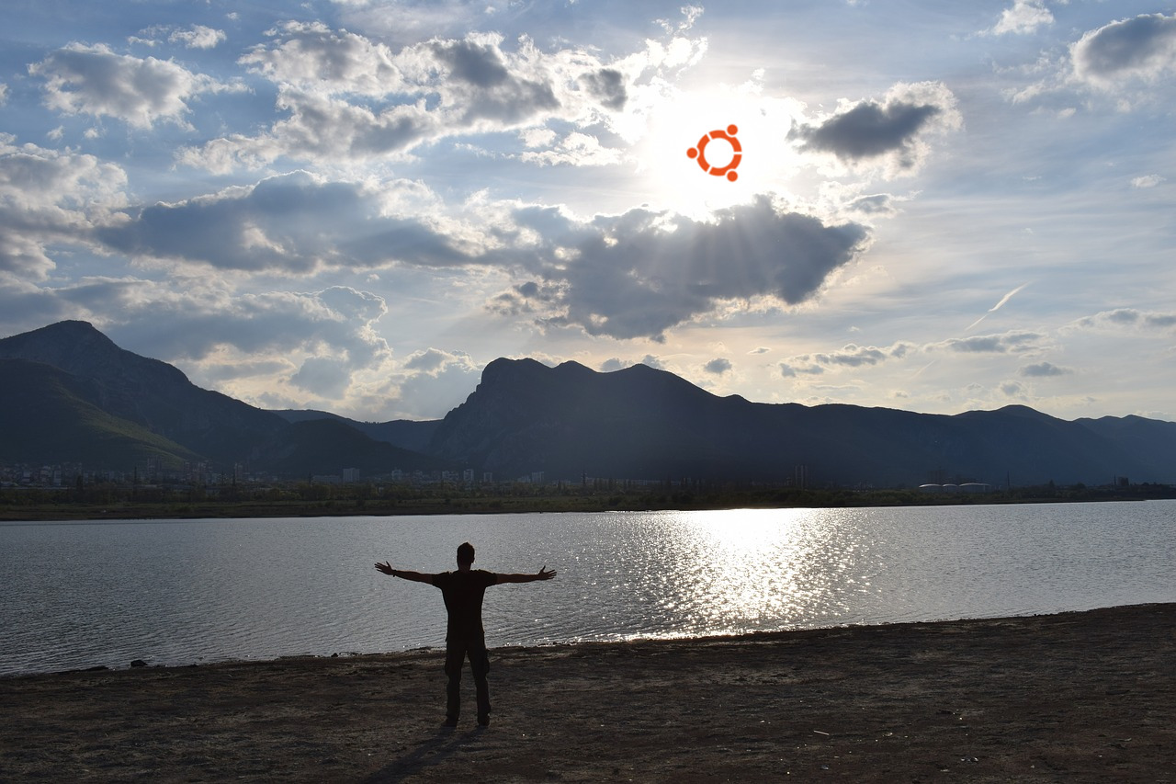

Thank you for your attention!
ubports.com/get-involved
ubuntu-touch.io
halium.org
Jan Sprinz | jan@ubports.com | @NeoTheThird

