Slide 1
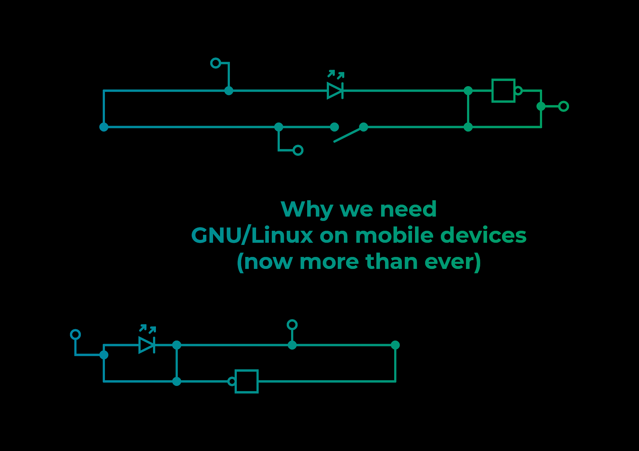

Slide 2


Mobile OS market share 2018

Slide 3
Android
is not an option

Slide 4
Android is foss, isn’t it?
crucial features are being moved to GMS, increasingly also security features
every device has its own patched Linux kernel (and modified AOSP on older devices)
many devices are locked down
not a single fully functional foss android device exists

Slide 5
Fuchsia and the Zirkon kernel
the looming danger to our way of life

Slide 6
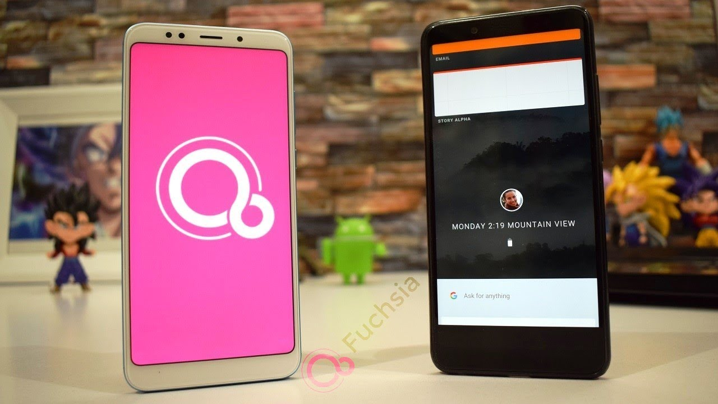
(c) Google

Slide 7
permissive-licensed kernel, proprietary userland….
sound familiar?

Slide 9
Where do we go from here?

Slide 10

anbox.io

Slide 11

halium.org
(c) Halium Project

Slide 12
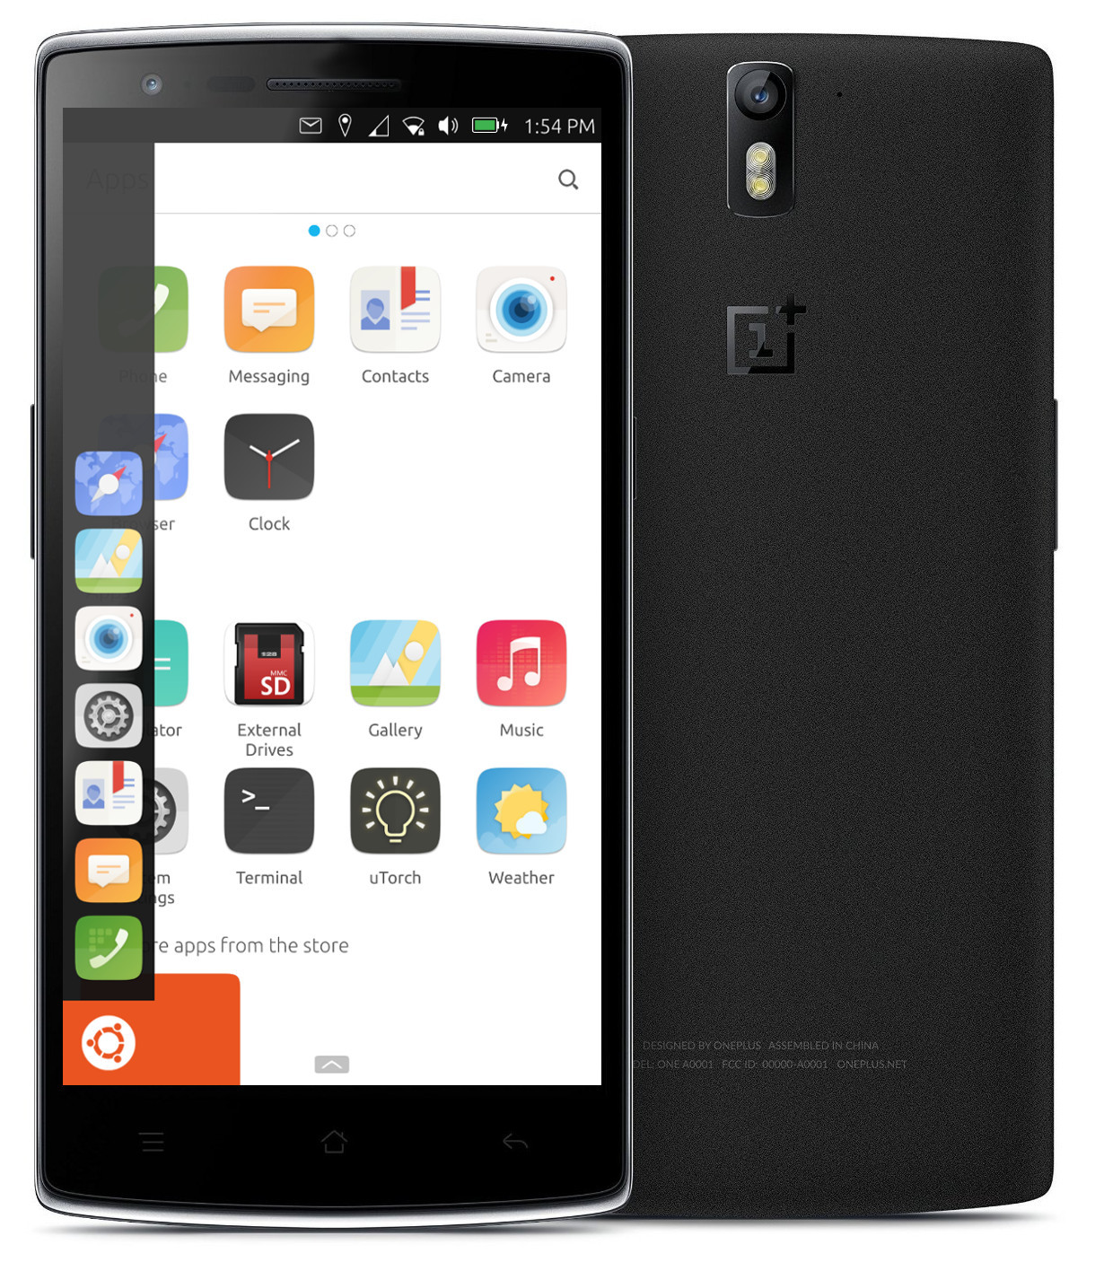
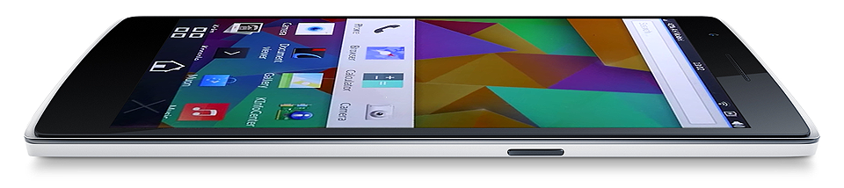
plasma-mobile.org
ubuntu-touch.io
(c) UBports Community
(c) KDE Community

Slide 13
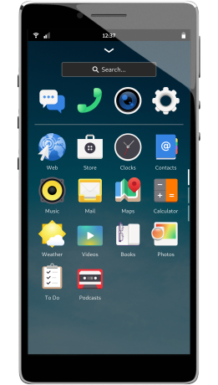
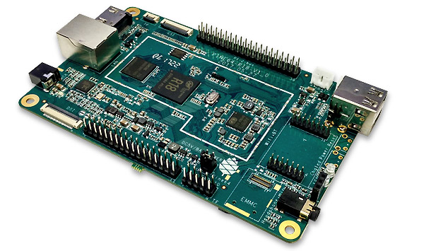
puri.sm
pine64.org
(c) Purism
(c) Pine64

Slide 14


