Slide 1
Cracking Open Kerberos: Understanding How Active Directory Knows Who You Are
Session Code: SIA402

Slide 2
Overview
Kerberos Overview
How Kerberos Authenticates: Tickets to Paradise
Making Sure You Use Kerberos… Not NTLM
Cranking Up Kerberos: Encryption Methods
Watching Kerberos
Keeping Kerberos Trim: Dealing with Token Bloat
Understanding Kerberos Delegation
SPN City: Kerberos's Service Names

Slide 3
Why Are We Here at 8:30 AM?
Most of the time, Kerberos is "just there"
So why this talk? Three reasons
There are some "edge conditions" that it can run up against that can be confounding to troubleshoot
Some networking arrangements need a bit of special tweaking
Windows 6/7 offer us some new options in shoring up our authentication and heck, if you've already paid for it, then why not use those tools?

Slide 4
Kerberos Overview

Slide 5
Kerberos Overview
It's an authentication protocol – so it's not involved with authorization
Standards-based
Used for authentication in AD forests

Slide 6
It's a Matchmaker
Kerberos sees users (which are usually the client) as UPNs and services as SPNs
Your AD logon name – the one that looks like an email address (e.g., mark@bigfirm.com) – is your UPN
SPNs are a mite uglier, and I've got a section on them later
Kerberos "introduces" UPNs to SPNs by giving a UPN a "ticket" to the SPN's service

Slide 7
How Kerberos Authenticates

Slide 8
Authentication Overview/Review
If you've been to my Windows Logins talk, you may remember Tom:
Tom wants to talk to his local print server, \\PS:
To do that, Tom needs a bit of data called a service ticket to PS
ADMIT ONE
ST-PS
Tom gets that service ticket by asking his local Key Distribution Center (KDC) for it
(You and I would call the KDC an AD domain controller)

Slide 9
Kerberos In Pictures to accomplish that…
KDC
Tom needs something that gives him the right to talk to those servers
Tom’s DCs create both kinds of tickets
That “something” is called a ticket; there are two kinds
ADMIT ONE
ADMIT ONE
ST-TWS
Service tickets get Tom access to services, like the “workstation” service on TOMSPC, or the print server service on PS
ADMIT ONE
ST-PS
Ticket Granting Tickets give Tom the right to ask the DC to issue him service tickets
ADMIT ONE
TGT

Slide 10
How Tickets Work
Goal: a KDC first generates a random cryptographic key and then it gets that key to the user and the service
Why? Well, once they've got that key, they have a shared secret and can
authenticate
(optionally) encrypt/sign communications
Key is short-lived, ten hours in Windows

Slide 11
The Sequence: First, a TGT
First, Tom authenticates himself to the KDC, using his (Tom's) password hash as a crypto key
Once he's proved who he is, the AS creates a key that Tom can use to talk to the KDC (for just ten hours) – let's call it "Tom's 'today' password" or "Tom's 'today' key"
The KDC wraps this new temporary key into a ticket called the "ticket-granting ticket"
This TGT is created by something called the Authentication Service or AS… time for a sidebar

Slide 12
Two Keys, Two Services
Initial logon:
Get a ticket-granting ticket (TGT) from the "Authentication Service" (AS)
Afterwards, when you want access to a service, ask the Ticket Granting Service (TGS) for a Service Ticket
Use the TGT to re-authenticate yourself to the TGS

Slide 13
How Does This Fit In a DC?
Key Distribution Center = Authentication Service + Ticket Granting Service
KDC=AS+TGS
The role of KDC, AS, TGS are just part of what an AD DC does
You can’t, however, see AS vs TGS etc in Task Manager; it’s all in LSASS
Back to the sequence…
KDC
AS
TGS

Slide 14
Kerberos In Pictures First, Tom needs a Ticket Granting Ticket
Tom requests a TGT from the AS and proves he’s Tom by encrypting the date as “YYYYMMDDHHMMSSZ” using Tom’s password as the encryption key (this is called the "preauthenticator")
KDC
AS
TGS
The AS decrypts the time/date stamp with Tom’s password and checks that it’s close to the actual time; if it is, then the AS gives Tom a TGT
ADMIT ONE
TGT
(Oh, and how close is “close” vis-à-vis time/date as far as AS is concerned? You get to configure that, but the default is 5 minutes.)

Slide 15
So Far…
Tom has pressed ctrl-alt-del, punched in a name and password, and gotten a TGT
But he’s still not logged onto PS
He’ll get print server
So that’s the next thing he needs to ask for, from the Ticket Granting Service

Slide 16
Tell Me Again… Why Two Tickets?
Answer: to protect Tom's password.
The original logon preauthenticator was encrypted with the user's password, which doesn’t change much and so shouldn't be exposed unless necessary
The TGT gives the user a "password for the day"

Slide 17
Kerberos in Pictures next, Tom gets a Service Ticket to his PC
KDC
Tom shows the TGS his TGT and asks for an ST to PS's print server service
AS
ADMIT ONE
TGT
TGS
ADMIT ONE
ST-PS
The TGS validates the TGT and creates a Service Ticket identifying Tom to PS; Tom then presents that to PS
PS
This identifies – “authenticates” – Tom to PS; PS then looks at Tom’s personal and group SIDs and, if there’s a permissions match, okays Tom.
Now Tom is logged onto his local print server!

Slide 18
So Far…
Tom’s logged onto his workstation
He’s got a TGT that he’ll use to request Service Tickets from the Ticket Granting Service
He’s got a Service Ticket to his workstation
These “tickets” are really just data in TOMSPC’s RAM
Tom can see them with klist, from the 2003 Resource Kit
Klist is now built into Server 2008 and 2008 R2

Slide 19
Sample klist Output: TGT
Client: TOM @ BIGFIRM.COM
Server: krbtgt/BIGFIRM.COM @ BIGFIRM.COM
KerbTicket Encryption Type: AES-256-CTS-HMAC-SHA1-96
Ticket Flags 0x60a00000 -> forwardable forwarded renewable pre_authent
Start Time: 5/11/2009 13:16:53 (local)
End Time: 5/11/2009 23:16:49 (local)
Renew Time: 5/18/2009 13:16:49 (local)
Session Key Type: AES-256-CTS-HMAC-SHA1-96

Slide 20
Sample klist Output: Service Ticket
Client: TOM @ BIGFIRM.COM
Server: cifs/PS.bigfirm.com @ BIGFIRM.COM
KerbTicket Encryption Type: AES-256-CTS-HMAC-SHA1-96
Ticket Flags 0x40a00000 -> forwardable renewable pre_authent
Start Time: 5/11/2009 13:32:59 (local)
End Time: 5/11/2009 23:16:49 (local)
Renew Time: 5/18/2009 13:16:49 (local)
Session Key Type: AES-256-CTS-HMAC-SHA1-96

Slide 21
Tom and His Tickets (the more complete list)
KDC
ADMIT ONE
TGT
AS
(He actually also needed a ticket to his own workstation, but we didn’t have time to show that)
TGS
ADMIT ONE
ST-TWS
TOMSPC
ADMIT ONE
ST-PS
PS

Slide 22
What's in a Ticket, Anyway?
Tickets contain
time start
total lifetime
your security token
optional IP address info

Slide 23
Securing Tickets: the Keys
Kerberos's crypto depends on certain keys for its strength:
The user's password is the key for the authentication to the AS
An internal account called "krbtgt" has a password that the KDC uses to ensure that you didn't fake a TGT
When the KDC generates a service ticket, it encrypts it using the password of the service (the password of PS's AD machine account, in Tom's case)
Remember those… we'll use them again

Slide 24
Cranking Up Kerberos: Encryption Methods

Slide 25
Kerberos and Crypto
Needs good encryption algorithm; original used DES, which was nice years ago but sorta weak now
Initial AD created in a regime where exporting 57+ bit encryption was unlawful
Result: RC4-HMAC, RFC 4757
Good dev info at http://blogs.technet.com/authentication/
If we're going to the trouble to ensure that we're using Kerberos, we may as well control the quality of encryption that we use

Slide 26
Windows 6/7 Crypto Changes
Windows Vista/2008 adds AES
Needs 2008 DFL
Happens automatically upon shift to 2008 DFL
Server 2003 R2 and earlier DCs cannot employ AES
Side-effect: win 6/7 systems will always fail in their first logon attempt (as they "forget" to include a pre-authenticator), that is normal!

Slide 27
Supported Kerberos Crypto
DES/CRC and DES/MD5
For compatibility with non-Windows systems only, never used in an AD
RC4 HMAC/MD5
Crypto used in all pre-Vista AD members and DCs
AES128/AES256 and SHA1
Used between Vista+ clients, 2008+ DCs
At some point – perhaps now for some organizations – you'll want to force a minimum level of crypto

Slide 28
Windows 7 / 2008 R2 Group Policies
Can restrict crypto types in Kerberos through group policy setting that only Win 7 and R2 can use
In Security Options, "Network Security: Configure encryption types allowed for Kerberos"
You can either set this on clients, servers, or both

Slide 29
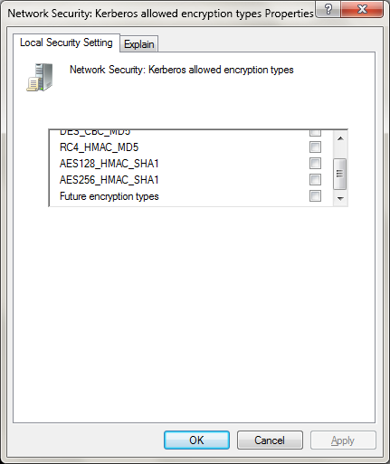

Slide 30
Watching Kerberos

Slide 31
Netmon and Kerberos
Many people seem to think that you can't use Netmon, Wireshark and the like to track Kerberos – "the traffic's all encrypted!"
The trick? It's not encrypted at the endpoints
Here are a few tips on using Netmon with Kerberos
If there are lot of frames, consider defining a "display filter" of tcp.port==88 to show only Kerberos-related traffic (on Netmon – Wireshark's different but similar)

Slide 32
Color-Code Kerb Traffic
Use display filters if you like, but oftimes you'll need the context of the records
Click Filter / Color Filters and create three filters
First, use the criterion "Krberror" to separate out the Kerb frames with errors; I make them red
Then use the criterion "Kerberosv5 && !Krberror" to show regularly Kerberos traffic in blue

Slide 33
Finishing the Filter
You will still see, however, that there's unparsed TCP traffic that's going to or from port 88 (the port AD uses for Kerberos traffic)
Let's color that, too:
rule: !Kerberosv5 && tcp.port==88
I color it green, use whatever you like
Don't forget to elevate NM when you run it
Run it on either end, no promiscuity needed, if a router might be filtering something, then run it on both ends

Slide 34
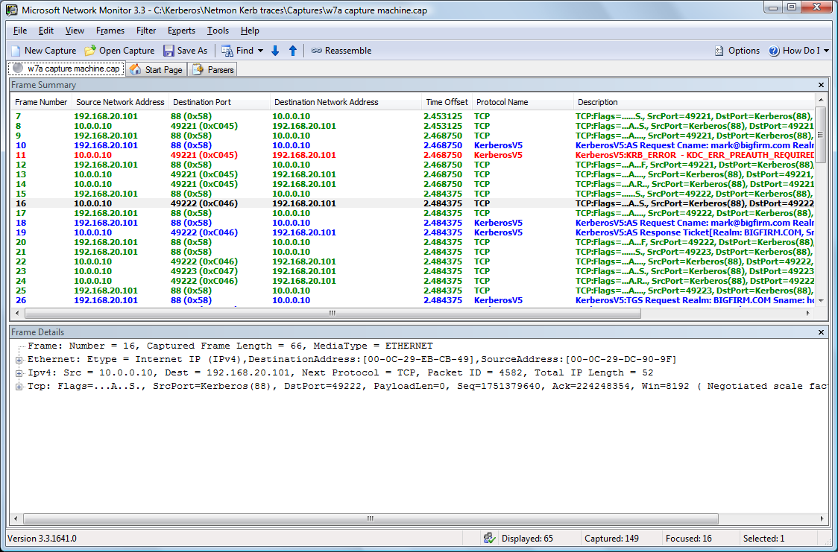

Slide 35
Using a Trace or the Logs common Kerberos issues
AD troubleshooting rule #1:
It's probably DNS.
AD troubleshooting rule #2:
If rule 1 doesn't apply, then it's probably DNS.
The time service really, really, really has to be working, or Kerberos will fail
If it's a three-tier sort of authentication, like a Web application with a SQL back-end, then understand delegation and SPNs, which we're going to get to soon
Traces can help with all of that… use them!

Slide 36
Forcing Kerberos to Use TCP speaking of stuff you find when sniffing a trace…
Kerberos chooses either TCP or UDP
Kerberos UDP and VPNs don't mix well
In W2K, XP, 2003 then Kerberos goes UDP if the packet is < 1465 (2003) or < 2000 bytes (XP, 2000)
Answer: set the minimum to 1 byte, so it's always TCP – see KB 244474, but…
Win2K systems may need patch at KB 320903
What about Vista and later? They always use TCP

Slide 37
Kerberos Logs
Most Kerberos-related event log entries are actually pretty clear – some in System, some in Security
For more, look to "Troubleshooting Kerberos Errors" white paper – search the Web for "Troubleshooting Kerberos Errors in Windows" to find the download from the Microsoft site

Slide 38
Extra Logging
You can set Kerberos to log its activity to the System log
Go to HKEY_LOCAL_MACHINE\SYSTEM\CurrentControlSet\Control\Lsa\Kerberos\Parameters
Add new REG_DWORD value LogLevel, set to 1
Reboot for it to take effect
Details in Kerb Troubleshooting white paper

Slide 39
Creating Kerberos Logs
In Parameters, REG_DWORD LogToFile =1 to create an ASCII log file
KerbDebugLevel (REG_DWORD) sets the verbosity of the log
Look to the white paper for specific error code-to-English translation

Slide 40
Making Sure You Use Kerberos… Not NTLM

Slide 41
Kerb's Not the Only Auth Protocol
You probably know that pre-Windows 2000 systems only used LM, NTLM, NTLMv2 authentication protocols
They were good for their time, but in modern networks they're attack targets
What many don't know is that they're surprisingly persistent
Part of the 2009 IT pro's job is to eradicate them as much as is possible

Slide 42
Why Kerberos Rather than NTLM?
Stronger encryption than NTLM/LM auth algorithms
Mutual authentication
Time stamps, signing, man-in-the-middle much more difficult
NTLM is a 4LA, Kerberos is an 8LA
Exposes user hash much less frequently than NTLM does

Slide 43
What? When Do I Not Use Kerb?
Even in an AD-centric network, you may not get Kerberos
NET USE to an IP address
Connect to a workgroup system on Windows of any version
Connect to a pre-2000 system
Failover from a busy DC
Badly-written apps
Intranet site not added to "local intranet" zone

Slide 44
Kerberos Logon vs NTLM Logon
How you know you're NTLM-ing:
Can't join machines to domains
Don't get group policies
Netmon traces show NTLM, not Kerberos traffic
Klist shows no tickets, yet you're logged in
Tracking this stuff down by hand is a pain, so Windows 7 and Server 2008 R2 offer some new group policies

Slide 45
NTLM Restriction Policies
Essentially these new policies let you first track and then block NTLM logons
There are basically three policies, each with an "audit" and a "block" option:
Incoming NTLM traffic (server tracking)
Outgoing NTLM traffic (client tracking)
Domain traffic (DC tracking)
They create new event log entries of source "NTLM," numbers 8001, 8002, 8003, 8004

Slide 46
NTLM Restrictions
In Computer Config / Windows Settings / Security Settings / Local Policies / Security Options
All start with "Network security: Restrict NTLM:
Log entries go to the log in Applications and Services Log / Microsoft / Windows / NTLM
Some sources say that the log will be named "NTLMBlock" in the final release
These only work on Win 7 and 2008 R2

Slide 47
"Incoming NTLM Traffic"
Systems acting as servers can audit/block NTLM logons
from accounts in the local domain
from accounts in any domain in the forest(s)
Two policy settings:
Audit incoming NTLM Traffic (audits only)
Incoming NTLM Traffic (blocks and logs)

Slide 48
"NTLM authentication in this domain"
Tracks only intra-domain logins, options
domain accounts to domain servers
domain accounts
domain servers
all
Again, two policies, one that just audits, another that blocks: "Audit NAITD" and "NAITD"
Can exempt servers with "Add server exceptions for NTLM authentication in this domain"

Slide 49
"Outgoing NTLM traffic to remote servers"
Attempts by client software on this computer to use NTLM logons to other systems audited/tracked
One policy does both audit and block; options
"allow all"
"audit all"
"deny all"
Can exempt servers with "Add remote server exceptions for NTLM authentication"

Slide 50
Simple Illustrative Example
Set up an R2 DC that is also a file server
Create group policies to track NTLM activity
Join a Windows 7 system as a domain member
Log onto the member with a local account
NET USE to the share with the /u: option to present domain credentials

Slide 51
Result
On the server, you'll see events 8002, NTLM incoming traffic that would be blocked
On the client, you'll see events 8001, NTLM outgoing traffic that would be blocked
Another example:
Log into the W7 box as a domain member
NET USE to the file server using \\ followed by the IP address

Slide 52
Keeping Kerberos Trim: Dealing with Token Bloat

Slide 53
What is Token Bloat?
Kerberos tickets only set aside a certain amount of space for their data
Part of what goes in that data is your token
If the token's too large, it can't fit, and the Kerberos logon fails, and at that point either you're not logged on (in which case you notice the problem) or you log on under NTLM (in which case you don't notice a problem until you note that there are a few important things you can't do)
KB 275266 discusses one very clear case

Slide 54
Token Bloat Symptoms
Logon failure dialog box referring to "too many SIDs"
Logged on via NTLM, not Kerberos (as discussed previously)
Event Kerberos ID 6 (some process has failed due to oversize token)
Event LSASRV ID 6035 (DCs can't replicate) [bad one to see]
Event "Directory Service," ID 1308: KCC failure [ditto]

Slide 55
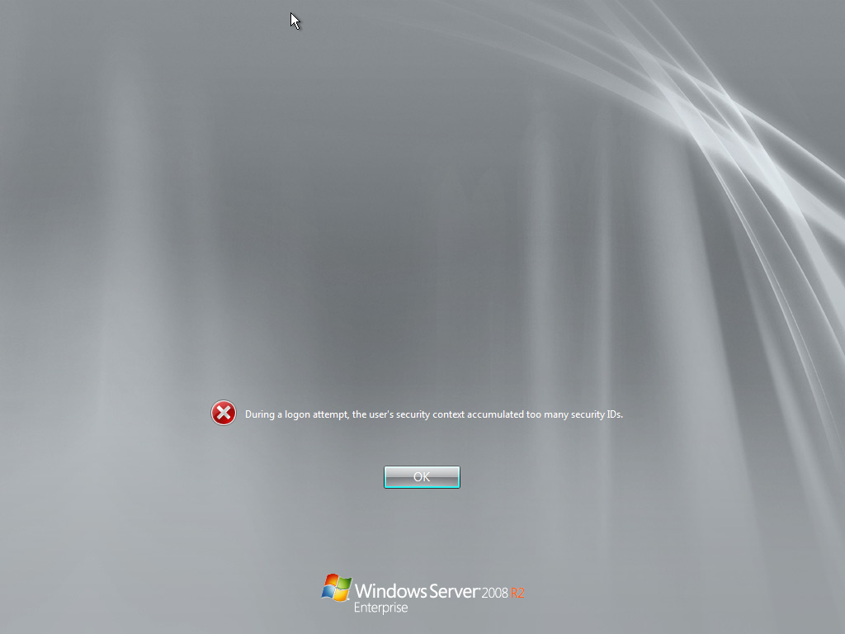

Slide 56
What Causes Bloat
Lots of group memberships
(Nested memberships count!)
SID histories
About 1024 SIDs in a token is the limit

Slide 57
Testing for Bloat: NTDSUTIL
Tool to help enumerate all group memberships:
ntdsutil
group membership evaluation
run bigfirm.com mark
Produces a tab-delimited file
Lists groups and nested groups
Look at WhenChanged parm first, as it's the most recent changes; also look at large "Depth From User" to smoke out heavy nesting
Look also at group owner and groups that have changed from distribution to security group

Slide 58
Example Group Evaluation
We have a
domain: bigfirm.com
user: mark
Universal group named "Really Great Guys"
Contains global group named "Great Guys"
Mark's in "Great Guys"
Run evaluation in ntdsutil
group membership evaluation
run bigfirm.com mark

Slide 59
Fixing It
Basically remove groups and/or SID histories
May have to boot in Safe Mode to get to the accounts
Ditto DCs that have been locked out because they're a member of too many groups (ntdsutil works for DCs as well)

Slide 60
Want To See the Blight of Bloat?
You can, with the BloatMaster 5000™
Open Notepad, type this in, save as "makebloat.cmd:"
net user joe Big$Pw22 /add
for /l %%a in (1 1 1200) do (net group junkgroup%%a /add & net group junkgroup%%a joe /add)
Run this on a DC
You'll now have a domain user named "Joe" who's bloated (and you'll have 1200 new global groups), and who can not log in

Slide 61
Cleanup: "The Anorexiomatic"
Don't want to keep those groups?
Run this from an elevated command prompt on a domain controller:
for /l %a in (1 1 1200) do (net group junkgroup%a /delete)
(This assumes that you don’t already have global groups with names like "junkgroup47" in your domain)

Slide 62
Enlarging TOken
kb 263693

Slide 63
Testing for Bloat: tokensz
Get at www.microsoft.com/downloads
Calculates token size for a user account
Notice that this means it'll tell you the size of your token correctly even if you've just joined a group and haven't logged off/on
Basic syntax:
tokensz /compute_tokensize
add /user:username to compute user other than the currently-logged-in one
(Blows up in some oversize token cases)

Slide 64
Example Tokensz Run
tokensz /compute_tokensize /user:mark
Name: Kerberos Comment: Microsoft Kerberos V1.0
Current PackageInfo->MaxToken: 12000
QueryKeyInfo:
Signature algorithm = HMAC-SHA1-96
Encrypt algorithm = Kerberos AES256-CTS-HMAC-SHA1-96
KeySize = 256
Flags = 2083e
Signature Algorithm = 16
Encrypt Algorithm = 18
Start:5/6/2009 2:05:25
Expiry:5/6/2009 12:05:25
Current Time: 5/6/2009 2:05:25
MaxToken (complete context) 1387

Slide 65
Token Size Formula (Reference)
This is what's inside tokensz, basically
Token size = ticket overhead (estimate at 1200 bytes) + 40 x (# domain local users you're a member of + #universal group memberships in UGs outside your domain + #groups in your SID history) + 8 x (# global groups you belong to + #universal groups you belong to)

Slide 66
Kerberos Delegation

Slide 67
What's Kerberos Delegation?
We've talked about a three-player model before
If Tom wants to access a domain-secured Web server, it'll look like this:

Slide 68

ADMIT ONE
TGT
KDC
AS
TGS
ADMIT ONE
ST-PS
preauthenticator

Slide 69
Now Let's Add a Fourth Player
What if the Web application we ran needed data to respond to our requests, data that lived on a database server?
Well, when the Web server queries the database server, what credentials does it offer?

Slide 70
ADMIT ONE
TGT
This is an important logon; it could either be a hard-wired, broad-spectrum link, or – more likely in modern networks – a passing ("delegation") of Tom's token to the database server
KDC
AS
TGS
ADMIT ONE
ST-PS
Web Server
Database server

Slide 71
Delegation Specifics
How's it done? Depends on the app
Why not use a hard-wired "LocalSystem to LocalSystem" connection?
Simple… least privilege
But what about when we want to take things further?
That's where constrained delegation takes place

Slide 72
Definitions
Tom hands his ST to the service running the Web server
The Web server then needs to present credentials to the database server
… why is it okay?
Because Tom handed the Web server a ticket that could be delegated
Think of the word in the Exchange context and it'll make more sense
There's just one problem…

Slide 73
It won't work.
You see, this whole idea that some server service could grab one of your tickets and run around town shopping with your credit card doing things in your name is downright frightening, so it's disabled by default.

Slide 74
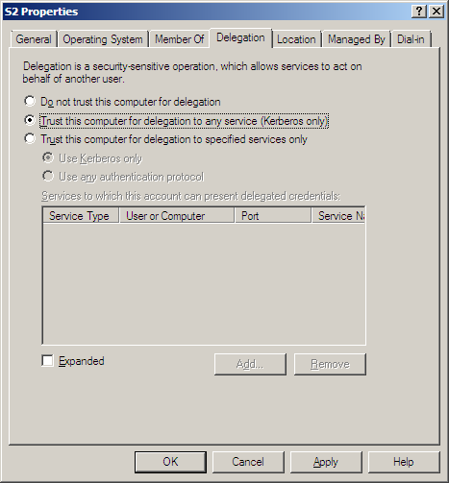

Slide 75
Delegation and Win2x
Windows 2003 offered more granularity in controlling delegation
Called "constrained delegation," it let you say, "you can only pass my token along to service type X in domain Y, etc"
Again, usually set up by the installing app… or you may have to work with the devs to hand-craft a delegation
But if we're going to start naming services that we trust, it's time to turn to SPNs…

Slide 76
SPN City: Kerberos's Service Names

Slide 77
Service Principal Names
Kerberos needs an account for every instance of every service running in the domain – particular services running on particular servers, application pools in IIS and the like
Remember that Kerberos encrypts service tickets to a given service with that service's password hash
In most cases, that means the machine account's password – but sometimes we want to run a service under a user account, and then things get interesting

Slide 78
Service Principal Names
Because you might have some services on a given server running under the context of that server's machine account and other services running under some other set of AD accounts, Kerberos includes a sort of label for the service that abstracts the service from the machine
It's also useful for services that offer many equally-good systems, like picking a DC
The label is called a Service Principal Name or SPN

Slide 79

A Simple Example
In a Kerberized application, a client (UPN, "mark@bigfirm.com") requests a ticket to a given SPN, like TERMSRV/R2S1.bigfirm.com
In this simple example, Kerberos must find the user account corresponding to the UPN and the machine corresponding to the SPN
(It's obvious in this case, but not in all)
Kerberos looks up the UPN and SPNs in the global catalog

Slide 80
Service Principal Names structure
SPNs look like
ldap/R2S2.bigfirm.com:6000/bigfirm.com
<type of service>/ <hostname> [:<port>] [/servicename]
Type of service = description of the server, like "CIFS" for file server, "LDAP" for DC, etc
Hostname = obvious, but for two things:
As we'll see, it's a good idea to create SPNs using both the host name and the FQDN
"Hostname" really means host name – CNAMES will not work (which can lead to some Sharepoint problems)

Slide 81
Service Principal Names structure
Port's obvious, only include if non-standard
"Servicename" is either
DNS service name of a "replicable" service – like a replicated SQL database or an AD instance – available throughout the domain; represented as the domain's name, like "bigfirm.com"
A DN/GUID in AD, like cn=mysvc,dc=bigfirm,dc=com
The DNS name of an SRV or MX record

Slide 82
Service Principal Names structure
Everyone has a "host" spn:
HOST/CLASSVISTA
HOST/Classvista.bigfirm.com
DCs have LDAP spns:
ldap/R2S2/BIGFIRM
ldap/8a53de22-291a-44b9-b112-4fa5d87b16a9._msdcs.bigfirm.com
ldap/R2S2.bigfirm.com/BIGFIRM
ldap/R2S2
ldap/R2S2.bigfirm.com
ldap/R2S2.bigfirm.com/bigfirm.com

Slide 83
Service Principals examples
DCs also have FRS or DFS-R spns:
Dfsr-12F9A27C-BF97-4787-9364-D31B6C55EB04/R2S1.bigfirm.com
Anyone with Remote Desktop/Services:
TERMSRV/R2S1
TERMSRV/R2S1.bigfirm.com

Slide 84
SPN Lookup
A given instance of a service has an SPN identifier
The account that holds that SPN stores it in AD in the servicePrincipalName attribute
servicePrincipalName can hold any number of SPNs
Thus, given an SPN, AD must search those values across the forest to find the user/machine account associated with the SPN – the GCs keep a list

Slide 85
Why You Care
Reason #1: if Kerberos looks up a SPN and finds that more than one account contains that SPN, the music stops
Reason #2: if Kerberos looks up a SPN and no account contains that SPN, then again the melody ceases
So we need some SPN tools

Slide 86
Finding SPNs: Listing on a system
Find all SPNs associated with an account with "–L"
setspn –l s2
Use the hostname, not the FQDN
As it's just pointed at one account, it's just listing the value of servicePrincipalName in the AD account

Slide 87
Finding SPNs: Querying AD
spn_query.vbs queries GC for a SPN
Find it on Technet – search on "spn_query" and "Craig Wiand"
Takes wild cards, so the searching is easier

Slide 88
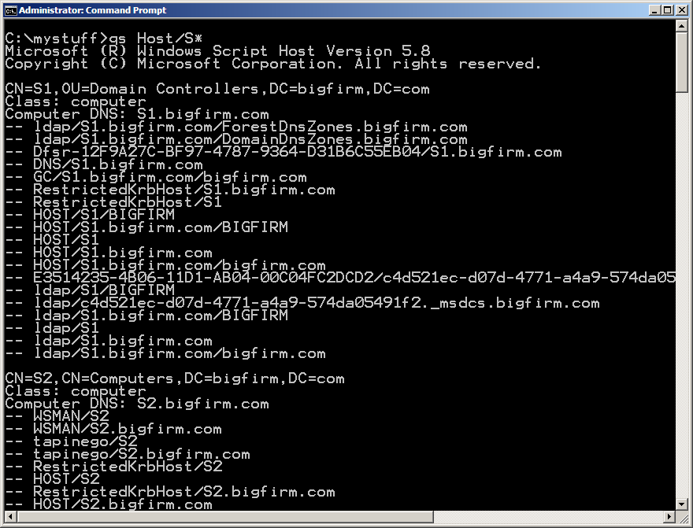

Slide 89
Adding a SPN
setpsn –a lets you add a new SPN to a given AD account
To make that work, you've got to supply
Service name (HTTP, CIFS, etc)
The name of the computer that the service resides upon
The port used to access the service

Slide 90
Adding a SPN
Often done in secured Web apps (i.e. Sharepoint) or database servers
Usually there's some automatic help in creating and installing SPNs
But some home-grown systems may require a SPN
Install one with –a
My favorite way to screw it up: accidentally put a given SPN on more than one system

Slide 91
setspn -a
To assert that there's a service called "prophecy" running on port 20201 on the physical system s1.bigfirm.com BUT that the service runs under a user account named "joe" in bigfirm.com, we'd type
setspn –a prophecy/s1.bigfirm.com:20201 joe
IMPORTANT: you should always also register just the hostname
setspn –a prophecy/S1:20201 joe

Slide 92
SPNs and 2008
Small but important change to -a option on setspn
In Server 2008 and later, setspn first searches AD to see if a proposed SPN already exists
(Yay!)
And if you hate managing SPNs a lot, take a look at 2008 R2's Managed Service Accounts (MSAs)

Slide 93
Managed Service Accounts background: what problem does this solve?
Services must run under an account, and LocalSystem/LocalService/NetworkService can't always do the job
IIS, Exchange, SQL are some common examples
In that case, techies need to create accounts to act as service accounts
That works fine, except for the issue of passwords: they need regular changing or services stop working

Slide 94
Managed Service Accounts background: what problem does this solve?
Basically, it's a pain to manage passwords for the user accounts that we happen to use for services
Also, introducing new user accounts into services means having to develop expertise with setspn
Additionally, you've got to be a domain admin to modify SPNs… MSAs let you delegate this to others

Slide 95
Managed Service Accounts answer: managed service accounts
New class of accounts
Sorta user accounts, sorta machine accounts (new icon)
Need one account / member

Slide 96
Managed Service Accounts installation steps (overview)
Create one on the domain
"Install" it on the member server
Configure the svchost or the IIS application pool so that it logs on as that account, and from there password updates etc are automatic

Slide 97
Managed Service Accounts password details
240-character passwords created
MSAs ignore group policies about passwords and ignore fine-grained password policies
Automatically handle password changes every 30 days

Slide 98
Managed Service Accounts SPN management
As mentioned, you can control who can administer SPNs rather than needing to be a domain admin
If you rename a machine account, the SPN gets fixed automatically
If you change a DNS host name, the SPN gets fixed automatically
SPN management requires 2008 R2 DFL

Slide 99
Managed Service Accounts requirements/details
Requires at least one 2008 R2 DC (which means a 2008 R2 schema on the forest)
Requires AD Powershell (and therefore AD Web Service) to create accounts
Live in their own new folder (not an OU) called "Managed Service Accounts"
Servers hosting services that use the accounts must be R2/Win 7
Need R2 DFL to get the automatic SPN management

Slide 100
Thank You!
You can find me at help@minasi.com
My free technical newsletters, online forum, and information on my in-person seminars and pre-recorded audio seminars is at my Web site at www.minasi.com
Tomorrow: 12 Tips to Secure Your Network 2:45 room 153
8:30 tomorrow: UAC and Windows Integrity, right here
UAC haters, I dare you to come and be converted! ☺

Slide 101
Two Tickets, Two Services
First you introduce yourself to the KDC by logging on; you only want to have to do this once a day and so you ask the KDC for a “ticket to the KDC”… that’s the Ticket-Granting Ticket
That is granted by a piece of the KDC called the “Authentication Service” or AS
Once you’ve got a TGT, then you can show the TGT to the KDC and say “remember me? Now I need a Service Ticket to such-and-such service”
Service tickets are issued by a different part of the KDC called the Ticket Granting Service or TGS

Slide 102
The Sequence: Next, a Service Tkt
Now that Tom's got a "ticket to the KDC," he uses it to re-introduce himself to the KDC, but this time, to the Ticket Granting Service (TGS) rather than the AS
Tom authenticated himself to the KDC the first time with something encrypted using his password hash as the key
This time, Tom again authenticates himself to ask for a service ticket, but this time he'll use something encrypted with his "today" key

Slide 103
Kerberos why two kinds of tickets?
You could imagine a sort of Kerberos where Tom always authenticates to the TGS with his password hash
Lots of ticket requests means lots of stuff encrypted with his password hash… and so more chances for bad guys to get lucky with a decrypt
So – and here’s the important part – what Kerberos gives you in the TGT is essentially just a “password for the day”
Service ticket-related information is encrypted with the password for the day; only TGT-related information is encrypted with your actual password -- one transaction per day!

Slide 104
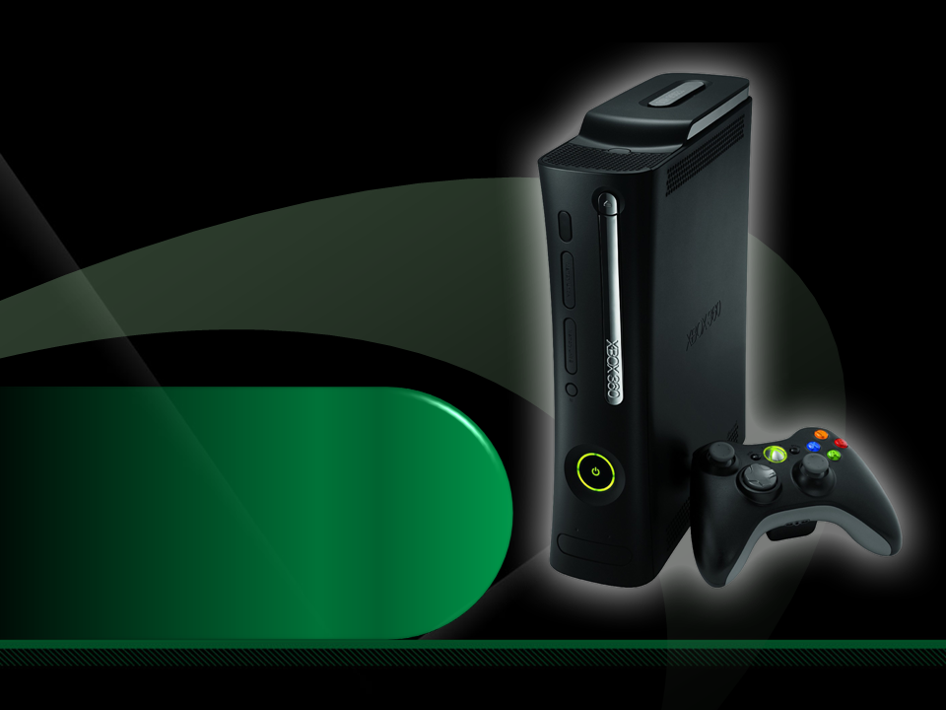
Complete an evaluation on CommNet and enter to win an Xbox 360 Elite!

