Slide 1
flexCompositor - pip
Neo 2025/09/30

Slide 2
Topic
1.flexCompositor - pip screen element | 2-7
2.Request/ Response - securityAlert | 9-10

Slide 3
flexCompositor - pip screen element
[screen]
;<name>=virtual-<n>,<w>x<h>,app(<appName>)
pipDisplay0=pip-0,1920x1080
pip
sink
child
VirtualDisplay - For storing app content
field | required | description
pip-<n> | v | <n> : Avoid repetition
<w>x<h> | v | width x height

Slide 4
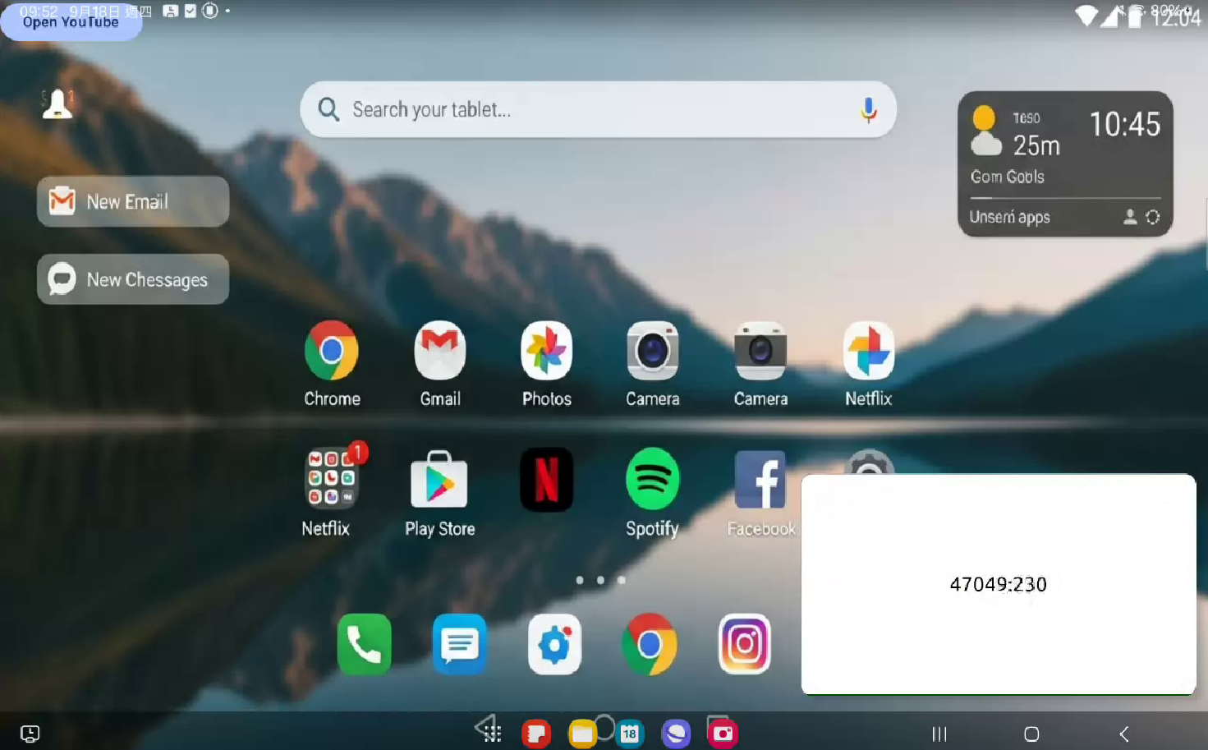
flexCompositor - pip screen element
ParentActivity
The logic responsible for switching with the child.
ChildActivity
The logic responsible for switching with the parent.
inherits
inherits
UiParentActivity
UI style
UiChildActivity
UI style

Slide 5
flexCompositor - pip screen element
[screen]
stream0=stream-0,1920x1080,\
server(192.168.1.6,50000),\
codec(h264)
pipDisplay0=pip-0,1920x1080
[mapping]
stream0(0,0,1920,1080)->pipDisplay0
UiChildActivity
UiChildActivity is currently set to receive the source from the flexCompositor mapping
In PiP mode, the mapping applies to the child.
server
192.168.1.6
50000
parent
Stream
parent
sink
src
child
child

Slide 6
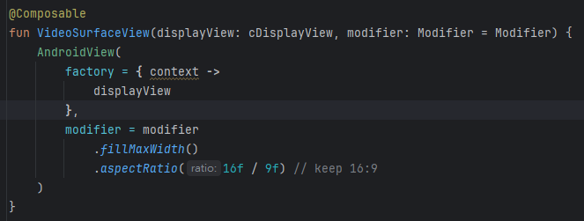
flexCompositor - pip screen element
Window Manager
addView()
Floating window
Allows specifying exact position and size
SurfaceView
Wrap into an
Activity
Activity
The layout position is not controllable and is entirely managed by the system.
UiChildActivity
Stream
In order to use the system-provided PiP mode
sink
src

Slide 7
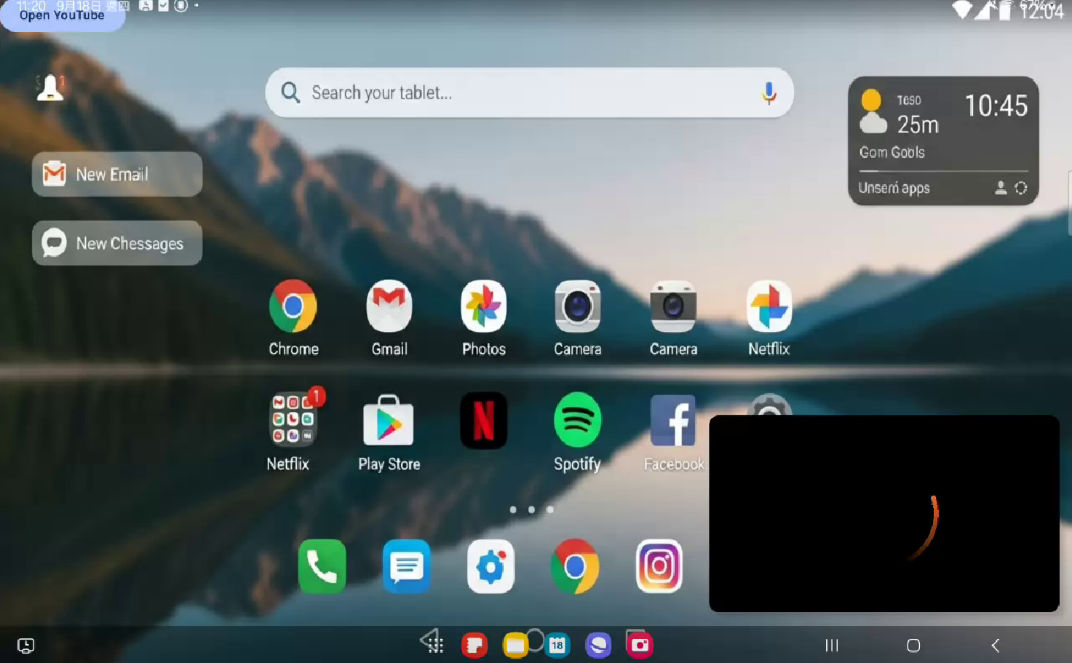
flexCompositor - pip screen element
draw buffer
Is there a new stream buffer?
TRUE
Counter
>20
FALSE
FALSE
Counter=0
TRUE
draw
Loading circle
draw
Loading circle
Counter++
draw buffer
delay(17ms)

Slide 8
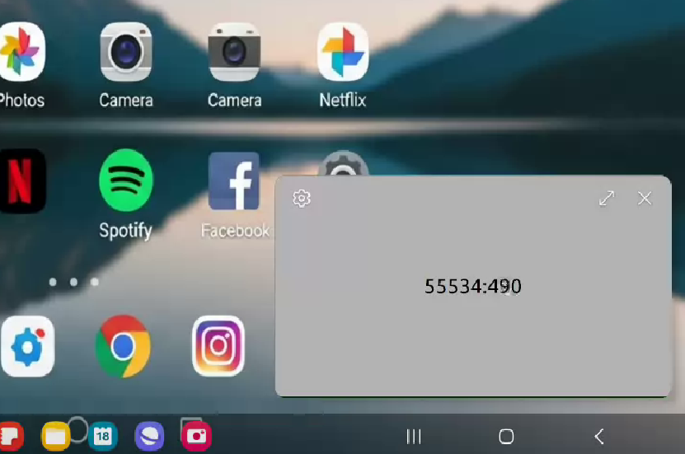
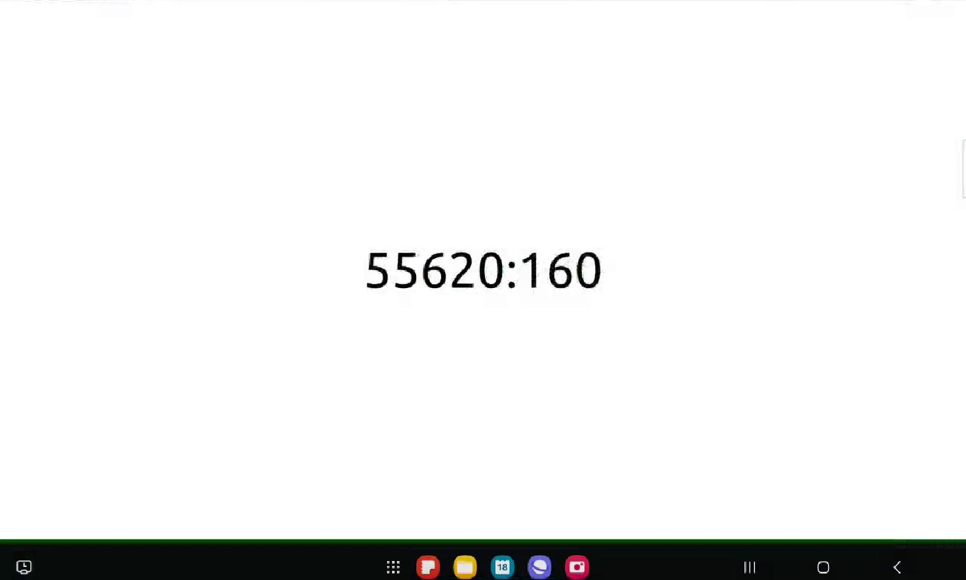
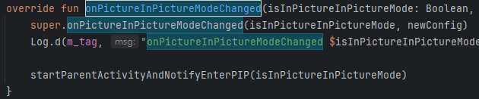
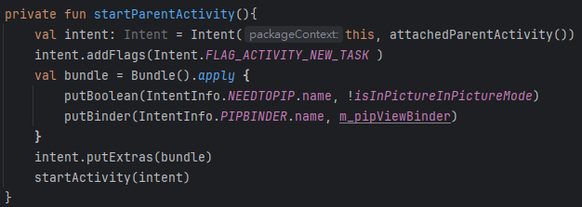
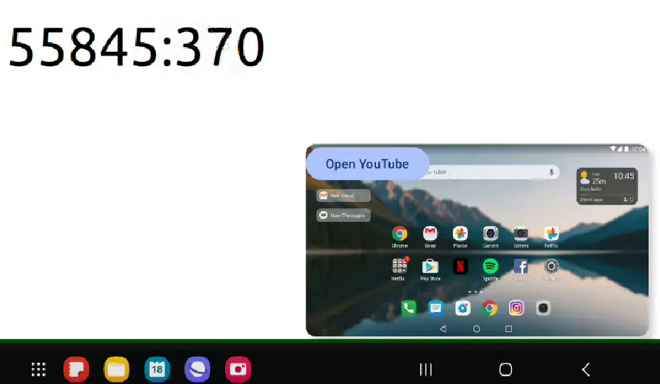
flexCompositor - pip screen element
1. The onPictureInPictureModeChanged callback indicates when PIP mode has been exited.
2. At this point, startActivity is used to launch the ParentActivity, along with information indicating that it should enter PIP mode.

Slide 9
Request - securityAlert
tcp(:50000)
securityAlert
field | required | description
nessage | v | An alert event similar to detecting a person
Launcher
(client)
FlexCompositor
(server)
“Type: jsonRequest\r\n”
“Length: <decValue>\r\n”
“Checksum: <4digit hexValue>\r\n”
“\r\n”
{
“securityAlert”:[
{“message”: “people detect”}
]
}
JSON data
“Type: jsonResponse\r\n”
“Length: <decValue>\r\n”
“Checksum: <4digit hexValue>\r\n”
“\r\n”
JSON data

Slide 10
Response- securityAlert
tcp(:50000)
sourceSwitchers
field | required | description
status | v | ok / timeout / checksum_error
Launcher
(client)
FlexCompositor
(server)
“Type: jsonRequest\r\n”
“Length: <decValue>\r\n”
“Checksum: <4digit hexValue>\r\n”
“\r\n”
JSON data
“Type: jsonResponse\r\n”
“Length: <decValue>\r\n”
“Checksum: <4digit hexValue>\r\n”
“\r\n”
{
“securityAlert”:[
{“status”: “ok”}
]
}
JSON data

