Slide 1
Time Series Prediction using LSTMs
CBS DWM Presentation
Harsh Jain, 25

Slide 2
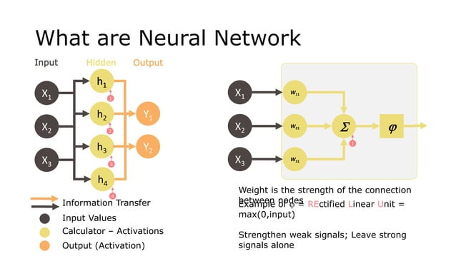

Slide 3
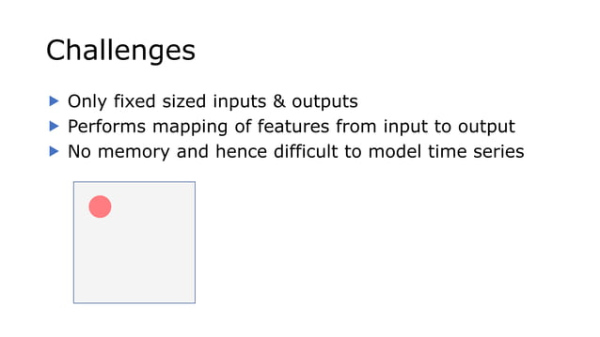

Slide 4
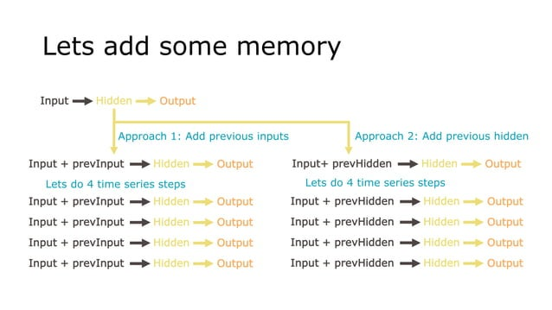

Slide 5
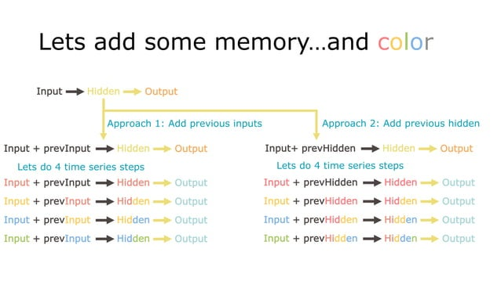

Slide 6
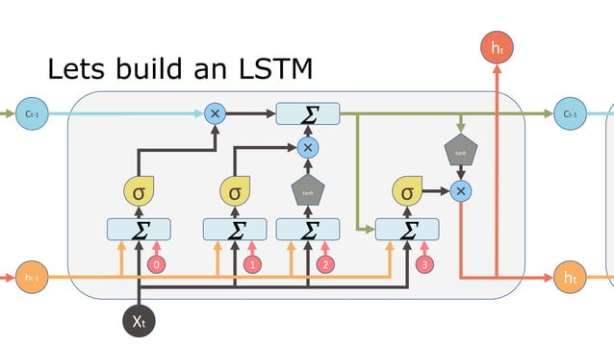

Slide 7
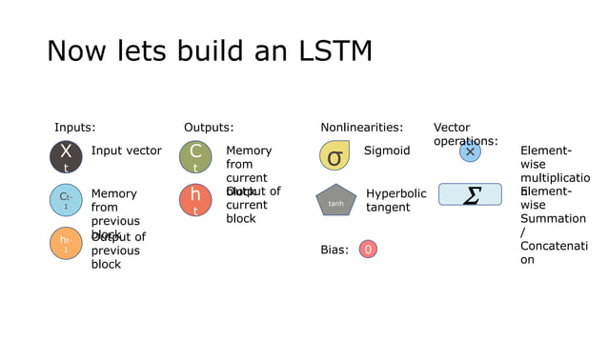

Slide 8
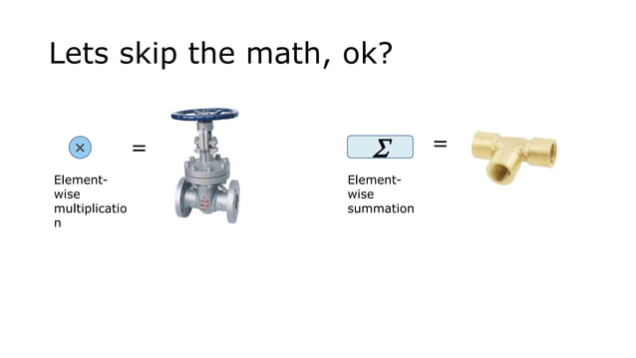

Slide 9
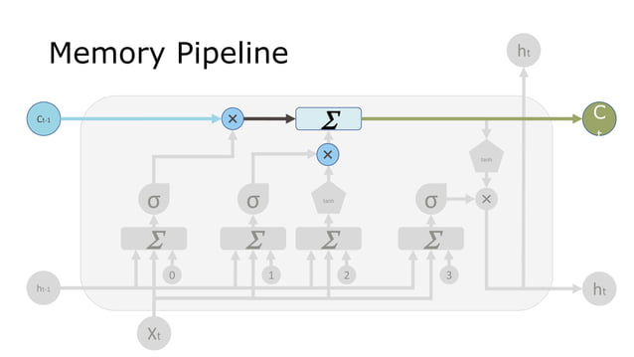

Slide 10
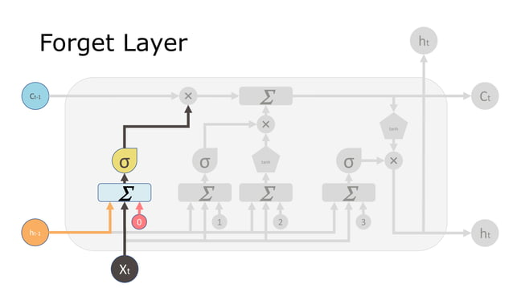

Slide 11
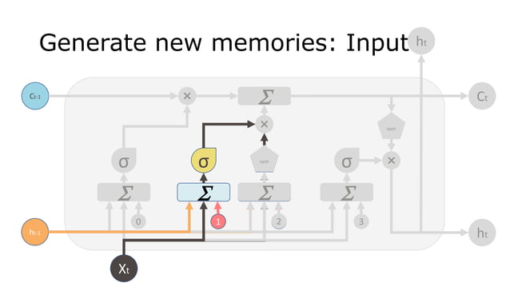

Slide 12
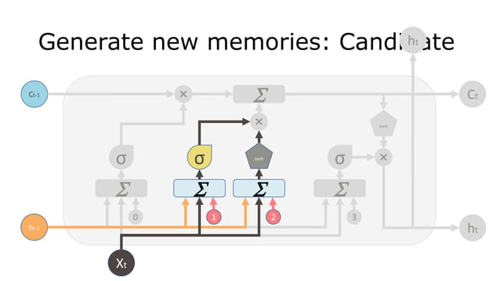

Slide 13
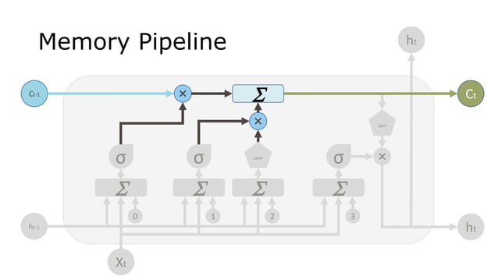

Slide 14
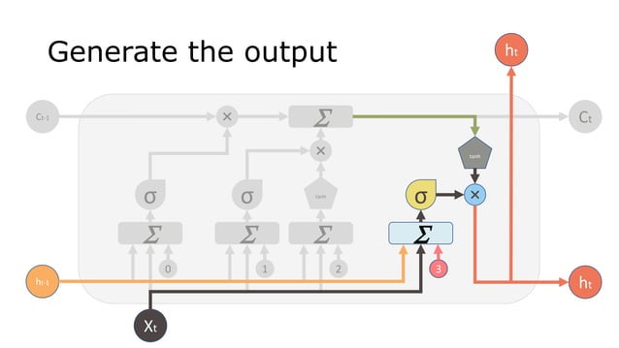

Slide 15


Slide 16
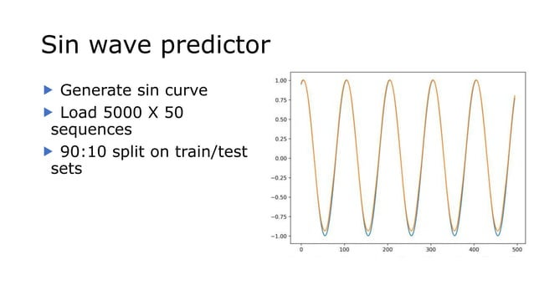

Slide 17
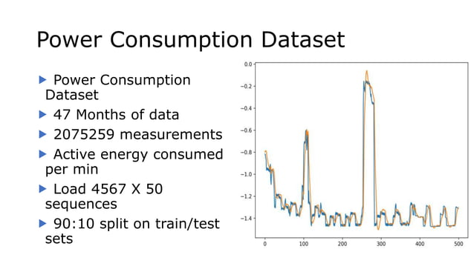

Slide 18
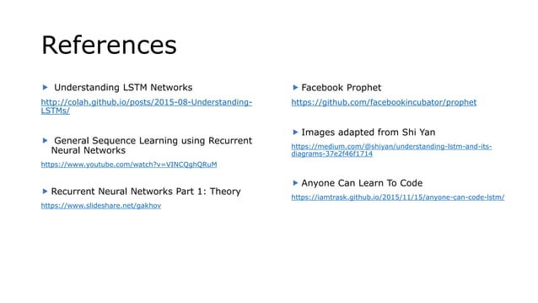

Slide 19
Contacts
Github : https://github.com/NeoZ666/DWM_CBS_LSTMPresentation
Huggingface : https://huggingface.co/HarshSinyal
Linkedin : https://www.linkedin.com/in/harsh-sinyal-07980a23b

